Slide 1
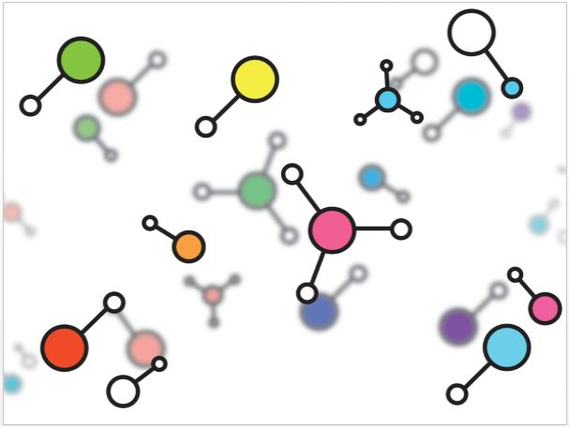
FACTORS AFFECTING DRUG ABSORPTION

Slide 2
INTRODUCTION
The term “Biopharmaceutics” first appeared in a review article, “Bio-pharmaceutics : Absorption Aspects” edited by Dr. John G. Wagner in the Journal of Pharmaceutical Sciences (Vol.50; 359-386, 1961).
As defined by Wagner:
“ the study of the interrelationship of the physicochemical properties of the drug, the dosage form in which the drug is given & the route of administration on the rate & extent of systemic drug absorption.”
It is also define as “study of factors influencing the rate and amount of drug reaches the systemic circulation and the use of this information to optimise the therapeutic efficacy of drug products.”
1

Slide 3
Factors affecting drug absorption
Pharmaceutical factors:
Physicochemical factors:
1) Drug solubility & dissolution rate
2) Particle size & effective surface area
3) Polymorphism & amorphism
4) Pseudopolymorphism (hydrates/solvates)
5) Salt form of the drug
6) Lipophilicity of the drug (pH- Partition-hypothesis)
7) pKa of drug & gastrointestinal pH
8) Drug stability
3

Slide 4
Factors affecting drug absorption
Pharmaco-technical factors or dosage form charecteristics and their ingredients:
1) Disintegration time (tablets/capsules)
2) Dissolution time
3) Manufacturing variables
4) Pharmaceutical ingredients (excipients/adjuvants)
5) Nature & type of dosage form
6) Product age & storage condition
4

Slide 5
Factors affecting drug absorption
Patient related factors:
7) Disease states
8) Blood flow through the GIT
9) Gastrointestinal contents:
a) Food- drug interactions
b) Fluids
c) Other normal GI contents
10) Pre-systemic metabolism by:
a) Luminal enzymes
b) Gut wall enzymes
c) Bacterial enzymes
d) Hepatic enzymes
Physiological factors:
1) Route of administration
2) Membrane physiology
a) Nature of cell membrane
b) Transport processes
3) Age
4) Gastric emptying time
5) Intestinal transit time
6) Gastrointestinal pH
2

Slide 6
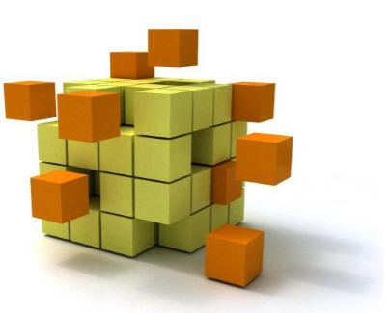
DRUG SOLUBILITY & DISSOLUTION RATE

Slide 7
Drug Solubility & Dissolution rate
Absorption of a drug is possible only when it is present in the solution form, wherein the molecules are independent & assume molecular dimensions.
Based on the dosage form, the variation in absorption could be depicted as:
Solution > Suspensions > Capsules > Compressed Tablets > Coated Tablets
NOTE: Except in case of CRDDS.
Solubility is defined as …………..
“ The maximum amount of solute dissolved in the given solvent under standard conditions of temperature, pressure & pH.
In order to avoid bioavailability problems, the drug must have a minimum aqueous solubility of 1%.
5

Slide 8
DISINTEGRATION AND DISSOLUTION

Slide 9
Solid dosage form
Dissolution is rate limiting step for lipophillic drugs.
Solid drug particles
Permeation is rate limiting
stair for hydrophilic drugs.
Drug in solution at absorption site
Drug in the body
7

Slide 10
Drug Solubility & Dissolution rate
The rate determining steps in absorption of orally administered drugs are:
1. Rate of dissolution
2. Rate of drug permeation through the bio-membrane.
Dissolution is the rate determining step for hydrophobic & poorly aqueous soluble drugs.
E.g. Griesiofulvin & Spironolactone.
Permeation is the rate determining step for hydrophilic & high aqueous soluble drugs.
E.g. Cromolyn sodium & Neomycin.
6

Slide 11
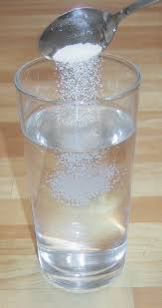
WHAT IS DISSOLUTION?
WHAT IS DISSOLUTION?
Dissolution is a process in which a solid substance solubilises in a given solvent i.e mass transfer from the solid surface to the liquid phase

Slide 12
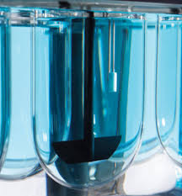
WHY DISSOLUTION STUDIES?
To show that the release of drug from the tablet is close to 100%
To show that batch to batch rate of drug release is uniform
To show that release is equivalent to those batches proven to be bioavailable

Slide 13
THEORIES OF DISSOLUTION
Diffusion layer model/film theory
Danckwert’s model/surface renewal theory
Interfacial barrier theory

Slide 14
DIFFUSION LAYER MODEL/FILM THEORY
2)Diffusion of soluble solute from the stagnant layer to the bulk of the solution(rate determining step).
The theory is based on absence of any reactive or chemical forces.
It consist of two consecutive steps:
1)Formation of stagnant film or diffusion layer

Slide 15
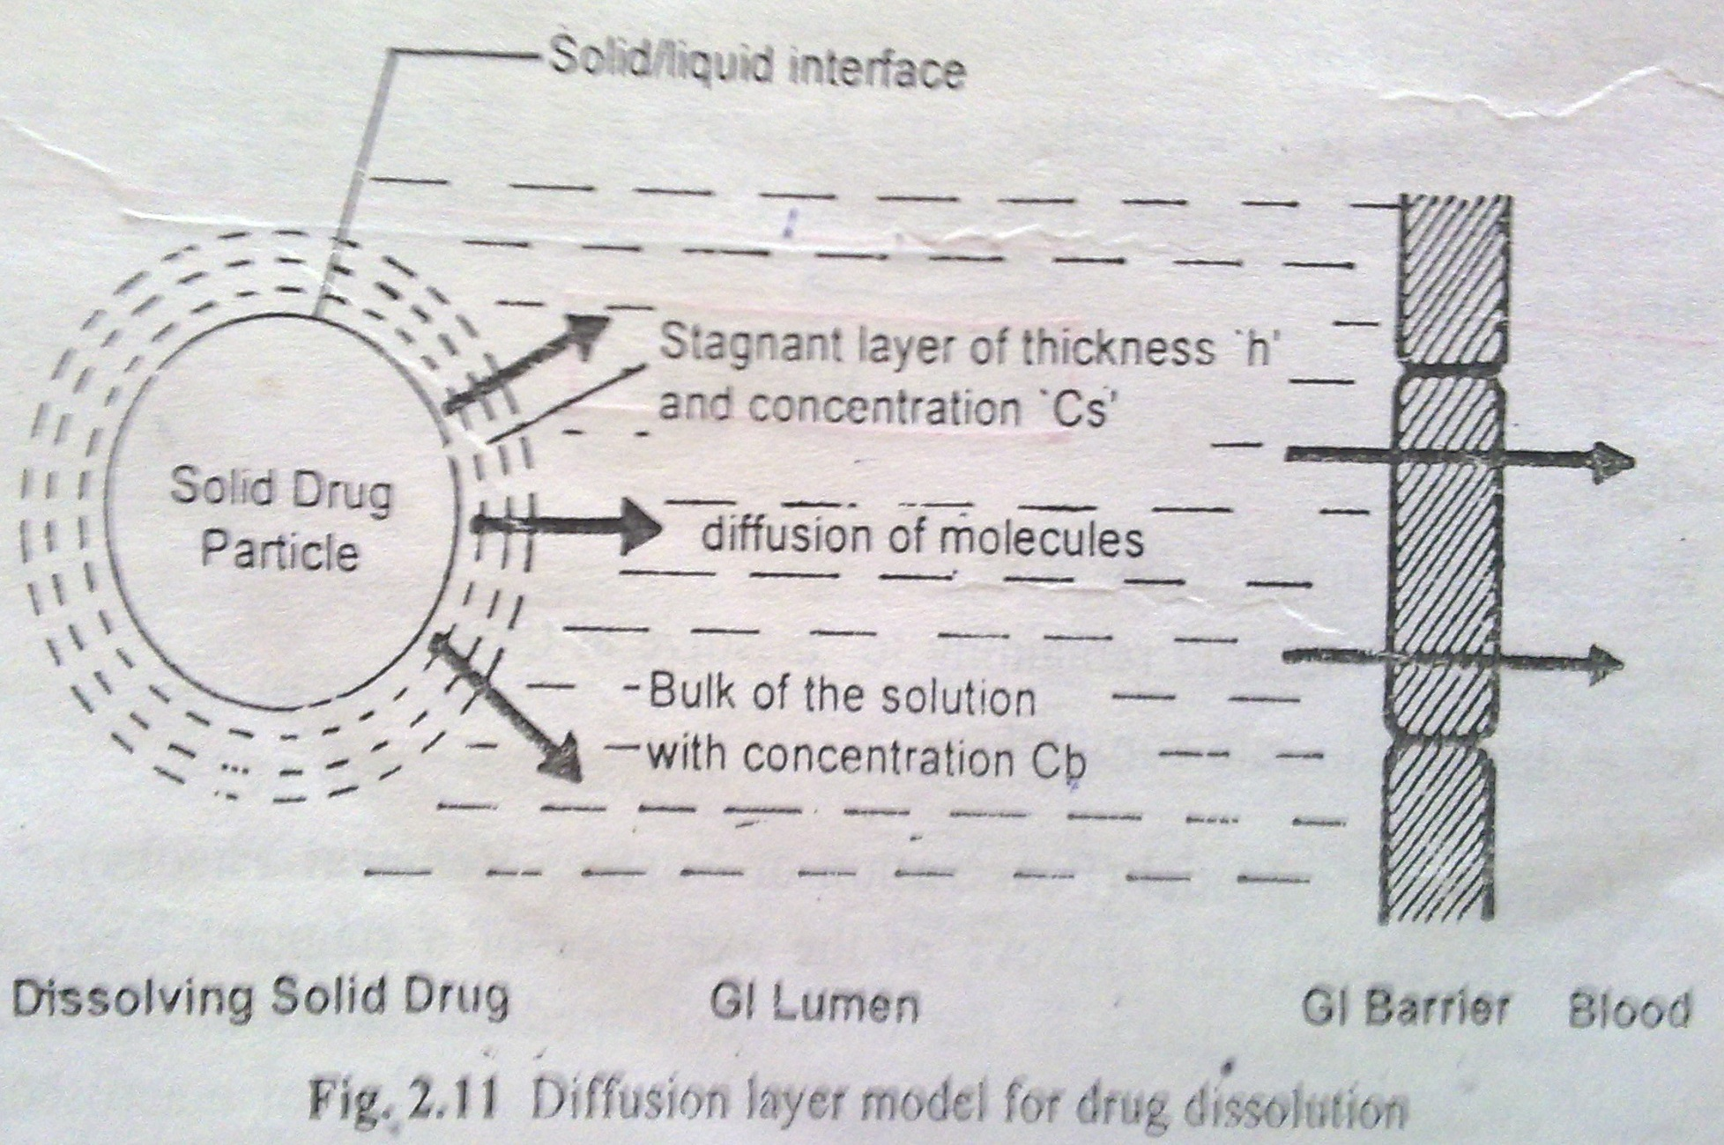
Diffusion layer model

Slide 16
The equation to explain the rate of dissolution when the process is diffusion controlled and involve no chemical reaction was given by
Noyes and Whitney:
dc/dt = k(Cs-Cb)
Where ,
dc/dt= dissolution rate of drug
K=dissolution rate constant
Cs=concentration of drug in the stagnant layer
Cb=concentration drug in bulk of solution

Slide 17
Drug Solubility & Dissolution rate
Modified Noyes-Whitney’s Equation -
Where,
D= diffusion coefficient of drug.
A= surface area of dissolving solid.
Kw/o= water/oil partition coefficient of drug.
V= volume of dissolution medium.
h= thickness of stagnant layer.
(Cs – Cb )= conc. gradient for diffusion of drug.

Slide 18
This is first order dissolution rate process,for which the driving force is concentration gradient
This is true for in-vitro dissolution which is characterized by non-sink conditions.
The in-vivo dissolution is rapid as sink conditions are maintained by absorption of drug in systemic circulation i.e. C_{b}=0 and rate of dissolution is maximum.

Slide 19
Under sink conditions, if the volume and surface area of the solid are kept constant, then
dC
dt
This represents that the dissolution rate is constant under sink conditions and follows zero order kinetics.
=
K

Slide 20
PARAMETERS | SYMBOL | INFLUENCE ON DRUG DISSOLUTION
Diffusion coefficient | D | Greater the value, faster is the dissolution rate
Surface area of solid | A | Greater the surface area, faster the dissolution rate
Water/oil partition coefficient | Kw/o | Higher the value, faster the dissolution rate
Concentration gradient | Cs-Cb | Greater the value, faster the dissolution rate
Thickness of stagnant layer | h | More the thickness, lesser is the diffusion and dissolution rate

Slide 21
IN VITRO-IN VIVO CORRELATIONS
The relation can be improved by:
Bathing the dissolving solid in fresh solvent.
Increasing the volume of dissolution fluid.
Partitioning dissolved drug from aqueous phase to organic phase.
Adding water-miscible solvent to the dissolution fluid.
Adding adsorbent to remove the dissolved drug.

Slide 22
Noyes-Whitney equation assumes that the surface area of the dissolving solid remains constant which is practically impossible for dissolving solids.
To account for particle size decrease and change in surface area, Hixson and Crowell’s c Equation:
w₀^{1/3} – w^{1/3} = k .t
W=mass of drug remaining to be dissolved at time t
k=dissolution rate constant
W =original mass of the drug

Slide 23
DANCKWERT’S MODEL
Disapproved the existence of a stagnant layer at solid- liquid interface.
There exist turbulence in the dissolution medium at the solid-liquid interface.
Mass of eddies or packets reach the solid- liquid interface due to eddy currents.
Absorb solute by diffusion and carry it back into bulk solution.

Slide 24
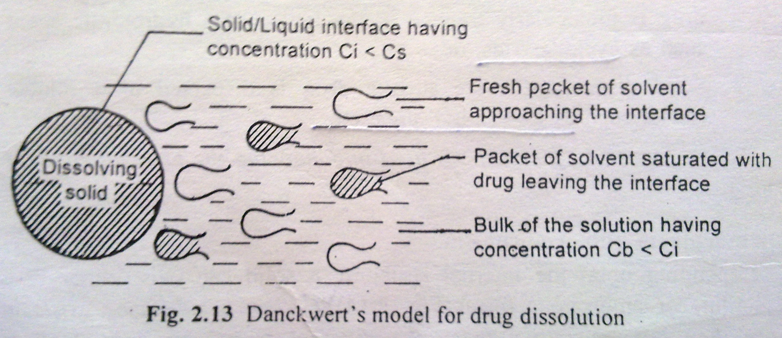
Danckwert’s Model for drug dissolution

Slide 25
DANCKWERT’S MODEL
As the packets are continuously replaced with new packets of fresh solvent, the concentration at interface never reaches Cs.
Since solvent packets are exposed to new solid surface each time, the theory is also known as surface renewal theory.

Slide 26
DANCKWERT’S MODEL

Slide 27
DANCKWERT’S MODEL
The Danckwert model is expressed by the equation:
V.dC/dT= dm/dt = A ( Cs-Cb). (ү.D)1/2
Where, m=mass of solid dissolved
y= rate of surface renewal

Slide 28
Interfacial barrier model
According to interfacial barrier model, an intermediate concentration can exist at the interface as a result of solvation mechanism and is a function of solubility rather than diffusion.
While considering the dissolution of a crystal each face of the crystal will have a different interfacial barrier
Equation :
G= Ki (Cs – Cb)
Where Ki = effective interfacial transport rate
G = Dissolution rate per unit area

Slide 29
PARTICLE SIZE & SURFACE AREA

Slide 30
Particle Size & Surface Area
Particle size plays a major role in drug absorption & this case is important when the drug is poorly soluble (aqueous solubility).
Dissolution rate of solid particles α surface area
Smaller particle size, greater surface area then higher will be dissolution rate, because dissolution is thought to take place at the surface area of the solute( Drug).
Particle size reduction has been used to increase the absorption of a large number of poorly soluble drugs
E.g. Bis-hydroxycoumarin, digoxin, griseofulvin
9

Slide 31
Particle Size & Surface Area
Types of surface area
1) Absolute surface area
2) Effective surface area
In absorption studies, the effective surface area is of much important than absolute.
To increase the effective surface area, we have to reduce the size of particles up to 0.1 micron. So these can be achieved by “micronisation process’’.
But in these cases, one of the most important thing to be kept in mind that what type of drug is need to be micronised if it is………
a) HYDROPHILIC OR b) HYDROPHOBIC
10

Slide 32
Particle Size & Surface Area
a) HYDROPHILIC DRUGS:
In hydrophilic drugs the small particles have higher energy than the bulk of the solid resulting in an increased interaction with the solvent.
Examples,
1.Griesiofulvin – Dose reduced to half due to micronisation.
2.Spironolactone – the dose was decreased to 20 times.
3.Digoxin – the bioavailability was found to be 100% in micronized tablets.
After micronisation, it was found that the absorption efficiency was highly increased
11

Slide 33
Particle Size & Surface Area
b) HYDROPHOBIC DRUGS:
In this, micronization techniques results in decreased effective surface area & thus fall in dissolution rate.
Reasons for such change involves:
Air entrapment – wettability
Surface free energy – float or sink
Such problems can be prevented by:
a) Use of surfactant as a wetting agent which
- decreases the interfacial tension.
- displaces the absorbed air with the solvent. (Ex: Phenacetin)
b) Add hydrophilic diluents like PEG, PVP, dextrose etc.
(which coat the surface of hydrophobic drug particles.)
12

Slide 34
POLYMORPHISM

Slide 35
Polymorphism
These are the types of morphological structures which differ in molecular packing (crystal structure), but share the same chemical composition.
The word “Polymorphs” refers to the existence of the same material in more than one morphological forms like crystals, amorphous, etc.
Polymorps are of two types:
a) Enantiotropic polymorph (E.g. Sulfur)
b) Monotropic polymorph (E.g. Glyceryl stearates)
13
Notes:
which can be reversibly changed into another form by altering the temperature or pressure.
which is unstable at all the temperature or pressures.

Slide 36
Polymorphism
Polymorphism has profound influence on formulation development as it may exhibit different solubility, dissolution rate, compactibility, hygroscopicity,etc.
Ex: succinylsulfathiazole
6 anhydrate polymorphs (I, II, III, IV, V, VI)
3 monohydrate forms (HI, HII, HIII)
1 acetone solvate
1 n-butanol solvate
14
Notes:
which can be reversibly changed into another form by altering the temperature or pressure.
which is unstable at all the temperature or pressures.

Slide 37
Polymorphism
AMORPHISM:
Some drugs can exist in amorphous form (i.e. having no internal crystal structure). Such drug represents the highest energy state.
They have greater aqueous solubility than the crystalline forms because a energy required to transfer a molecule from the crystal lattice is greater than that required for non-crystalline (amorphous form).
Ex: : the amorphous form of Novobiocin is 10 times more soluble than the crystalline form.
Thus, the order of different solid dosage forms of the drugs is…………………… Amorphous > Meta-stable > stable
15
Notes:
which can be reversibly changed into another form by altering the temperature or pressure.
which is unstable at all the temperature or pressures.

Slide 38
PSEUDO-POLYMORPHISM

Slide 39
Pseudopolymorphs
When the solvent molecules are entrapped in the crystalline structure of the polymorph, it is known as pseudo-polymorphism.
Types:
Solvates
“the stoichiometric type of adducts where the solvent molecules are incorporated in the crystal lattice of the solid are called as the solvates, and the trapped solvent as solvent of crystallization.”
Hydrates
“when the solvent in association with the drug is water , the solvate is known as a hydrate.”
Ex: n-pentanol solvates of flurocortisone and succinyl-sulfathiazole
16
Notes:
which can be reversibly changed into another form by altering the temperature or pressure.
which is unstable at all the temperature or pressures.

Slide 40
SALT FORMS

Slide 41
Salt forms of drug
It is a method of converting a drug into its salt form by virtue of which its solubility, dissolution & thereby absorption increases to many folds comparatively.
While considering the salt form of drug, pH of the diffusion layer is important not the pH of the bulk of the solution.
Example: Salt of weak acid - It increases the pH of the diffusion layer, which promotes the solubility and dissolution of a weak acid and absorption is bound to be rapid.
17
Notes:
which can be reversibly changed into another form by altering the temperature or pressure.
which is unstable at all the temperature or pressures.

Slide 42
Salt forms of drug
GI Barrier
diffusion layer higher pH(5-6)
Bulk of solution relatively lower pH(1-3)
Blood
GI Lumen
Salt of weak acid
Soluble form of the drug
Diffusion of soluble
drug particles
Drug in blood
rapid dissolution
drug in solution
fine precipitate of weak acid
Fig: Dissolution and absorption of an acidic drug administered in a salt form
19

Slide 43
Salt forms of drug
Other approach: Formation of in – situ salt formation i.e……
“increasing in pH of microenvironment of drug by incorporation of a buffering agent.” (E.g. aspirin, penicillin)
But sometimes more soluble salt form of drug may result in poor absorption.
(Ex: Sodium salt of phenobarbitone viz., its tablet swells and did not get disintegrate, thus dissolved slowly and results in poor absorption)
18
Notes:
which can be reversibly changed into another form by altering the temperature or pressure.
which is unstable at all the temperature or pressures.

Slide 44
_{p}H partition Hypothesis

Slide 45
pH Partition Hypothesis
The theory expresses the interrelationship of Dissociation Constant & Partition Co-efficient of the drugs with the pH of GIT for predicting the drug absorption.
It states that……
“for drug compounds of molecular weight more than 100, which are primarily transported across the bio-membrane by passive diffusion” the process of absorption is governed by:
1. The dissociation constant pKa of the drug.
2. The lipid solubility of the un-ionized drug.
3. The pH at the absorption site.
20
Notes:
which can be reversibly changed into another form by altering the temperature or pressure.
which is unstable at all the temperature or pressures.

Slide 46
pH Partition Hypothesis
A) Drug pKa and GI pH:
Amount of drug that exists in un-ionized form and in ionized form is a function of pKa of drug and pH of the fluid at the absorption site, and it can be determined by Handerson-Hasselbach equation:
For weak acids,
pH = pKa + log [ionized]
[un-ionized] ..(1.1)
% Drug ionized = 10^{pH-pKa} x 100 … (1.2)
1+10^{pH-pKa}
For weak bases,
pH = pKa + log[un-ionized]
[ionized] …(1.3)
% Drug ionized = 10^{pKa-pH} x 100 …(1.4)
1+10^{pKa-pH}
21
Notes:
which can be reversibly changed into another form by altering the temperature or pressure.
which is unstable at all the temperature or pressures.

Slide 47
pH Partition Hypothesis
Drug pKa and GI pH:
If there is a membrane barrier that separates the aqueous solutions of different pH such as the GIT and the plasma, then the theoretical ratio R of drug concentration on either side of the membrane can be given by the following equations:
For weak acids,
R_{a} = C_{GIT} = 1+10^{pHGIT-pKa}
C_{plasma} 1+10^{pHplasma-pKa} …. (1.5)
For weak bases,
R_{b} = C_{GIT} = 1+10^{pKa-pHGIT}
C_{plasma} 1+10^{pKa-pHplasma} .... (1.6)
22
Notes:
which can be reversibly changed into another form by altering the temperature or pressure.
which is unstable at all the temperature or pressures.

Slide 48
pH Partition Hypothesis
B) Lipophilicity & drug absorption:
The lipid solubility of the drug is determined from its oil/water partition co-efficient (PC_{o/w}) value, whereby the increase in this value indicates the increase in % drug absorbed.
PC_{o/w} = Distribution of the drug in the organic phase (octanol)
Distribution of the drug in the aqueous phase
Nowadays, the calculation is done by the value in log & mostly n-octanol vs water as partitioning medium.
Log PC values | Interference on absorption | Examples
Less than 0 (polar) | Poor intestinal absorption | Gentamycin
0 to 1 | Good GI absoption | Minoxidil
About 3 | Appreciable GI absorption | Chlorpromazine
More than 5 (highly nonpolar) | Poor intestinal absorption | Pimozide
23

Slide 49
Drug stability

Slide 50
Drug Stability
A drug for oral use may destabilize either during its shelf life or in the GIT.
Two major stability problems resulting in poor bioavailability of an orally administered drug are
degradation of the drug into inactive form
Ex: Penicillin G (enzymatic degradation)
Ex: Ampicillin (in place of Penicillin due to resistance)
interaction with one or more different component(s) either of the dosage form or those present in the GIT to form a complex that is poorly soluble or is unabsorbable.
NOTE: The stability profile of drugs in GI conditions must be studied before selecting a particular drug for improved dissolution.
24

Slide 51
Dosage Form Characteristics and Pharmaceutical Ingredient.
1) Disintegration Time.
2) Dissolution Time.
3) Manufacturing variables.
4) Pharmaceutical Ingredient.
5) Nature type of dosage form.
6) Product age and storage condition.

Slide 52
1. Disintegration time
DT- only for tablet and capsule
DT- no means a guarantee of drugs bioavailability
DT- is depend on binder and compression force
For DT- suitable amount of disintegration is incorporate
Solid dosage form
Deaggregation
Fine
particle
Granules
Dissolution

Slide 53
2. Manufacturing/Processing Variables
Dosage form related factor that affect dissolution 1)Excipients 2) Mfg. processes
1) Method of Granulation
Wet granulation dissolve faster than other
limitation 1. Formation of crystal bridge
2. Hydrolysis
3. Affect the thermolabile drug
Recent method : agglomerative phase of communition (APOC)

Slide 54
3. Pharmaceutical ingredients (Excipients/ adjuvant)
A drug is rarely administered in its original form
Drug – Excipients
Excipients –
i) Acceptability
ii) Physicochemical stability during shelf-life
iii) Uniformity of composition and dosage
iv) Optimum bioavailability and functionality

Slide 55
Vehicle
Diluents
Binder
Disintegrants
Lubricants/ Antifrictional agents
Coatings
Suspending agents/ Viscosity imparters
Surfactants
Buffers
Complexing agent
Colorants
Crystal growth inhibitors

Slide 56
5. Nature and type of dosage form.
TABLET
Disintegration
ABSORPT
ION
ABSORPT
ION
Dissolution of shell
GRANULES
CAPSULE
Deaggregation
POWDER
SUSPENTION
FINE PARTICLES
EMULTION
DISSOLUTION
POW
DRUG IN SOLUTION
SOLUTION
Absorption
DRUG IN BLOOD

Slide 57
6. Product age and storage condition.
Temperature
Humidity

Slide 58
B) PATIENT RELATED FACTOR
1)Age.
2)Gastric emptying time
3)Intestinal transit time
4)Gastrointestinal pH.
5)Disease state
6)Blood flow through the GIT
7)Gastrointestinal content-a)Other drug b)Food
c)Fluid d)Other normal GI content
8)Pre-systemic metabolism by

Slide 59
1.Age
In- infant:
In- elderly
2.Gastric Emptying
Definition- The passage from stomach to
the small intestine is called as gastric
emptying
RLS step-in absorption
Rapid GE increases bioavailability

Slide 60
1.Gastric emptying rate: is the speed at which the stomach contents empty in to intestine.
2.Gastric emptying time: is the time required for gastric content to empty in o small intestine.
3.Gastric emptying t1/2: is the time taken for half the stomach content to empty.
In-vivo GE of drug studied by Radio- opaque contrast materials.

Slide 61
FACTORS EFFECTING GASTRIC EMPTYING
Volume of meal.
Composition of meal.
Physical state and viscosity of meal.
Temperature of the meal.
GI PH.
Electrolytes and osmotic pressure
Body posture
Emotional state
Exercise
Disease state.
Drug

Slide 62
3.Intestinal transit
INTESTINAL REGION | TRANSIT TIME
Duodenium | 5 min
Jejunum | 2 hr
Ileum | 3 to 6 hr
Cecum | o.5 to 1hr
Colon | 6 to 12 hr
Delayed in intestinal transit is desirable
Drug that dissolve or release slowly from their dosage
form ( sustained dosage form)
Drug that dissolve only in the intestine
Drug absorbed from specific site in the intestine

Slide 63
4.Gastrointestinal pH
1 Disintegration
Disintegration of some dosage form is pH sensitive.
2 Dissolution
Weak acids or weak bases whose solubility is affected by pH
pH that favors formation of salt of the drug enhances the dissolution.
3 Absorption
4 Stability
e.g. stomach pH affect degradation of penicillin G and erythromycin.

Slide 64
5. Disease state
1 Gastrointestinal disease
Altered GH motility
Gastrointestinal disease and infection
Gastrointestinal surgery
2. Cardiovascular disease
3. Hepatic disease
4. Disease state
6. Blood flow to GIT

Slide 65
7. Gastrointestinal contents
1. Food-drug interaction :
DELAYED | DECREASED | INCREASED | UNAFFECTED
Aspirin | Penicillin | Griseofulvin | Methyldopa
Paracetamol | Erythromycin | Nitrofurantoin | Propylthiouracil
Diclofenac | Ethanol | Diazepam | Sulfasomide
Digoxin | Tetracycline | Water soluble vitamins
The influence of food on physiological function
RULE: Drug are better absorbed under fasting
conditions and food retards or prevent it.

Slide 66
Delayed or decreased drug absorption by food due to
Delayed gastric emptying, affecting drugs unstable in the stomach e.g. penicillin's.
formation of a poorly soluble, unabsorbable complex e.g. tetracycline-calcium.
Increased viscosity due to food thereby preventing drug dissolution and/or diffusion towards the absorption site.
Increased drug absorption by food due to
Increased time for dissolution of a poorly soluble drug.
Enhanced solubility due to GI secretion like bile.
Prolonged residence time and absorption site contact of the drug e.g. water-soluble vitamins.
Increased lymphatic absorption e.g. Acitretin.

Slide 67
2. Fluid volume
3. Interaction of drug with normal GI
constituents
4. Drug-drug interactions in the GIT
A) Physicochemical drug- drug interaction
can be due to – a) Adsorption
b) Complexation
c) Ph change
B) Physiologic drug-drug interactions can be
due to- a) Decreased GI transit
b) Increased gastric emptying
c) Altered GI metabolism

Slide 68
8. Presystemic metabolism/ first-pass effects
Decreases in bioavailability due to
Decreases absorption
first-pass metabolism
Four systems affect Presystemic metabolism
Luminal enzyme
Gut wall enzyme
bacterial enzyme
Hepatic enzyme

Slide 69
references

Slide 70
References
1. Brahmankar D.M., Jaiswal S.B., First edition, “Absorption of Drugs” Biopharmaceutics and Pharmacokinetics – A treatise, Vallabh Prakashan, Delhi 1995.
2. Shargel L., Andrew B.C., Fourth edition “Physiologic factors related to drug absorption” Applied Biopharmaceutics and Pharmacokinetics, Prentice Hall International, INC., Stanford 1999.
3. Aulton M.E. Pharmacetutics “The Science of Dosage Form Design”, 2nd Ed.; Churchill Livingstone.
25

Slide 71
References
4. Swarbrick J., Boylan J.C., Third Edition Marcel Dekker; “Absorption” Encyclopedia of Pharmaceutical Technology,, INC., New York 1988:1:1-32.
5. G.R.Chatwal, First edition, “Biopharmaceutics & Pharmacokinetics”, Himalaya Publishing House, 6-18, 2003.
6. C V S Subramanyam, First edition, “Textbook of Biopharmaceutics & Pharmacokinetics”, Vallabh Prakashan, 62-133, 2010.
26

Slide 72
Thank you all
For Attention………….

