Slide 1
Antidotes

Slide 2
What are antidotes?
Antidote:
Antidote is any substance which reverse, counteracts, stop the effect of poison.

Slide 3
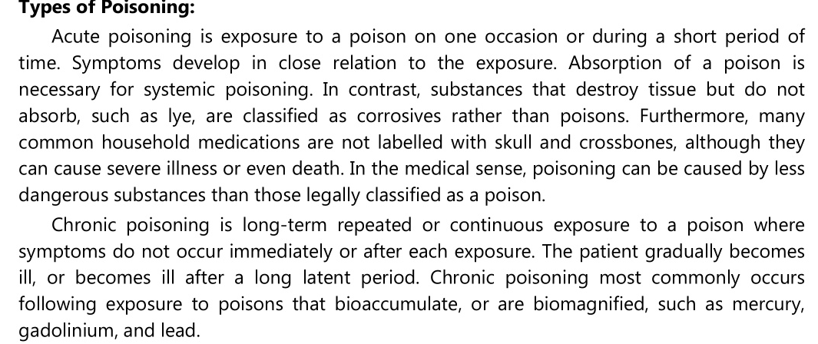

Slide 4
Classification
Depending on their mechanism of antidote are classified into,
1. Physiological antidote: It counteracts effect of poison by producing other physiological effect
Example- Sodium nitrite in cyanide poisoning.

Slide 5
2. Chemical antidote: It changes chemical nature of poison.
Examples- Sodium Thiosulphate in cyanide poisoning
Chelating agents- Sodium & Calcium Edetate

Slide 6
3. Mechanical antidote: They prevent absorption of poison across the intestinal wall by adsorbing the toxins on to their surface.
E.g. Activated charcoal and kaolin.

Slide 7
Role of antidote in cyanide poisoning:
In cyanide poisoning, sodium nitrite and sodium thiosulphate are used as antidotes.
Firstly injection of sodium nitrite is given which causes the oxidation of the ferrous (Fe++) ion of haemoglobin to the ferric (Fe+++) ion of methaemoglobin.

Slide 8
The methaemoglobin then combines with serum cyanide that has not yet entered the cell to produce cyanomethaemoglobin, thus protecting the essential cytochrome oxidase enzyme from the cyanide ion.

Slide 9
This cytochrome oxidase enzyme is required for electron transfer cycle and cellular respiration. After 5 minutes a slow intravenous infusion of sodium thiosulphate is given. The thiosulphate ions react with cyanide ions in presence of rhodanese enzyme to non-toxic thiocynate ions which is excreted through the urine

Slide 10
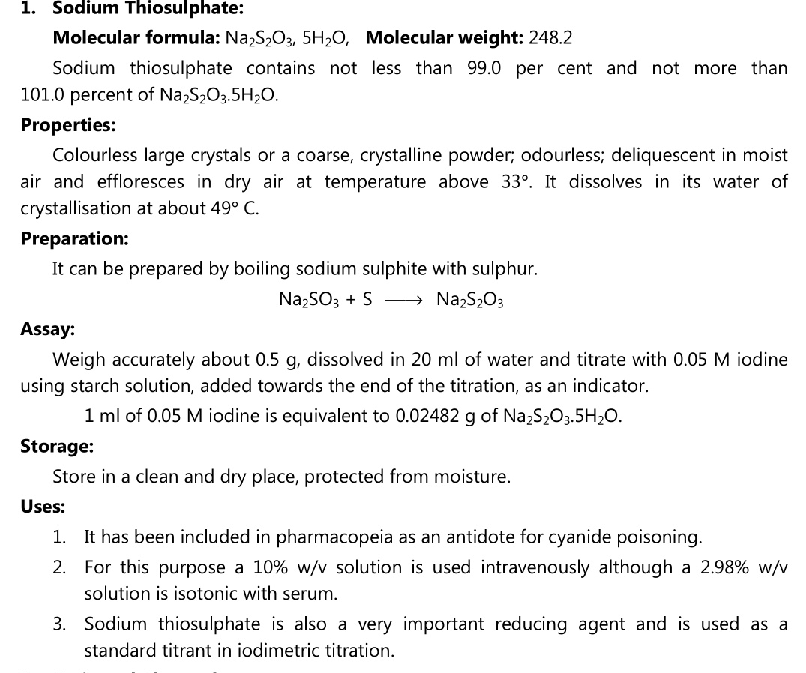

Slide 11
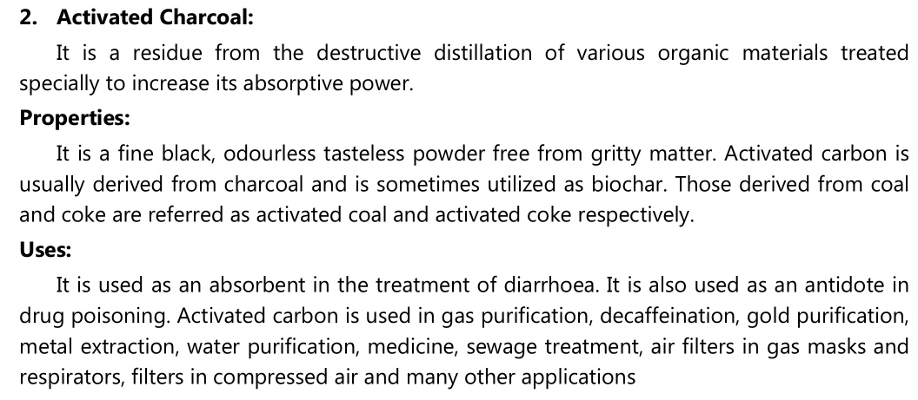

Slide 12
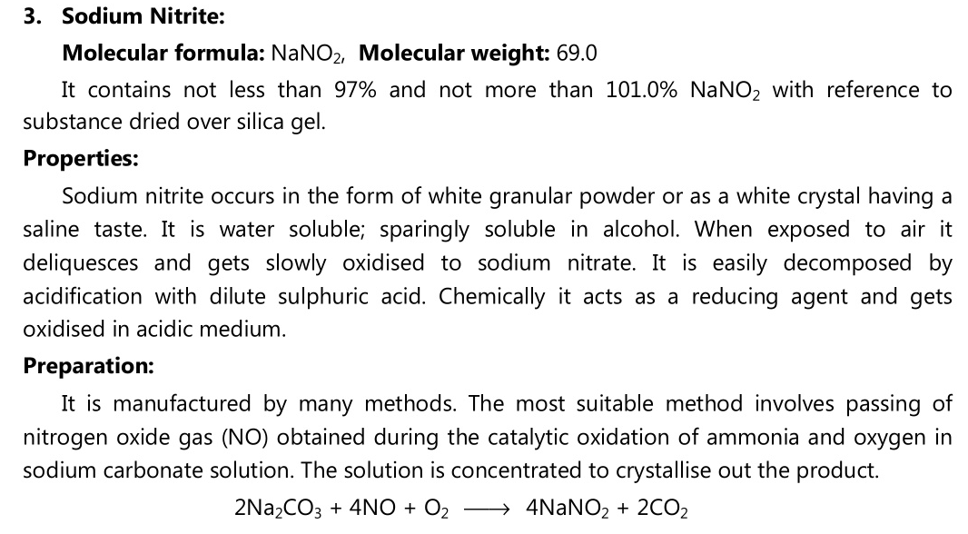

Slide 13
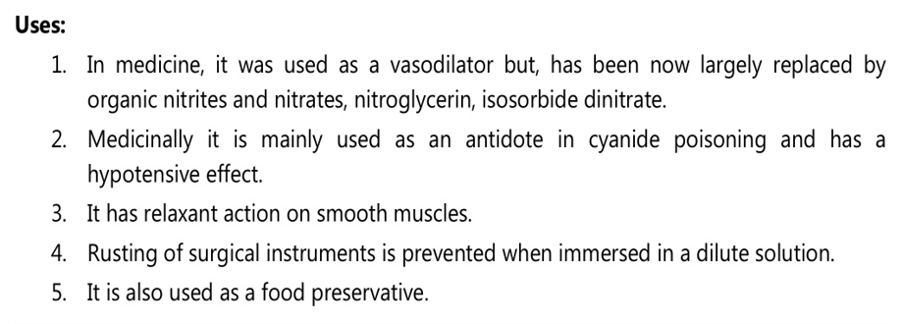

Slide 14
List of antidote along with the types of poisoning treated
Sodium nitrite – cyanide poisoning
Sodium thiosulphate- cyanide poisoning
Desferrioxamine- Iron salt
BAL/Dimercaprol- mercury salt
Penicillamine- Copper and lead salt
Calcium chloride- fluoride
Hydrogen peroxide-Phosphorous

Slide 15
References
Pharmaceutical inorganic chemistry volume – I, by G. R. Chatwal published by himalaya page no 365
https://www.google.co.in/image

