Slide 1
ANTI-HISTAMINICS
By
Shaikh Matin
Assist. Professor
H R Patel Institute of Pharmaceutical Education and Research, Shirpur

Slide 2
HISTAMINE
Histamine is an important chemical messenger communicating information from one cell to another and is involved in a variety of complex biologic actions. It is mainly stored in an inactive bound form, from which it is released as a result of an antigen–antibody reaction initiated by different stimuli such as venoms, toxins, proteolytic enzymes, detergents, food materials, and numerous chemicals.
Histamine exerts its biologic function by interacting with at least three distinctly specific receptors H1, H2, and H3. It was the mediator associated with allergic manifestations. It binds to and activates specific receptors in the nose, eyes, respiratory tract, and skin, causing characteristic allergic signs and symptoms.
It also causes contraction of smooth muscles, relaxation of capillaries, and gastric acid secretion.

Slide 3
HISTAMINE
Histamine is β-Imidazolyl ethylamine. It is synthesized locally from amino acid histidine. It is stored in mast cell, along with acidic protein heparin.
Histamine is comprised of an imidazole ring connected to an amino group through ethylene bridge.
It is called as tissue amine & is involved in diversified physiological processes.
It is released in body usually in response to tissue injury, inflammation, & allergic or hypersensitivity reactions.

Slide 4
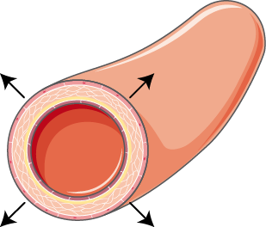
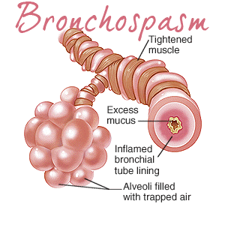
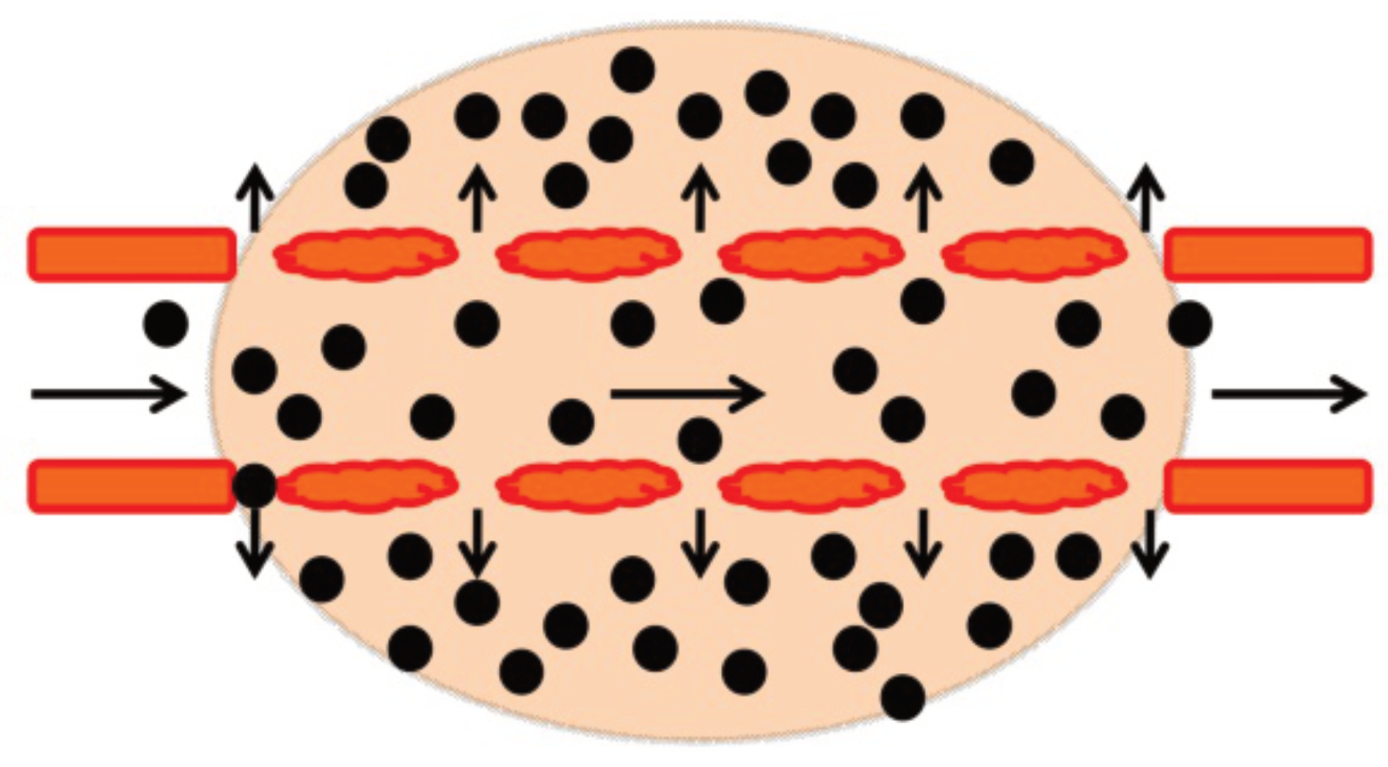
Physiological actions of Histamine
Vasodilation
Broncho-constriction
Allergic reaction (itching)
Gastric Secretion
Vascular permeability
Broncho-spasm
Pain
Immunosuppression

Slide 5
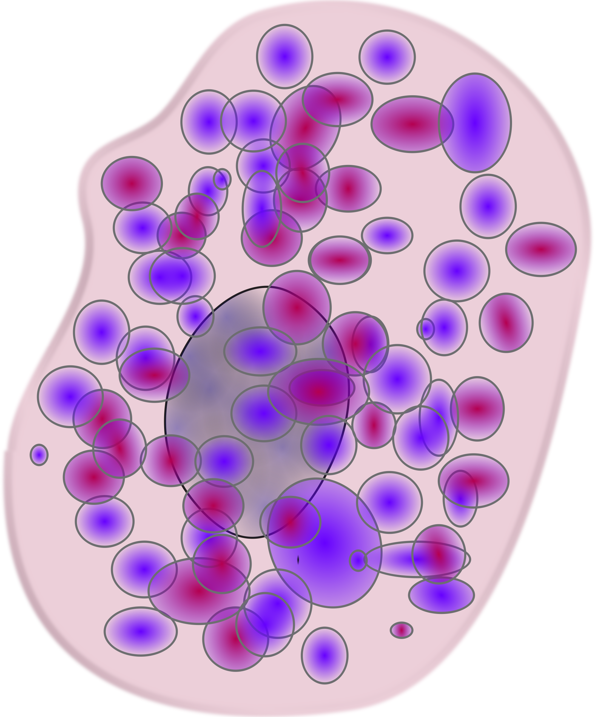
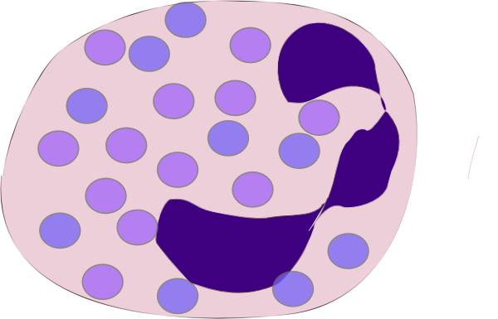
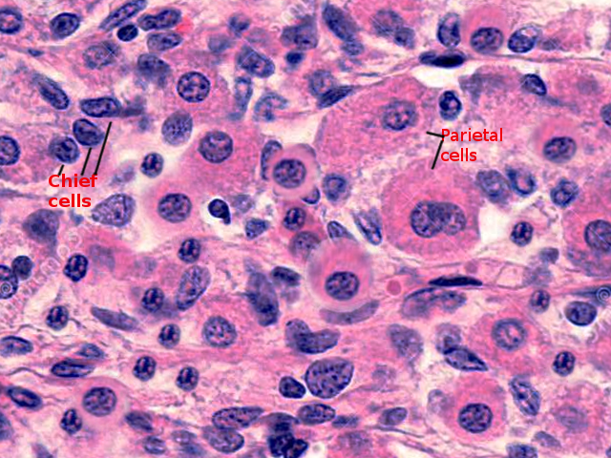
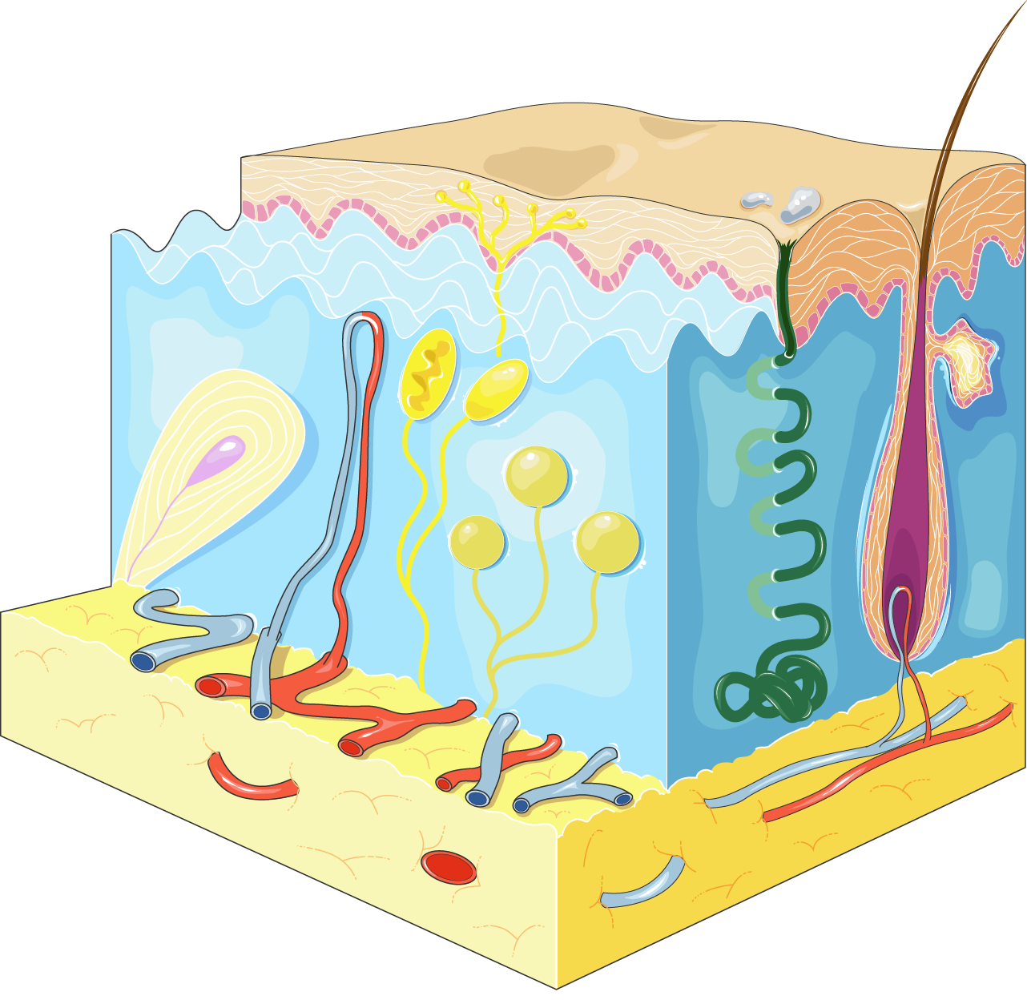
Location:
The tissue fixed mast cells & blood basophiles are principle cells where histamine is stored in secretary granules
Basophile Cell:
Parietal Cell
ECC
Mast cell:
Skin:
Bone marrow
Lungs:
GIT

Slide 6
Biosynthesis
HISTIDINE
Histamine decarboxylase
CO₂
HISTAMINE

Slide 7
Metabolism
Histamine-N-methyl transferase
HISTAMINE
Diamine Oxidase
N-Methyl histamine
MAO
Imidazole-4-Acetaldehyde
Aldehyde Dehydrogenase
1-Methylimidazole-4-acetaldehyde
Imidazole-4-AcetIc Acid
Aldehyde Dehydrogenase
Imidazole-Acetic Acid Phosphoribosyl transferase
1-Methylimidazole-4-acetic acid
I-Ribosyl-Imidazole-4-AcetIc Acid

Slide 8
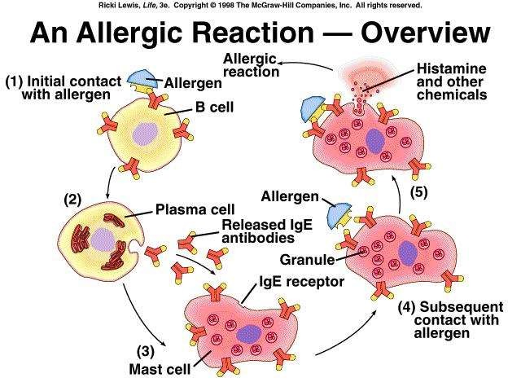
Release of Histamine:
Histamine is released in response to tissue injury, inflammation & allergic reaction.
An allergen (antigen) interacts with Ab on mast cells.
Once the mast cell Ab-Ag Complex is formed, a series of events occurs.
That series of events leads to cell granulation & release of histamine from mast cell.
The released histamine bound with histamine receptor.

Slide 9
Receptors
Type | Location | Function
H1 | Smooth muscle of intestine, bronchi & BV, endothelium & CNS | Allergic reaction itching, Inflammation GI smooth muscle contraction, Bronchial smooth muscle contraction Blood Vessels dilation
H2 | Parietal Cells | Gastric secretion
H3 | - | Presynaptically present and controls the release of histamine.
H4 | Thymus, small intestine, spleen, colon, basophils, bone marrow. | Located at eosinophiles, basophiles and other mast cells which also promote chemotaxis.

Slide 10
ANTI-HISTAMINICS
These are the drugs act against the action of histamine either competively or non
competitively.
H1 Antagonist (Antiallergens):
These are the agents which inhibit binding of histamine at H1 receptor.
H2 Antagonist (Anti-secretary drugs):
These are the agents which is used in peptic ulcer, gastric ulcer, Zollinger-Ellison Syndrome, as antacid

Slide 11
H₁ Antagonists
1st generation antihistamines are more likely to cause sedation in therapeutic doses affect autonomic receptors (cholinergic and adrenergic) these are classical/(older)
2nd generation antihistamines are sometimes called “non-sedating” antihistamines. But better call it low-sedating & newer.
3rd generation antihistamines are the active metabolites of 2nd generation agents

Slide 12
H₁ Antagonists
First Generation H1 receptor antagonists (Classical Anti-Histamine)
General Structure of 1st Generation Drugs

Slide 13
First Generation H1 receptor antagonists Classical Anti-Histamine
Aminoalkyl ethers ethers
Diphenhydramine hydrochloride
Doxylamine Succinate

Slide 14
First Generation H1 receptor antagonists Classical Anti-Histamine
Propylamine Derivatives
Chlorpheniramine maleate
Triprolidine hydrochloride

Slide 15
First Generation H1 receptor antagonists Classical Anti-Histamine
Ethylenediamine Derivatives
Tripelennamine hydrochloride

Slide 16
First Generation H1 receptor antagonists Classical Anti-Histamine
Piperazine Derivatives
Chlorcyclizine hydrochloride
Buclizine hydrochloride
Meclizine hydrochloride

Slide 17
First Generation H1 receptor antagonists Classical Anti-Histamine
Phenothiazine Derivatives
Promethazine hydrochloride
Trimeprazine tartarate

Slide 18
First Generation H1 receptor antagonists Classical Anti-Histamine
Dibenzo-cyclohepatanes
Azatidine
Loratidine
Cyproheptidine hydrochloride

Slide 19
Second Generation H1 receptor antagonists Classical Anti-Histamine
Cetrizine
Acrivastine

Slide 20
Third Generation H1 receptor antagonists Classical Anti-Histamine
Levocetrizine

Slide 21
SAR of 1st Generation Anti-histamine
General Structure of 1st Generation Drugs

Slide 22
SAR of Aryl group
Aryl group can be Phenyl ring or heteroatom ring
Diphenhydramine hydrochloride
Doxylamine

Slide 23
SAR of Aryl group
Ar ^{I} can be aryl (phenyl) or aryl methyl
Diphenhydramine hydrochloride
Triprolidine hydrochloride

Slide 24
Nature of X
When X = Oxygen (Aminoalkyl ether)
Nitrogen (Ethylene Diamine)
Carbon (Propylamine)

Slide 25
Alkyl Chain
Ethylene Chain is essential for activity
Diphenhydramine hydrochloride

Slide 26
Alkyl Chain
Extension or branching of this chain results in less active compounds

Slide 27
Terminal Nitrogen
The terminal Nitrogen atom should be tertiary amine for maximum activity.
Diphenhydramine hydrochloride
Doxylamine

Slide 28
Terminal Nitrogen
Diethyl amine (-N-(C₂H₅)₂) derivatives are found to possess better activity.

Slide 29
Terminal Nitrogen
The terminal Nitrogen can be cyclized into the ring
Triprolidine hydrochloride

Slide 30
Terminal Nitrogen
Since the antihistamine have a close resemblance with anticholinergic agent, most of antihistamine do exhibit anticholinergic action & vice versa.

Slide 31
Pharmacophore
X ray crystallography predicts that two phenyl & protonated Nitrogen mainly interact with H₁ receptor.
For proper binding the distance between two aromatic ring should be 4.90 Aº & between second aromatic ring & protonated nitrogen should be 5.3 Aº.

Slide 32
Therapeutic Application
Asthma
Hypnotic
Parkinsonism
Motion Sickness
Cardiac Arrhythmia
Antitussive

Slide 33
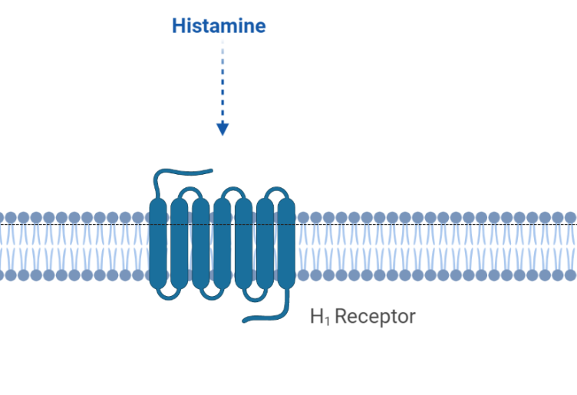
MOA: H₁ Antagonist
Histamine binding to H₁ receptor can cause allergic and hypersensitivity reactions s/a fever, itching, dermatitis etc.
Antihistamine are used to treat these symptoms by inhibiting the binding of histamine to it`s receptor by blocking it by competitive antagonism.
Antihistamine

Slide 34
Synthesis :
Diphenhydramine Hydrochloride
K₂CO₃
HCl
Dimethyl amino ethanol
Diphenyl bromo methane
Diphenhydramine
Diphenhydramine hydrochloride

Slide 35
Synthesis :
Promethazine Hydrochloride
S
I₂
-HCl
AlCl₃
HCl
Phenothiazine
Promethazine
Diphenyl amine
Sulphur
1-Chloro-2-(dimethylamino)Propane

Slide 36
H₂ Receptor Blocker
The H₂ receptor antagonist are competitive inhibitors of histamine at the parietal cell H₂ receptor. They supress the normal secretion of acid by parietal cells & meal stimulated secretion of acid. Histamine released by ECL cells in the stomach is blocked from binding on
parietal cell H2 receptors that stimulate acid secretion.

Slide 37
H₂ Receptor Blocker
Cimetidine

Slide 38
H₂ Receptor Blocker
Ranitidine

Slide 39
H₂ Receptor Blocker
Famotidine

Slide 40
SAR of H₂ Receptor antagonist
Basic Heterocyclic ring
Flexible Chain
Polar Group
N
R

Slide 41
MOA of H₂ Receptor antagonist
Basic Heterocyclic ring
Originally imidazole ring was found to be active, example cimetidine.
Cimetidine

Slide 42
SAR of H₂ Receptor antagonist
Other heterocyclic ring like furan, thiazole enhance the potency
Ranitidine
Famotidine

Slide 43
SAR of H₂ Receptor antagonist
Introduction of basic moieties like dimethyl amino, methyl guanidine on heterocyclic ring improves activity.
Ranitidine
Famotidine

Slide 44
SAR of H₂ Receptor antagonist
2,5 di substitution is best for furan
Ranitidine

Slide 45
SAR of H₂ Receptor antagonist
Flexible Chain
Chain comprises of either 4 or 3 Carbon long chain containing sulphur atom.
Ranitidine

Slide 46
SAR of H₂ Receptor antagonist
Flexible Chain
Sulphur atom should be present between heterocyclic ring & Polar group ( N atom)
Cimetidine

Slide 47
SAR of H₂ Receptor antagonist
Flexible Chain
Replacement of Sulphur (S) by methylene group (-CH₂-) drops activity
Cimetidine

Slide 48
SAR of H₂ Receptor antagonist
Polar Group
The terminal nitrogen group should be polar
Ranitidine

Slide 49
SAR of H₂ Receptor antagonist
Polar Group
Cyanoguanidine substituent results in potent compound
Cimetidine

Slide 50
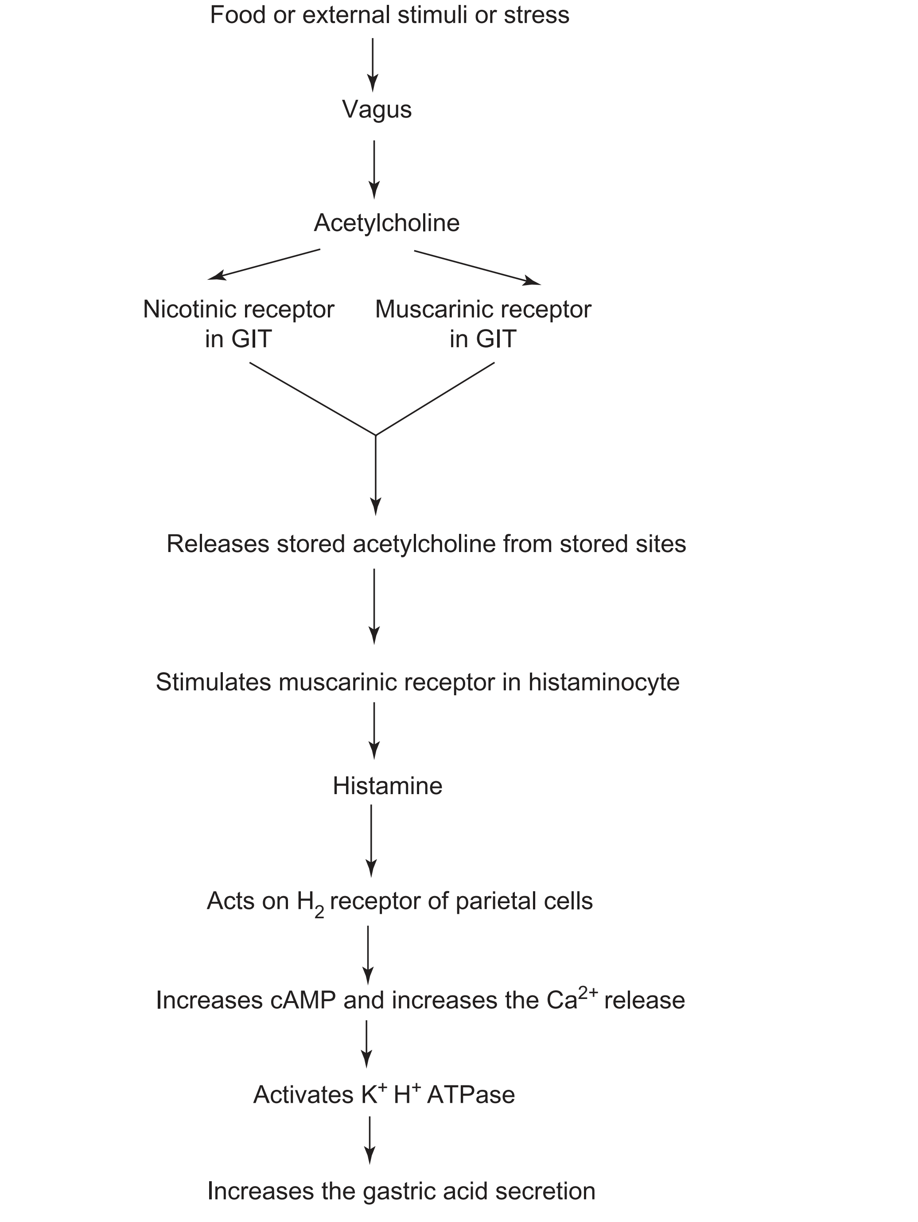
MOA of H₂ Receptor antagonist
Histamine action on gastric acid:
These drugs inhibit the acid production by reversibly competing with histamine for the binding with H₂-receptor on the basolateral membrane of parietal cells.
The most predominant effect of H₂-receptor antagonist is on acid secretion.
Histamine on H₂-receptors produces cAMP-dependent protein kinase to elicit the response in the gastrointestinal tract (GIT).
The H₂-antagonists reversibly bind the H₂-receptors and reduce the cAMP formation, which is responsible for the activation of proton pump and subsequently reduces the gastric acid formation in the GIT.
H₂ Receptor antagonist

Slide 51
Therapeutic Application
Duodenal Ulcers
Gastric Ulcers
Pathological Hypersensitivity
Upper GI Bleeding
Gastroesophageal reflux disease
Zollinger-Ellison Syndrome

Slide 52
Proton Pump Inhibitors
Drugs which are used to reduce or inhibit gastric acid production & secretion, are known as Proton Pump Inhibitors (PPI`s).
These are more potent & longer duration of action than H₂ antagonist. They act by irreversibly blocking H+/K+ ATPase enzyme of gastric parietal cells.

Slide 53
Proton Pump Inhibitors
Lansoprazole

Slide 54
Proton Pump Inhibitors
Omeprazole

Slide 55
Proton Pump Inhibitors
Rabeprazole

Slide 56
Proton Pump Inhibitors
Pantoprazole

Slide 57
SAR of Proton Pump Inhibitors
Basic structure for PPI`s

Slide 58
SAR of Proton Pump Inhibitors
Benzimidazole ring should be substituted since non substituted benzimidazole derivatives causes thyroid enlargement.

Slide 59
SAR of Proton Pump Inhibitors
Replacement of the -SOCH₂-, linking chain by variety of other groups like -SCH₂-, -SO₂CH₂-, leads to loss of activity.

Slide 60
SAR of Proton Pump Inhibitors
Extending -SOCH₂- chain give rise to inactive compounds

Slide 61
SAR of Proton Pump Inhibitors
The substituent which increases nucleophilicity of Pyridine Nitrogen makes compound more stable s/a –OCH3 & easily convertible to active form sulfenamide.

Slide 62
SAR of Proton Pump Inhibitors
Presence of –OCH3 (electron withdrawing) at C-6 on benzimidazole make compound more stable & easily convertible to active form sulfenamide.

Slide 63
SAR of Proton Pump Inhibitors
Presence of –OCH3 (electron withdrawing) at C-6 on benzimidazole make compound more stable & easily convertible to active form sulfenamide.

Slide 64
SAR of Proton Pump Inhibitors
Pantoprazole
Replacement of -OCH₃ (methoxy group) by fluoromethyl (-CH₃F) group decreases the activity.

Slide 65
SAR of Proton Pump Inhibitors
Omeprazole
Replacement of -OCH₃ (methoxy group) by trimethyl group (-CH₃) groups decreases the activity

Slide 66
SAR of Proton Pump Inhibitors
Omeprazole
Addition of difluoroaldehyde (-FCHO-F) group at 6th position increases the activity

Slide 67
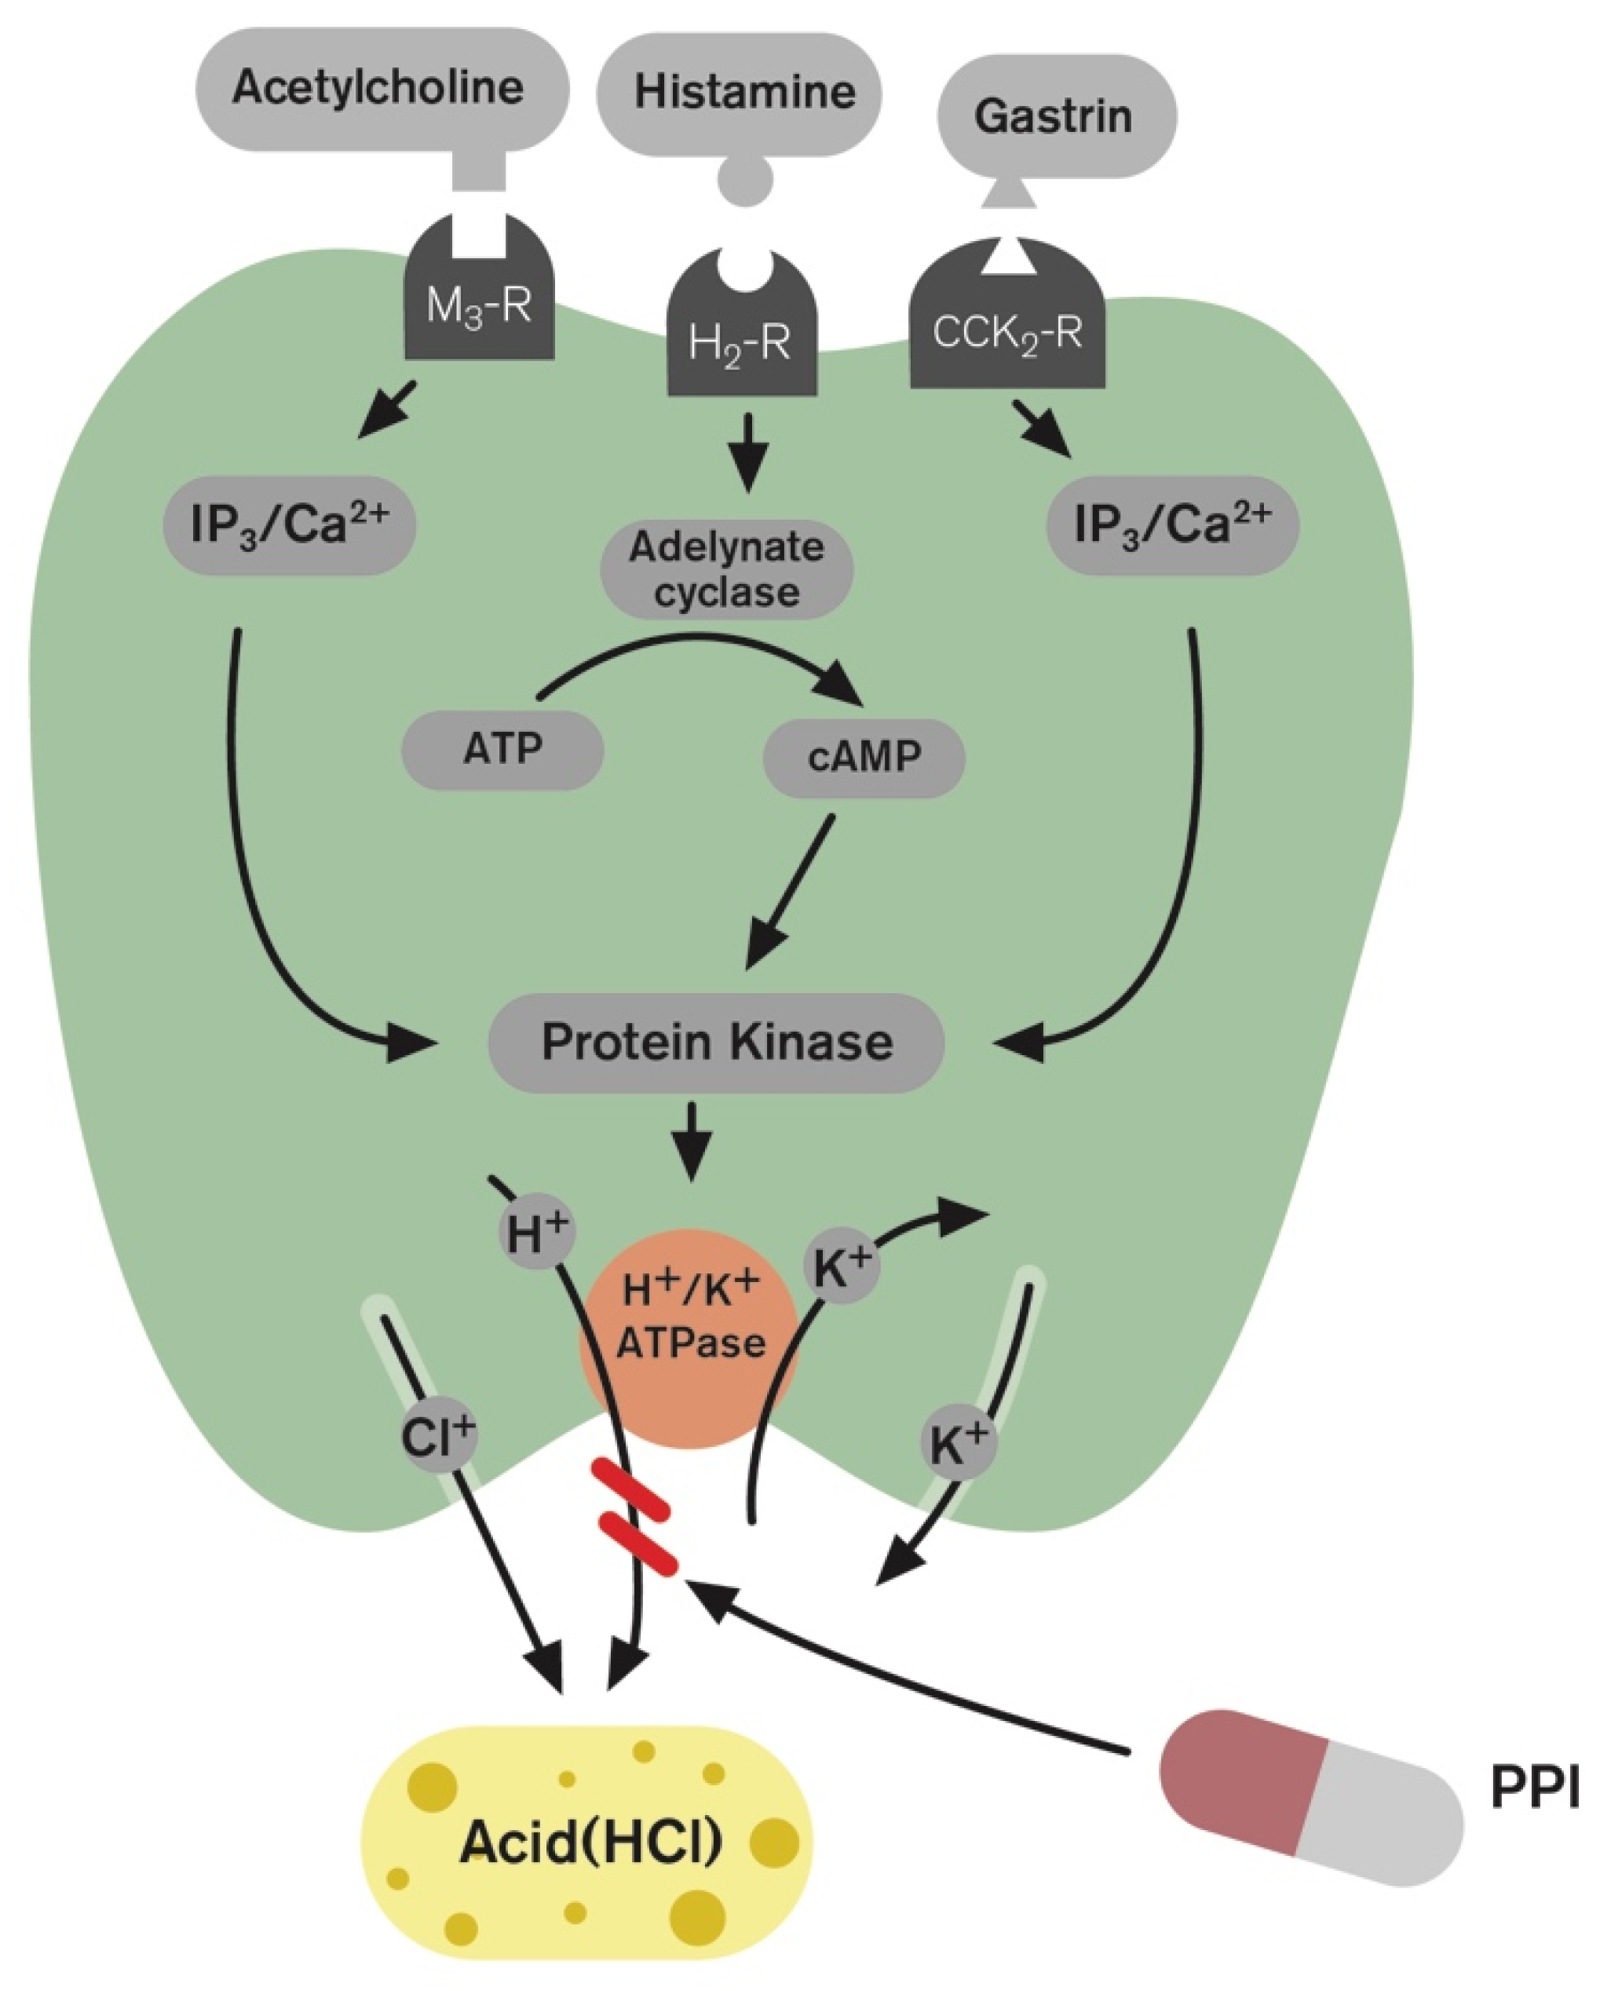
MOA of Proton Pump Inhibitors
These drugs suppress gastric acid secretion through H+ K+ ATPase pump, the two major signaling pathways that are present with the parietal cells, that is, cAMP dependent and Ca2+.
The respective receptors for the actions are M₃ and H₂.
These receptors are modulated through the respective ionic mechanism and elicited by the acetylcholine from M3 and histamine from H2 receptor for release of the gastric acid mediated through H+ K+ ATPase pump. The proton pump inhibitors act on these receptors and inhibit H+ K+ ATPase and reduce the activation of parietal cells to release the gastric acid.

Slide 68
MOA of Proton Pump Inhibitors
The ultimate mediator of acid secretion is the H⁺ - K⁺ ATPase ( Proton pump) of the parietal cell.
All the PPI`s contain a sulphinyl (-SO-) group in a bridge between substituted benzimidazole & pyridine ring.
At neutral pH these agents are chemically stable, lipid-soluble, weak-bases that are devoid of inhibitory activity.
These drugs reach parietal cells from the blood gets protonated & thereby trapped. The protonated agent rearranges to form a sulphenic acid (-SOH) & Sulphenamide (-SN-).
The sulphenamide interacts covalently with Sulfhydryl (-SH) group of cysteine of the H+/K+ ATPase enzyme i.e Proton Pump, & inhibit irreversibly & thereby blocks gastric acid secretion.

Slide 69
PPI`s
Sulphenic acid
Sulphenamide
Enzyme-Inhibitor
Complex

Slide 70
Mast Cell Stabilizers
It inhibits the release of histamine, leukotrienes & other substances that cause hypersensitivity reactions from the mast cells.
It is a mast cell stabilizer & it have anti-inflammatory activity.
Cromolyn Sodium

Slide 71
Mast Cell Stabilizers
MOA
It inhibit degranulation of mast cells thus preventing the release of histamine.
It stabilizes the membranes of mast cells, stopping the release of allergy mediators (histamine, leukotrienes & others) & supressing activation of eosinophiles, neutrophiles, thrombocytes, & macrophages which takes part in the formation of bronchospasm.

Slide 72
Mast Cell Stabilizers
Uses
Bronchial Asthma
Used in Nasal Solution for allergic rhinitis
Eye drop to treat allergic conjuctivitis

