Slide 1
Antimicrobial agents

Slide 2
Antimicrobial agents
Antimicrobial agents
These are the agents which cause suppression of growth of the micro organism. E.g. Kmno_{4,} H₂O_{2,}
Antiseptics:
Antiseptics are the agents which are applied on living tissues to destroy or inhibit the micro-organism
E.g. Hydrogen peroxide, Kmno_{4 ,} Iodine.

Slide 3
Disinfectants:
Disinfectants are agents which are applied on inanimate objects & kill the microbes outright.
E.g. Chlorinated lime, potassium permanganate, formaldehyde, phenol etc.
Sanitizers:
These are disinfectants used to maintain public health standard are known as sanitizers.

Slide 4
Germicides
The agents which kill microorganism (Germ). E.g iodine, alcohols.
Bacteriostatic
These are the agent which inhibiting the growth of bacteria. E.g boric acid
Sterilization
The process of destroying pathogenic microorganism and their products is known as sterilization.

Slide 5
Mechanism of action of antimicrobial agents
Mechanism of action of antimicrobial agents
Inorganic compounds generally exhibit antimicrobial action by any of the three mechanisms viz.
(i) Oxidation
(ii) Halogenation
(iii) Protein binding or precipitation.

Slide 6
1. Oxidation:
Compounds acting by this mechanism belong to class of peroxide, peroxyacids, oxygen liberating compounds like permanganate and certain Oxo-halogen anions.
Microorganisms require protein for their growth. Various reducing groups are present in proteins which are oxidized by oxidizing agents.

Slide 7
They act on proteins containing sulfhydryl group and oxidizes free sulfhydryl to disulphide bridge and inactivate its function. Hence change in molecular shape of protein, leads to destruction of protein.
Examples: Hydrogen peroxide, Potassium permanganate, non-metals act by this mechanism.

Slide 8
2. Halogenation:
These compounds act by liberating chlorine or iodine or hypochlorite. They act on peptide linkage and change its potential and property. They cause destruction of specific functions of protein resulting in death of microorganism.
E.g. – Iodine & iodine preparations, chlorinated lime etc.

Slide 9
3. Protein Precipitation:
The compounds like metal ions interact with protein. The complex formed lead to inactivation of protein.
E.g. – boric acid, borax, silver nitrate.

Slide 10
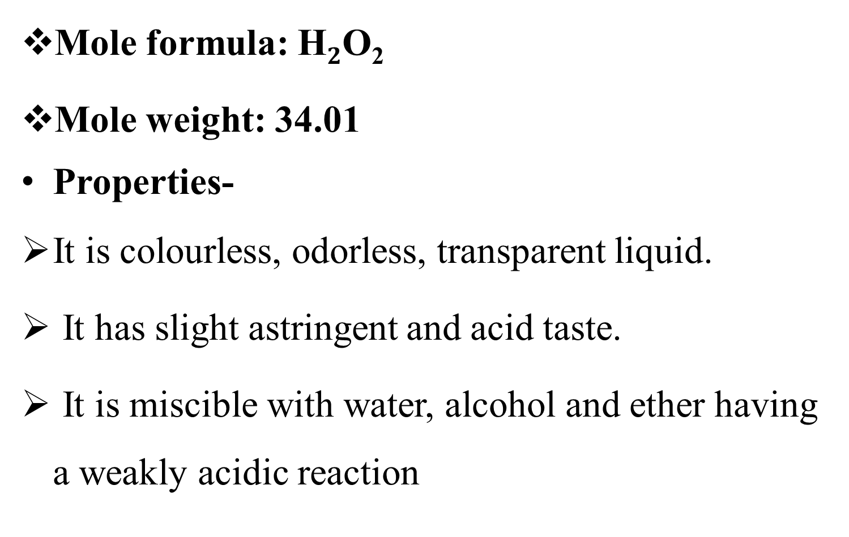
Hydrogen peroxide-
Mole formula: H$2$O₂
Mole weight: 34.01
Properties-
It is colourless, odorless, transparent liquid.
It has slight astringent and acid taste.
It is miscible with water, alcohol and ether having a weakly acidic reaction

Slide 11
Chemical properties:
It oxidizes potassium iodide to iodine and potassium bromide to bromine in acidic medium.
When black lead sulphide reacts with hydrogen peroxide, it is oxidized to white lead sulphate.
Hydrogen peroxide reduces silver oxide to metallic silver.
Its dilute solution has decolorizing and bleaching actions.

Slide 12
Uses-
Mild antiseptic.
Disinfectant.
Cleansing agent for cuts & wounds and for loosening ear wax.
1.6% solution is used in deodorants, gargles & mouth washes.
Antidote in phosphorous & cyanide poisoning.
Bleaching agent.

Slide 13
Storage
It is stored in containers protected from light, in bottles closed with glass stoppers or plastic caps provided with a vent for the escape of oxygen. It is kept in cool place.
Incompatibilities
With reducing agents, oxidizing agents, alkalies and iodides, permanganates.

Slide 14
Assay of hydrogen peroxide.
Principle:
This assay is based upon the oxidation-reduction type of titration in which solution of potassium permanganate acts as an oxidizing agent and hydrogen peroxide also act as an oxidizing agent but in presence of strong oxidizing agent like potassium permanganate, hydrogen peroxide acts as reducing agent. The potassium permanganate solution acts as self indicator.

Slide 15
The ability of potassium permanganate solution to oxidize is due to the conversion of the MnO4- to Mn++ in acidic solution. MnO4- are purple in colour & solution of salts containing Mn++ are colourless, hence permanganate solution is decolourised by reducing agent like hydrogen peroxide. The moment there is an excess addition of potassium permanganate, solution becomes purple at the end point..
CHEMICAL REACTION FOR ASSAY:
2KMnO4 + 3H2SO4+ 5H2O2 → K2SO4 + 2MnSO4 +5O2↑ +8H2O

Slide 16
Potassium permanganate-
Mole formula: KMnO4
Mole weight: 158.04
Properties-
Potassium permanganate occurs in the form of dark purple colored monoclinic prisms, almost opaque with a blue metallic luster.
It is odorless. An aqueous solution has sweetish astringent taste.
It is water soluble and more soluble in boiling water.

Slide 17
Potassium permanganate is a powerful oxidizing agent.
In acidic solution potassium permanganate is reduced form Mn+7 to manganous ion Mn+2 with evolution of oxygen.
In neutral or alkaline media also oxygen is liberated.

Slide 18
Uses
Topical anti-infective.
Antiseptic & Antibacterial, Astringent
Antidote in barbiturate poisoning.
Oxidizing agent.
1:5000-1:15,000 solutions is used in cleaning wounds & ulcers.
Used in mouthwashes and gargles

Slide 19
Storage
It is kept in tightly closed container
Incompatibilities
With reducing agents iodides organic or oxidisable substances.

Slide 20
Iodine
Mole formula: I₂
Mole weight: 253.8
Properties-
Iodine occurs as heavy, bluish black rhombic prism or plates with metallic luster.
It volatilizes at ordinary temperature.
It melts at higher temperature.
It is practically insoluble in water but soluble in alcohol.
It is freely soluble in chloroform and solvent ether.

Slide 21
Uses
The aqueous solution of iodine are used as fungicide and germicide
It is used for treatment of pharyngitis and tonsillitis
In alkaloidal poisoning
It is used as trace element because its deficiency may lead to goitre
It is used as antiseptic and disinfectant
It is used as bactericide for treatment of wounds

Slide 22
Storage conditions
Iodine is stored in bottles with round glass stoppers in a cool place protected from light.
Incompatibilities
It is incompatible with hypophosphite, sulphites, some metals and reducing agents

Slide 23
Enlist various Iodine preparations.
Aqueous Iodine Solution - It is known as Lugol's solution.
Weak Iodine Solution
Strong Iodine Solution
Iodine tincture
Iodine ointment
Phenolated iodine solution
Povidone-iodine- It is a member of a class of compounds known as iodophors.

Slide 24
Povidone Iodine solution
Properties
It occurs as yellowish brown amorphous powder
It has slight characteristics odour
Its aqueous solution is acidic to litmus
It is soluble in water and alcohol and practically insoluble in organic solvent
It have faint smell of iodine

Slide 25
Uses
It is used as antiseptic and disinfectant
It is used in gargles and mouthwashes
Used in cut and burns
Used in Eczema
Storage conditions
Store in airtight containers.
Incompatibilities
With H₂O₂

Slide 26
Advantages of povidone iodine over iodine?
It is preferred over the iodine because of,
Water solubility
Non irritating nature
Less toxicity
Non staining nature
It can be easily removed from skin and clothes by washing.

Slide 27
Chlorinated Lime
Synonym - Bleaching powder
Molecular formula - Ca(OCl)Cl. H₂O or CaOCl₂
Properties-
It is a dull white powder with characteristic odor.
On exposure to air it absorbs moisture & decomposes by liberating chlorine.
It is sparingly soluble in water & insoluble in alcohol.

Slide 28
Preparation-
It is obtained by action of chlorine on calcium hydroxide. This is done at 25^{oc} to minimize the formation of calcium chloride.
Ca(OH)₂ + Cl₂ → Ca(OCl) Cl + H₂O

Slide 29
Uses-
It is used as disinfectant & bleaching agent.
It shows bactericidal action. It is used to disinfect urine, sputum & other organic material.
It is employed for disinfecting drainages.
It is a powerful bleaching agent .

Slide 30
It is used as one to two grams per liter for sterilization of water.
Chlorinated lime is used in the preparation of surgical chlorinated soda solution, employed as a wound disinfectant

Slide 31
Boric acid-
Synonym: Orthoboric acid.
Formula: H₃BO₃
Mole weight:61.83
Properties:
It is a white, colorless crystalline powder, odorless, unctuous to touch.
It has bitter, sweetish after taste
It is soluble in alcohol, freely soluble in glycerin, propylene glycol and boiling water

Slide 32
Stable in air, on heating at 100^{0C} it is converted in to metaboric acid,
At 160^{0C} in to tetraboric acid,
At more than 160^{0C} boric acid is converted in to boron trioxide.
Boric acid is very weak acid, so it cannot be titrated accurately with standard alkali. Hence glycerin is added in its titration.
Incompatibility: It is incompatible with tannins, bases.

Slide 33
Storage of Boric acid- It should be stored in air-tight, well closed container.
Uses of Boric acid-
It has weak bacteriostatic and fungistatic action
It is used as local anti-infective drug in the form of cream, ointment and lotion.
Buffer in topical preparations.
Vehicle for ophthalmic solution.
Boric acid is useful as suppositories base.

Slide 34
Definition of Astringent.
Define as compounds that show protein precipitation by the action coagulation when applied to damage skin or mucous membrane.
Properties
odourless, colorless, transparent, crystalline powder.
Sweet astringent taste.
soluble in water & insoluble in alcohol
Uses
Topical astringent
Mouth wash & gargles
Dusting powder
Styptic & antiseptic
Haemostatic for cuts & ulcers

Slide 35
Alum
Mole formula: Aluminium Ammonium sulphate (NH₄).Al(SO₄).12H₂O
Aluminium potassium sulphate Al. K (SO₄).12H₂O
Mole wt. : 474.4
Synonym: Alumen, purified alum
Properties
Occurs as large crystals which are colourless.
It is odourless.
It has sweet astringent taste.

Slide 36
It is acidic to litmus.
It is soluble in water and glycerine but insoluble in alcohol.
On heating at it looses its water of crystallization.
Uses
Astringent
Antiseptic for cuts and wound
For purification of water
Dusting powder

Slide 37
Protective agent for protection of skin.
Dyeing industry.
Hemostatic agent.
Mouthwashes and gargles.
Storage
Alum should be stored in well closed containers
Incompatibilities
Alkali hydroxides carbonates borax and lime water

Slide 38
Zinc sulphate
Mole formula: ZnSO₄.7H₂O
Mole wt. : 287.54
Synonym: White Vitrol
Properties
It occurs as white crystalline powder or colourless transparent crystals.
It is odourless.
It has sweet astringent taste.

Slide 39
It is soluble in water and glycerine but insoluble in alcohol the aqueous solution of zinc sulphate is acidic to litmus.
Uses
Astringent
Antiemetic
Treatment of ulcers, infection of cornea and in conjunctivitis
Granulation
Healing of wound

Slide 40
Storage
Zinc sulphate should be stored in well closed containers
Incompatibilities
With lead, barium, calcium, boric acid.

