Slide 1
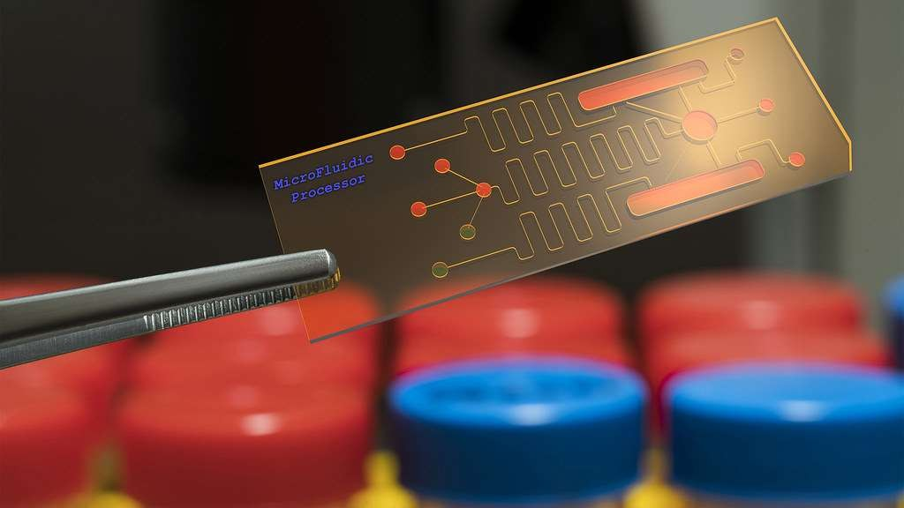
Bio sensor
Ms. D A Chaudhari
H. R. Patel Institute of Pharmaceutical Education and Research, Shirpur

Slide 3
DEFINITION
Self-contained integrated device that is capable of providing specific qualitative or semi-quantitative analytical information using a biological recognition element which is in direct-spatial contact with a transduction element. (IUPAC,1998)
Biosensor ≠ Bioanalytical System
An Enzyme Electrode is a Biosensor

Slide 4
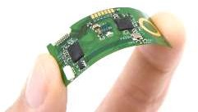
CURRENT DEFINITION
A sensor that integrates a biological element with a physiochemical transducer to produce an electronic signal proportional to a single analyte which is then conveyed to a detector.

Slide 5
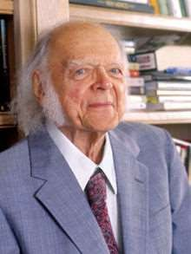
Father of Biosensors Leland C. Clark invented the Clark Oxygen Electrode, a pivotal device that allows real-time monitoring of patient’s blood oxygen levels and has made surgery Safer and more successful for millions around the world

Slide 6
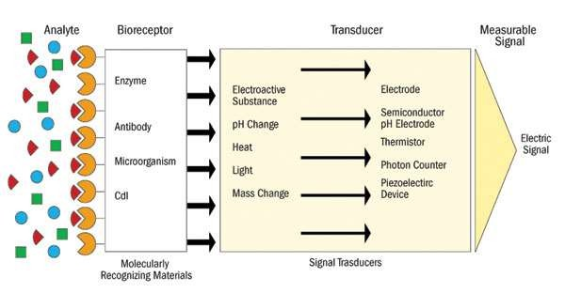
COMPONENTS
Detector

Slide 7
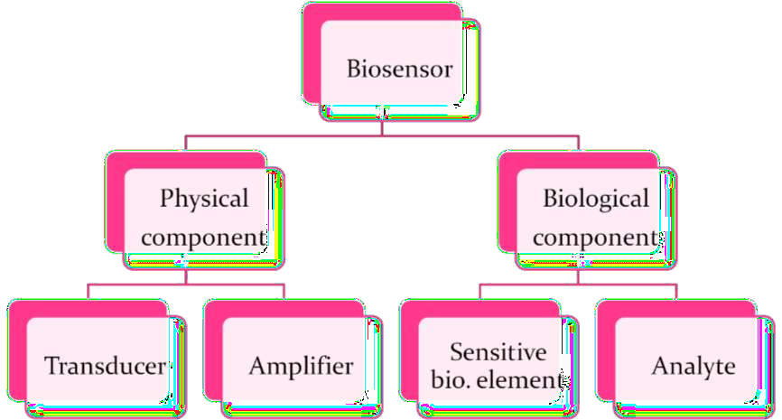

Slide 8
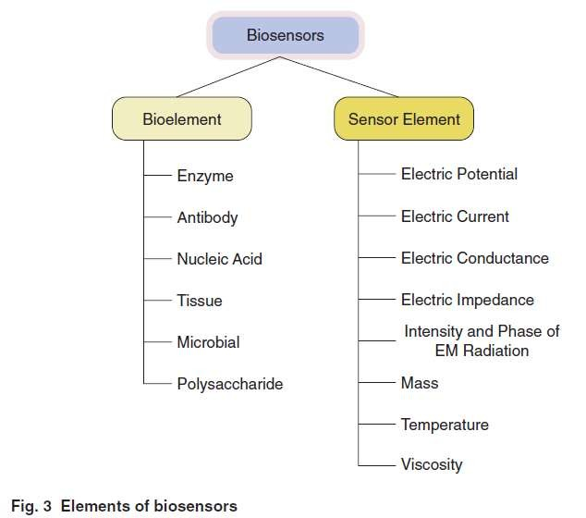
ELEMENTS OF BIOSENSORS

Slide 9
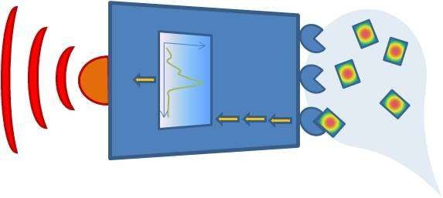
BIOSENSOR
Analyte
Response
Detection
Signal
Analysis
Sample handling/preparation

Slide 10
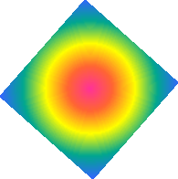
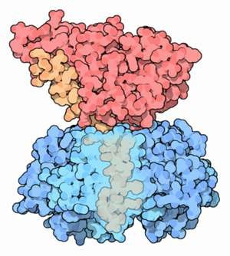
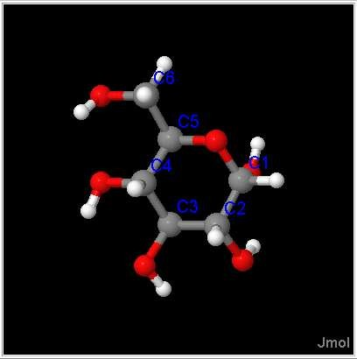
THE ANALYTE
(What do you want to detect?)
Molecule
Protein, toxin, peptide, vitamin, sugar, metal ion
Cholera toxin
Glucose

Slide 11
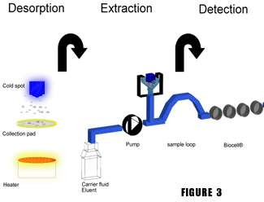
SAMPLE HANDLING
(How to deliver the Analyte to the Sensitive Region?)
(Micro) fluidics
Concentration (increase/decrease)
Filtration/selection

Slide 12
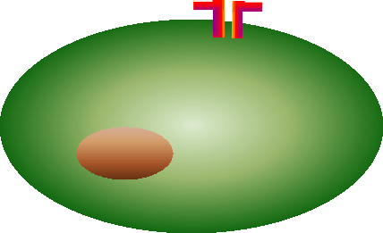
DETECTION/RECOGNITION
(How do you specifically recognize the analyte?)
Fab
Active site
Membrane receptors
Competitive binding
Fc
Antibody
Enzyme
Cell
Polymer/Hydrogel

Slide 13
SIGNAL
(How do you know there was a detection?)
Common Signaling Principles
Optical(SPR,ELM,IR).
Electrical(Voltametry,Potentiometry,
Conductivity).
Electromechanical(QCM
Thermal.
Magnetic.
Pressure.
Specific recognition?
Often the detector is immobilized on a solid support/sensor.
(The immobilisation permits repeated use of the costly Biological Molecule.)

Slide 14
WORKING PRINCIPLE
Analyte diffuses from the solution to the surface of the Biosensor.
Analyte reacts specifically & efficiently with the Biological Component of the Biosensor.
This reaction changes the physicochemical properties of the Transducer surface.
This leads to a change in the optical/electronic properties of the Transducer Surface.
The change in the optical/electronic properties is measured/converted into electrical signal, which is detected.

Slide 15
BASIC CHARACTERESTICS
LINEARITY : Should be High – For the Substrate Concentration.
SENSITIVITY : Value of Electrode Response per Substrate Concentration.
SELECTIVITY : Chemical Interference must be minimized for obtaining Correct Result.
detection of High
RESPONSE TIME :Time necessary for having 95% of the Response.

Slide 16
ADVANTAGES
Highly Specific.
Independent of Factors like stirring, pH, etc. Linear response, Tiny & Biocompatible.
Easy to Use, Durable.
Require only Small Sample Volume. Rapid, Accurate, Stable & Sterilizable.

Slide 17
TYPICAL SENSING TECHNIQUES
🠶Fluorescence.
🠶DNA Microarray.
🠶SPR (Surface Plasma Resistance).
🠶Impedance Spectroscopy.
🠶SPM (Scanning Probe Microscopy, AFM, STM).
🠶QCM (Quartz Crystal Microbalance).
🠶SERS (Surface Enhanced Raman Spectroscopy).
🠶Electrochemical.

Slide 18
TYPES
Calorimetric/Thermal Detection Biosensors.
Optical Biosensors.
Resonant Biosensors.
Piezoelectric Biosensors.
Ion Sensitive Biosensors.
Electrochemical Biosensors.
Conductimetric Sensors.
Amperometric
Potentiometric
Sensors. Sensors.

Slide 19
Calorimetric / Thermal Detection Biosensors.
Uses Absorption / Production of Heat.
Total heat produced/absorbed is ᾶ Molar Enthalpy/Total No. of molecules in the rn.
Temp. measured by Enzyme Thermistors.
Advantages:
No need of Frequent recalibration.
Insensitive to the Optical & Electrochemical Properties of the sample.
Uses:
Detection of: (1) Pesticides .
(2) Pathogenic Bacteria.

Slide 20
Optical Biosensors.
Colorimetric for colour - Measures change in
Light Adsorption.
Photometric for Light Intensity - Detects the
Photon output.
Resonant Biosensors.
An Acoustic Wave Transducer is coupled with
Bioelement.
Measures the change in Resonant Frequency.

Slide 21
Piezoelectric Biosensors.
Uses Gold - To detect specific angle at which ȇ waves are emitted when the substance is exposed to laser light/crystals like quartz, which vibrates under the
influence of an electric field.
Change in Frequency ᾶ Mass of Absorbed material.
Ion Sensitive Biosensors.
Are semiconductor FETs with ion-sensitive surface.
Surface Electrical Potential changes when the ions &
semiconductors interact.
Measures the Change in Potential.
Uses:
o pH Detection.

Slide 22
Electrochemical Biosensors.
Underlying Principle – Many chem.rns produce or consume ions or ȇs causing some change in the elctrical properties of the solution that can be sensed out & used as a measuring parameter.
Uses:
Detection of :
Hybridized DNA
DNA- binding Drugs &
Glucose Concentration.
Conductimetric Sensors.
Measures Electrical Conductance/Resistance of the
solution.

Slide 23
Conductance Measurements have relatively Low
Sensitivity.
Electrical Field is generated using sinusoidal(ac) voltage, which helps in minimizing undesirable effects
like:
i. Faradaic processes. Double layer charging &
ii.
iii. Concentration polarization.
Amperometric Biosensors.
High Sensitivity Biosensor.
Detects electroactive species present in the
biological test samples.
Measured Parameter – Current.

Slide 24
Potentiometric Sensors.
Working Principle – When ramp voltage is applied to an electrode in solution, a current flow occurs
because of electrochemical reactions.
Measured Parameter – Oxidation / reduction Potential of an Electrochemical rn.

Slide 25
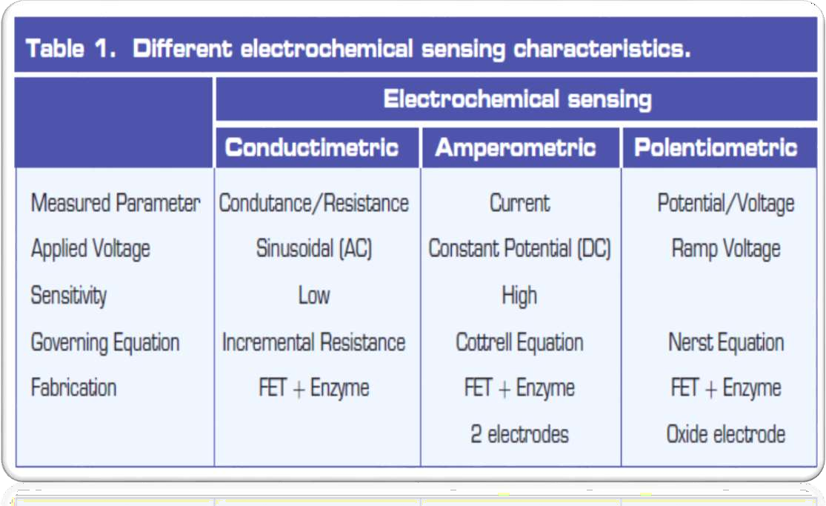

Slide 26
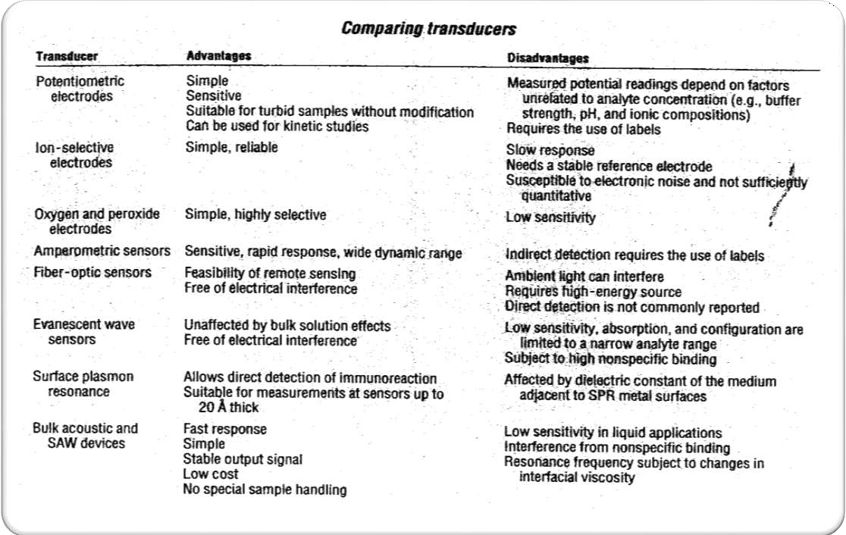

Slide 27
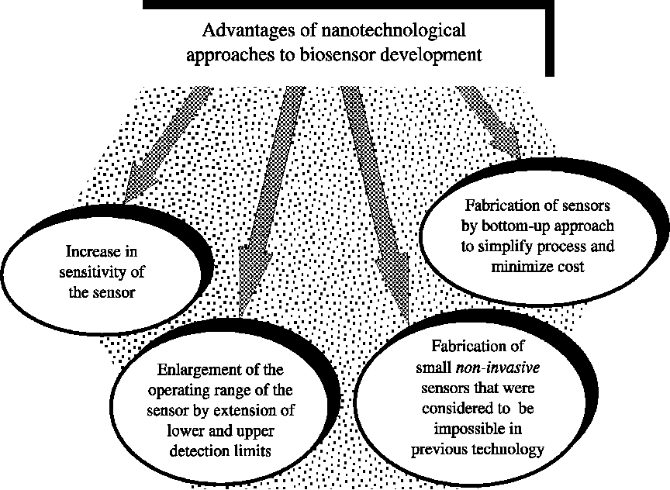

Slide 28
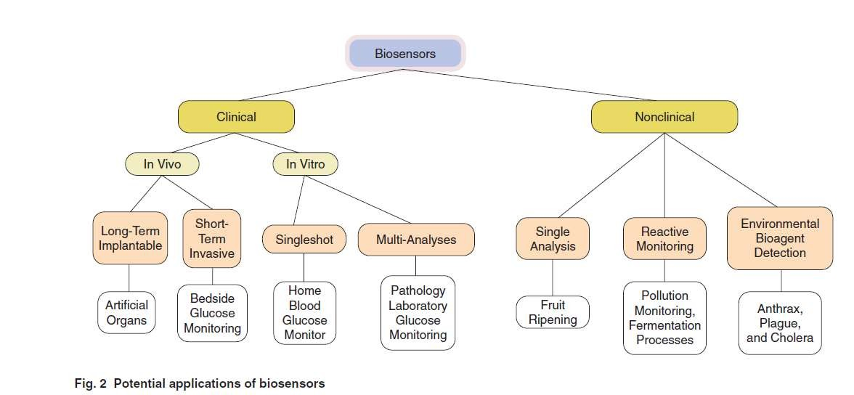
APPLICATIONS

Slide 29
Food Analysis.
Study of Biomolecules & their Interaction.
Drug Development.
Crime Detection.
Medical Diagnosis (Clin&Lab).
Environmental Field Monitoring.
Quality Control.
Industrial Process Control.
Detection Systems for Biological Warfare Agents.
Manf. Of Pharmaceuticals & Replacement organs.

Slide 30
BIOSENSOR FOR AGRICULTURAL & FOOD INDUSTRY
Detection of viral, fungal, bacterial diseases of plants.
In food industry, detection of total microbes & food quantification in soft drinks.
To determine the freshness of other fish, beef & other food items.
Makes Bacteria GLOW by OPTICAL Biosensor

Slide 32
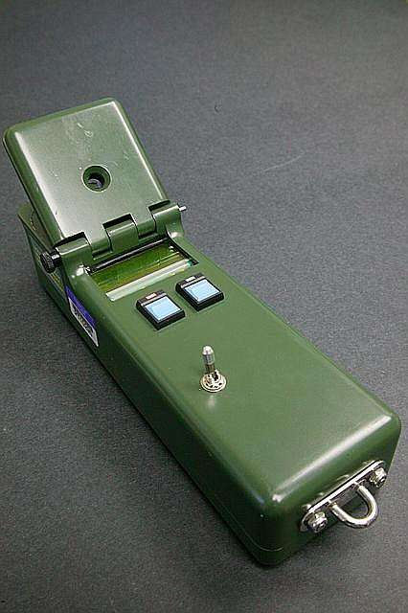
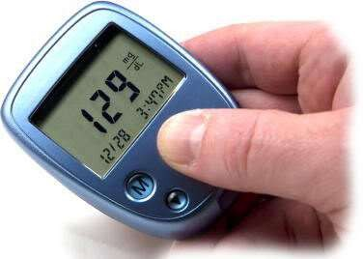
The DNA capture element instrument- for hereditary diseases
Glucometer- for measurement of glucose in blood.

Slide 33
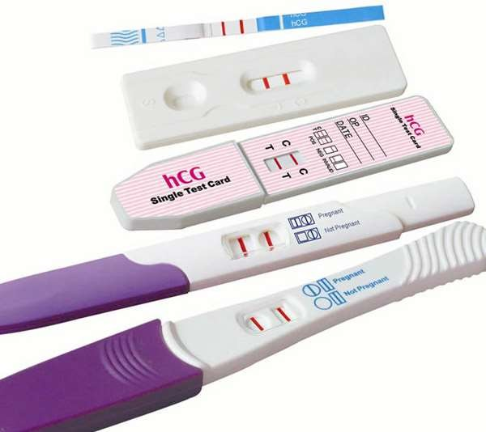
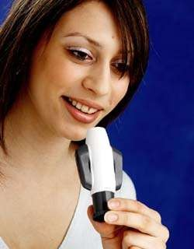
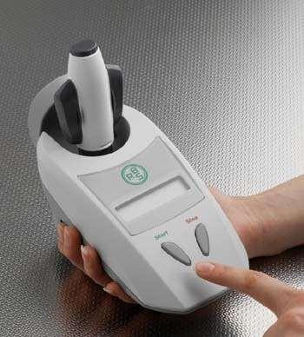
Pregnancy Test.
Detects the hCG protein in urine.
Interpretation and data analysis
performed by the user.
Infectious Disease Biosensor.
Data analysis and interpretation performed by a microprocessor.

Slide 34
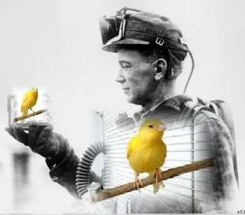
Old time coal miners’ Biosensor
Data analysis and interpretation performed by the coal miner.

Slide 35
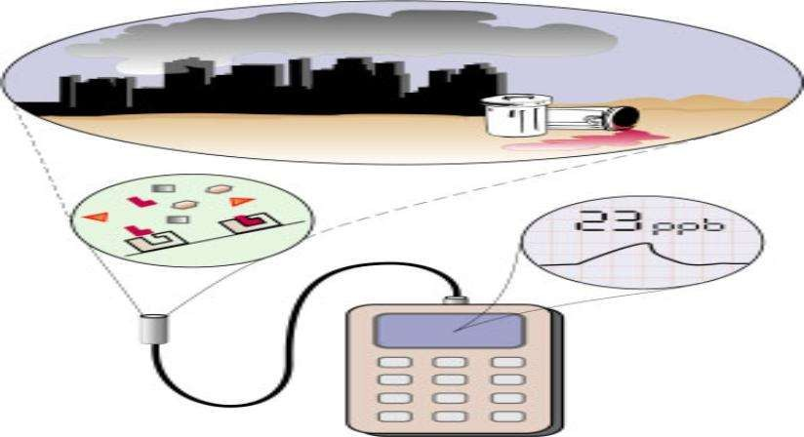
BIOSENSOR FOR DETECTION OF POLLUTION & OF THE CHEMICALS PRESENT IN THE ENVIRONMENT

