Slide 1
Corticosteroids
Suhas Agey
Assistant Professor
Department of Pharmacology
HRPIPER, Shirpur

Slide 2
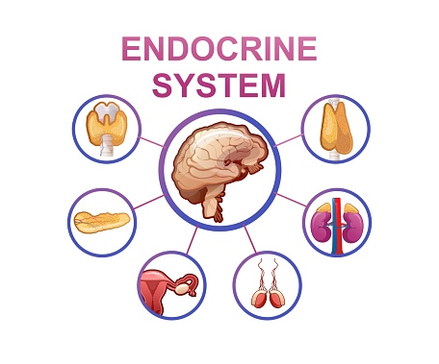
Contents
Introduction
Biosynthesis
Classification
Mineralocorticoids
Glucocorticoids
Mechanism of action
Androgens

Slide 3
Introduction
The adrenal cortex secretes steroidal hormones which have glucocorticoid, mineralocorticoid and weakly androgenic activities.
The corticoids (both gluco and mineralo) are 21 carbon compounds having a cyclopentanoperhydro-phenanthrene (steroid) nucleus.
They are synthesized in the adrenal cortical cells from precursor molecule -cholesterol.
Adrenal steroidogenesis takes place under the influence of ACTH which makes more cholesterol available for conversion to pregnenolone and induces steroidogenic enzymes.

Slide 4
BIOSYNTHESIS

Slide 5
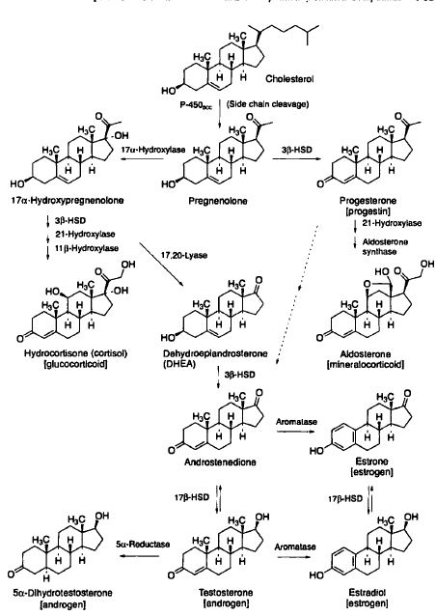
Fig from Wilson and Gisvold's

Slide 7
Corticosteroids
They maintain fluid-electrolyte. cardiovascular and energy substrate homeostasis as well as functional status of skeletal muscles and nervous system.
They prepare the body to withstand effects of all kinds of noxious stimuli and stress.
Glucocorticoid Effects on carbohydrate, protein and fat metabolism.
Mineralocorticoid Effects on Na+ K+ and fluid balance.

Slide 8
A. Mineralocorticoids
The principal mineralocorticoid (aldosterone) action is enhancement of Na+ and water reabsorption from the distal convoluted tubule in kidney.
There is an associated increase in K+ and H+ excretion.
Its deficiency results in decreased maximal tubular reabsorptive capacity for Na+; kidney is not able to retain a even in the Na+ deficient state so that Na+ is progressively lost.

Slide 9
B. Glucocorticoids
As the name implies, glucocorticoids regulate the glucose homeostasis
Glucocorticoids consist of 3 hormones
Cortisol (also called hydrocortisone)
Corticosterone and
Cortisone
Glucocorticoids are usually released in response to stressful stimuli, hence considered as a stress-relieving hormone.

Slide 10
Action of Glucocorticoids
Glucose formation- Glucocorticoids promote glycogen deposition in liver by promoting gluconeogenesis. They inhibit glucose utilization by peripheral tissues. results in hyperglycaemia and a diabetes-like state.
Protein breakdown. They cause protein breakdown and amino acid mobilization from peripheral tissues. These AA used up in gluconeogenesis and excess urea is produced resulting in negative nitrogen balance.
Lipolysis. Glucocorticoids stimulate lipolysis, the breakdown of triglycerides and release of fatty acids from adipose tissue into the blood.

Slide 11
Action of Glucocorticoids
Anti-inflammatory effects. Glucocorticoids inhibit white blood cells that participate in inflammatory responses. Unfortunately, glucocorticoids also retard tissue repair; as a result, they slows wound healing.
Resistance to stress. The additional glucose supplied by the liver cells provides tissues with a ready source of ATP to combat a range of stresses, including exercise, fasting, fright, temperature extremes, high altitude, bleeding, infection, surgery, trauma, and disease.
Immunosuppressant response. High doses of glucocorticoids depress immune responses. For this reason, glucocorticoids are prescribed for organ transplant recipients to retard tissue rejection by the immune system

Slide 12
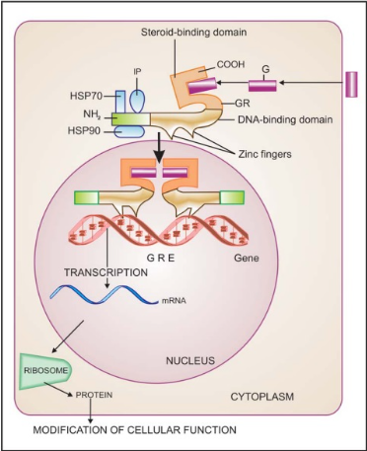
Corticosteroids mechanism of action
The aldosterone penetrates the cell membrane and binds to the Gluco/mineralocorticoid receptor (G/M-R)
The aldosterone binds to the steroid binding domain near the carboxy terminus.
Binding of the steroid to G/MR dissociates the complexed proteins (HSP90) removing their inhibitory influence on it.
The steroid bound receptor dimer translocates to the nucleus, and interacts with specific DNA sequences called ‘mineralocorticoid responsive elements' (MREs) within the regulatory region of appropriate genes.
GC-regulation of protein synthesis
MC- directs synthesis of proteins (aldosterone-induced proteins- AIP-Na+K+ ATPase).

Slide 13
PHARMACOKINETICS
All corticoids, except DOCA are absorbed and are effective by the oral route.
Hydrocortisone undergoes high first pass metabolism, has low oral: parenteral activity ratio. Oral bioavailability of synthetic corticoids is high.
Hydrocortisone is 90% bound to plasma protein, mostly to a specific cortisol-binding globulin
The corticosteroids are metabolized primarily by oxidation followed by conjugation with glucuronic acid or sulfate and are excreted in urine.

Slide 14
USES
A. Replacement therapy
Acute adrenal insufficiency It is an emergency. Hydrocortisone (100 mg) /dexamethasone (8-16 mg) are given i.v.
Chronic adrenal insufficiency (Addison's disease) Hydrocortisone given orally is the most commonly used drug.
B. Pharmacotherapy
Arthritis (i) Rheumatoid arthritis, (ii) Osteoarthritis, (iii) Rheumatic fever, (iv) Gout etc
Collagen diseases- Systemic lupus erythematous (SLE), dermatomyositis, nephritis, glomerulonephritis etc.
Severe allergic reactions Corticoids used in anaphylaxis, angioneurotic edema, urticaria and serum sickness.
Autoimmune diseases Autoimmune haemolytic anaemia, thrombocytopenia , chronic hepatitis Prednisolone 1- 2 mg/kg/day.
Bronchial asthma- Cases of Status asthmaticus, Acute asthma exacerbation, Severe chronic asthma; i.v. glucocorticoid is given

Slide 15
Infective diseases- They are indicated in conditions like severe forms of tuberculosis, severe lepra reaction, bacterial meningitis and pneumonia in AIDS patients.
Eye diseases- allergic conjunctivitis, iritis, iridocyclitis, keratitis etc; Topical instillation given as eye drops
Skin diseases- dermatitis, Stevens-Johnson syndrome and other severe afflictions.
Intestinal diseases- Ulcerative colitis, Crohn 's disease, coeliac disease are inflammatory bowel diseases.
Neurological conditions Cerebral edema due to tumours, tubercular meningitis, etc., responds to corticoids.
Malignancies Corticoids are an essential component of combined chemotherapy of acute lymphatic leukaemia, Hodgkin 's and other lymphomas
Organ transplantation- High dose corticoids are given along with other immuno-suppressants to prevent the rejection reaction.
Septic shock- low-dose (hydrocortisone 100 mg 8 hourly i.v. infusion for 5-7 days)

Slide 16
Adverse effect
A. Mineralocorticoid- Sodium and water retention, edema, hypokalaemic alkalosis and a progressive rise in BP.
B. Glucocorticoid
Cushing's syndrome:
Hyperglycaemia
Muscular weakness:
Susceptibility to infection:
Delayed wound healing
Peptic ulceration
Osteoporosis:
Glaucoma:
Growth retardation:
Foetal abnonnalities:
Psychiatric disturbances:
Glucocortlcoid antagonist The antiprogestin mefepristone, also acts as a glucocorticoid receptor antagonist. In Cushings syndrome, it can suppress the overdose of corticosteroid.

Slide 17
Thank you…!!

Slide 23
Introduction- GLANDS
EXOCRINE GLANDS
Exocrine glands are glands that secrete their products into ducts.
EXAMPLE:
Sweat glands
Salivary glands
Mammary glands
Stomach
Liver etc.

Slide 24
Introduction- GLANDS
ENDOCRINE GLANDS- Glands that secrete hormones directly into the blood circulation and not through a duct.
EXAMPLE:
Pituitary gland
Thyroid gland
Parathyroid Gland
Adrenal glands
Pancreas
Pineal gland
Thymus Gland
Gonads (Testes/ Ovaries)

Slide 25
HORMONEs
A hormone is a molecule that is released in one part of the body but regulates the activity of cells in other parts of the body by entering into the blood circulation.
FUNCTIONS
Help maintain homeostasis, despite imbalance, such as infection, trauma, emotional stress, dehydration, starvation, hemorrhage, and temperature extremes.
Help regulate metabolism and energy balance.
Help regulate contraction of smooth and cardiac muscle and secretion by glands.
Play a role in the smooth, sequential growth and development of the human body.
Contribute to the basic processes of reproduction, including gamete production, fertilization, nourishment of the embryo and fetus, delivery, and nourishment of the newborn.

Slide 26
Chemical Classification of Hormones
Lipid Soluble
Steroid Hormones- Estrogen, Progesterone, Testosterone, Aldosterone, corticoids
Thyroid Hormones- T3 and T4
Water Soluble
Amine Hormones-
A. Catecholamines Epinephrine, Norepinephrine and dopamine
B. Other- Melatonin, Histamine
Protein or Peptide Hormones- Growth Hormones, Insulin, Oxytocin, ADH, TSH, ACTH, FSH, LH, Prolactin, PTH, Calcitonin
The Gas Nitric Oxide (NO)

Slide 27
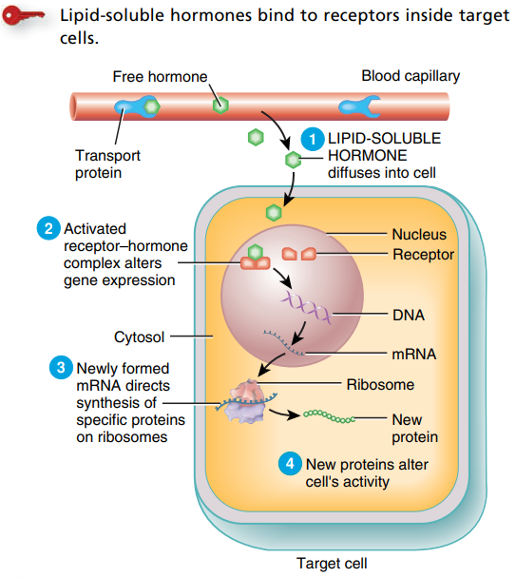
Mechanisms of Hormone Action –A. Lipid soluble Hormones
Lipid soluble Hormones - includes steroid hormones, bind to receptors within target cells.
A free lipid-soluble hormone molecule diffuses from the blood, through interstitial fluid, and through the lipid bilayer of the plasma membrane into a cell.
the hormone binds to and activates receptors located within the cytosol or nucleus. The activated receptor–hormone complex then alters gene expression: It turns specific genes of the nuclear DNA on or off.
The new proteins alter the cell’s activity and cause the responses typical of that hormone

Slide 28
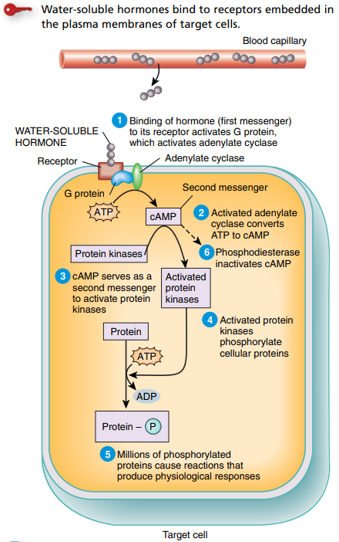
Mechanisms of Hormone Action- B. WATER soluble Hormones
Water-soluble hormones (amine, peptide or protein) bind to receptors that present on the cell surface/ plasma membrane
When a water-soluble hormone binds to its receptor at the outer surface of the plasma membrane, intracellular changes takes place.
These changes leads to series of activation or inactivation of intracellular enzymes or proteins or ion channels (Signal transductions)
It results into the physiological response.

Slide 29
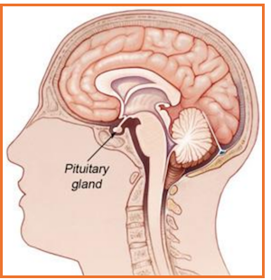
Pituitary Gland
The pituitary gland or hypophysis is a pea-shaped structure that lies in the hypophyseal fossa of the sphenoid bone attached to the hypothalamus by a stalk called the infundibulum.
It is also called the “Master” endocrine gland because it secretes several hormones that control other endocrine glands.

Slide 30
Pituitary Gland
Anatomically and functionally, the pituitary gland is divided into 2 parts
Anterior pituitary (Adenohypophysis) secretes hormones that regulate a wide range of bodily activities and are stimulated by releasing hormones and suppressed by inhibiting hormones from the hypothalamus.
Posterior pituitary (Neurohypophysis): - It is consist of neurons that store and release two hormones.

Slide 31
PITUITARY HORMONES
Anterior lobe: Secretary cells & their Hormones
Somatotrophs - Growth hormone (GH) & Insulin-like Growth Factor (IGF)
Thyrotrophs- Thyroid-stimulating hormone (TSH)
Corticotrophs- Adrenocorticotrophic hormone (ACTH)
Lactotrophs- Prolactin
Gonadotrophs- Follicle-stimulating hormone (FSH) & Luteinizing hormone (LH)
Posterior lobe:
Vasopressin (ADH)
oxytocin

Slide 35
Hypothalamus and Pituitary Gland
Hypophyseal Portal System
The neurosecretory cells in the hypothalamus synthesize the releasing and inhibiting hormones in their cell bodies.
Hypothalamic hormones that release or inhibit anterior pituitary hormones reach the anterior pituitary through a portal system.
The superior hypophyseal arteries, branches of carotid arteries, bring blood into the hypothalamus. These arteries divide into a capillary network called the primary plexus.
From the primary plexus, blood drains into the hypophyseal portal veins that pass down the anterior pituitary, the hypophyseal portal veins divide again and form another capillary network called the secondary plexus.

Slide 37
Hypothalamus and Anterior Pituitary Gland

Slide 38
Hypothalamus and Anterior Pituitary Gland

Slide 39
Hypothalamus and posterior Pituitary Gland

Slide 40
Anterior Pituitary- Human Growth Hormone and Insulin-like Growth Factors (IGF)
The main function of hGH is to promote the synthesis and secretion of small protein hormones called insulin-like growth factors (IGF) in the liver, skeletal muscles, cartilage, bones etc.
It stimulates the growth and division of most body cells but especially those in the bones and skeletal muscles.
Body growth in response to the secretion of GH is evident during childhood and adolescence, and thereafter secretion of GH maintains the mass of bones and skeletal muscles.

Slide 41
Anterior Pituitary- A. Human Growth Hormone and Insulin-like Growth Factors (IGF)
Protein Metabolism- hGH and IGF is a protein anabolic hormone. IGFs cause cells to grow and multiply by increasing uptake of amino acids into cells and accelerating protein synthesis. IGFs also decrease the breakdown of proteins and the use of amino acids for ATP production.
Carbohydrate metabolism- IGFs and hGH may also stimulate liver cells to release glucose into the blood.
Lipid Metabolism- IGFs and hGH enhance lipolysis in adipose tissue, which results in increased use of the released fatty acids for ATP production by body cells.

Slide 42
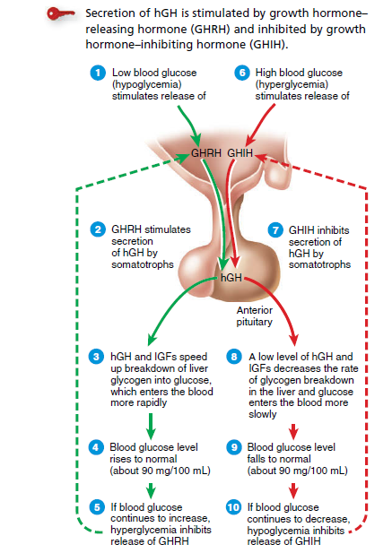
CONTROL OF GROWTH Hormones
Somatotrophs in the anterior pituitary release bursts of GH every few hours, especially during sleep.
Their secretary activity is controlled mainly by two hypothalamic hormones:
(1)growth hormone–releasing hormone (GHRH) promotes secretion of human GH, & (2) growth hormone–inhibiting hormone (GHIH) suppresses it.
A major regulator of GHRH and GHIH secretion is the blood glucose level

Slide 43
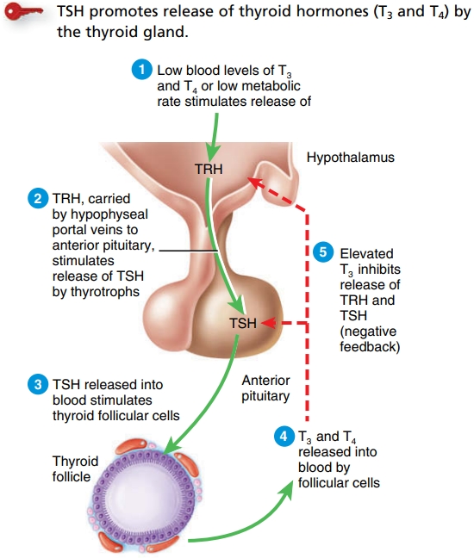
Anterior Pituitary- B. Thyroid Stimulating Hormone (TSH)
Thyroid-stimulating hormone (TSH) stimulates the synthesis and secretion of the two thyroid hormones, triiodothyronine (T3) and thyroxine (T4), both produced by the thyroid gland.
Thyrotropin-releasing hormone (TRH) from the hypothalamus controls TSH secretion.
The release of TRH in turn depends on blood levels of T3 and T4; high levels of T3 and T4 inhibit secretion of TRH via negative feedback.

Slide 44
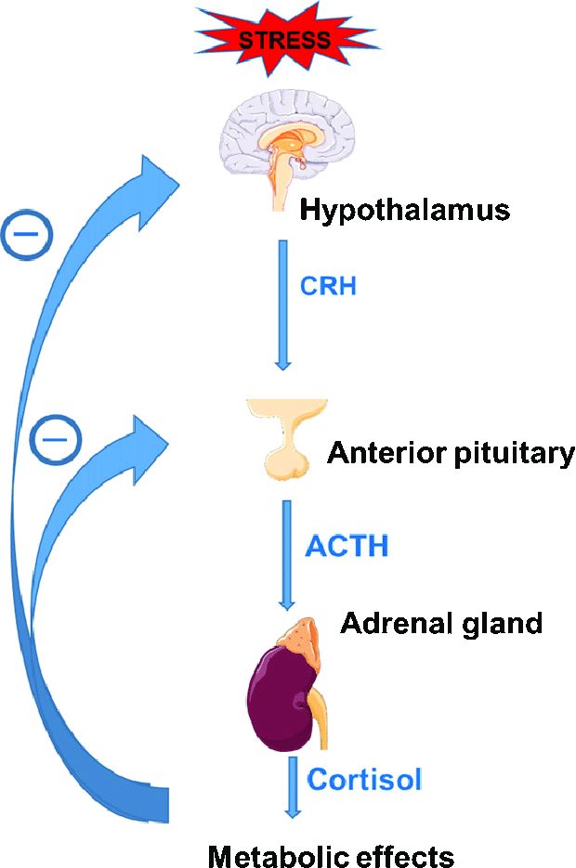
Anterior Pituitary- C. Adrenocorticotropic Hormone (ACTH)
Corticotropes secrete ACTH.
ACTH controls the production and secretion of glucocorticoids (cortisol) by the cortex of the adrenal glands.
Corticotropin-releasing hormone (CRH) from the hypothalamus stimulates the secretion of ACTH by corticotropes. Stress-related stimuli, such as low blood glucose or physical trauma.
Glucocorticoids inhibit CRH and ACTH release via negative feedback

Slide 45
Anterior Pituitary- D. Follicle-Stimulating Hormone (FSH) and Luteinizing Hormone (LH)
i. Follicle-Stimulating Hormone
In females, the ovaries are the targets for follicle-stimulating hormone (FSH). Each month FSH initiates the development of several ovarian follicles.
In males, FSH stimulates sperm production in the testes.
Gonadotropin-releasing hormone (GnRH) from the hypothalamus stimulates FSH release. The release of GnRH and FSH is suppressed by estrogens in females and by testosterone in males through negative feedback systems.
ii. Luteinizing Hormone
In females, luteinizing hormone (LH) triggers ovulation and stimulates the formation of the corpus luteum in the ovary that secretes progesterone.
In males, LH stimulates Leydig cells in the testes to secrete testosterone.

Slide 46
E. Prolactin (PRL)
PRL initiates and maintains milk production by the mammary glands.
The hypothalamus secretes both inhibitory and excitatory hormones that regulate prolactin secretion. In females, prolactin inhibiting hormone (PIH), which is dopamine, inhibits the release of prolactin.
During pregnancy, the prolactin level rises, stimulated by prolactin-releasing hormone (PRH) from the hypothalamus. The sucking action of a nursing infant causes a reduction in the hypothalamic secretion of PIH.
The function of prolactin is not known in males, but its hypersecretion causes erectile dysfunction (impotency).
In females, hypersecretion of prolactin causes galactorrhea (inappropriate lactation) and amenorrhea (absence of menstrual cycles).

Slide 47
Posterior Pituitary (neurohypophysis)
It does not synthesize hormones, it does store and release two hormones.
It consists of axons and axon terminals of more than 10,000 hypothalamic neurons.
The cell bodies of these neurons are in the paraventricular and supraoptic nuclei of the hypothalamus that secretes the hormone oxytocin and antidiuretic hormone (ADH) respectively.
After their production in the cell bodies of neurons, oxytocin and ADH are packaged into secretory vesicles, which pass to the axon terminals in the posterior pituitary, where they are stored until nerve impulses trigger exocytosis and release of the hormone.

Slide 48
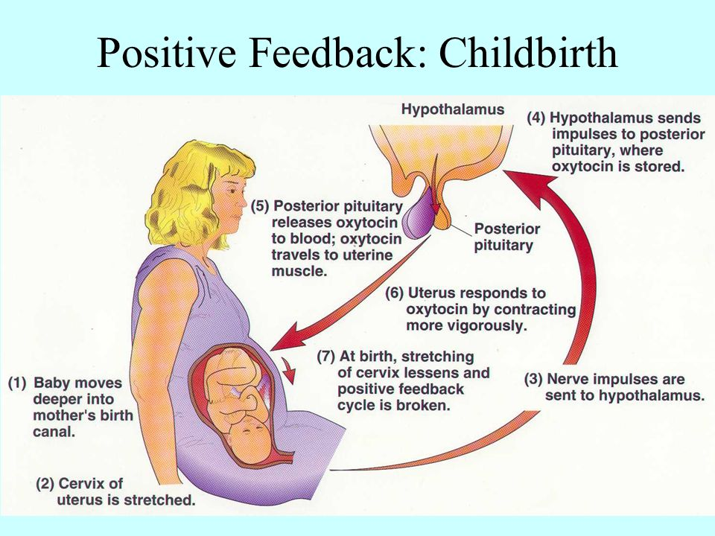
A. Oxytocin
Oxytocin affects two target tissues:
A. The mother’s uterus
Function- Contraction of smooth muscles of the uterus during labor that results in childbirth
B. Breasts
Functions- Contraction of smooth muscles of breast cells that leads to the milk ejection.

Slide 49
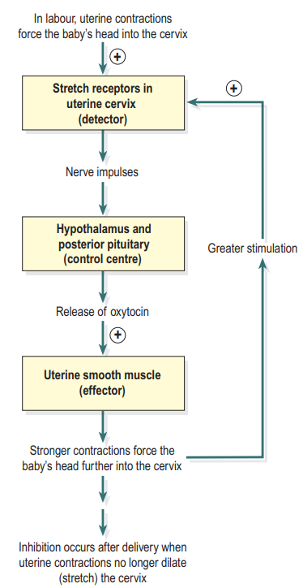
+ve Feedback System
The first contractions of labor (stimulus) push part of the fetus into the cervix
It causes stimulation of Stretch-sensitive nerve cells of the cervix.
As stretching increases, they send more nerve impulses to the hypothalamus, which in turn releases oxytocin into the blood.
Oxytocin causes muscles in the wall of the uterus (effector) to contract even more forcefully.
The contractions push the fetus farther down the uterus, which stretches the cervix even more.
The cycle of stretching, hormone release, and ever-stronger contractions is interrupted only by the birth of the baby.

Slide 50
+ve Feedback System- Milk ejection

Slide 51
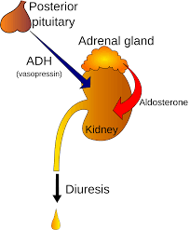
Antidiuretic Hormones (ADH)
As its name implies, (antidiuretic) is a substance that decreases urine production.
Functions
ADH causes the kidneys to return more water to the blood, thus decreasing urine volume.
ADH also decreases the water lost through sweating and
ADH causes constriction of arterioles, which increases blood pressure.

Slide 52
ADH- Regulation
High blood osmotic pressure or decreased blood volume)- due to dehydration or hemorrhage, diarrhea, or excessive sweating-stimulates osmoreceptors, neurons in the hypothalamus.
Osmoreceptors activate the hypothalamic neurosecretory cells that synthesize and release ADH.
The blood carries ADH to three target tissues: the kidneys, sudoriferous (sweat) glands, and blood vessel walls.
The kidneys decrease urine output; sweat glands lower the water loss from the skin, and vasoconstriction increases the BP.
This lower osmotic pressure of blood inhibits the osmoreceptors
Inhibition of osmoreceptors reduces or stops ADH secretion.

Slide 53
Thyroid Gland
The butterfly-shaped thyroid gland is located just inferior to the larynx (voice box). It is composed of the right and left lateral lobes, one on either side of the trachea,
Microscopic structure consists of spherical sacs called thyroid follicles, the wall of each follicle consists primarily of cells called follicular cells
The follicular cells produce two hormones: thyroxine, which is also called tetraiodothyronine (T4), and triiodothyronine (T3).
A few cells called parafollicular cells or C cells lie between follicles. They produce the hormone calcitonin (CT), which helps regulate calcium homeostasis.

Slide 55
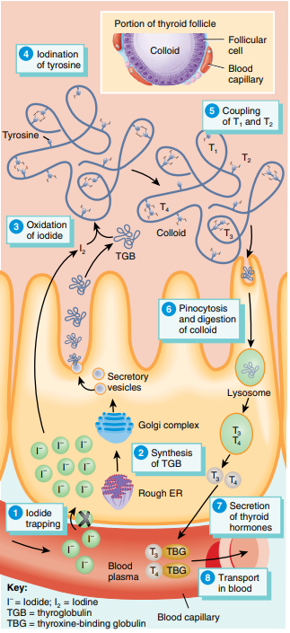
Biosynthesis, Storage, and Release of Thyroid Hormones
Iodine is an essential element for the synthesis of thyroid hormones.
Iodide trapping.
Synthesis of TGB
Oxidation of iodide
Iodination of tyrosine
Coupling of T1 and T2.
Pinocytosis
Secretion of thyroid hormones.
Transport in the blood.

Slide 56
Actions of Thyroid Hormones
Increase basal metabolic rate (BMR)- the rate of oxygen consumption under standard or basal conditions. by stimulating the use of cellular oxygen to produce ATP.
Calorigenic effect- As cells produce and use more ATP, more heat is given off, and body temperature rises. This phenomenon is called calorigenic effect. ATP stimulates the synthesis of additional Na+/K+ ATPase.
Metabolism-The thyroid hormones stimulate protein synthesis and increase the use of glucose and fatty acids for ATP production. lipolysis and enhance cholesterol excretion, thus reducing blood cholesterol levels.

Slide 57
Actions of Thyroid Hormones
Sympathetic activity- The thyroid hormones enhance some actions of the norepinephrine and epinephrine.
Growth and development- Together with human growth hormone and insulin, thyroid hormones accelerate body growth, particularly the growth of the nervous and skeletal systems.
Memories and Mood- Deficiency of thyroid hormones during fetal development, infancy, or childhood causes severe mental retardation and stunted bone growth called dementia.

Slide 58
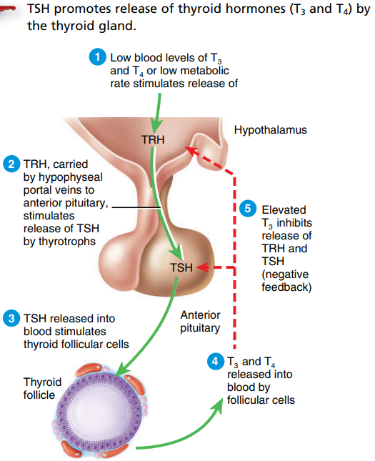
Control of Thyroid Hormone Secretion
Low blood level of T3 and T4 stimulates leads to stimulation of TRH from the hypothalamus, which stimulates the release of TSH from the anterior pituitary
TSH stimulates the synthesis and release of thyroid hormones.

Slide 59
Calcitonin
The hormone produced by the parafollicular cells of the thyroid gland is calcitonin (CT). CT can decrease the level of calcium in the blood.
Target Cells and their actions
Bones- Stimulates the absorption of Ca++ into the bones, Promotes osteogenesis, and inhibits the action of osteoclasts.
Kidney (nephron)- reabsorption of Ca++ from the lumen of the nephron to the blood vessels.
Intestine- absorption of Ca++ into the blood.

Slide 60
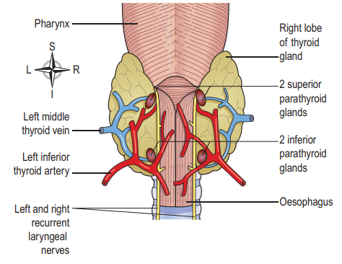
Parathyroid Glands
There are four small parathyroid glands, each weighing around 50 g, two embedded in the posterior surface of each lobe of the thyroid gland.
Cells of PTG are called chief cells or principal cells and they produce parathyroid hormone (PTH).
PTH function is to increases the blood Ca++ level by acting on its target cells.

Slide 61
Parathyroid Glands
Target cells and their action
Bones- Decrease Ca++ absorption into the bone tissue, inhibits osteogenesis, and increase the action of osteoclasts.
Kidney (nephron)- Increases the reabsorption of Ca++ from the lumen of the nephron to the blood vessels. PTH also promotes the formation of the hormone calcitriol, the active form of vitamin D. Calcitriol also increases the blood Ca++ level.
Intestine- Increases the absorption of Ca++ into the blood.

Slide 62
Control of Secretion of Calcitonin and Parathyroid Hormone

Slide 63
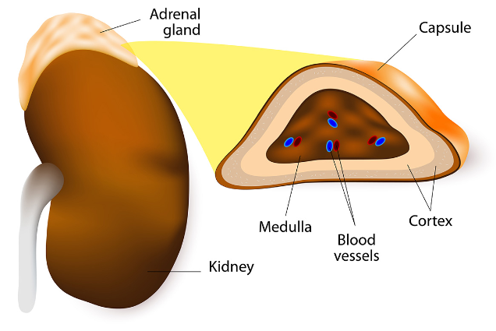
Adrenal Glands
The paired adrenal glands or suprarenal glands, one of which lies superior to each kidney.
In adults, each adrenal gland is 3–5 cm in height, 2–3 cm in width, and a little less than 1 cm thick, with a mass of 3.5–5 g.
The glands are composed of two parts that have different structures and functions.
The outer part is the cortex and the inner part is the medulla.

Slide 64
Adrenal Glands
The adrenal cortex
The adrenal cortex is subdivided into three zones each producing 3 groups of steroid hormones from cholesterol.
zona glomerulosa- Mineralocorticoids (Aldosterone)
zona fasciculata- Glucocorticoids (Cortisol)
zona reticularis- Sex hormones (androgens)
The adrenal Medulla - consists of
Epinephrine (Adrenaline) and
Norepinephrine (Nor-adrenaline)

Slide 65
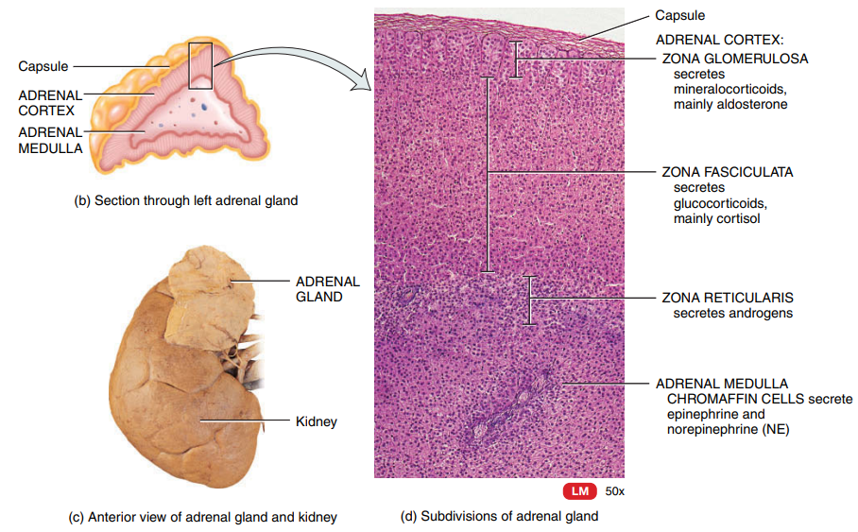

Slide 66
A. Mineralocorticoids
Aldosterone is the major mineralocorticoid.
Functions are
It regulates the homeostasis of two mineral ions—1. sodium ions (Na+) and 2. potassium ions (K+)—and help adjust blood pressure and blood volume.
Aldosterone also promotes the excretion of H+ in the urine; this removal of acids from the body can help prevent acidosis.

Slide 67
Control of Aldosterone Secretion- renin–angiotensin–aldosterone (RAAS) pathway

Slide 68
B. Glucocorticoids
As the name implies, glucocorticoids regulate the glucose homeostasis
Glucocorticoids consist of 3 hormones
Cortisol (also called hydrocortisone)
Corticosterone and
Cortisone
Glucocorticoids are usually released in response to stressful stimuli, hence considered as a stress-relieving hormone.

Slide 69
Effects/ Functions of Glucocorticoids
Glucose formation- Glucocorticoids stimulate the liver to promote gluconeogenesis
Protein breakdown. Glucocorticoids increase the rate of protein breakdown, mainly in muscle fibers, and thus increase the liberation of amino acids into the bloodstream.
Lipolysis. Glucocorticoids stimulate lipolysis, the breakdown of triglycerides and release of fatty acids from adipose tissue into the blood.
Resistance to stress. The additional glucose supplied by the liver cells provides tissues with a ready source of ATP to combat a range of stresses, including exercise, fasting, fright, temperature extremes, high altitude, bleeding, infection, surgery, trauma, and disease.

Slide 70
Effects/ Functions of Glucocorticoids
Anti-inflammatory effects. Glucocorticoids inhibit white blood cells that participate in inflammatory responses. Unfortunately, glucocorticoids also retard tissue repair; as a result, they slow wound healing.
Immunosuppressant response. High doses of glucocorticoids depress immune responses. For this reason, glucocorticoids are prescribed for organ transplant recipients to retard tissue rejection by the immune system

Slide 71
Control of Glucocorticoid Secretion
Hypothalamus and anterior pituitary increase CRH and ACTH release respectively in response to a variety of physical and emotional stresses or low blood levels of glucocorticoids.

Slide 72
Androgens
In both males and females, the adrenal cortex secretes small amounts of weak androgens. The major androgen secreted by the adrenal gland is dehydroepiandrosterone (DHEA).
Functions
Adrenal androgens stimulate the growth of axillary and pubic hair in boys and girls and contribute to prepubertal growth.
In males after puberty its secretion is low as compared to testes androgen and thus its effects are insignificant.
In females, however, adrenal androgens play important roles.
a. They promote libido (sex drive) and are converted into estrogens
b After menopause, when the ovarian secretion of estrogens stops, all-female estrogens come from the conversion of adrenal androgens.

Slide 73
Adrenal Medulla
The chromaffin cells of the adrenal medulla secrete two major hormones epinephrine (80%) and norepinephrine(20%), also called adrenaline and noradrenaline, respectively.
These hormones prepare the body for the stressful situation (Fight or Flight response)
Control of secretion of adrenaline and NA
In stressful situations and during exercise, impulses from the hypothalamus stimulate sympathetic preganglionic neurons, which in turn stimulate the chromaffin cells to secrete epinephrine and norepinephrine.

Slide 75
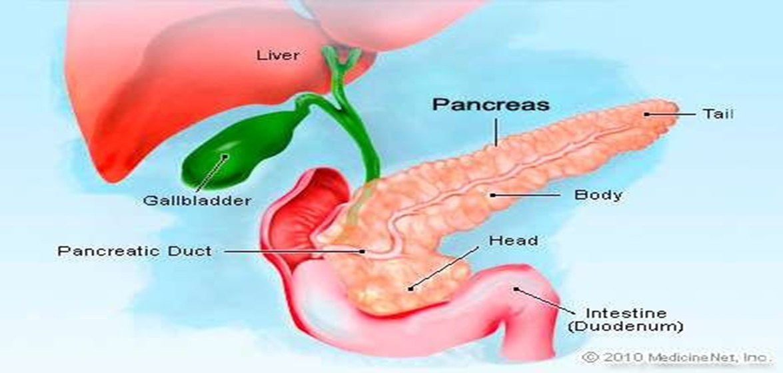
Pancreas
The pancreas is both an endocrine gland and an exocrine gland.
Roughly 99% of the exocrine cells of the pancreas are arranged in clusters called acini.
Scattered among the exocrine acini are 1–2 million tiny clusters of endocrine tissue called pancreatic islets of Langerhans.
Pancreatic hormones are secreted directly into the bloodstream and circulate throughout the body.

Slide 76
Cell Types in the Pancreatic Islets
Each pancreatic islet includes four types of hormone-secreting cells:
Alpha (α) cells- secrete glucagon; it raised the blood glucose level
Beta (β) cells- secrete insulin; it lowers the blood glucose level
Delta (δ) cells- secrete somatostatin, inhibit both insulin, glucagon and GH release.
F cells- secretes pancreatic polypeptide, it inhibits somatostatin secretion, gallbladder contraction, and secretion of digestive enzymes by the pancreas.

Slide 77
Cell Types in the Pancreatic Islets

Slide 78
Control of Secretion of Glucagon and Insulin
Low blood glucose level (hypoglycemia) stimulates the secretion of glucagon from alpha cells of the pancreatic islets. Usually during fasting, dieting or starvation.
High blood glucose (hyperglycemia) stimulates the secretion of insulin by beta cells of the pancreatic islets. Insulin is usually secreted after half an hour of a meal.

Slide 79
Action of insulin
Once attaches to the targets cells receptors (liver, muscle cells and adipocytes), insulin stimulates the uptake and use of glucose.
Glycogenesis- In the liver and skeletal muscles, insulin converts glucose to glycogen.
Protein synthesis- Insulin accelerates uptake of amino acids by cells and forms proteins.
Lipogenesis- promoting synthesis and storage of fatty acids in adipose tissue.
Decrease glycogenolysis- breakdown of glycogen into glucose.

Slide 80
Thymus gland
The thymus is located behind the sternum between the lungs.
The hormones produced by the thymus- thymosin, thymic humoral factor (THF), thymic factor (TF), and thymopoietin- promote the maturation of T cells that destroys microbes and foreign substances and may retard the aging process.

Slide 81
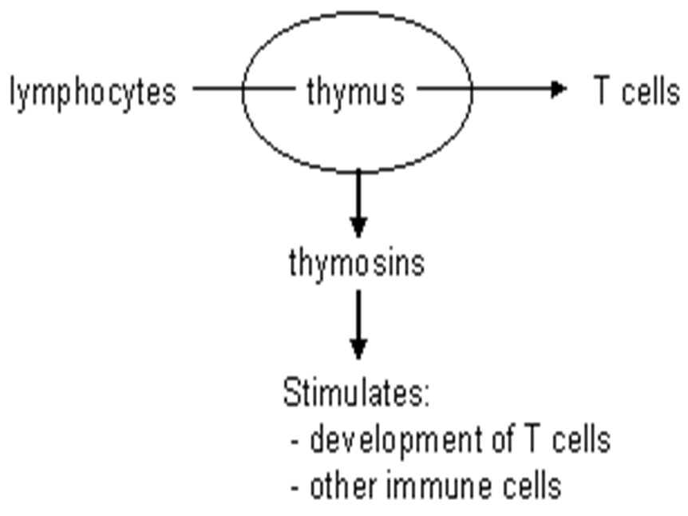
Functions of thymus gland
Lymphocytes originate from red bone marrow. Those that enter the thymus develop into activated T-lymphocytes.
T-lymphocytes then leave the thymus and enter the blood.
Thymic processing produces mature T-lymphocytes that can distinguish ‘self’ tissue from foreign tissue, and also provides each T-lymphocyte with the ability to react to only one specific antigen from the millions.

Slide 82
Pineal Gland
The pineal gland is a small endocrine gland attached to the roof of the third ventricle of the brain on the surface of the epithalamus.
The pineal gland secretes melatonin, an amine hormone derived from serotonin.

Slide 83
Functions
Melatonin appears to contribute to the setting of the body’s biological clock, which is controlled by the suprachiasmatic nucleus of the hypothalamus.
During sleep, plasma levels of melatonin increase tenfold and then decline to a low level before awakening.
Melatonin also is a potent antioxidant that may provide some protection against damaging oxygen free radicals.
Melatonin levels are higher in children and decline with age into adulthood

Slide 84
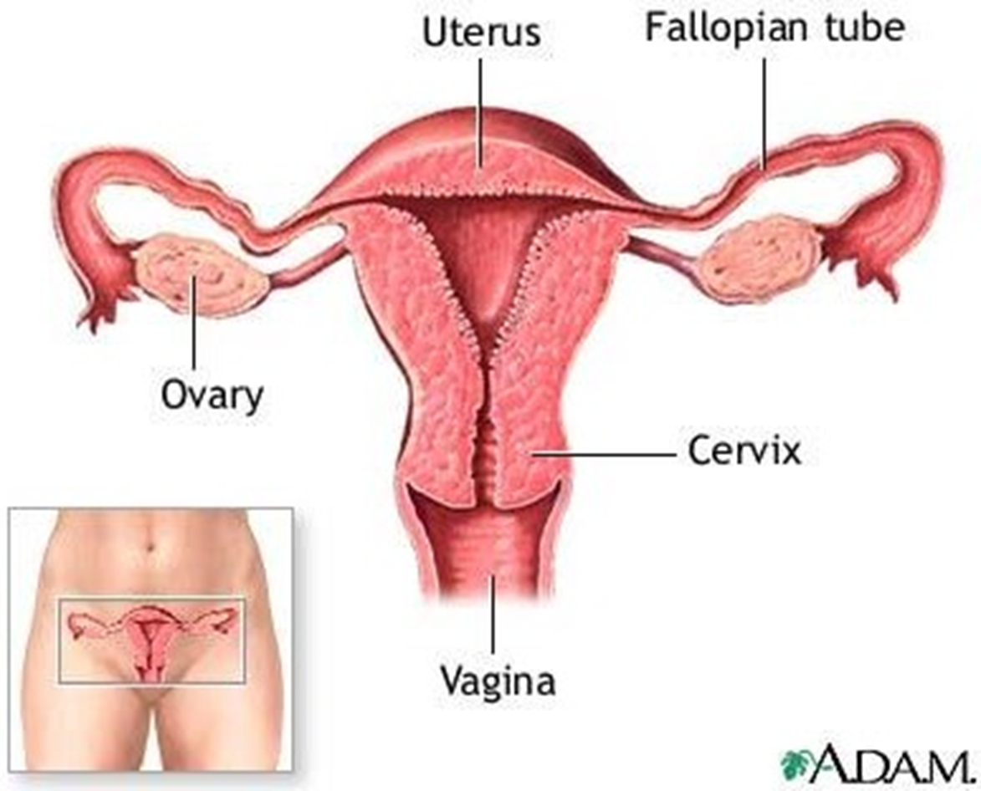
Ovaries and testes
The ovaries, paired oval bodies located in the female pelvic cavity, produce steroid sex hormones, estrogens and progesterone.
These female sex hormones, along with follicle-stimulating hormone (FSH) and luteinizing hormone (LH) from the anterior pituitary
Regulate the menstrual cycle,
Maintain pregnancy, and
Prepare the mammary glands for lactation.

Slide 85
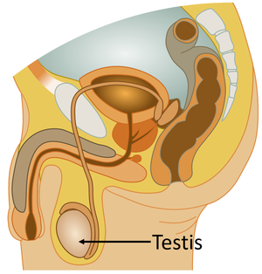
Testes
The male gonads, the testes, are oval glands that lie in the scrotum. The main hormone produced and secreted by the testes is testosterone.
regulates the production of sperm, and stimulates the development and maintenance of male secondary sex characteristics, such as beard growth and deepening of the voice.

Slide 86
I. Pituitary Gland Disorders- Hypersecretion
Gigantism-
This occurs in children when there is excess GH while epiphyseal cartilages of long bones are still growing, i.e. before ossification of bones is complete.
The effects of excess GH include:
excessive growth of bones
enlargement of internal organs
formation of excess connective tissue
enlargement of the heart and raise blood pressure
reduced glucose tolerance and leads to diabetes mellitus.

Slide 87
I. Pituitary Gland Disorders- Hypersecretion
B. Acromegaly:
This means ‘large extremities’.
It is due to excessive secretion of GH during adulthood, bones of the hands, feet, cheeks, and jaws thicken and other tissues enlarge.
It is characterized by:
Broad, thick nose
Thickening of the skin
Prominent brow
widening of the mandible

Slide 88
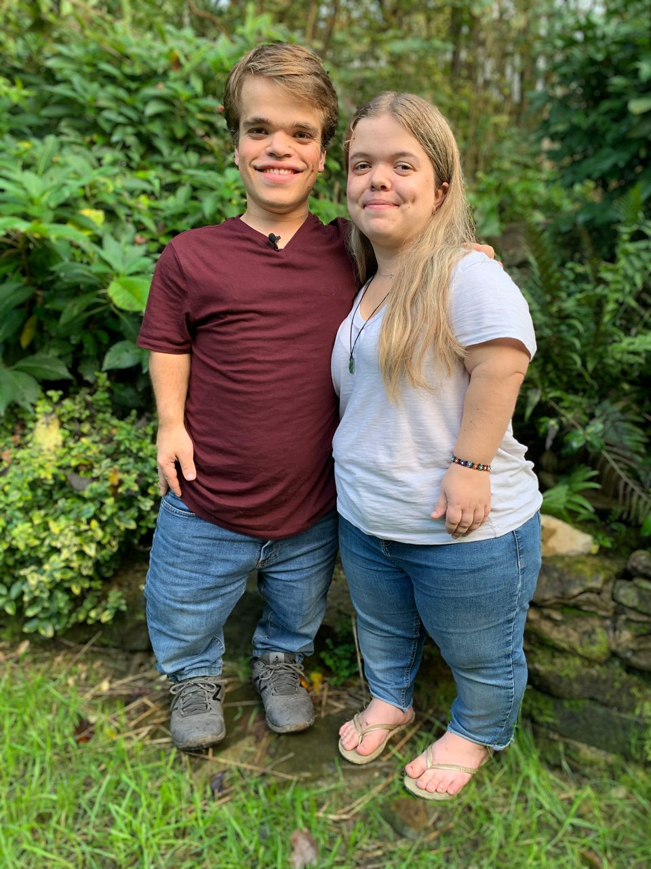
I. Pituitary Gland Disorders- Hyposecretion
Dwarfism
This is caused by severe deficiency of GH, and possibly of other hormones, in childhood.
The condition may be due to a genetic abnormality or a tumor.
It is characterized by
Shortness of stature
Small genitalia
Delicate extremities.
Delayed puberty is delayed
episodes of hypoglycemia.

Slide 89
Disorders of the posterior pituitary
Diabetes insipidus
This is a relatively rare condition usually caused by hyposecretion of ADH.
It is usually caused by a brain tumor, head trauma, or brain surgery that damages the posterior pituitary or the hypothalamus.
A common symptom of DI is
excretion of large volumes of urine
dehydration and thirst.
Bedwetting is common in afflicted children.

Slide 90
Disorders of the thyroid gland- Hyperthyroidism
THYROTOXICOSIS
Hyperthyroidism also known as thyrotoxicosis, arises as the body tissues are exposed to excessive levels of T3 and T4. The main effects are due to increased basal metabolic rate.
There are 2 forms of thyrotoxicosis
Graves’ disease
toxic nodular goiter

Slide 91
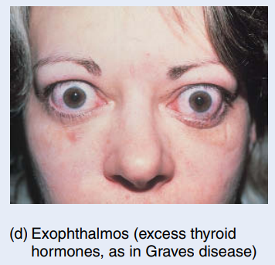
Disorders of the thyroid gland- Hyperthyroidism
Graves’ disease-
Graves disease is an autoimmune disorder in which the person produces antibodies that mimic the action of thyroid-stimulating hormone (TSH). The antibodies continually stimulate the thyroid gland to grow and produce thyroid hormones.
A primary sign is an enlarged thyroid.
Exophthalmos- Graves patients often have peculiar edema behind the eyes, called exophthalmos, which causes the eyes to protrude.
occurs seven to ten times more often in females than in males, usually before age 40.

Slide 92
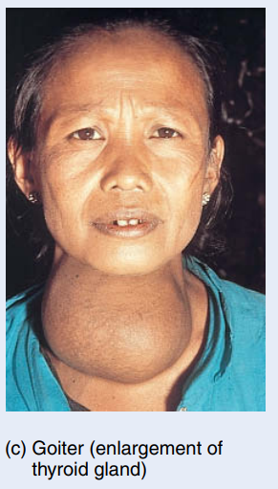
Disorders of the thyroid gland- Hyperthyroidism
Toxic nodular goiter
A goiter is simply an enlarged thyroid gland.
It may be associated with hyperthyroidism, hypothyroidism, or euthyroidism, which means normal secretion of thyroid hormone.
In some places in the world, dietary iodine intake is inadequate; the low level of thyroid hormone in the blood stimulates the secretion of TSH, which causes thyroid gland enlargement.

Slide 93
Hypothyroidism
This condition is prevalent in older adults and is more common in females than males.
The deficiency of T3 and T4 in adults results in an abnormally low metabolic rate.
There may be accumulation of mucopolysaccharides in the subcutaneous tissues causing swelling, especially of the face, hands, feet and eyelids (myxedema).
The commonest causes are autoimmune thyroiditis, severe iodine deficiency and healthcare interventions, e.g. antithyroid drugs, surgical removal of thyroid tissue, or ionizing radiation.

Slide 94
Parathyroid Gland Disorders
Hypoparathyroidism- too little parathyroid hormone—leads to a deficiency of blood Ca2, which causes neurons and muscle fibers to depolarize and produce action potentials spontaneously. This leads to twitches, spasms, and tetany (maintained contraction) of skeletal muscle.
Hyperparathyroidism- an elevated level of parathyroid hormone, most often due to a tumor of one of the parathyroid glands. An elevated level of PTH causes the excessive breakdown of bone matrix, raising the blood levels of calcium and phosphate ions and causing bones to become soft and easily fractured. High blood calcium level promotes the formation of kidney stones.

Slide 95
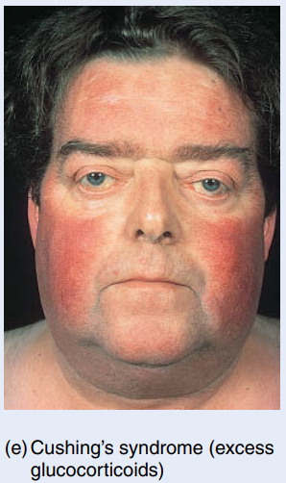
Adrenal Gland Disorders
A. Cushing’s Syndrome
Hypersecretion of cortisol by the adrenal cortex produces Cushing’s syndrome. Causes include a tumor of the adrenal gland that secretes cortisol, or a tumor elsewhere that secretes adrenocorticotropic hormone (ACTH), which in turn stimulates the excessive secretion of cortisol.
Signs and symptoms-
Moon face
Weakness
Hyperglycemia
Hypertension
Poor wound healing
Decrease resistance to stress

Slide 96
Adrenal Gland Disorders
B. Addison’s Disease
Hyposecretion of glucocorticoids and aldosterone causes Addison’s disease
It is an autoimmune disorder in which antibodies cause adrenal cortex destruction or block the binding of ACTH to its receptors.
Causes- Pathogens, such as the bacterium that causes tuberculosis, also may trigger adrenal cortex destruction.
Symptoms- mental lethargy, anorexia, nausea and vomiting, weight loss, hypoglycemia, and muscular weakness.
Loss of aldosterone leads to decreased sodium in the blood, low blood pressure, dehydration, decreased cardiac output, arrhythmias, and even cardiac arrest.

Slide 97
Adrenal Gland Disorders
C. Pheochromocytomas
Usually benign tumors of the chromaffin cells of the adrenal medulla, called pheochromocytomas, cause hypersecretion of epinephrine and norepinephrine.
The result is a prolonged version of the fight-or-flight response: rapid heart rate, high blood pressure, high levels of glucose in blood and urine, an elevated basal metabolic rate (BMR), flushed face, nervousness, sweating, and decreased gastrointestinal motility.

Slide 98
Pancreatic Islet Disorders
Diabetes mellitus-
It is the fourth leading cause of death by disease in the United States.
It is a group of metabolic diseases that are characterized by high blood glucose (Hyperglycemia) that occurs due to the abnormal metabolism of carbohydrates, proteins, and fats.
Symptoms-
Polyuria
Polydipsia
Polyphagia

Slide 99
Diabetes mellitus
There are two types of diabetes mellitus—type 1 and type 2
Type 1 diabetes- is previously known as insulin-dependent diabetes mellitus (IDDM).
It is an autoimmune disease in which a person’s immune system destroys the pancreatic beta cells. As a result, the pancreas produces little or no insulin.
Type 2 diabetes, formerly known as non-insulin-dependent diabetes mellitus (NIDDM), is much more common than type 1, representing more than 90% of all cases.
Clinical symptoms are mild, and the high glucose levels in the blood often can be controlled by diet, exercise, and weight loss.

Slide 100
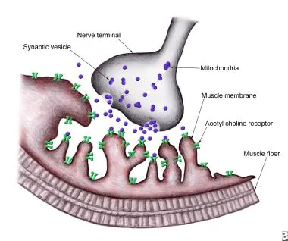
Thymus gland Disorder
Myasthenia gravis is a chronic autoimmune, neuromuscular disease characterized by the production of autoantibodies from thymus gland, that bind to and block the acetylcholine receptors of the neuromuscular junction. The transmission of nerve impulses to muscle fibres is blocked.
Symptoms
muscle weakness
Extrinsic and eyelid muscles affects 1st - drooping of the eyelid
Diplopia (double vision),
followed by those of the neck (possibly affecting chewing, swallowing and speech) and limbs.

Slide 101
Thank you…!!
Wake up, Run a mile, let the adrenaline flow through your blood and nerves and be ready for a wonderful miraculous day. A day full of energy, enthusiasm and concentration.

