Slide 1
Cycloalkanes
Ms.Asama Pathan
Dept.of Pharmaceutical Chemistry
H.R.P.I.P.E.R

Slide 2
Nomenclature
Cycloalkanes or cycloparaffins are saturated hydrocarbon in which the carbons atoms are joined by single covalent bonds to form a ring. They are also called alicyclic compounds

Slide 3
Methods of Preparation
1. From Di-halide
2. From Calcium salts of Di-carboxylic acid

Slide 4
3. From Esters of Di-carboxylic Acids ( DIECKMANN REACTION)
4. From Alkenes ( Simmons-Smith Reaction)

Slide 5
5. From Aromatic Hydrocarbon

Slide 6
1.Ring Opening Reactions
A. Addition of Cl2 and Br2
B. Addition of HBr and HI
C. Addition of H2

Slide 7
2.Substitution Reactions

Slide 8
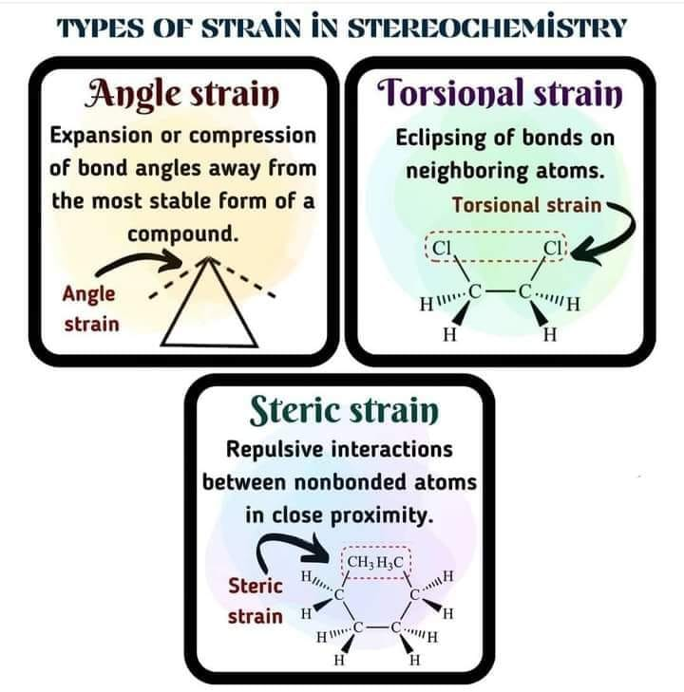

Slide 9
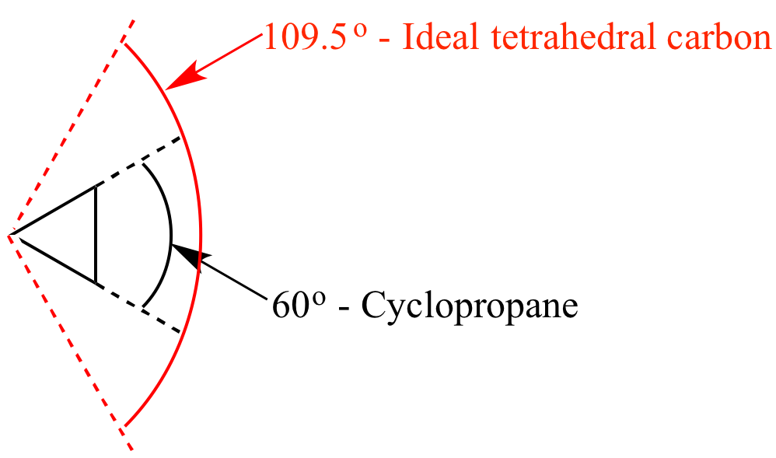
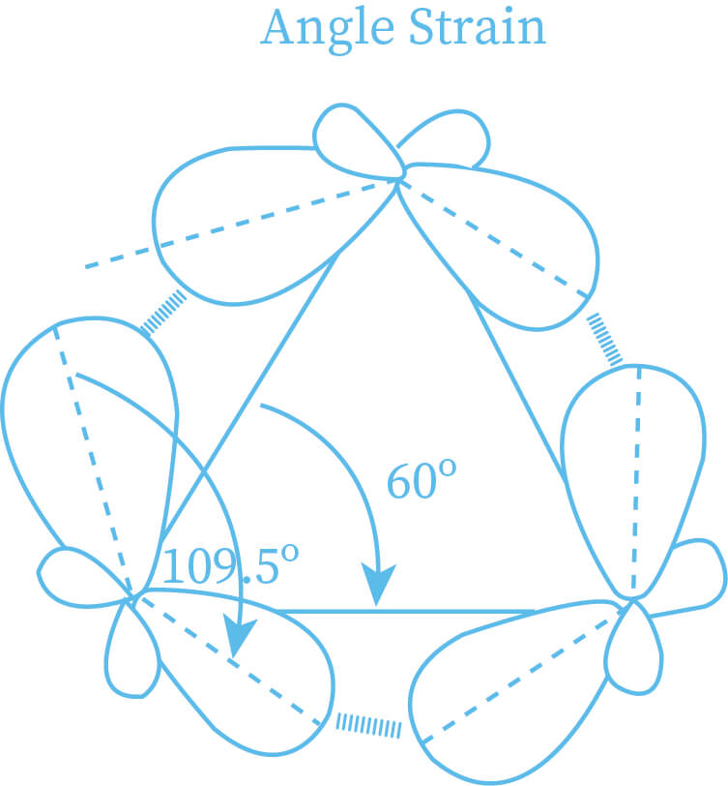
Angle strain occurs when bond angles deviate from the ideal bond angles to achieve maximum bond strength in a specific chemical conformation
Angle strain is maximum in the case of cyclopropane thus according to the theory cyclopropane should be highly strained molecule and consequently most unstable.
the angle strain in case of cyclobutane is less than that in case of cyclopropane that shows greater stability. therefore cyclobutane undergoes ring opening reaction but under more drastic condition.

Slide 10
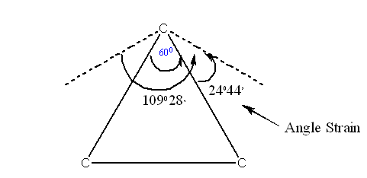
Baeyer Strain Theory
In 1885 Adolf Baeyer proposed theory to explain the relative stability of first cycloalkanes. Normal angle between any pair of bonds of a cabon atom 109⁰ 28
Baeyer Postulated that any deviation of bond angles from normal tetrahedral value would impose a condition of internal strain on the ring
The theory explains reactivity and stability of cycloalkanes.
- Baeyer proposed that the optimum overlap of atomic orbitals is achieved for bond angel of 109.50. In short, it is ideal bond angle for alkane compounds.
- Effective and optimum overlap of atomic orbitals produces maximum bond strength and stable molecule.
- If bond angles deviate from the ideal then ring produce strain.
- Higher the strain higher the instability.
- Higher strain produce increased reactivity and increases heat of combustion.

Slide 11
Baeyer’s theory is based upon some assumptions as following
1. All ring systems are planar. Deviation from normal tetrahedral angles results in to instable cycloalkanes.
2. The large ring systems involve negative strain hence do not exists.
3. The bond angles in cyclohexane and higher cycloalkanes (cycloheptane, cyclooctane, cyclononane, etc.) are not larger than 109.5⁰ because the carbon rings of those compounds are not planar (flat) but they are puckered (Wrinkled)

Slide 12
Compound | Bond angle | Angle Strain
Cyclopropane | 60 | 24⁰ 44’
Cyclobutane | 90 | 9⁰ 44’
Cyclopentane | 108 | 0⁰ 44’
Cyclohexane | 120 | -5⁰ 16’

Slide 14
These assumptions are helpful to understand instability of cycloalkane ring systems.
- The ring of cyclopropane is triangle. All the three angles are of 60⁰ in place of 109.5⁰ (normal bond angle for carbon atom) to adjust them into triangle ring system.
- In same manner, cyclobutane is square and the bond angles are of 90⁰ in place of 109.5⁰ (normal bond angle for carbon atom) to adjust them into square ring system.
- The deviation for cyclopropane and cyclobutane ring systems then normal tetrahedral angle will produce strain in ring. The ring strain will make them unstable as compare to molecules having tetrahedral bond angle.
- So, cyclopropane and cyclobutane will easily undergo ring opening reactions to form more stable open chain compounds.
- Now compare the stability of cyclopropane and cyclobutane.

Slide 15
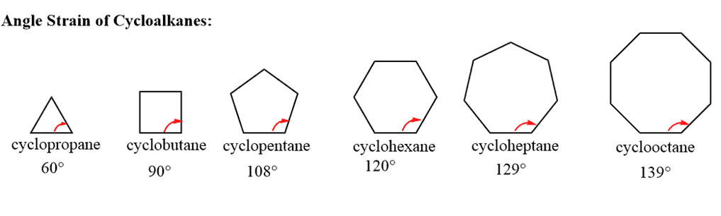
According to Baeyer, the relative order of stability for some common cycloalkanes is as under.
Cyclopentane > Cyclobutane > Cyclopropane

Slide 16
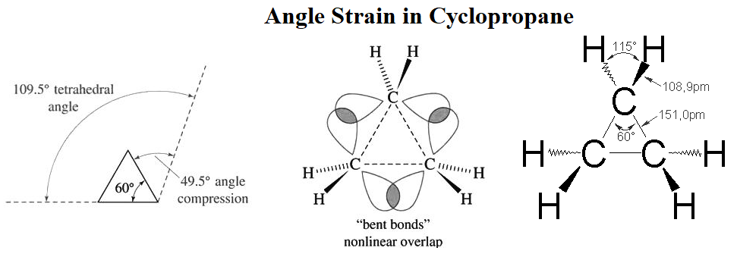
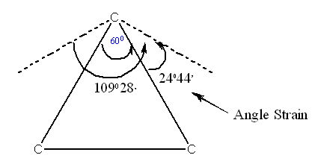
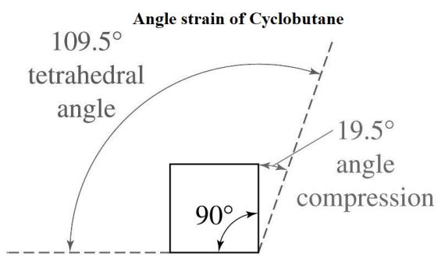
The bond angle in cyclopropane is 60⁰.
The normal tetrahedral bond angle value is 109.5⁰.
Therefore, deviation = (normal tetrahedral bond angle) – (actual bond angle)
Deviation = 109.5⁰ – 60 = 49.5⁰
o The bond angle in cyclobutane is 90⁰.
The normal tetrahedral bond angle value is 109.5⁰.
That is why, deviation = (normal tetrahedral bond angle) – (actual bond angle)
Deviation = 109.5⁰ – 90 = 19.5⁰.

Slide 17
Limitation of Baeyer’s strain theory
✓ Successfulness of Baeyer’s angle strain theory
- Baeyer rightly proposed that cyclopropane and cyclobutane are flat molecule and having angle of 60˚ and 90˚ those are much deviated from the ideal tetrahedral value of 109.50 hence these ring systems are unstable and easily undergo ring opening reactions. There is much angle strain in cyclopropane and cyclobutane.
- Baeyer also proposed that Cyclopentane is not need to be planar but it is planar as in that condition the angle is much near to ideal tetrahedral angle.
✓ Unsuccessfulness of Baeyer’s angle strain theory
- Baeyer was not able to explain the effect of angle strain in larger ring systems.
- According to Baeyer Cyclopentane should be much stable than cyclohexane but practically it is reversed.
- Larger ring systems are not possible according to Baeyer as they have negative strain but they exist and much stable.
- Larger ring systems are not planar but puckered to eliminate angle strain.

Slide 18
Orbital Picture of Angle Strain
- As we known that the bond formation effective atomic orbital overlap is required.
- For carbon atom, in a molecule if it is sp3 hybridized then the bond angle is 109.50 and orbital overlap is maximum.
- This is the reason for highly stable compounds.
- For an open chain compound, when carbon is connected to other two carbon atoms, it is sp3 hybridized and utilize these hybrid orbitals to form the bonds.
- In cyclopropane, the bond angle is 600 instead of 109.50.
- The carbon Atom don’t use sp3 hybridized orbital hybridized to form the bond
- Hence, the bond is weaker as compare to usual carbon-carbon bond.

Slide 19
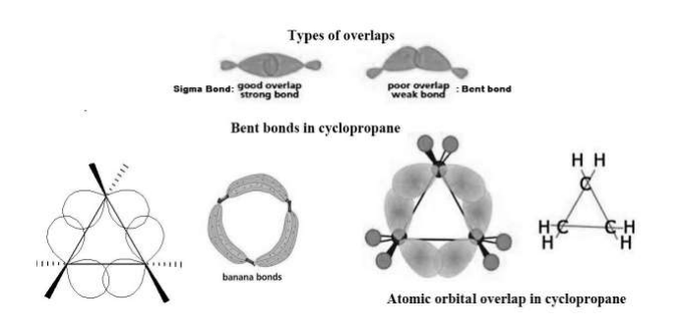

Slide 20
Coulson-Moffitt Model (Bent bond and Banana bond)
- Bent bond One of the first bent bond theories for cyclopropane was the so-called Coulson-Moffitt Model
- A bent bond, also known as a banana bond, is a type of covalent chemical bond with a geometry somewhat reminiscent of a banana.
- The term itself is a general representation of electron density or configuration resembling a similar "bent" structure within small ring molecules, such as cyclopropane (C3H6) or as a representation of double or triple bonds within a compound that is an alternative to the sigma and pi bond model.

Slide 21
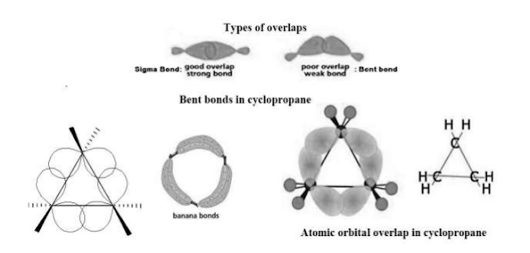
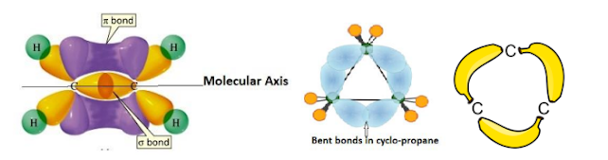

Slide 22
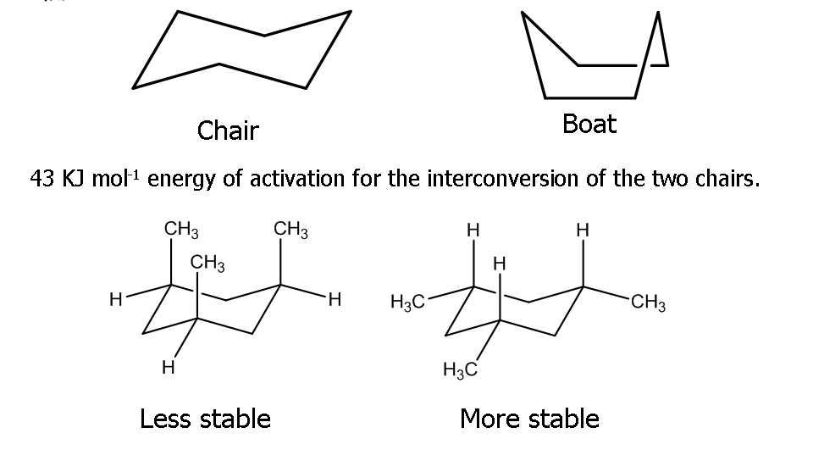
Conformations of cyclohexane and its derivatives

Slide 23
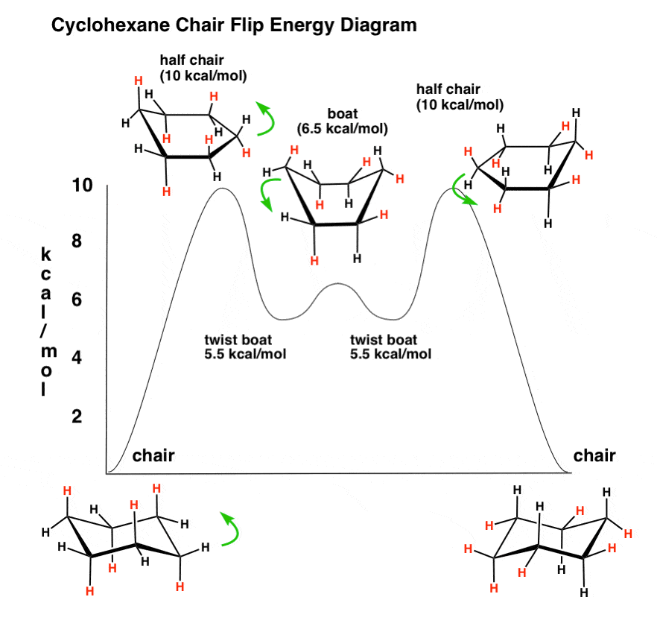

Slide 24
Sachse Mohr’s theory (Theory of strainless rings)
- Baeyer suggested that both large and small polymethylene rings should be strained, but Hermann Sachse, soon pointed out that large rings need not be strained, because the carbons need not be coplanar.
- Sachse Mohr’s theory proposed that higher member ring can become free from strain if all the ring carbons are not forced into one plane. They exhibit in two non-planar puckered conformations both of which are completely free from strain. These are called the Chair Form and Boat Form.

Slide 25
The chair conformation is the most stable conformation of cyclohexane.
- In chair cyclohexane there are two types of positions, axial and equatorial. The axial positions point perpendicular to the plane of the ring, whereas the equatorial positions are around the plane of the ring.

Slide 26
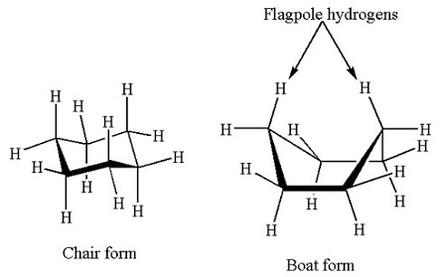

Slide 27
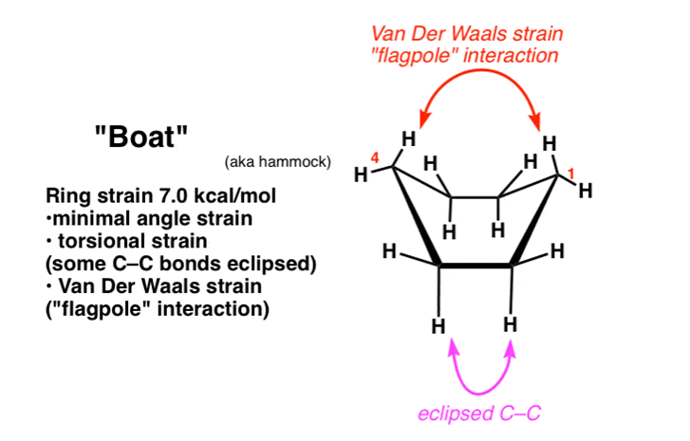
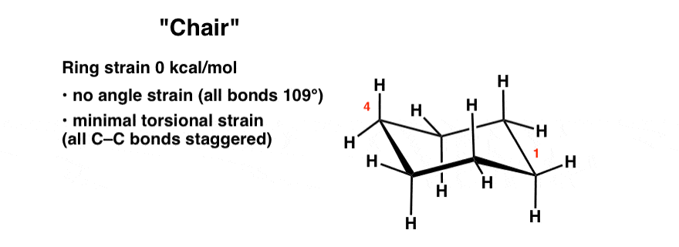

Slide 28
Reference:
Arun Bahl and B.S.Bahl “ Textbook of of Organic Chemistry”

