Slide 1
Drugs for Gout and Rheumatoid arthritis
Suhas Agey
Assistant Professor
Department of Pharmacology
HRPIPER, Shirpur

Slide 2
Contents
Gout
Uricosurics drugs
Uric acid synthesis inhibitors
Rheumatoid arthritis
Non-biological drugs
Biological drugs
Adjuvant drugs

Slide 3
DRUGS USED IN GOUT
Gout
It is a metabolic disorder characterized by hyperuricaemia (high blood uric acid level) leading to pain, swelling, and inflammation
Uric acid, a product of purine (DNA-nucleotide bases) metabolism. When blood uric acid levels are high, it precipitates and deposits in joints, build up of uric acid crystals in the joints.
Main goals of Gout medications are
to reduce pain, inflammation, and the frequency of gout attacks
to prevent long-term renal and joint damage.

Slide 4
Classification

Slide 5
A. Uricosurics drugs (Probenecid )
Probenecid is a highly lipid-soluble organic acid
Uric acid is largely reabsorbed by active transport, only 1/10th of the filtered load is excreted in urine.
Probenecid act by inhibiting urate transporter (URAT1) and decreasing the reabsorption of uric acid in the proximal tubules of kidney.
Probenecid, therefore, inhibits reabsorption and promotes excretion of uric acid, and lowers its blood level.

Slide 6
Probenecid
Pharmacokinetics
Adverse effects
Probenecid is generally well tolerated. Dyspepsia (indigestion) is the most common side effect
Uses
Chronic gout and hyperuricaemia: Probenecid is a second line/adjuvant drug to allopurinol.
Probenecid is completely absorbed orally; 90% plasma protein bound: partly conjugated in liver and excre ted by the kidney; plasma t½ is 6-8 hours.

Slide 7
Uric acid synthesis inhibitors
Allopurinol
Allopurinol was synthesized in 1956 as part of a study of purine antagonists for cancer chemotherapy, however, it had no antineoplastic activity.
The enzyme xanthine oxidase is involved in two steps, the conversion of adenosine to xanthine and the conversion of xanthine to uric acid.
Allopurinol inhibit synthesis of uric acid by reversibly inhibiting the enzyme- Xanthine oxidase
Mechanism
DNA base- Adenine
Hypoxanthine
Xanthine
Uric acid
Adenine deaminase
×
Xanthine oxidase
Allopurinol
×
Xanthine oxidase

Slide 8
Allopurinol
Allopurinol itself is a short-acting (t½ 2 hrs) competitive inhibitor of xanthine oxidase, but its major metabolite alloxanthine is a long-acting (t½ 24 hrs) and non-competitive inhibitor.
Alloxanthine is thus primarily responsible for uric acid synthesis inhibition.
Pharmacokinetics
About 80% of orally administered allopurinol is absorbed. It is not bound to plasma proteins; metabolized largely to alloxanthine.
Adverse effects
Hypersensitivity reaction consisting of rashes, fever, malaise and muscle pain is the most frequent.
T. Uses
Allopurinol is the first choice drug in chronic gout.

Slide 9
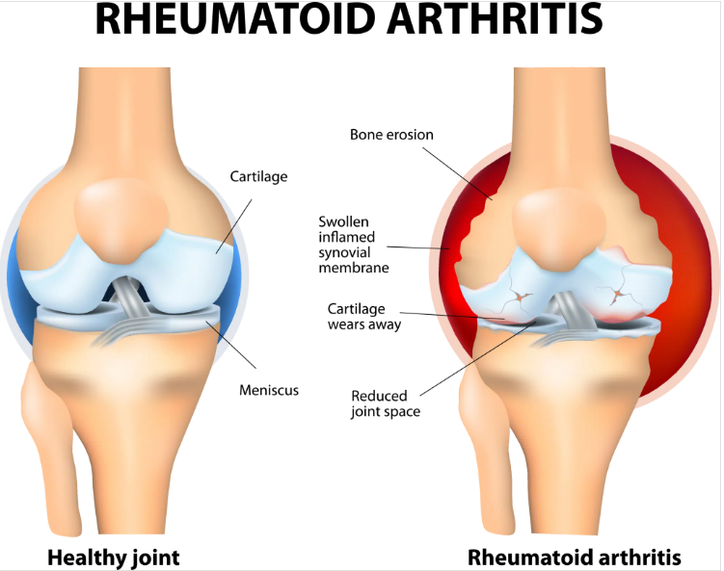
Rheumatoid arthritis (RA)
Rheumatoid arthritis (RA) is a type of autoimmune disorder that causes inflammation in the joints and surrounding tissue.
It is a chronic (long-term) condition typically affects the smaller joints in the hands and feet, but it can also affect the wrists, elbows, shoulders, hips, knees, ankles and spine.
Rheumatoid process- In some people repeated injuries/ infections causes, the immune system to attacks the tissues in the joints, causing inflammation and damage.
symptoms includes joint pain, stiffness, swelling, and loss of function.

Slide 10
ANTIRHEUMATOID DRUGS
These are drugs which, can suppress the rheumatoid process, bring about a remission and retard disease progression, but do not have nonspecific anti inflammatory or analgesic action.
Disease modifying anti-rheumatic drugs (DMARDs)=Antirheumatoid drugs + NSAIDs + Corticosteriods
The goals of drug therapy in RA are:
Ameliorate pain, swelling and joint stiffness -- (NSAIDS + CS)
Prevent articular cartilage damage
bony erosions
Antirheumatoid drugs

Slide 11
Classification

Slide 12
Classification

Slide 13
1. Non-biological drugs
Immunosuppressants
Immunosuppressants are drugs which inhibit cellular/humoral or both types of immune responses, and have their major use in organ transplantation and autoimmune diseases.
Methotrexate (Mtx)
Mtx has prominent immunosuppressant and anti inflammatory property.
Mechanism- This folic acid analogue acts by inhibiting dihydrofolate reductase (DHFRase), thus blocking the conversion of dihydrofolic acid (DHFA) to tetrahydrofolic acid (THFA).
Beneficial effects in RA are probably related to inhibition of cytokine production, chemotaxis and cell-mediated immune reaction. Proliferation of imm une-inflammatory cells is inhibited.

Slide 14
Methotrexate (Mtx)
Onset of symptom relief is relatively rapid (3- 6 weeks), therefore Mtx is preferred for initial treatment.
Mtx is now the DMARD of first choice and the standard treatment for most patients
Response is more predictable and sustained over long-term. Combination regimens of 2 or 3 DMARDs mostly include Mtx.
Oral bioavailability of Mtx is variable and may be affected by food.
Probenecid and aspirin increase Mtx levels and toxicity. Trimethoprim can add to inhibition of dihydrofolate reductase and depress bone marrow.
Oral ulceration and g.i. upset are the major side effects of low dose Mtx regimen.

Slide 15
2. Biological agents
Recently, several recombinant proteins/monoclonal antibodies that inhibit cytokines such as TNF-α or IL-1 have been produced and found to afford substantial benefit in autoimmune diseases like RA.
TNF-α inhibitors
Cytokine TNF-α plays a key role in the inflammatory cascade of RA by activating membrane bound receptors (TNFR1 and TNFR2) on the surface of T-cells, macrophages, etc
TNF-α inhibitors mainly suppress macrophage and T-cell function; inflammatory changes in the joint regress and new erosions are slowed.
Advantage- Quicker response than nonbiologic DMARDs has been obtained.
Disadvantage- Susceptibility to opportunistic infections, including tuberculosis and pneumocystis pneumonia is increased.

Slide 16
3. Adjuvant drugs (Corticosteroids)
Glucocorticoids have potent immunosuppressant and anti-inflammatory activity. They can be inducted almost at any stage in RA along with first or second line drugs.
Symptomatic relief is prompt and marked, but they do not arrest the rheumatoid process, though joint destruction may be slowed and bony erosions delayed.
Long-term use of corticosteroids carries serious disadvantages. Therefore,
• Either low doses (5- 7.5 mg prednisolone) are used to supplement NSAIDs.
• Or high doses are employed over short periods in cases with severe systemic manifestations.

Slide 17
Thank you…!!

