Slide 1
Hypolipidemic drugs
Mr. Suhas Agey
Assistant Professor
Department of Pharmacology
HRPIPER, Shirpur

Slide 2
Contents
A. Disease Specific
Introduction to disease
Biosynthesis of cholesterol
Structure of lipoproteins
Classification of Lipoproteins
Lipoprotein metabolic pathways
B. Drugs Specific
Hypolipidemic drugs
Pharmacology of statins
Pharmacology of bile acid sequestrants
Pharmacology of Fibrates
Pharmacology of cholesterol inhibitors

Slide 3
Introduction
The major lipids found in the bloodstream are cholesterol, cholesterol esters, triglycerides, and phospholipids. An excess plasma concentration of one or more of these compounds is known as hyperlipidemia.
Hyperlipidemia is a major cause of atherosclerosis which may lead to coronary artery diseases and ischemic cerebrovascular diseases.
In order to transport into the blood circulation, all lipids require the presence of soluble lipoproteins, hyperlipidemia ultimately results in an increased concentration of these transport molecules, a condition known as hyperlipoproteinemia.
Hyperlipemia denotes increased levels of triglycerides.

Slide 4
Biosynthesis of cholesterol
Acetyl Co-A (3)
3-Hydroxy, 3-methyl glutaryl Co-A (HMG-CoA)
Mavalonic acid (C-6)
Squalene (C-30)
Lanosterol (C-30)
Cholesterol (C-27)
HMG-Co-A Reductase

Slide 5
Triglycerides Biosynthesis
Glycerol 3- Phosphate + Acetyl Co-A Triglycerides (TG) (Stored in adipocytes)
3 fatty acid + Glycerol
Lipase

Slide 6
Transport of cholesterol and Triglycerides in blood
Cholesterol, triglycerides, and phospholipids are relatively insoluble in aqueous, physiologic fluids.
Lipoproteins- To be transported within the blood, these lipids are solubilized through association with macromolecular aggregates known as lipoproteins.
Apolipoproteins - Each lipoprotein is associated with additional proteins, known as apolipoproteins, on their outer surface. These apolipoproteins provide structural support and stability, bind to cellular receptors, and act as cofactors for enzymes involved in lipoprotein metabolism.

Slide 7
Structure of Lipoproteins
Lipoprotein Core-
Triglycerides and
cholesterol ester
Lipoprotein Surface-
Phospholipids Proteins
Free Cholesterol

Slide 8
Classification of Lipoproteins
Lipoprotein nomenclature is based on the mode of separation by ultracentrifugation. according to their density and identified as very-low-density lipoproteins (VLDLs), intermediate-density lipoproteins (IDLs), low-density lipoproteins (LDLs), and high-density lipoproteins (HDLs).

Slide 9
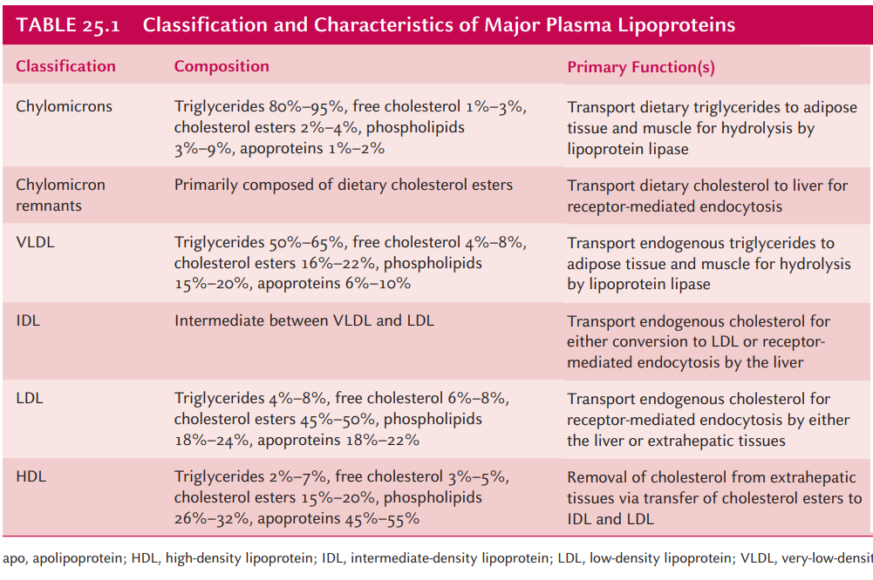
Classification of Lipoproteins

Slide 10
Pathway for Lipoprotein metabolism
Pathways of lipoprotein metabolism are divided into 2 types
Exogenous Pathway
Endogenous Pathway

Slide 11
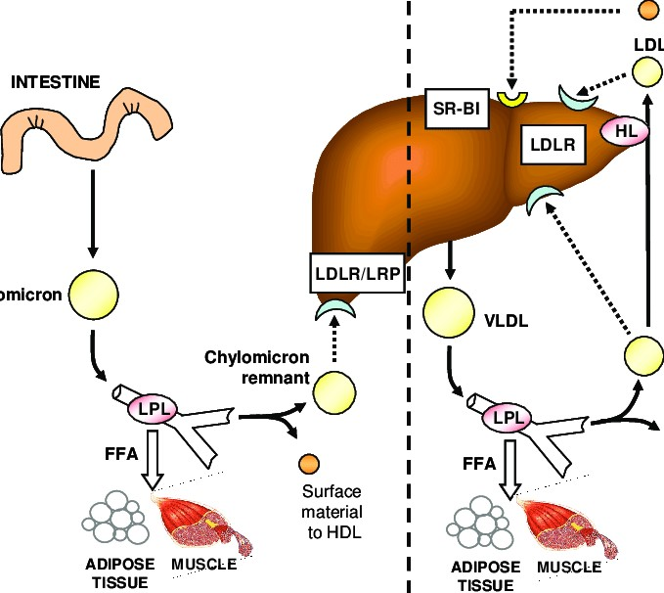
Pathway for lipoprotein metabolism
Pathway for Lipoprotein metabolism

Slide 12
Hypolipidemic Drugs
Drug Therapy: The primary goal of therapy is to:
Decrease levels of LDL
Increase in HDL

Slide 13
Hypolipidemic Drugs

Slide 14
HMG-CoA REDUCTASE INHIBITORS (Statins)-
Introduced in the 1980s, these classes of compounds are the most efficacious and best-tolerated hypolipidemic drugs.
Mechanism-
They are structural analogues of HMG-CoA, competitively inhibits HMG-CoA reductase enzyme.
They block the rate-limiting step in hepatic cholesterol synthesis (conversion of HMG-CoA to mevalonic acid by HMG-CoA reductase).
Statins

Slide 15
Statins inhibit HMG CoA reductase, leading to a decreased concentration of cholesterol within the cell.
Low intracellular cholesterol stimulates the synthesis of LDL receptors. (compensatory mechanism)
Increased number of LDL receptors promotes the uptake of LDL from blood
Low intracellular cholesterol decreases the secretion of VLDL.

Slide 17
Pharmacokinetics
Lovastatin and simvastatin are prodrugs that are hydrolyzed in the gastrointestinal tract to the active derivatives
Pravastatin, Atorvastatin, Fluvastatin and rosuvastatin are active as given
Absorption varies from 40% to 75% but Fluvastatin is completely absorbed.
Most of the absorbed dose is excreted in the bile; 5–20% is excreted in the urine.
Plasma Half-lives of these drugs range from 1 to 3 hours, atorvastatin (14 hours), pitavastatin (12 hours) and rosuvastatin (19 hours).

Slide 18
Adverse Effect of Statins
All statins are remarkably tolerated.
Mild effects include GI irritations, headache, rashes, and sleep disturbances.
Minor abnormality of liver function tests (Mild elevations of serum aminotransferases)
Increase in creatine kinase (released from skeletal muscle) in 10% of patients
Myopathy and rhabdomyolysis (disintegration or dissolution of muscle and elevation of muscle enzymes (creatine kinase, CPK).

Slide 19
Therapeutic Uses
Statins are the first choice drugs for primary hyperlipidemia and secondary hypercholesteremia. These drugs effectively lower LDL cholesterol levels, especially when combined with other cholesterol-lowering drugs.
They reduce the risk of coronary events and mortality in patients with ischemic heart disease, and they also reduce the risk of ischemic stroke.
Rosuvastatin, atorvastatin, and simvastatin have greater maximal efficacy than the other statins while Fluvastatin has less maximal efficacy

Slide 20
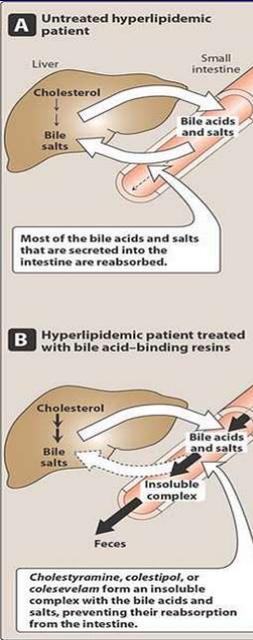
Bile Acid Sequestrants
Have significant LDL cholesterol–lowering effects, although the benefits are less than those observed with statins.
Mechanism
Most of the bile acids and salts that are secreted into the intestine are reabsorbed.
These drugs form an insoluble complex with the bile acids and salts, preventing their reabsorption from the intestine.

Slide 21
The resin/bile acid complex is excreted in the faeces, thus lowering the bile acid concentration.
This causes hepatocytes to increase the conversion of cholesterol to bile acids, which are essential components of the bile.
Intracellular cholesterol concentrations decrease, Which activates an increased hepatic uptake of cholesterol-containing LDL particles, leading to a fall in plasma LDL concentration.
This increased uptake is mediated by an up-regulation of cell surface LDL receptors.

Slide 22
Pharmacokinetics:
Orally given but neither absorbed nor metabolically altered by the intestine,
totally excreted in faeces.
Adverse Effect
ADVERSE EFFECTS
Gastrointestinal Disturbances: (constipation, nausea, and flatulence).
Impaired absorptions: At high doses, cholestyramine and colestipol, impair the absorption of the fat-soluble vitamins (A, D, E, and K).

Slide 23
LIPOPROTEIN-LIPASE ACTIVATORS(Fibrates):
The fibrates primarily activate lipoprotein lipase which is a key enzyme in the degradation of VLDL resulting in the lowering of circulating TGs.
Fibrates lower VLDL levels through PPAR-α-mediated stimulation of fatty acid oxidation, inhibition of triglyceride synthesis, and reduced expression of apoC-III. This latter effect enhances the action of lipoprotein lipase because apoC-III normally serves as an inhibitor of this enzyme.
PPAR-α may also mediate enhanced LDL receptor expression in the liver seen particularly with second-generation fibrates like bezafibrate, and fenofibrate.

Slide 25
Pharmacokinetics
Gemfibrozil and fenofibrate are completely absorbed after oral administration.
Fenofibrate is a prodrug, which is converted to the active moiety fenofibric acid.
Both drugs undergo extensive biotransformation
Excreted in the urine as glucuronide conjugates.

Slide 26
Adverse effects of Fibrates
Gastrointestinal disturbances.
Lithiasis: Because these drugs increase biliary cholesterol excretion, there is a predisposition to the formation of gallstones.
Muscle: Myositis (inflammation of a voluntary muscle) can occur with both drugs; thus, muscle weakness or tenderness should be evaluated.
Notes:
Lithiasis is the formation of stony concretions (calculi) in the body, most often in the gall bladder or urinary system

Slide 27
Cholesterol absorption inhibitor
Mechanism
Ezetimibe selectively inhibits the absorption of dietary and biliary cholesterol in the small intestine. leading to a decrease in the delivery of intestinal cholesterol to the liver. This causes a reduction of hepatic cholesterol stores and an increase in the clearance of cholesterol from the blood.
Ezetimibe lowers LDL cholesterol by approximately 17%.
Ezetimibe is often used as an adjunct to statin therapy or in statin-intolerant patients, due to its modest LDL-lowering effects.

Slide 28
Pharmacokinetics
Ezetimibe is primarily metabolized in the small intestine and liver via glucuronide conjugation.
Biliary and renal excretion.
Patients with moderate to severe hepatic insufficiency should not be treated with ezetimibe.
Adverse effect of Ezetimibe
Hypersensitivity reaction
Pancreatitis
loss of appetite

Slide 29
References
K. D. Tripathi, “Essentials of Medical Pharmacology,” 8th Edition, Jaypee Brothers Medical Publishers (P) LTD, New Delhi, 2018.
Foye WO Lemke TL Williams DA. Foye's Principles of Medicinal Chemistry. 7th ed. Philadelphia: Wolters Kluwer Health/Lippincott Williams & Wilkins; 2013.
https://www.ramauniversity.ac.in/online-study-material/pharmacy/bpharma/vsemester/pharmacology-ii/lecture-2.pdf
https://www.philadelphia.edu.jo/academics/nsaadi/uploads/Anti%20Hyperlipidemic%20Drugs.pdf

Slide 30
Thank you..

