Slide 1
INTERNATIONAL STANDARD ORGANIZATION
Mr. Shoheb S. Manyar
Assistant Professor
Department of Pharmaceutical Chemistry
H. R. Patel Institute of Pharmaceutical Education and Research, Shirpur

Slide 2
Contents
Introduction
ISO Series
Process for ISO Registration
ISO 9000 Series
Purpose of ISO 9000 Series
Benefits of the ISO 9000 Series
Limitations of ISO 9000 Series

Slide 3
INTERNATIONAL STANDARD ORGANIZATION (ISO)
ISO (International Organization for Standardization) is an independent, non-governmental organization that develops standards to ensure the quality, safety and efficiency of products, services and systems.
Formed in 23rd February 1947 and is headquartered in Geneva, Switzerland
The International Organization for Standardization (ISO) is an international standard setting body composed of representatives from various national standard organizations.
ISO is a leading international organization in standardization with a membership of about 165 national standards bodies
Sergio Mujica is secretariat of ISO

Slide 4
ISO overview
It is derived from the Greek word "isos" that means "equal”.
ISO is the world's largest developer of standards.
ISO’s principal activity is the development of technical document.
ISO standards are extremely useful not only to the manufacturers but also to the whole society as they contribute in the development, manufacturing and supply of products and services which are more efficient, safer and cleaner.

Slide 5
Cont…
ISO
Concept: determine characteristics of the management practices that must be standardized
Main objective: total quality improvement
Difficulties: many countries initiated and implemented their own National Quality Policies
Two main features:
Internal Quality Audit at predetermined interval
Continuous monitoring of Quality system

Slide 6
What is ISO certification?
ISO certification is a credential that validates a business's fulfillment of requirements relating to quality process standards as defined by the International Standards Organization (ISO).
The ISO is a non-governmental organization that determines specifications for products, services and systems for quality and efficiency.
International Organization for Standardization (ISO) certification establishes credibility and trust among consumers, clients and other business partners.
In today's international marketplace, such a designation validates that an organization adheres to global standards of quality assurance, manufacturing and business.

Slide 7
Some ISO certifications
The credentials relate to specific industries, including
Agriculture
Food safety
Health care
Manufacturing
Occupational health and safety
Risk management
Technology

Slide 8
Role of ISO
ISO makes trade between countries easier and fairer.
ISO provide governments with a technical base for health, safety and environmental legislation.
ISO helps in transferring technology to developing countries.
ISO standards ensure safety and quality of products and services to customers and other users.

Slide 10
Cont…
Each certification has its own set of standards and requirements. Some of the most common types of ISO certification are:
ISO 9000: One of the most common certifications is the ISO 9000, a grouping of standards that relates to quality management systems (QMS) and helps companies meet the needs of customers and other interested parties (Stakeholders) while meeting statutory and regulatory requirements related to a product or service.
It was originally published in 1987 by the International Organization for Standardization (ISO).

Slide 11
Cont…
ISO 13485:
The ISO 13485 is a sector-specific certification for the automotive industry.
It outlines standards that automotive manufacturers and distributors are to uphold for quality and efficiency, which are especially useful in relation to the international shipping of vehicles.
ISO 14001:
Relating to requirements for an environmental management system, the ISO 14001 is growing more prevalent because of consumer opinions concerning the impact of corporations on the environment.

Slide 12
ISO SERIES
There are five series of ISO. They are as follows
ISO 9000: It is a guide. (Fundamental quality concepts and guidelines)
ISO 9001: It is a set of requirements for the quality system. (QA in design, development, Production, installation and servicing)
ISO 9002: it is a set of standards for product. (Model for QA in Production & installation of manufacturing systems)
ISO 9003: It is a set of Quality Assurance in final inspection and testing.
ISO 9004: It is a guidelines for developing and implementing quality system principles structure, auditing and review.

Slide 13
OVERVIEW OF ISO 9000
ISO 9000 was first published in 1987 by ISO with the objective of defining common quality requirements globally instead of forcing organizations to adopt multiple or variety of quality assurance requirements.
ISO 9000 family of standards deals with quality management system including the seven quality management principles upon which the family of standards is based.
ISO 9001 is a subset of ISO 9000 family of standards that deals with the requirements that organizations wishing to meet the standard must fulfill.
The goal of ISO 9000 is to embed a quality management system within an organization, increasing productivity, reducing unnecessary costs and ensuring the quality of processes and products.
The standards are not limited to particular sectors but are widely applicable to every sector.

Slide 14
ISO 9000
ISO 9000 is a series of Quality Management Systems standards (QMS)
Published by the ISO that define, establish & maintain an effective QA system for manufacturing & service industries.
BENEFITS OF ISO 9000
Increased marketability
Reduces operational expenses
To comply with customers needs
To sell in the European Union market
To compete in domestic markets
To improve the quality system
Improved health, safety and reduction of waste

Slide 15
Quality Management Principles
QMS
The ISO 9000 series is based on quality management principles (QMP).
Quality management is an important component of a successful business that helps ensure companies produce services and products consistently and effectively.
There are several key components of quality management, including quality planning, control, assurance and improvement.
Learning how quality management works can help you ensure that a company is operating at a certain production standard to maintain high quality.

Slide 16
Cont…
In this, we explore what quality management is, why it's beneficial and its primary components and principles, as well as an example of quality management.
Key takeaways
Quality management means putting certain practices in place to ensure a company’s efficiency and to produce high-quality products consistently.
This process involves determining quality standards, forming plans to meet the company's goals, assessing the products and services produced and analyzing systems and procedures to improve production methods further.

Slide 17
The ISO 9000 series is based on seven quality management principles (QMP)

Slide 18
Quality management principles (QMP)
QMP1. Customer focus
Organizations should make their customers their primary focus during the quality management process.
Meeting and exceeding the expectations of customers often results in happier customers, which can lead to increased revenue and higher customer retention rates.
The more a company knows its customers' needs, the better able it can usually create products and services that meet those needs.

Slide 19
QMP2.
Another primary principle of successful quality control is strong leadership.
Leaders who engage their employees and motivate them to contribute to the company's goals may experience better quality management results.
Effective leadership can also create a more efficient workplace and improve the quality of the company’s products.

Slide 20
Possible actions
Possible actions include:
Communicate the organization’s mission, vision, strategy, policies and processes throughout the organization;
Create and sustain shared values, fairness and ethical models for behaviour at all levels of the organization;
Establish a culture of trust and integrity;
Some potential key benefits are:
— increased effectiveness and efficiency in meeting the organization’s quality objectives;
— better coordination of the organization’s processes;
— improved communication between levels and functions of the organization;
— development and improvement of the capability of the organization and its people to deliver desired results.

Slide 21
QMP3. Involvement of People
Being able to engage employees effectively is an important component of quality management.
The more engaged employees are, the more likely they are to be motivated to contribute to higher quality standards.
They may also be more willing to improve their skills continuously, stay consistent in their work and remain motivated when performing their tasks.

Slide 22
Cont…

Slide 23
Key benefits
Some potential key benefits are:
Improved understanding of the organization’s quality objectives by people in the organization and increased motivation to achieve them;
Enhanced involvement of people in improvement activities;
Enhanced personal development, initiatives and creativity;
Enhanced people satisfaction;
Enhanced trust and collaboration throughout the organization;

Slide 24
QMP4.
The process approach is principle of quality management emphasizes effectiveness and efficiency in terms of the company's processes.
Strong processes support improved performance, reduced cost and waste and steady improvement.
Some processes can improve the quality of include production, operations, marketing, accounting and distribution.

Slide 25
Key benefits
Some potential key benefits are:
Enhanced ability to focus effort on key processes and opportunities for improvement;
Optimized performance through effective process management, efficient use of resources and reduced cross-functional barriers;
Enabling the organization to provide confidence to interested parties related to its consistency, effectiveness and efficiency.

Slide 26
QMP5.
Another important aspect of successful quality management is a commitment to continuous improvement.
When creating quality management system, make room for regular improvement that includes analyzing what's working and what's not and making changes at the moment.
The more committed you are to continuous improvement, the better your overall quality management may be.

Slide 27
Possible actions
Possible actions include:
— promote establishment of improvement objectives at all levels of the organization;
— educate and train people at all levels on how to apply basic tools and methodologies to achieve improvement objectives;
— develop and deploy processes to implement improvement projects throughout the organization;
— track, review and audit the planning, implementation, completion and results of improvement projects;
— integrate improvement consideration into development of new or modified products and services and processes;
— recognize and acknowledge improvement.

Slide 28
Cont…

Slide 30
QMP6. Evidence-based decision-making
Companies should use an evidence-based approach when formulating their quality management plan.
This involves gathering and analyzing both qualitative and quantitative data when developing plans.
The evidence can include previous and current data on the company's quality management systems regarding whether the current systems achieve the desired results and how past decisions have impacted quality control.

Slide 31
Possible actions
Possible actions include:
— determine, measure and monitor key indicators to demonstrate the organization’s performance;
— make all data needed available to the relevant people;
— ensure that data and information are sufficiently accurate, reliable and secure;
— analyze and evaluate data and information using suitable methods;
— ensure people are competent to analyze and evaluate data as needed;
— make decisions and take actions based on evidence, balanced with experience.

Slide 32
QMP7. Relationship management
Different parties can play a significant role in an organization's performance and quality management efforts.
Primary parties that can impact quality management include retailers, suppliers and manufacturers.
Having strong relationships with these parties ensures that there’s open communication and that the company's goals are being met.

Slide 33
Possible actions
Possible actions include:
— determine relevant interested parties (such as providers, partners, customers, investors, employees or society as a whole) and their relationship with the organization;
— determine and prioritize interested party relationships that need to be managed;
— gather and share information, expertise and resources with relevant interested parties;
— measure performance and provide performance feedback to interested parties, as appropriate, to enhance improvement initiatives;
— establish collaborative development and improvement activities with providers, partners and other interested parties;
— encourage and recognize improvements and achievements by providers and partners.

Slide 34
Benefits of Quality Management
There are several reasons why quality management is an important component of a successful business.
Here are some of its benefits:
Ensures high-quality services and products
Supports overall customer satisfaction
Increases revenue and customer retention rates
Improves productivity within the organization
Reduces inventory and waste
Ensures the company follows all processes in a similar and effective manner
Helps companies establish a good reputation based on quality products and services
Increases operational consistency

Slide 35
BENEFITS OF THE ISO 9000 SERIES OF STANDARDS
Improved controls, discipline (e.g. prevents the use of short cuts and duplication of activities), procedures, documentation, communication, dissemination and customer satisfaction, quicker identification and resolution of problems, greater consistency (i.e. the job is done the same way, time after time and best practices are shared).
A reduction in errors, customer complaints and non-conforming products, services and costs and the retention of customers.
Identification of ineffective and surplus procedures and documents and other forms of waste.
A better working environment.

Slide 36
LIMITATIONS OF THE ISO 9000 SERIES OF STANDARDS
Cost
It is not cheap to become an ISO 9000-certified company.
The cost of the certification process depends greatly on the type of business, the size of the business and other factors that are different for every type of business
2. ISO Certification Process
The ISO 9000 certification process does not end with the final implementation of the initial certification.
It must be maintained throughout the life of the company, or at least the life span of the company as it pertains to the company being ISO 9000 certified.
This can lead to expenses

Slide 37
3. Employee Buy-in
If the employees are not interested in or capable of understanding and completing the policies and procedures required to maintain the ISO 9000 status, then the certification process will quickly break down and become meaningless.
4. Competitive Disadvantage
People who don't understand what ISO 9000 is may not be impressed with the ISO 9000 certification and may choose to do business with cheaper competitors who are not ISO 9000 certified and who can operate less expensively as a result.

Slide 38
DIFFERENCES BETWEEN STANDARDS AND REQUIREMENTS
Standards are defined levels of quality, and requirements are what is needed to make something else happen.
For the purposes of ISO, standards include requirements, guidelines, and specifications to point the way to quality output.
In the ISO 9000 series, different standards exist.

Slide 39
THANK YOU…

Slide 43
National standards bodies in INDIA ?
A national standards body (NSB) generally refers to one standardization organization that is that country's member of the ISO.
Bureau of Indian Standards (BIS) is the National Standard Body of India.
BIS is responsible for the harmonious development of the activities of standardization, marking and quality certification of goods and for matters connected therewith or incidental thereto.

Slide 44
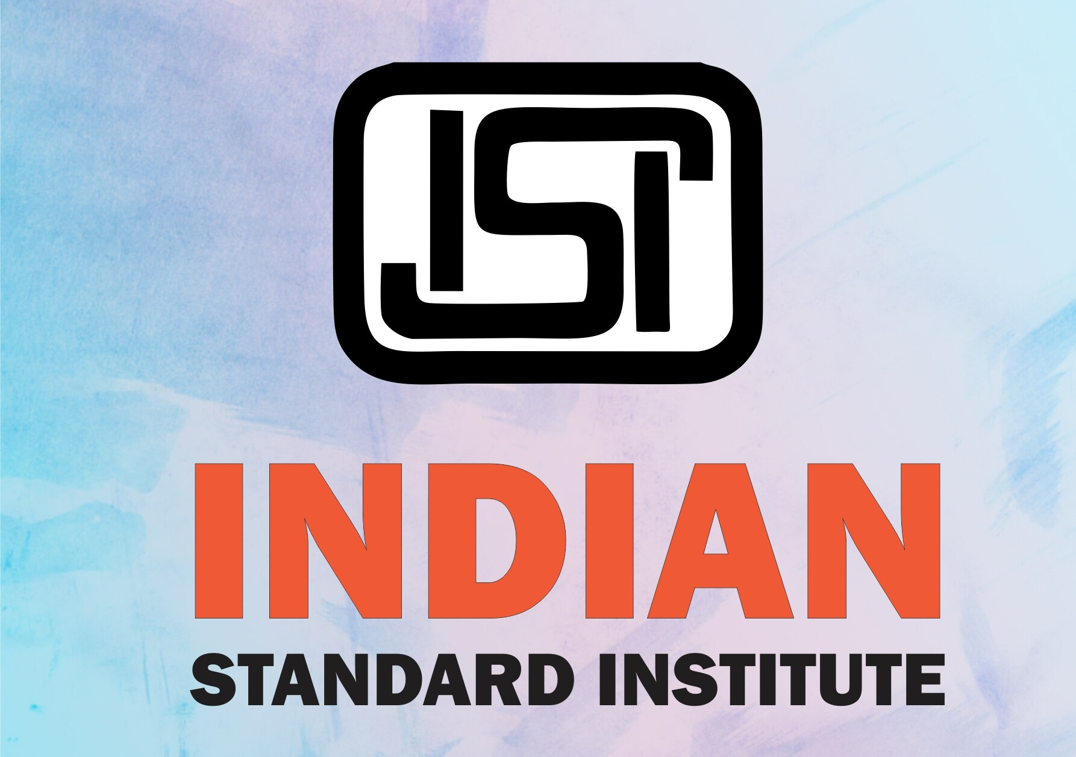
Cont…
ISI is the Indian Standards Institute.
ISI was founded to establish standards for the orderly growth of industries and for maintaining industrial output efficiency.
It offers an ISI mark which is a standards-compliance mark for industrial products in India.
What is ISI and BSI?
ISI is meant for a quality standard set by the Indian government.
The socio-economic conditions had changed in the mid-1980, and a stronger body is set as Bureau of Indian Standards (BIS). The ISI is later taking over by the BIS.

