Slide 1
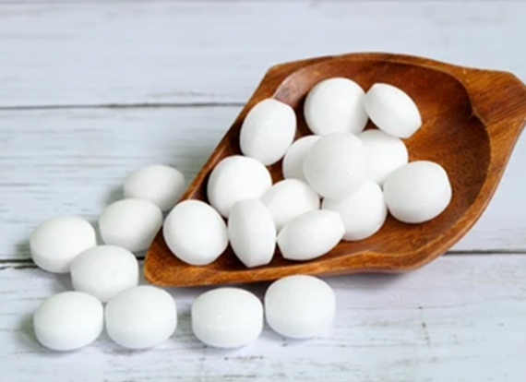
Naphthalene
Ms. Asama Yunus Pathan
Dept.of Pharmaceutical Chemistry
H.R.Patel Institute of Pharmaceutical education and Research Shirpur.

Slide 2
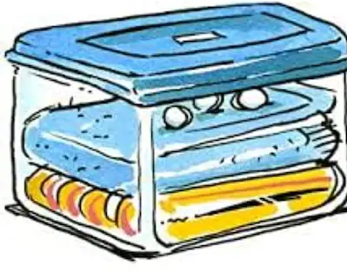
Naphthalene
The aromatic Hydrocarbon made up of two or more benzene rings fused together a
are called as Polynuclear or Fused-ring hydrocarbon.
Naphthalene is the class of arenes ,in which two benzene ring are fused in ortho position.
Orbital Picture
Kekule-Type Structure

Slide 3
Nomenclature

Slide 4
Structure Elucidation of Naphthalene
A. Kekule-Type Formula:
Molecular Formula :C₈H₁₀
2.Presence of benzene ring with two side chains :
Naphtahlene on oxidation gave phthalic acid Hence,it contained a benzene ring with two ortho side Chains.
So naphthalene contain the skeleton

Slide 5
Presence of two fused ring:
Erlenmeyer 1866 proposed for it Kekule-type of formula in which two benzene rings are fused in ortho position

Slide 6
All confirmed by Graebe (1869) as follows
1. Nitration of Naphthalene…oxidn……O-Nitrophthalic acid
2. Reduction of Naphthalene……Redn…….aminonaphthalene…..oxdn…Phthalic acid

Slide 7
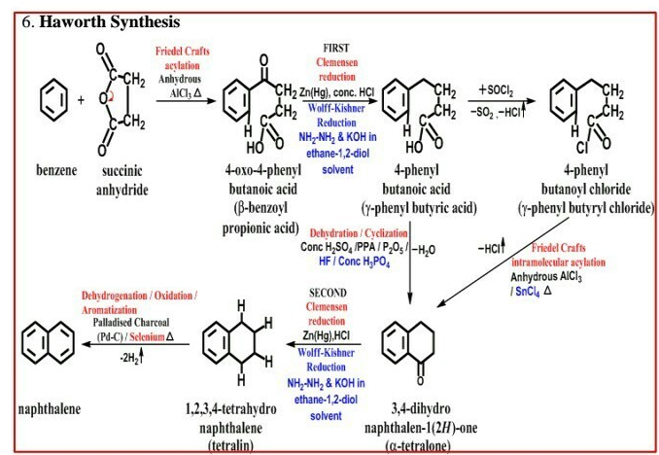

Slide 8
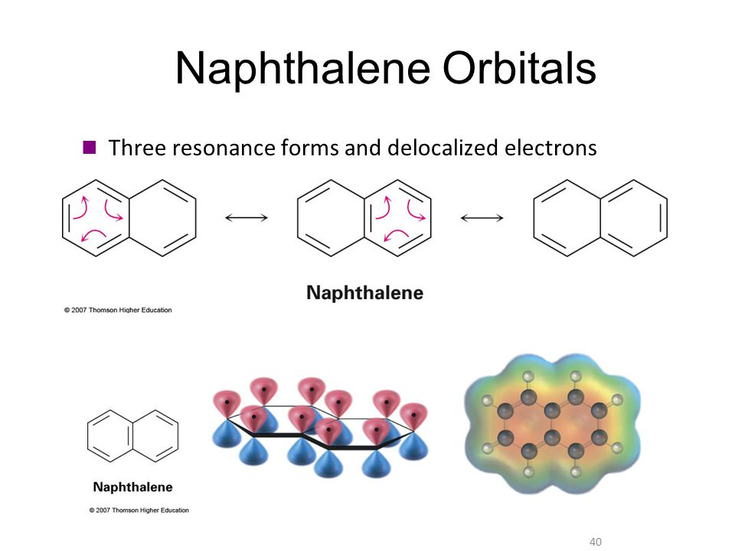

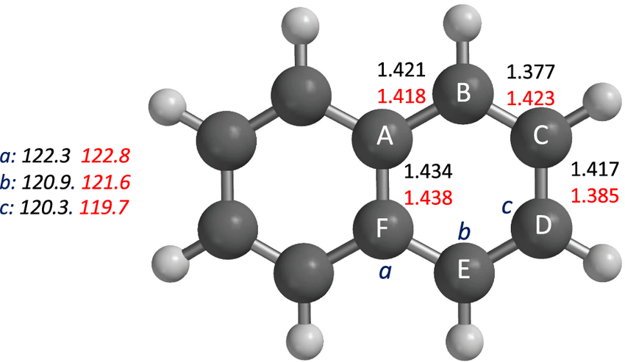
B. Resonance Model
C. Orbital Model
Bond Length

Slide 9
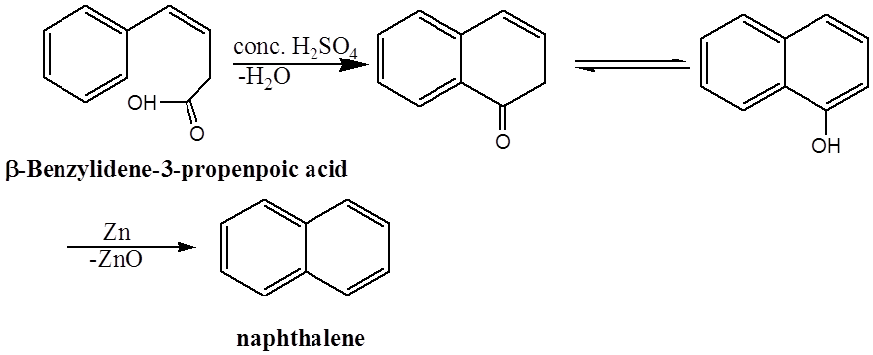
Preparation Method of Naphthalene

Slide 10
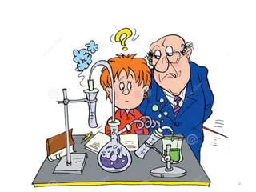
Chemical Properties of Naphthalene

Slide 11
1. Reduction

Slide 12
2. Oxidation

Slide 14
Nitration
Sulphonations
Halogenation
Friedal-Craft Acylation

Slide 15
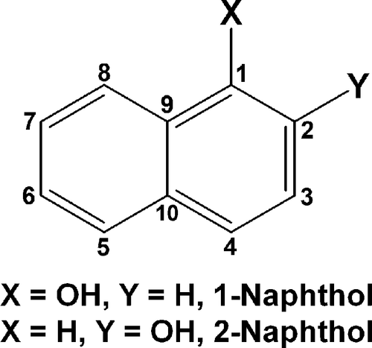
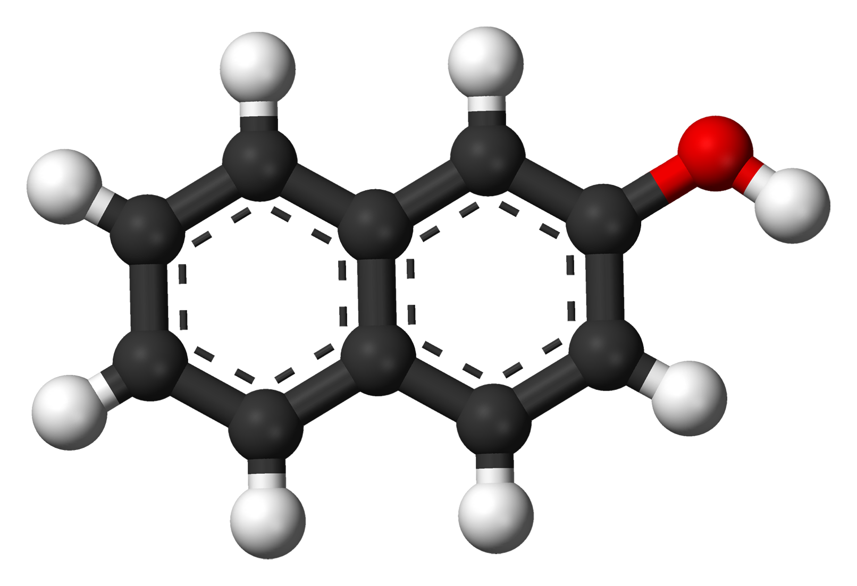
1.Naphthols

Slide 16
1.Preparation of Naphthols

Slide 17
Properties :
They are colourless solids
Mp of alpha-naphthols 123-124⁰ C and beta-naphthols 96⁰ C
Insoluble in water and soluble in benzene and very soluble in alcohol and ether
Bucherer Reaction

Slide 18
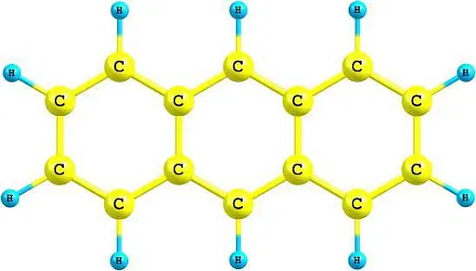
Anthracene

Slide 19
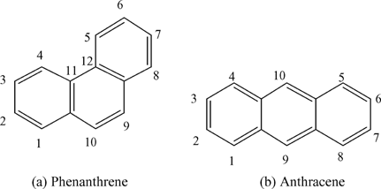

Slide 20
Structure Elucidation of Anthracene
A. Kekule-Type Formula:
I.Molecular Formula :C₁₄H₁₀
II. Presence of three fused benzene rings:

Slide 21
Haworth Anthracene Synthesis

Slide 22
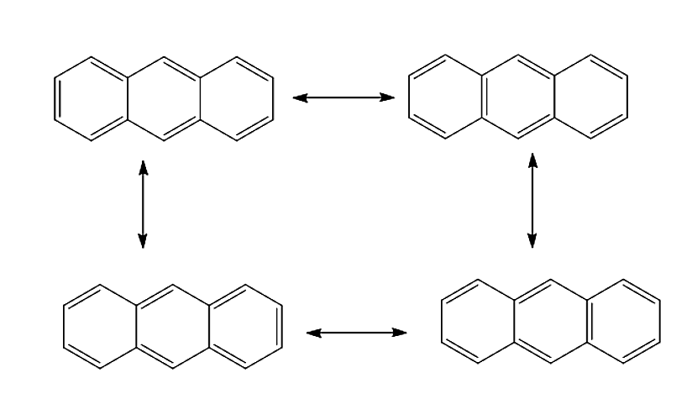
Resonance Model of Anthracene

Slide 23
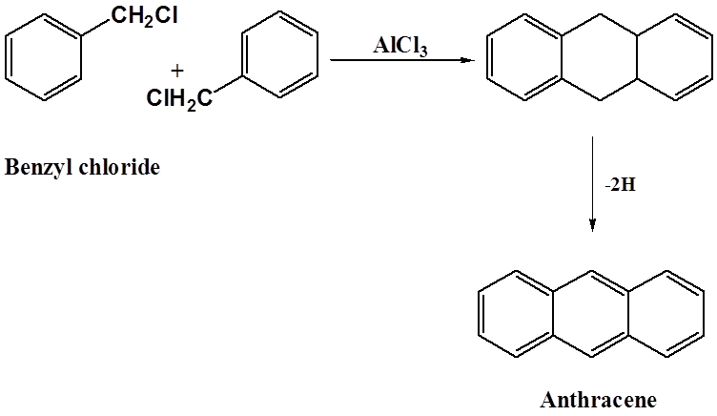
Preparation method of Anthracene
. Friedl Crafts

Slide 24
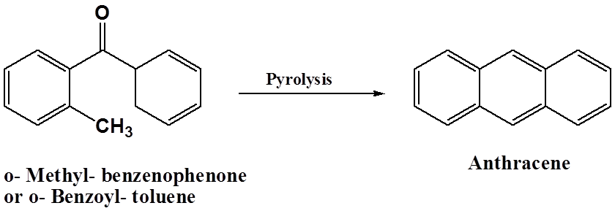
2. Elbe Reaction:

Slide 25
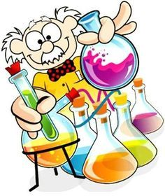
Chemical Properties of
Anthracene

Slide 26
1. Oxidation of Anthracene
2. Reduction of Anthracene

Slide 27
3. Halogenation
4. Nitration

Slide 28
5.Sulphonation

Slide 29
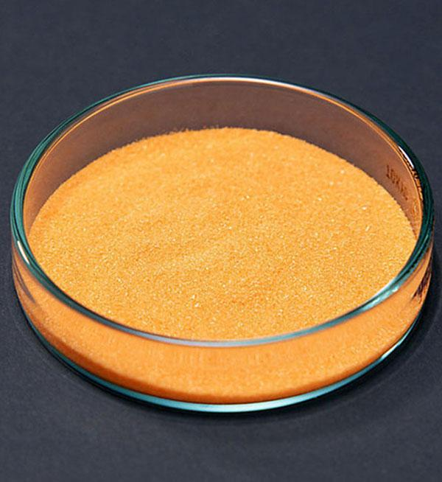
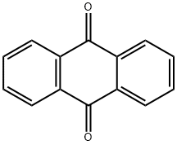
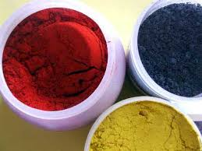
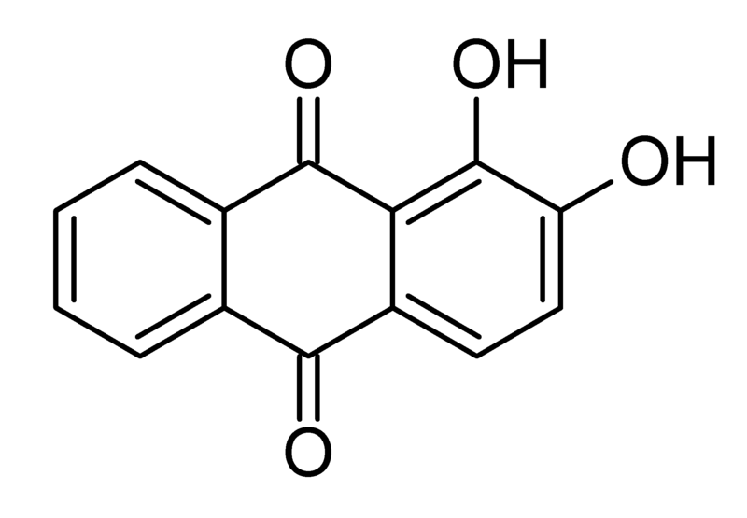
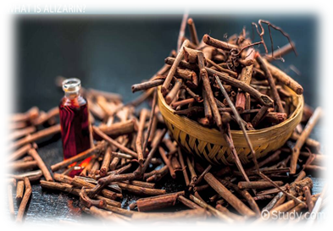
Anthraquinone
Yellow solid that forms needle like crystals
M.p. 286⁰ C
Insoluble in water and soluble in alcohol, ether, acetone and benzene
Uses:
Anthraquinone is used in the manufacture of alizarin and several other dyes.
Alizarin

Slide 30
Alizarin used as dye of splendid red colour.it was first obtained from the roots of the madder plant.
Properties
Alizarin forms Red Ruby crystals mp 290⁰ C
Its sparingly soluble in water ,soluble in alcohol and ether.
It is typically mordent dye, yielding different colours with different mordents.
Thus aluminium mordent gives a gives bright red colour.(Turkey red)

Slide 31
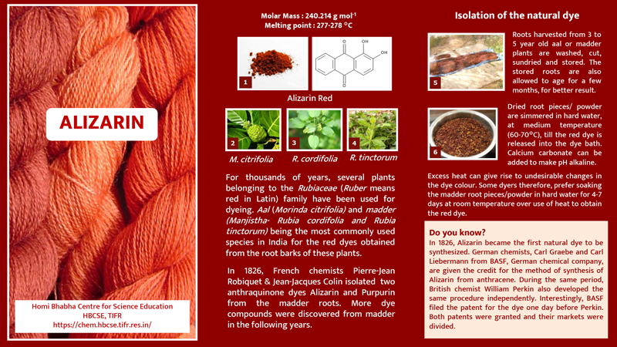

Slide 32
USES OF ANTHRACENE
Drugs like secnna, cascara and aloes contains anthraquinone as a glycine part for cathartic or laxative activity
Many herbal drugs contain anthracene and its derevatives for antimalarial, anti-HIV, antiviral and diuretic effects
Used as wood preservative
Insecticide in agriculture
Commonly used as UV tracer
Used as scintillator for detectors for high energy photons, electrons and alpha particles.

Slide 33
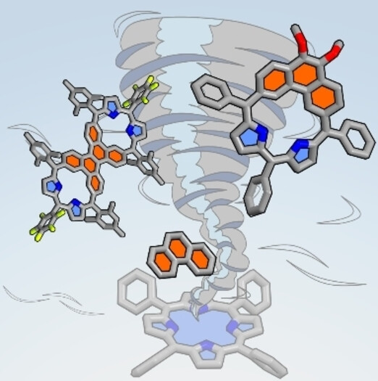
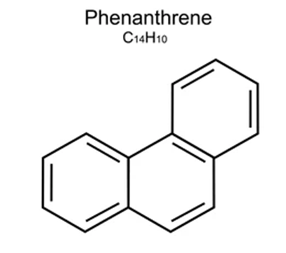
Phenatherene

Slide 34
Phenanthrene
Phenanthrene is apolycyclic aromatic hydrocarbon composed of three fused benzene rings.
In its pure form, it is found in cigarette smoke and is a known irritant, photosensitizing skin to light.
Phenanthrene appears as a white powder having blue fluorescence. Phenanthrene is the backbone of morphine

Slide 35
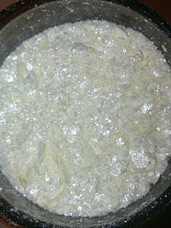
PROPERTIES OF PHENANTHRENE
Resonance energy of Phenanthrene is 92 kcal/mole.
It's solution in benzene shows blue colour fluorescence.
It is very reactive in the 9,10- positions.
The carbons in Phenanthrene are sp2 hybridised, having 14 π-electron delocalized system and is aromatic in nature.
Key difference between anthracene and phenanthrene: Anthracene is less stable compared to phenanthrene.

Slide 36
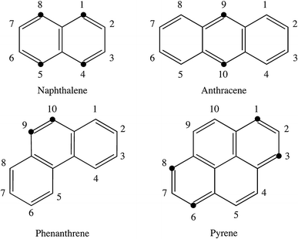

Slide 37
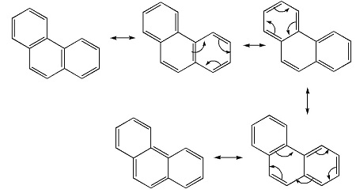
Resonance Structure of Phenanthrene

Slide 38
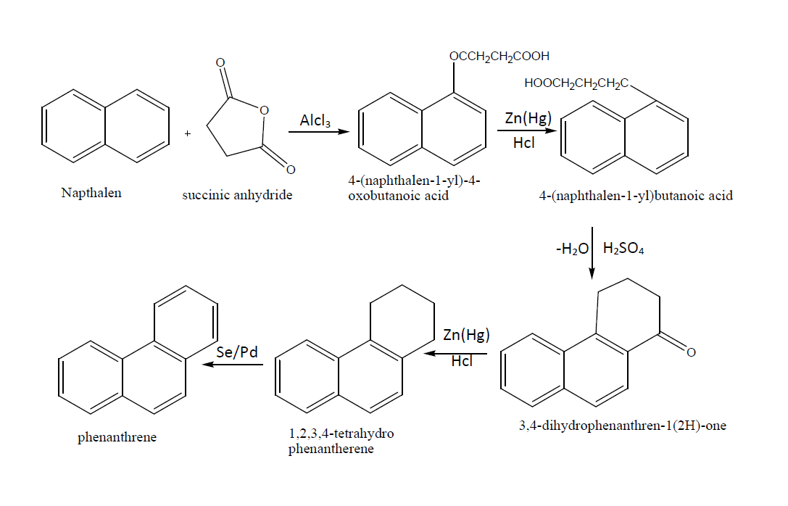
Haworth Phenanthrene Synthesis

Slide 39
1. Oxidation of Phenanthrene
2.Reduction of Phenanthrene

Slide 40
3.Halogenation of Phenanthrene

Slide 41
USES OF PHENANTHRENE
Phenanthrene is used to make dyes, plastics and pesticides, explosives and drugs.
It has also been used to make bile acids, cholesterol and steroids.
Phenanthrene occurs naturally as well as is a man-made chemical.
Animal studies have shown that Phenanthrene is a potential carcinogen { an agent with the capacity to cause cancer in humans}.
Perhydrophenanthrene is used in production of jet fuel.
Phenanthrene is also used for synthesizing alkalosis morphine and caffeine, dimethyl morphine.

Slide 42
Reference
Arun Bahl B.S.Bahl “ A textbook of Organic Chemistry”
https://www.sciencedirect.com/topics/pharmacology-toxicology-and-pharmaceutical-science/phenanthrene.
https://doi.org/10.1016/bs.acc.2016.03.001

Slide 43
Thanks!

