Slide 1
Pharmaceutical uses of enzymes

Slide 2
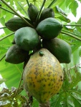
Papain
Cystine protease hydrolase enzyme
Source:
Papaya (Carica papaya)
Use: anti-inflammatory and digestive
meat tenderiser
breaks down tough meat fibres
teeth whitening agent
In some toothpastes
contact lens cleaner
jellyfish, bee/wasp stings, stingray wounds (home remedy)
breaks down protein toxins in the venom
wound debriding
digestive aid

Slide 3
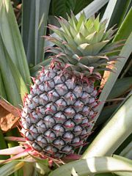
Bromelain
One of two proteases
Stem bromelain
Fruit bromelain
Use: meat tenderising
anti-inflammatory: sports injury, trauma, arthritis
digestive problems, phlebitis, sinusitis
platelet clumping, blood clots in arteries

Slide 4
Trypsin, Chymotrypsin
Serine proteases or endopeptidases
– ‘proteolytic’
- hydrolyse peptide bonds
modify the electrostatic environment of the serine
cystic fibrosis – trypsin deficiency
Chymotrypsin
more anti-inflammatory activity
used for sporting wounds

Slide 5
Pancreatin
Source: porcine pancreas
crude form used since before 1870
Use: for reduced exocrine secretion
pancreatic enzyme supplements - pancrelipase
cystic fibrosis
pancreatectomy
chronic pancreatitis
pancreatic cancer (if obstructs outflow)

Slide 6
Pepsin
Source: porcine gastric muscosa
Use: (protease)
gastric hypochlorhydria
deficiency of gastric enzymes
dyspepsia
Diastase
Refers to α-,β-,γ-amylase
f
Source:
Animal: eg porcine
Vegetable: mould (Aspergillus oryzae – taka-diastase), malt, bacteria
Action: catalyses breakdown of starch to maltose
Pectinase
Action: refers to enzymes that break down pectin
Source: extracted from fungi eg Aspergillus niger
Use: processing involving degradation of plant material
to speed up extraction of juice from fruit eg apples
retting – obtaining fibres of eg flax, jute, hemp

Slide 7
Streptokinase
Source: prepared from streptococcus is useful for clearing the blood clots. It activates the plasma plasminogen to plasmin, which in turn , attacks fibrin to convert into soluble products.

Slide 8
Urokinase
Source: isolated from human urine
Action:
convert plasminogen to plasmin which catalyses the breakdown of fibrin
Use:
deep vein thrombosis, pulmonary embolism
thrombosed IV cannulae, central venous catheters and haemodialysis shunts
peripheral arterial thromboembolism

Slide 9
Asparaginase
Source: isolated from E.coli
recombinant form expressed in the bacteria
The enzyme asparaginase is used in the treatment of leukemias. Tumor cells are dependent on asparagine of the host's plasma for their multiplication. By administering aparaginase the host's plasma levels o f asparagine are drastically reduced. This leads to depression in the viability
of tumor cells.
Action:
catalyses the conversion of the AA L-asparagine to L-aspartic acid reducing availability of L-asparagine to leukaemic cells
Use:
ALL acute lymphoblastic leukaemia
some subtypes of non-Hodgkin’s lymphoma

Slide 10
Hyaluronidase
Source:
buffalo leeches (segmented worms )
leeches of the sub-family Hirudinariinae
eg Hirudinaria manillensis, Poecilobdella granulosa
now human recombinant
Action: degrades or hydrolyses hyaluronic acid
part of the interstitial barrier (connective tissue)
Use: speeds dispersion and delivery of drugs
ophthalmic surgery with local anaesthetics
renders tissues more easily permeable to injected fluids
eg by subcutaneous injection – hypodermoclysis
extravasation
(inadvertant leakage of the drug out of a vein into surrounding tissue)

Slide 11
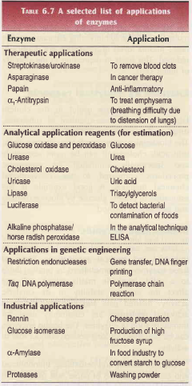

Slide 12
Many other recombinants
DNA-ase
liquefy mucopurulent secretions in bronchopulmonary disease
from bovine pancreas in 1956 (dornase)
now recombinant human for cystic fibrosis
Imiglucerase
analog of human β-glucocerebrosidase
Type I Gaucher disease
N-acetyl-galactosamine-4-sulfase
mucopolysaccharadosis
Alpha-L-iduronidase
mucopolysaccharadosis I
α-glucosidase
Pompe disease (rare)
Alpha-1-antitrypsin
alpha-1-antitrypsin deficiency (emphysema, liver)
enzyme mixture – coeliac disease (gluten)

