Slide 1
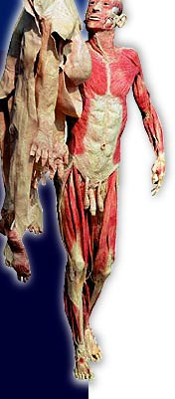
SKIN
By,
Prof. P. S. Bafna

Slide 2
General info about SKIN…………….
The skin is an organ of the Integumentary system.
Skin is an organ because it consists of different tissues that are joined to perform a specific function. Combination of 4 main tissues:
Epithelial
Connective
Smooth Muscle
Nervous
Largest organ of the body with a total area of about 20 square feet.
Body’s first line of defense!
The skin’s color is created by special cells called melanocytes, which produce the pigment melanin.

Slide 3
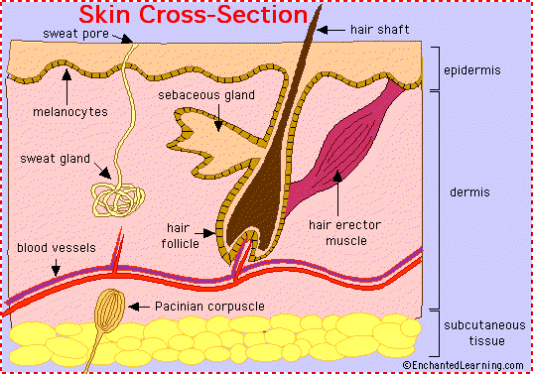
Anatomy of skin
Epidermis (thinner outer layer of skin)
Dermis (thicker connective tissue layer)
Hypodermis (subcutaneous layer or Sub-Q)

Slide 4
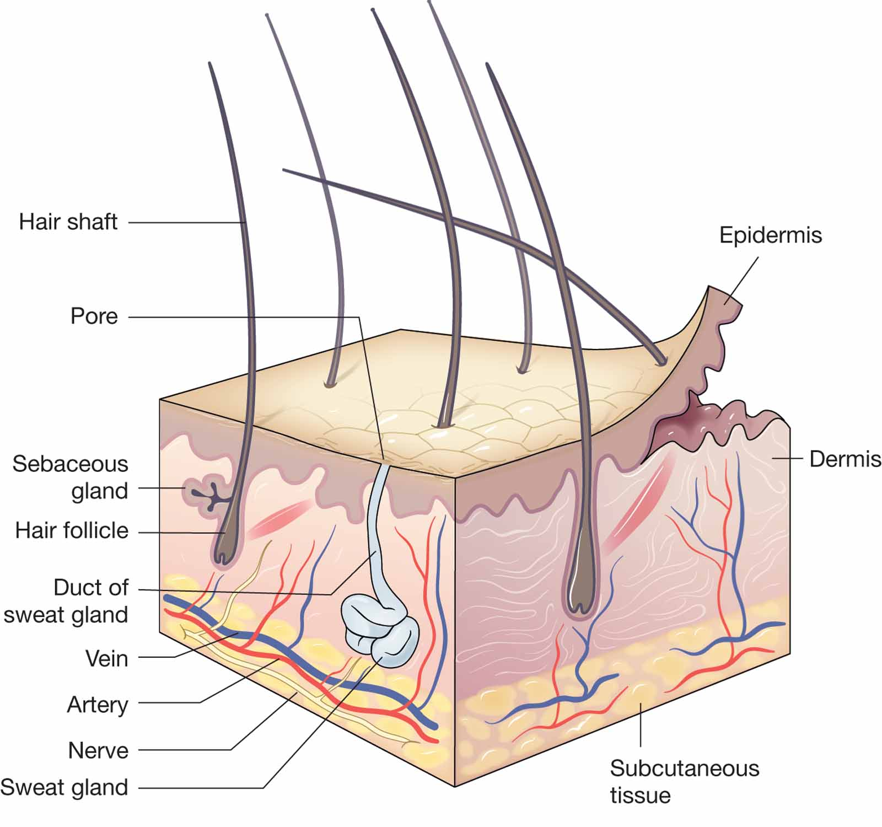

Slide 5
EPIDERMIS……….
Most superficial layer (Stratified keratinised Squamous epithelium).
Thickest on the palms and soles of feet.
Epidermis is non-vascular (no blood vessels).
Epidermis receives nourishment from dermis.
Cells far away from nourishment die.

Slide 6
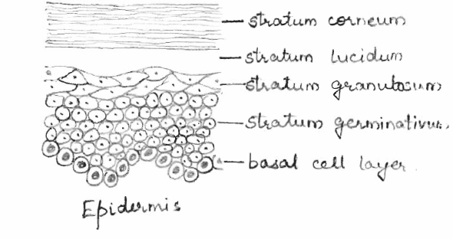
LAYERS OF EPIDERMIS…
Stratum corneum
Stratum lucidum
Stratum granulosum
Stratum spinosum
Stratum basal

Slide 7
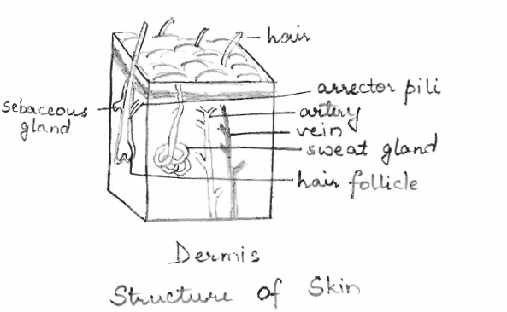

Slide 8
Dermis
Sensitive, highly vascular part.
Located just below the stratum basal.
Tough and elastic.
Consist of connective tissue, collagen fibres and elastic fibres.
Rupture of elastic fibres (during overstretching) results in permanant stretch mark.
Collagen fibres binds water (gives tensile strength).
This ability declines with age (wrinkles develope).
Fibroblast, macrophages and mast cells –main cells.
Structures– Blood vessels
Lymph vessels
Sensory nerve endings
Sweat glands
Hairs

Slide 9
FUNCTIONS OF SKIN
1. Protection-It forms the water proof layer & protects the inner delicate structures. Skin protects underlying tissues from invasion of microorganisms, chemicals, UV light and dehydration. The melanin pigment protects against the harmful UV rays.
2. Regulation of body temperature-Skin maintains body temperature by mechanism of evaporation of water from body according to environmental temperature.
3. Formation of vitamin D- 7-dehydrocholesterol is a lipid-based substance in the skin and ultraviolet light from the sun converts it to vitamin D.

Slide 10
4. Sensation-Sensory receptors in skin consist of nerve endings in the dermis that are sensitive to touch, pressure, temperature or pain. Stimulation generates nerve impulses in sensory nerves that are transmitted to the cerebral cortex.
5. Absorption- Some drugs & chemicals are absorbed through the skin.
6. Excretion- Skin is minor excretory organ for some substances includes sodium chloride, urea and aromatic substances like garlic and other spices.

Slide 11
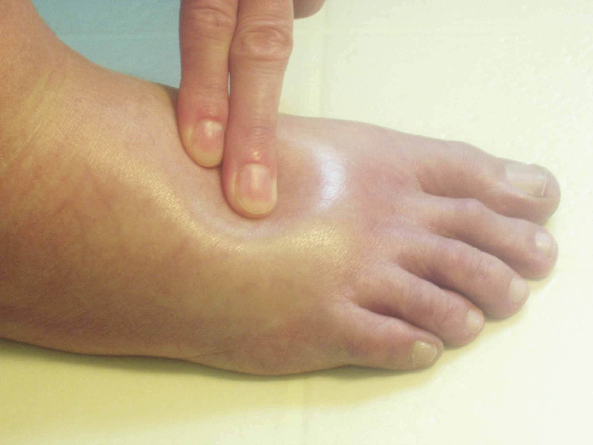
Diseases of skin
Edema
Notes:
11

Slide 12
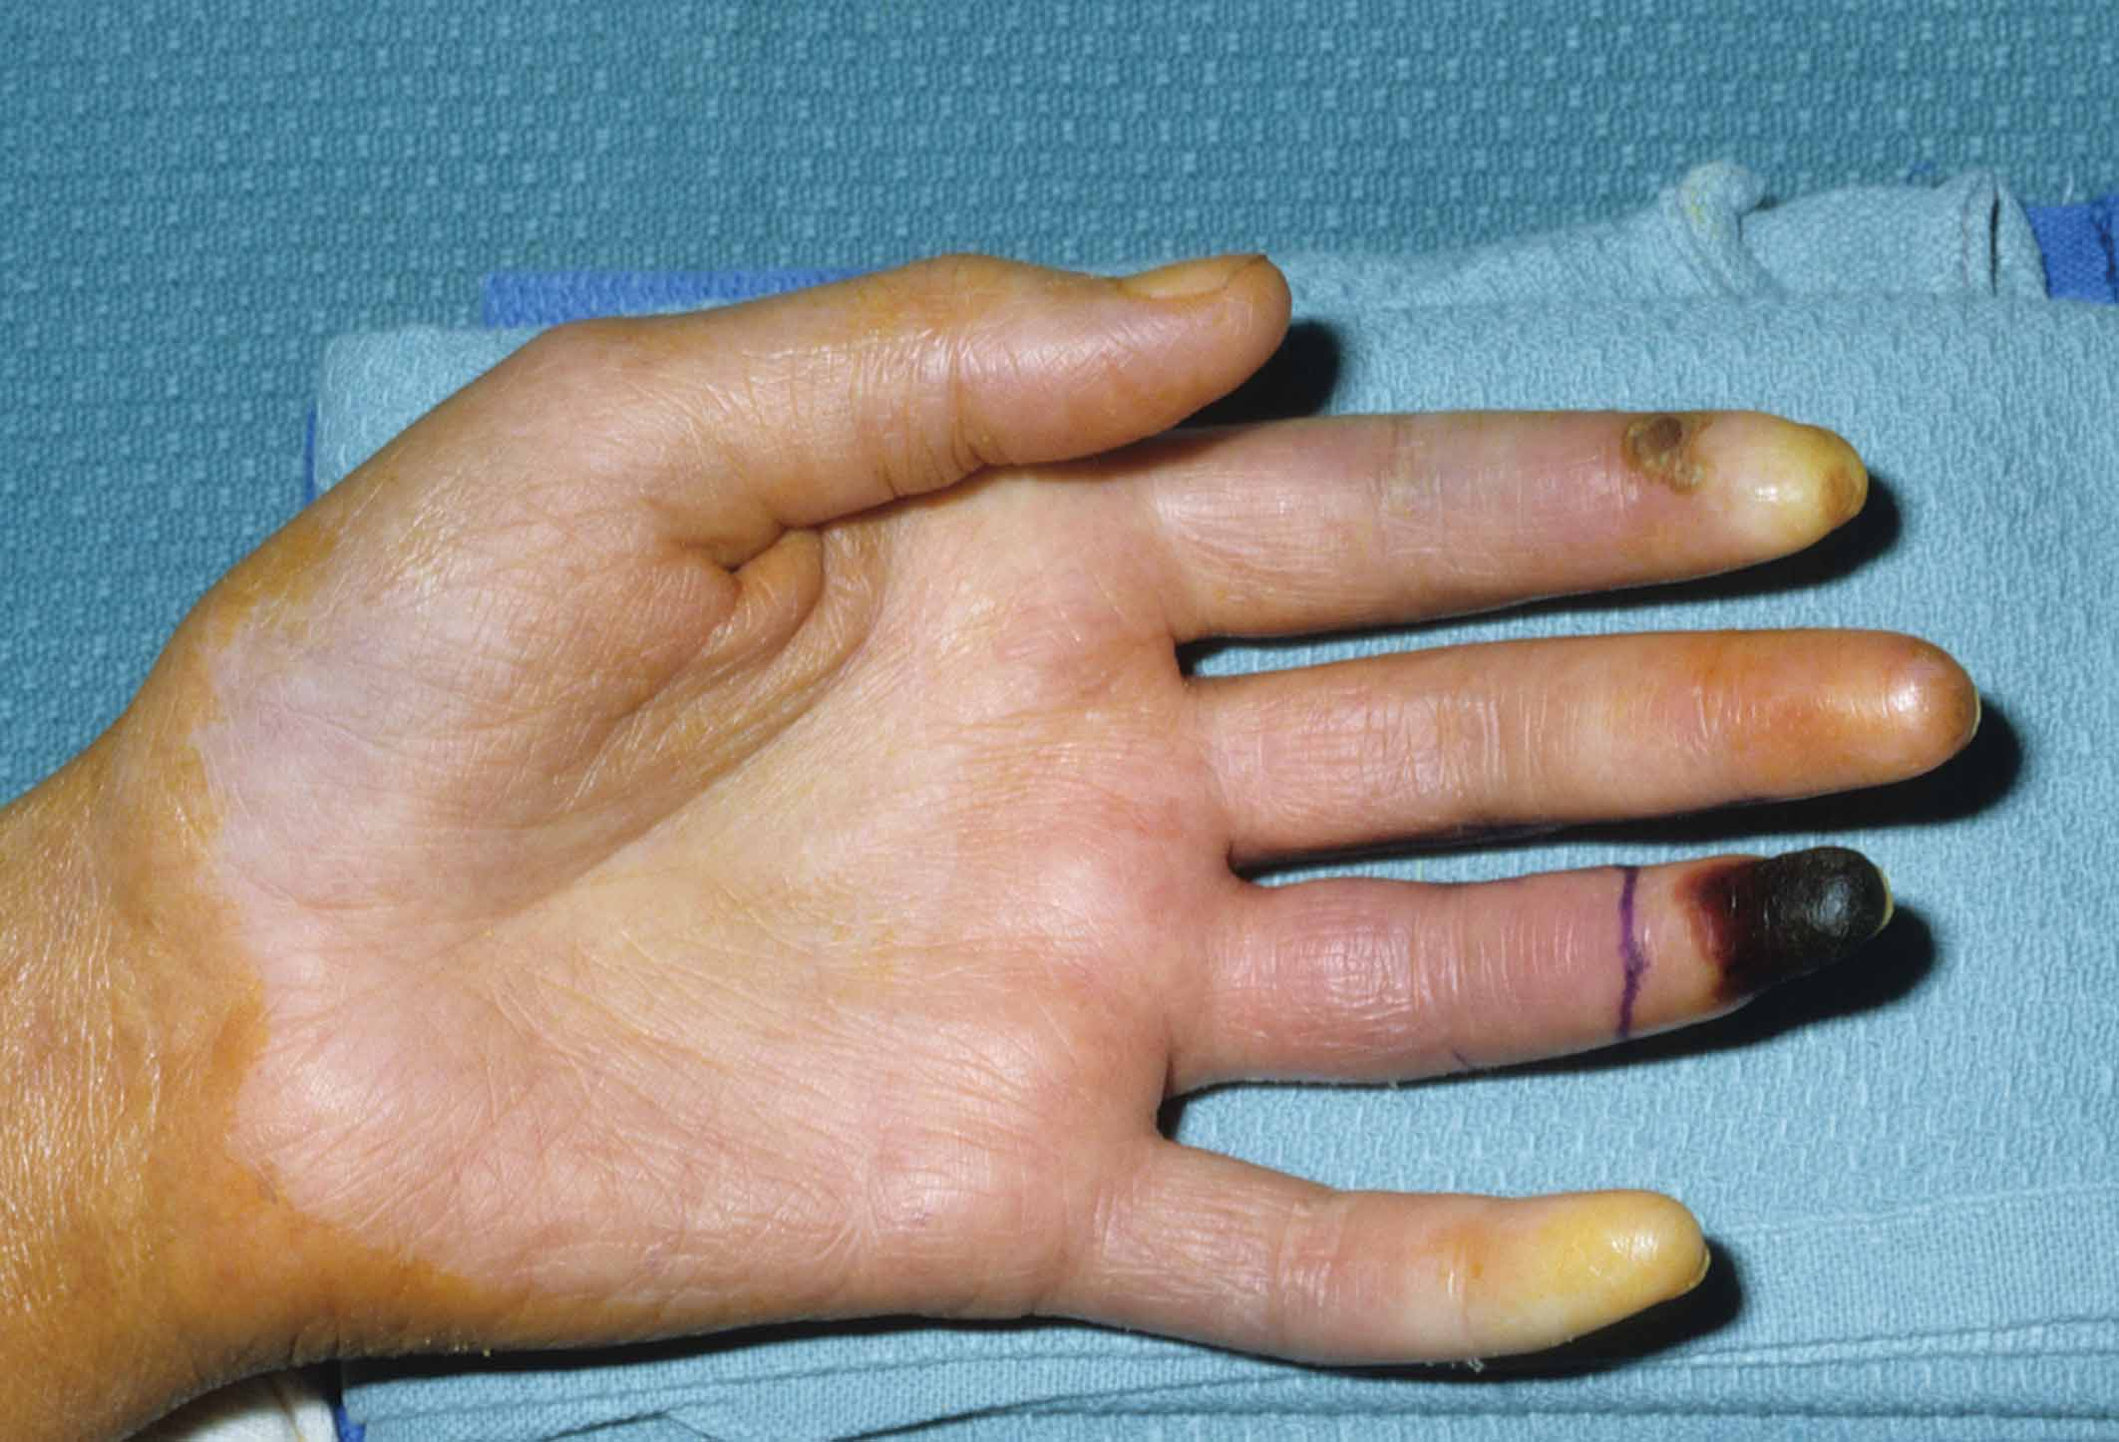
Necrosis and pallo
Notes:
12

Slide 13
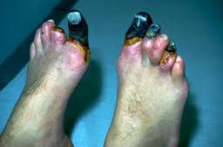

Slide 14
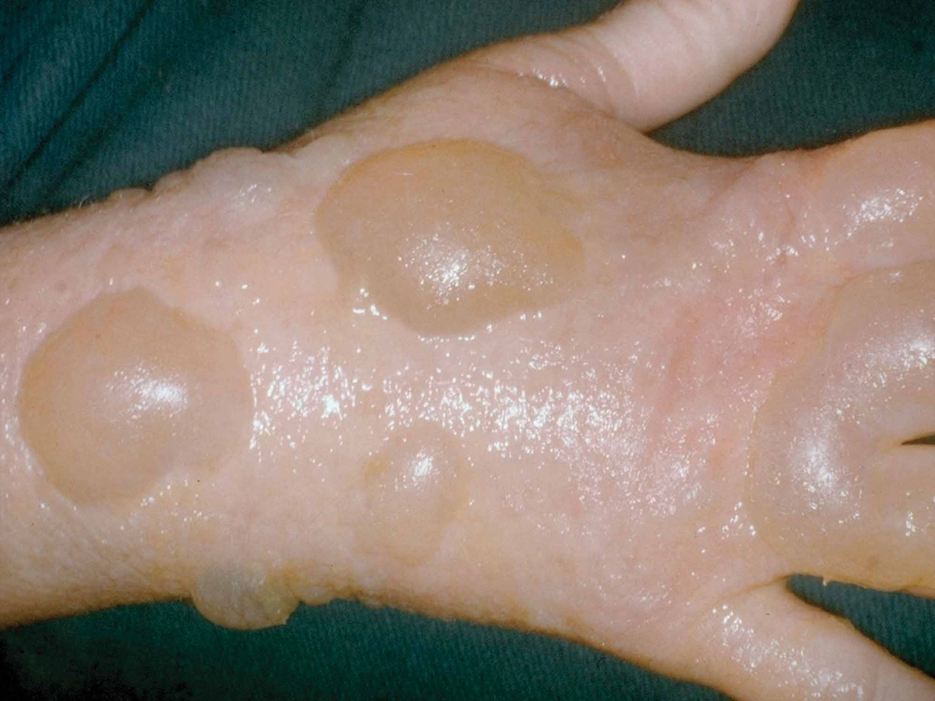
Second-degree burn of the hand
Notes:
14

Slide 15
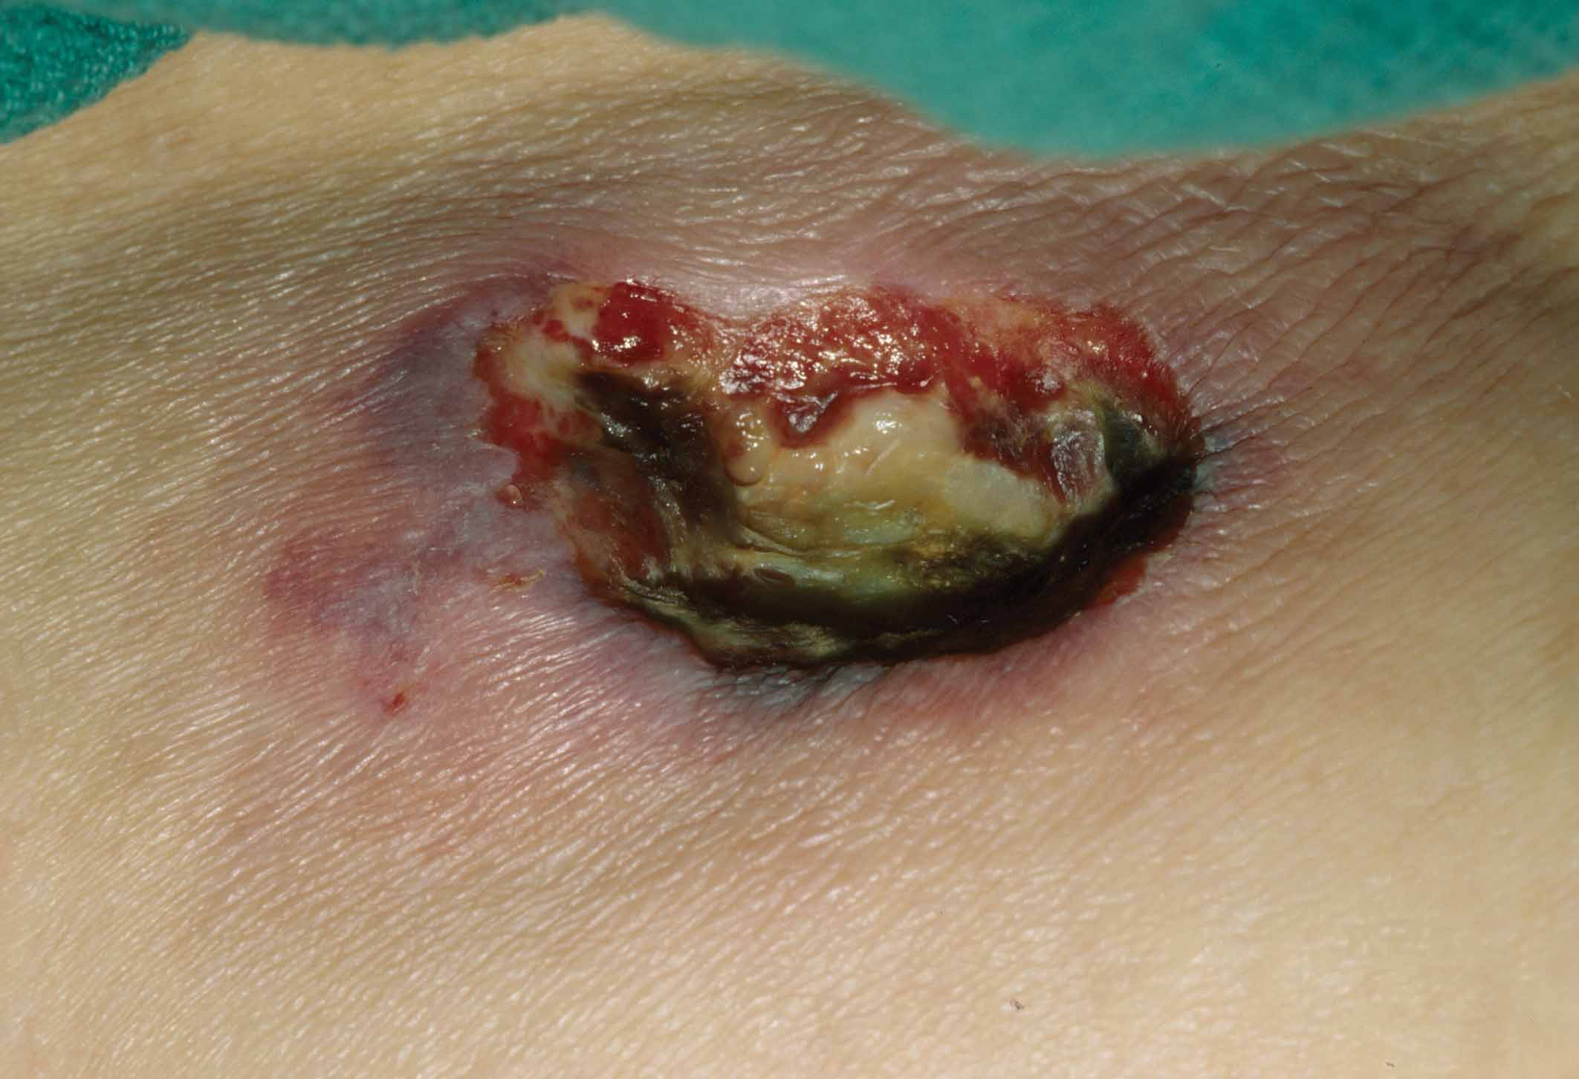
Decubitus ulcer
Notes:
15

Slide 16
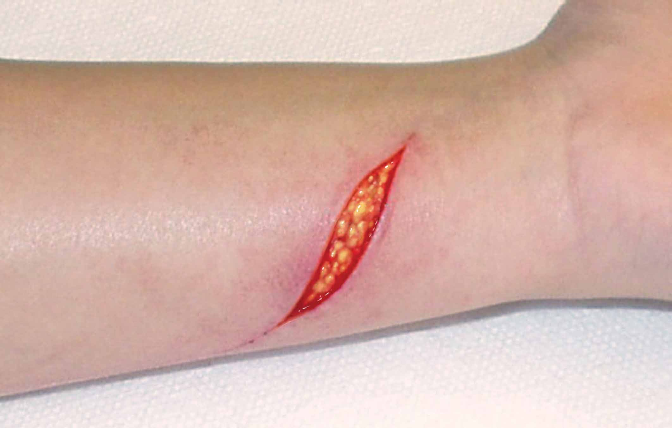
Laceration
Notes:
16

Slide 17
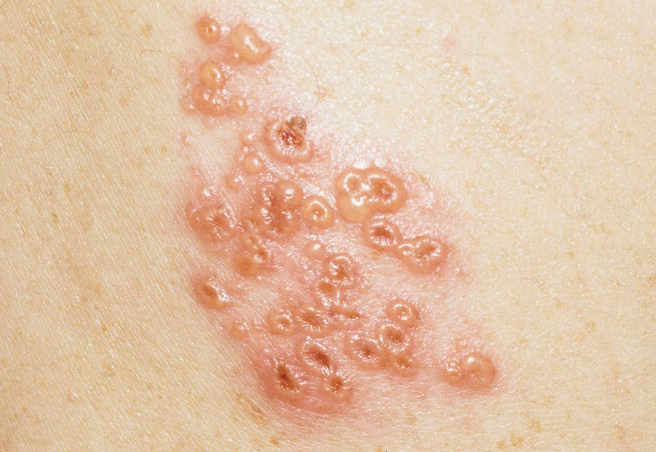
Shingles
Notes:
17

Slide 18
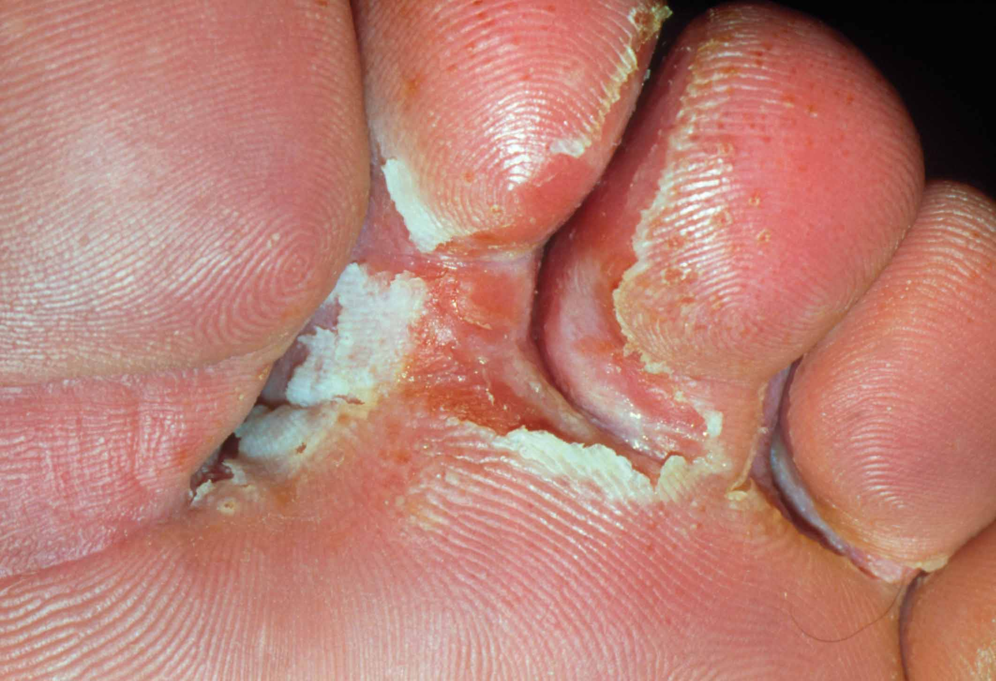
Tinea pedis
Notes:
18

Slide 19
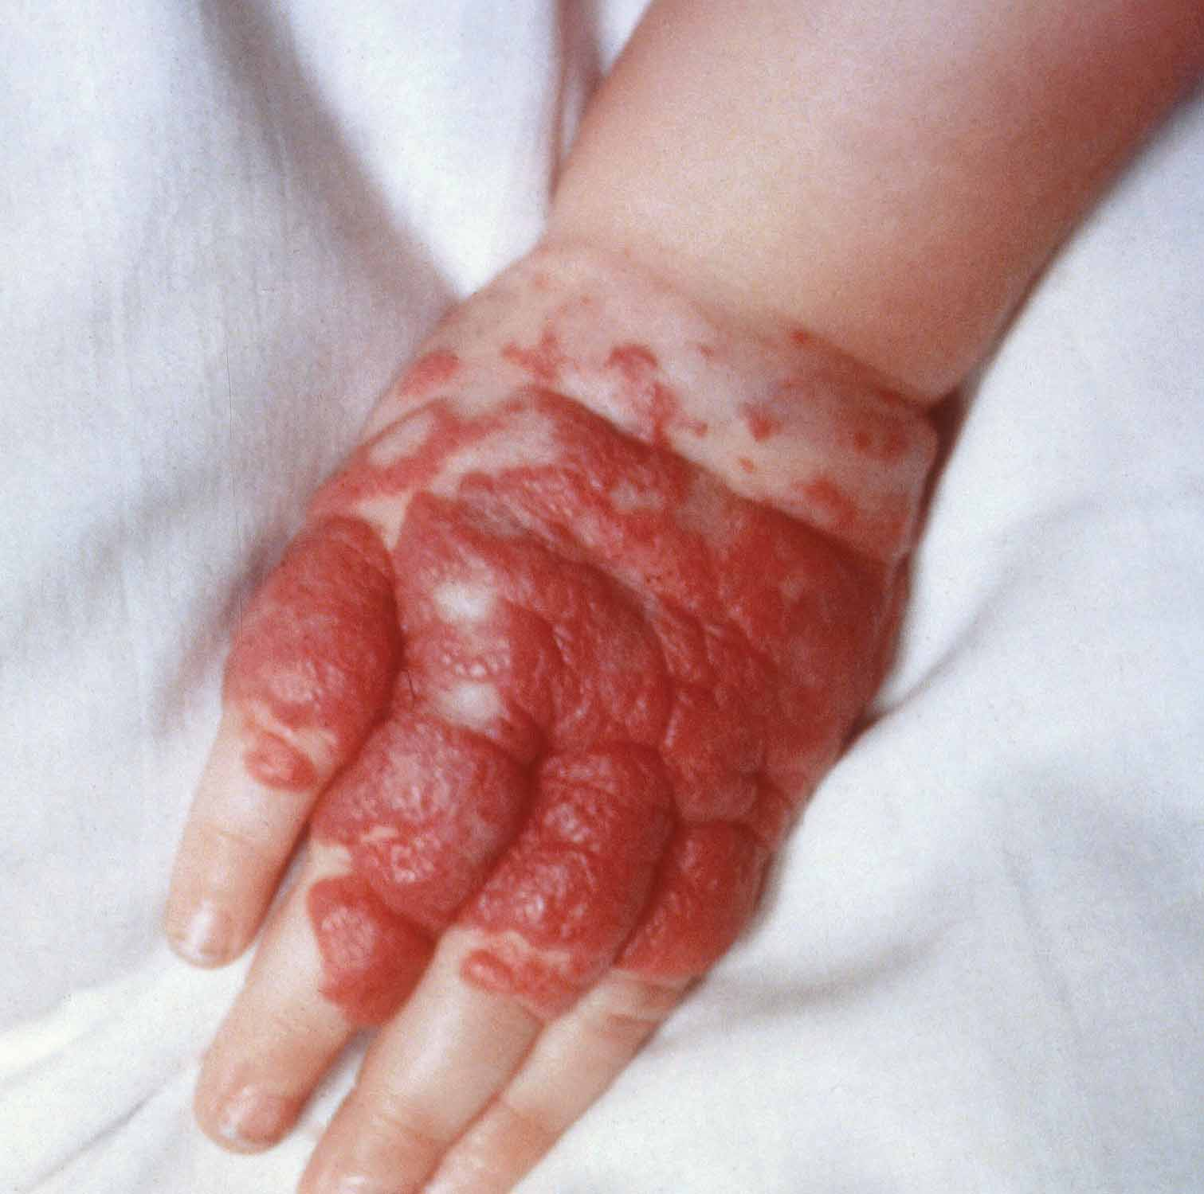
Hemangioma
Notes:
19

Slide 20
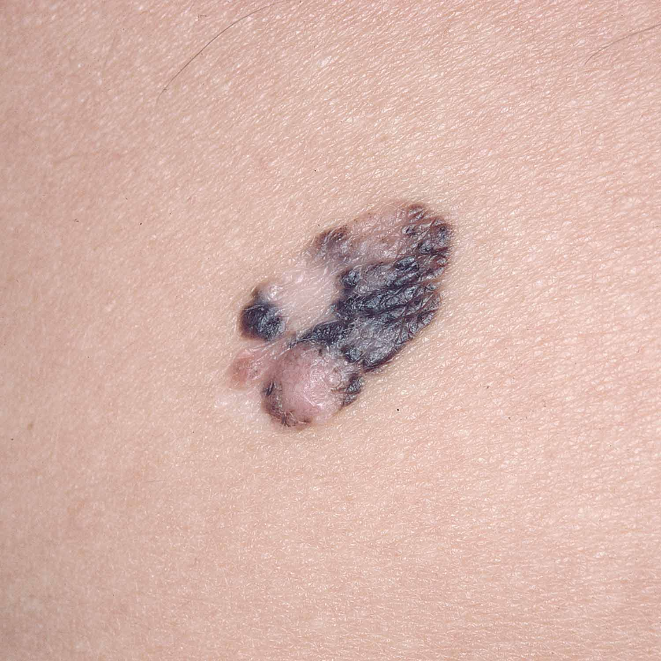
Malignant melanoma
Notes:
20

Slide 21
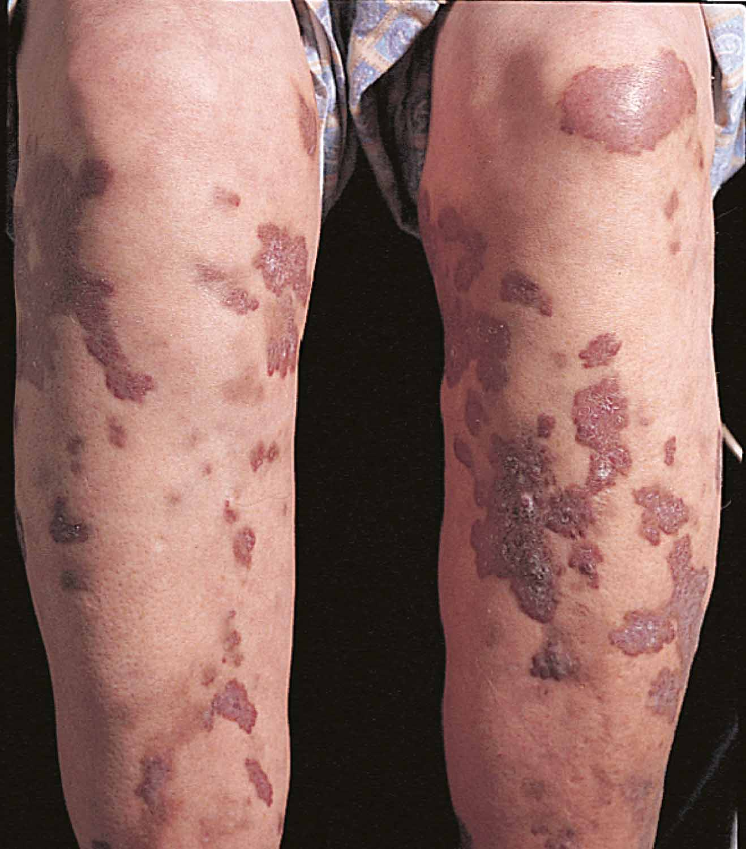
Figure 7-21 Kaposi’s sarcoma
Zeva Oelbaum/Peter Arnold, Inc.
Notes:
21
Renumber as Fig. 7-22, and insert new Fig. 7-23.

Slide 22
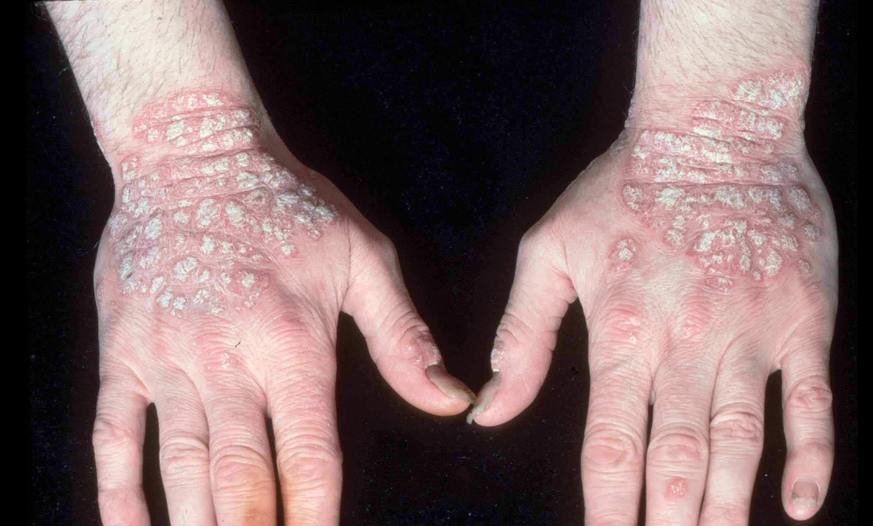
Figure 7-22 Psoriasis
NMSB/Custom Medical Stock Photo, Inc.
Notes:
22

