Slide 1
Computer Applications in Pharmacy
(BP 205T)
UNIT I – Number System
Discussion By- Mr. Premkumar S. Baviskar
Assistant Professor (Dept. of Pharmaceutics) HRPIPER Shirpur

Slide 2
Continuous Mode (A) | Theory Sessional (B) | Sub total C= (A+B) | End semester exam (D) | Theory Total E= (C+D) | Practical
10 | 15 | 25 | 50* | 75 | 25

Slide 3
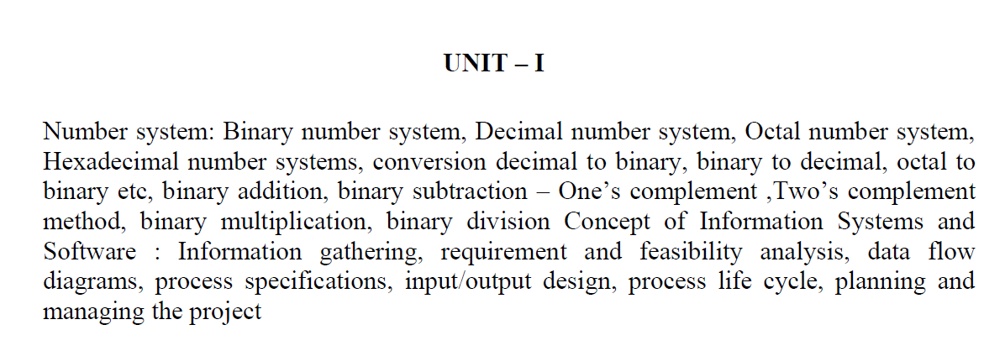

Slide 4
Number System

Slide 6
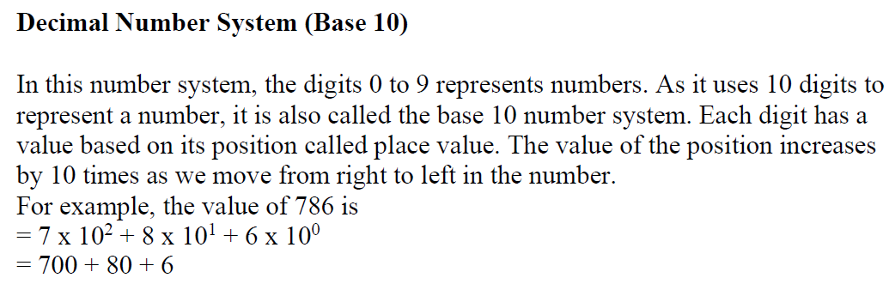

Slide 7
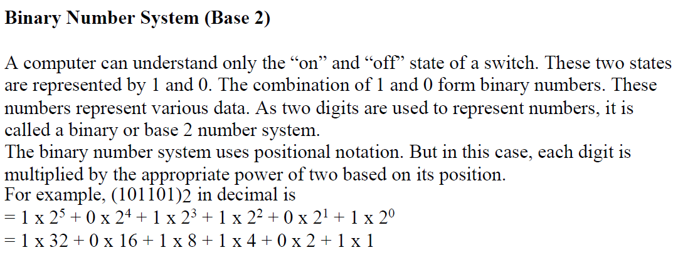

Slide 10
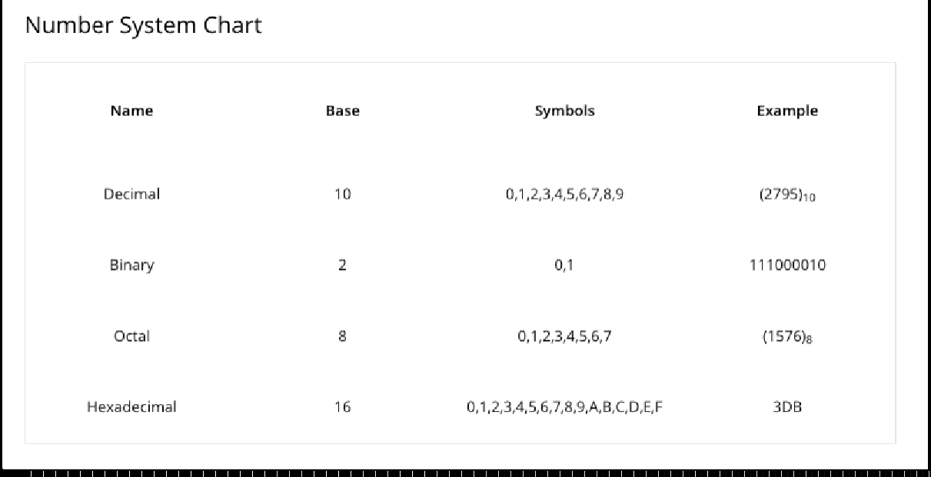

Slide 11
Binary to Decimal Conversion

Slide 12
Decimal to Binary Conversion

Slide 13
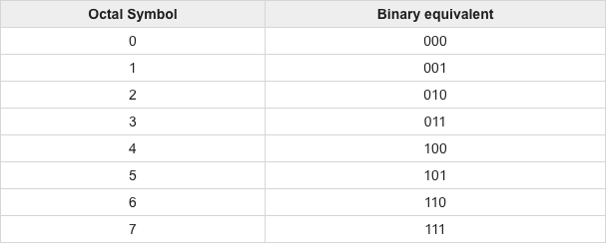
Octal to Binary

Slide 14
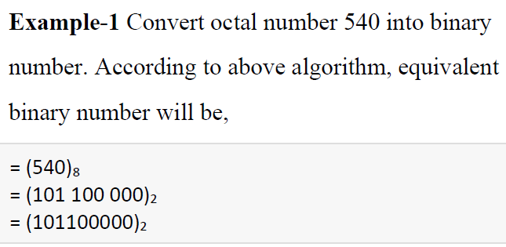

Slide 16
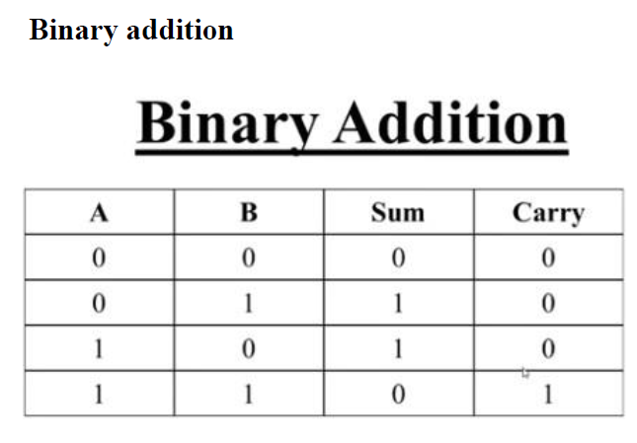

Slide 17
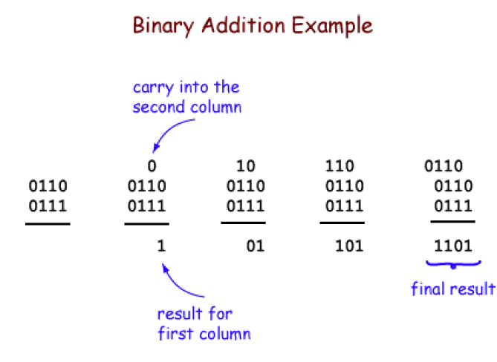

Slide 18
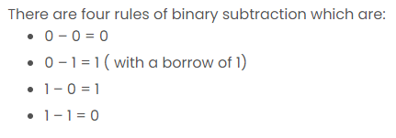

Slide 19
One’s Complement
If all bits in a byte are inverted by changing each 1 to 0 and each 0 to 1, we have formed the one’s complement of the number.

Slide 20
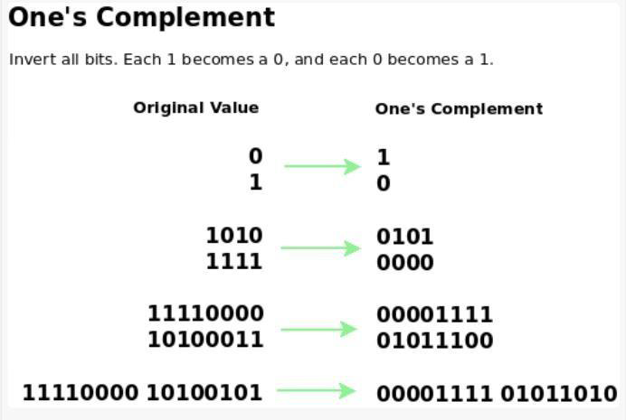

Slide 21
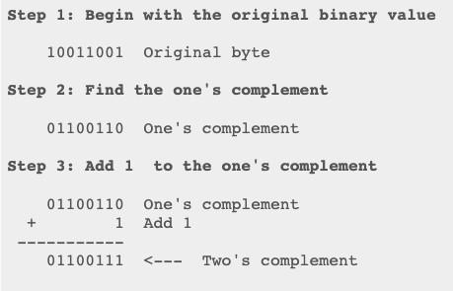
Two’s Complement (Binary Additive Inverse)

Slide 22
Information + System

Slide 23
What we will learn today?
Information System
Requirement and Feasibility Analysis
Data flow Diagrams

Slide 24
Can we define Information……..???

Slide 25
(Inform + ation) concept which helps to inform us or information can be defined as …. Knowledge or fact

Slide 26
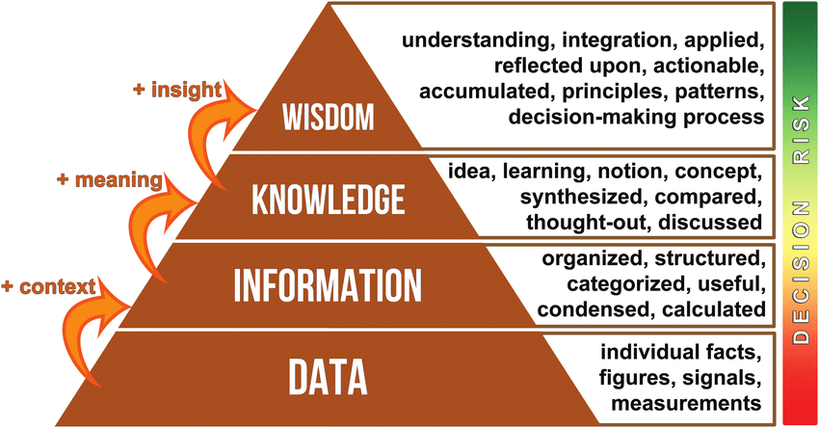
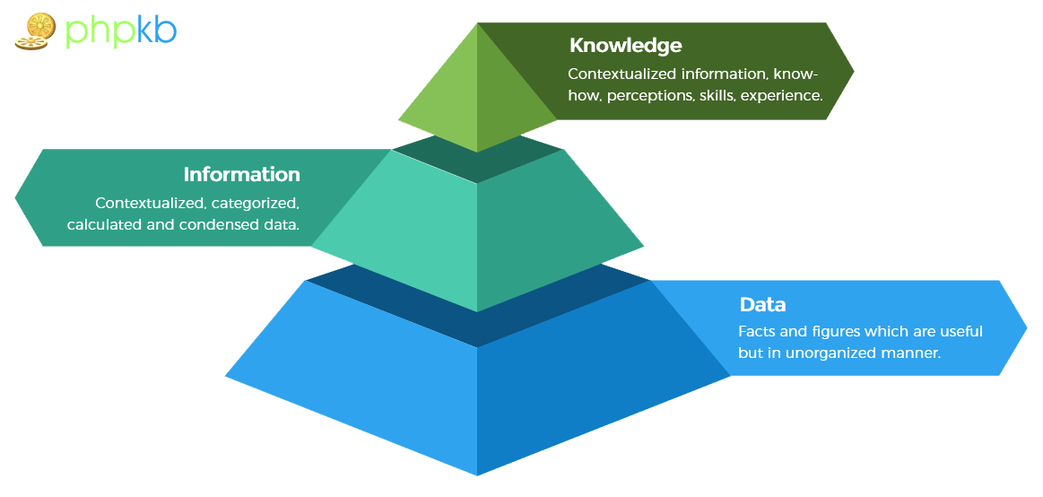

Slide 29
a set of ideas or rules for organizing something; a particular way of doing something.

Slide 30
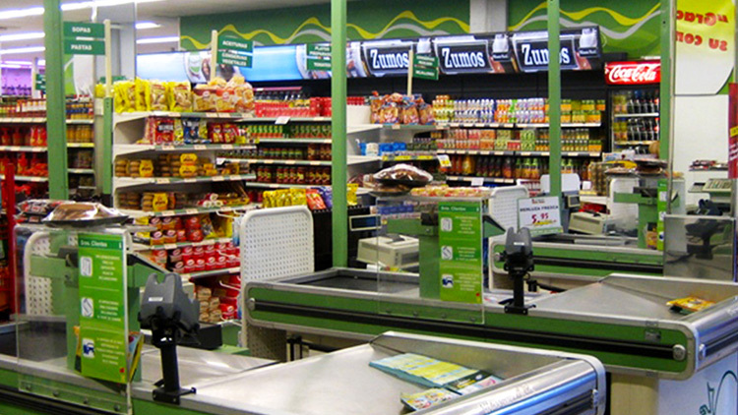
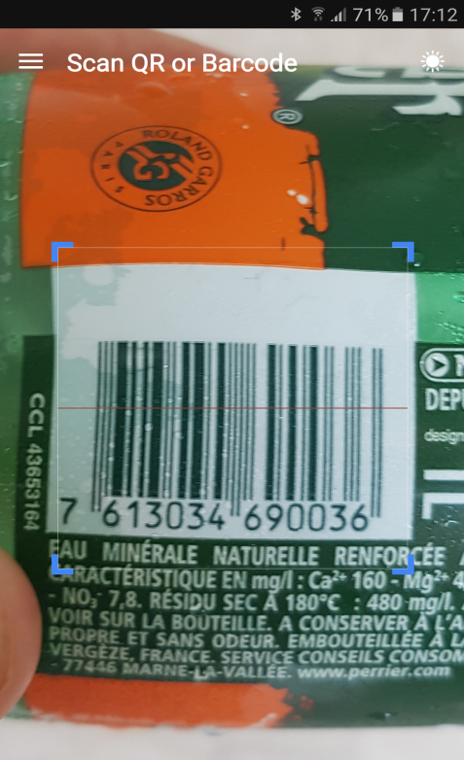

Slide 32
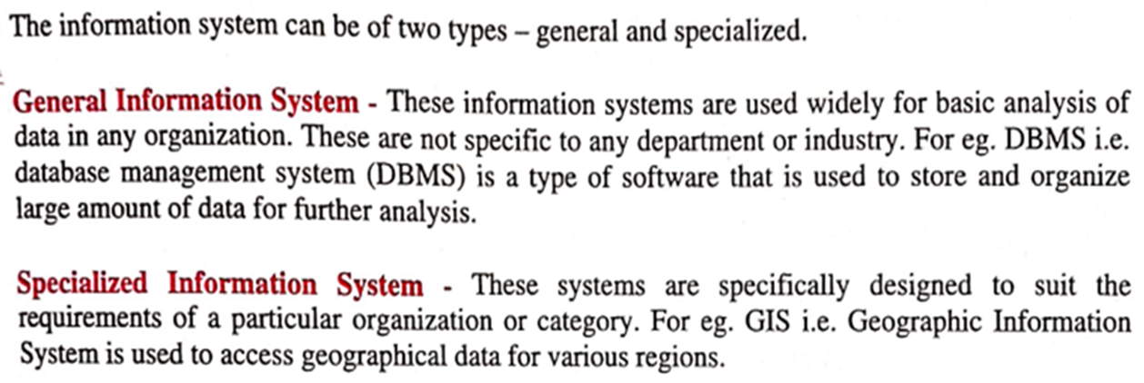

Slide 34
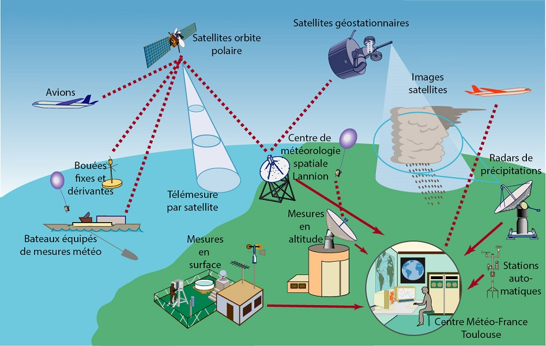

Slide 37
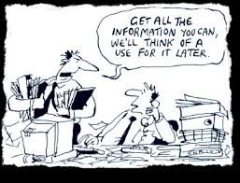

Slide 38
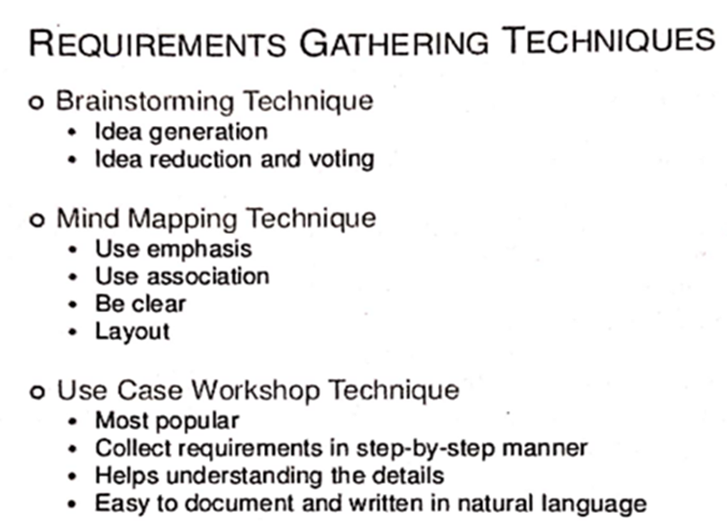

Slide 40
Requirement and Feasibility Analysis
What and How Analysis

Slide 41
Feasibility = Viability, Applicability, Possibility

Slide 42
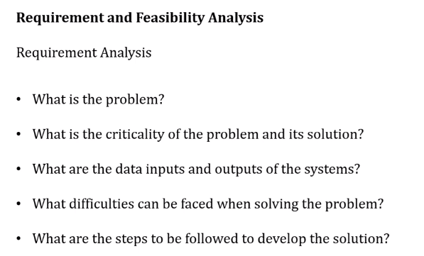

Slide 43
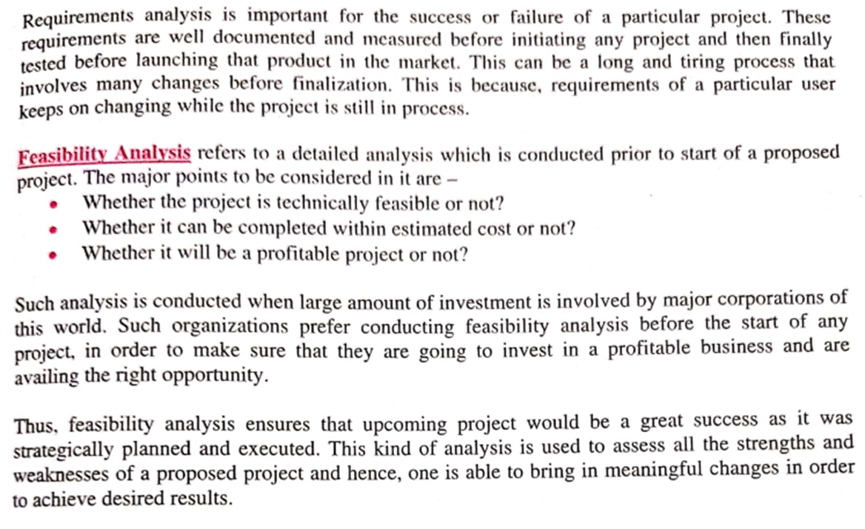

Slide 44
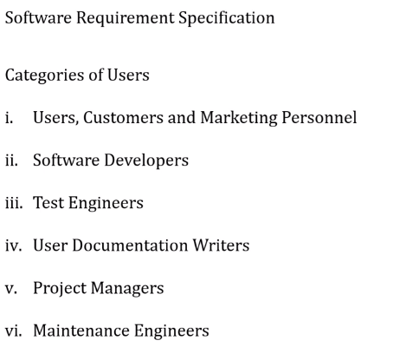

Slide 47
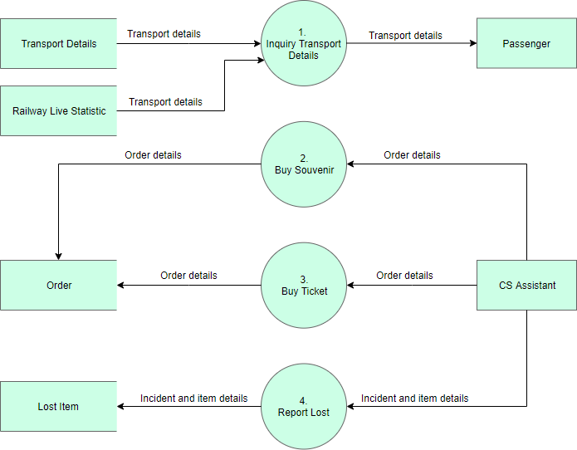
Yourdon and Coad Symbols

Slide 48
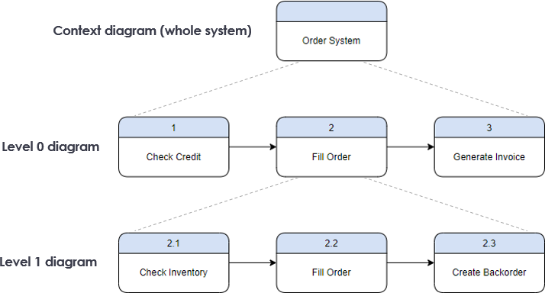
Gane and Sarson Symbols

Slide 50
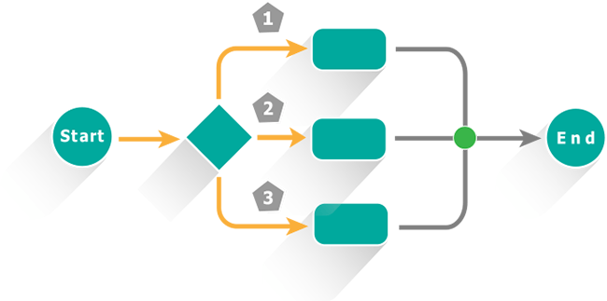
Process Specifications
Specifications?
specifications of laptop
specifications of Phone
specifications of Reactions

Slide 51
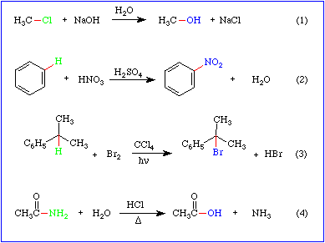

Slide 52
Process Specification refers to specifying a particular process.
Describes how to use input data in order to transform it into required output.
Specifies that what should be done to utilize the available information as input and generate an output.
Simply,
Process specification refers to method of documenting, analysing and explaining the process used to create an output in information system.

Slide 55
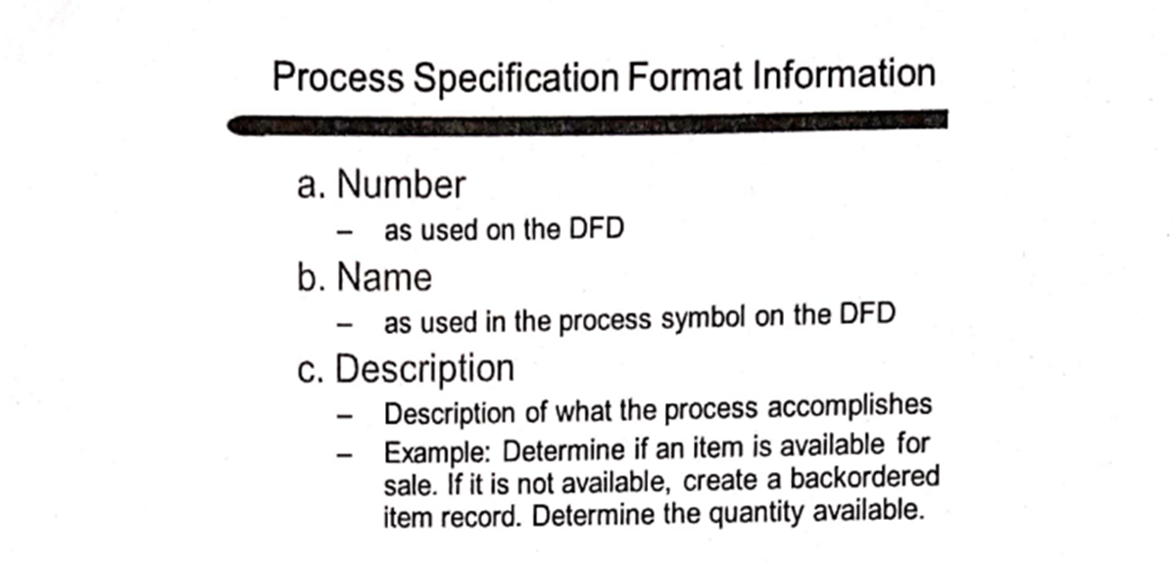

Slide 57
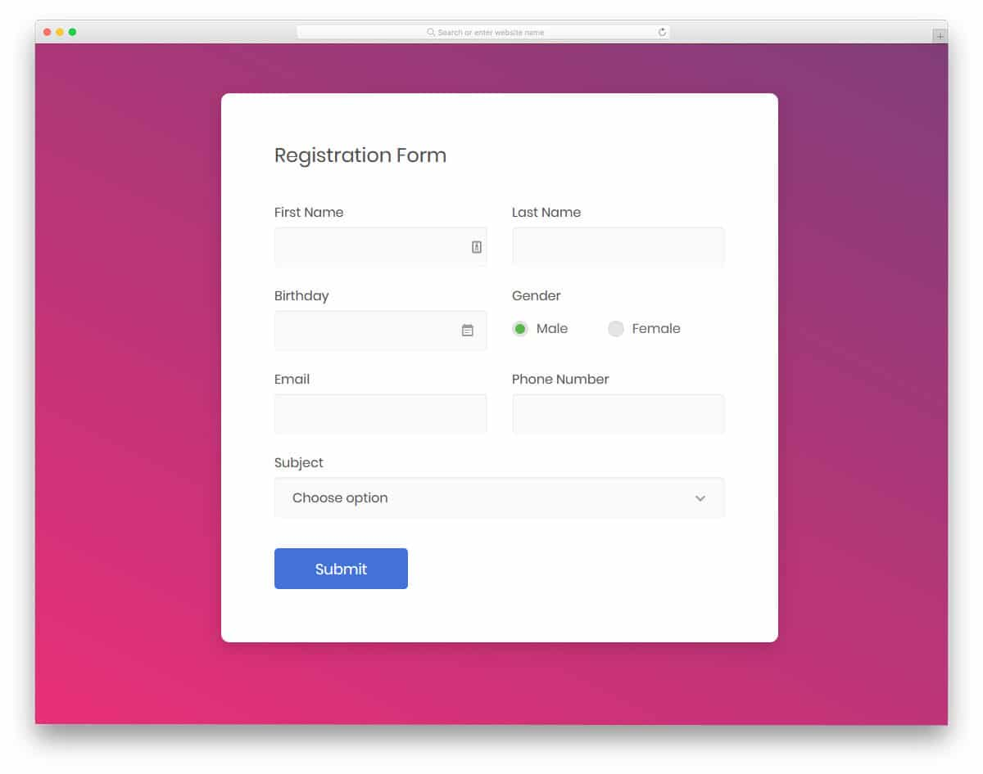

Slide 58
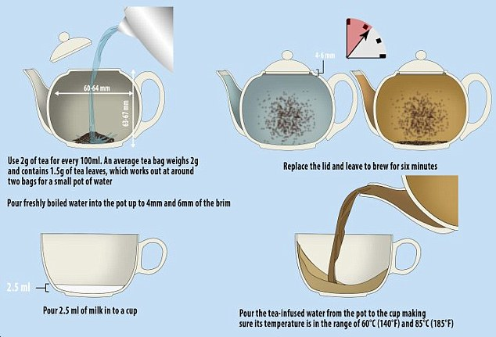

Slide 62
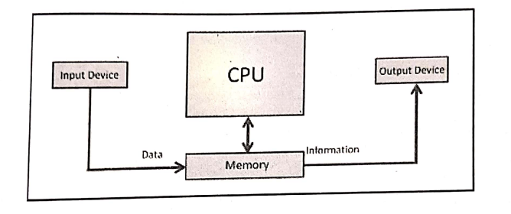
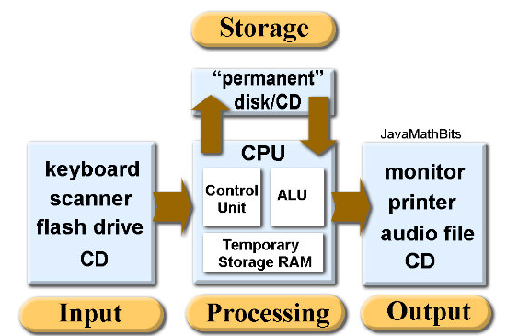

Slide 63
Process Life cycle
Process lifecycle,
It is method of understanding initial, intermediate and final stages of growth and development in any process.
It helps us how a particular process fits into our system.

Slide 64
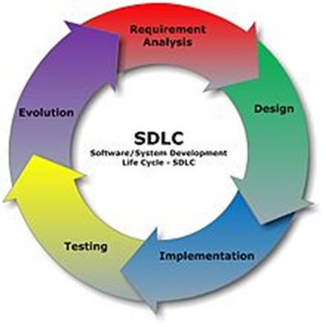

Slide 66
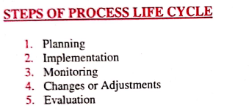

Slide 68
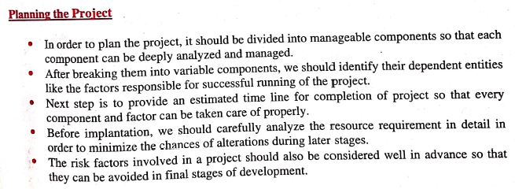
Planning and managing the project

Slide 71
Thank You

