Slide 1
PHARMACEUTICAL AEROSOLs
Prof. G. B. Patil
HRPIPER, Shirpur

Slide 2
Definition
Packaging of therapeutic active ingredients in a pressurized system.
Aerosols are depends on the power of compressed or liquefied gas to expel the contents from containers.

Slide 3
Advantages
A dose can be removed with out contamination of materials.
The medication can be delivered directly to the affected area in a desired form, such as spray, steam, quick breaking foam or stable foam.
Irritation produced by the mechanical application of topical medication is reduced or eliminated.
Ease of convenience of application.
Application of medication in thin layer

Slide 4
Components of aerosols
Propellant
Container
Valve & actuator
Product concentrate

Slide 5
Propellant
It is responsible for developing the power pressure with in the container and also expel the product when the valve is opened and in the atomization or foam production of the product.
For oral and inhalation eg.
Fluorinated hydrocarbons
Dichlorodifluromethane (propellant 12)
Dichlorotetrafluromethane (propellant 114)
Topical preparation
Propane
Butane
Isobutane
Compound gases
Nitrogen
Carbon di oxide
Nitrous oxide

Slide 6
Containers
They must be stand at pressure as high as 140 to 180 psig (pounds per sq. inch gauge) at 1300 F.
A. Metals
1. Tinplated steel
(a) Side-seam (three pieces)
(b) Two-piece or drawn
(c) Tin free steel
2. Aluminium
(a) Two-piece
(b) One-piece (extruded or drawn)
3. Stainless steel
B. Glass
1. Uncoated glass
2. Plastic coated glass

Slide 7
Physiochemical properties of propellants
Vapor pressure
Boiling points
Liquid density

Slide 8
Valves
To delivered the drug in desired form.
To give proper amount of medication.
Not differ from valve to valve of medication in pharmaceutical preparation.
Types
- Continuous spray valve
- High speed production technique.
- Metering valves
Dispersing of potent medication at proper dispersion/ spray approximately 50 to 150 mg ±10 % of liquid materials at one time use of same valve.

Slide 9
Valve components
Ferrule or mount cap
Valve body or housing
Stem
Gasket
Spring
Dip tube

Slide 10
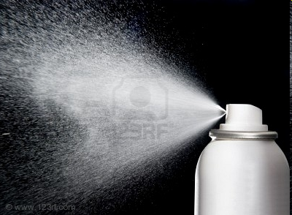
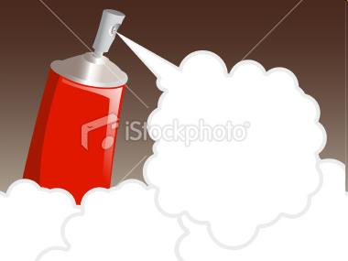
Actuator
To ensure that aerosol product is delivered in the proper and desired form.
Different types of actuators
Spray actuators
Foam actuators
Solid steam actuators
Special actuators

Slide 11
Formulation of pharmaceutical aerosols
Contains two essential components
Product concentrate
Propellant
Product concentrate
Product concentrate contains ingredients or mixture of active ingredients and other such as solvents, antioxidants and surfactants.
Propellant
May be single or blend of various propellants
Blends of propellant used in a p’ceutical formulation to achieve desired solubility characteristics or various surfactants are mixed to give the proper HLB value for emulsion system.
To give the desired vapor pressure, solubility & particle size.

Slide 12
Parameters consideration
Physical, chemical and p’ceutical properties of active ingredients.
Site of application

Slide 13
Types of system
Solution system
Water based system
Suspension or Dispersion systems
Foam systems
1. Aqueous stable foams
2. Nonaqueous stable foams
3. Quick-breaking foams
4. Thermal foams
Intranasal aerosols

Slide 14
Manufacturing of Pharmaceutical Aerosols
Apparatus
Pressure filling apparatus
Cold filling apparatus
Compressed gas filling apparatus

Slide 15
Quality control for pharmaceutical aerosols
Propellants
Valves, actuator and dip tubes
Testing procedure
Valve acceptance
Containers
Weight checking
Leak testing
Spray testing

Slide 16
Evaluation parameters of pharmaceutical aerosols
A. Flammability and combustibility
Flash point
Flame extension, including flashback
B. Physiochemical characteristics
Density
Moisture content
Identification of propellant(s)
Concentrate-propellant ratio
Vapor pressure
C. Performance
Spray pattern
Aerosol valve discharge rate
Dosage with metered valves
Net contents
Foam stability
Particle size determination
Leakage
D. Biologic characteristics
E. Therapeutic activity

Slide 17
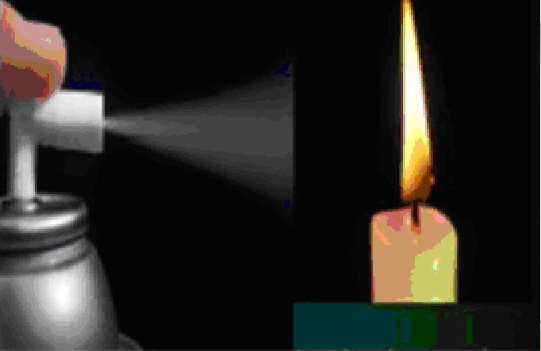
Flame Projection
This test indicates the
effect of an aerosol
formulation on the
extension of an open
flame.
Product is sprayed for 4 sec. into flame.
Depending on the nature of formulation, the fame is extended, and exact length was measured with ruler.

Slide 18
Flash point
Determined by using standard Tag Open Cap
Apparatus.
Step involves are →
Aerosol product is chilled to temperature of - 25 ⁰ F and transferred to the test apparatus.
Temperature of test liquid increased slowly, and the temperature at which the vapors ignite is taken a flash point.
Calculated for flammable component, which in case of topical hydrocarbons.

Slide 19
Vapor pressure
Determined by pressure gauge
Variation in pressure indicates the presence of air in headspace.
A can punctuating device is available for accurately measuring vapor pressure.

Slide 20
Density
Determined by hydrometer or a pycnometer.
Step involves are →
A pressure tube is fitted with metal fingers and hoke valve, which allow for the introduction of liquids under pressure.
The hydrometer is placed in to the glass pressure tube.
Sufficient sample is introduced through the valve to cause the hydrometer to rise half way up the length of the tube.
The density can be read directly.

Slide 21
Moisture content
Method used -- Karl Fischer method
G. C has also been used
Identification of propellants
G.C,
I.R Spectrophotometry
Aerosol valve discharge rate
Determined by taking an aerosol known weight and discharging the contents for given time using standard apparatus.
By reweighing the container after time limit has expired, the change in weight per time dispensed is discharge rate,
Expressed as gram per seconds.

Slide 22
Dosage with metered valves
Amt. of medication actually received by the patient.
Reproducibility has been determined by assay technique,
Another method is that, involves accurate weighing of filled container fallowed by dispersing of several doses, container can reweighed, and difference in weight divided by No. of dose, gives the average dosage.
Reproducibility of dosage each time the valve is dispersed

Slide 23
Net contents
Weight method
Filled full container, and dispensing the contents
Foam stability
Visual evaluation
Time for a given mass to penetrate the foam
Times for given rod that is inserted into the
foam to fall
The use of rotational viscometers

Slide 24
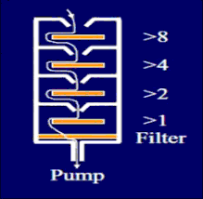
Cascade impactor
Particle size determination
Cascade impactor
Light scatter decay method
Cascade impactor
Operates on the projected through a series of nozzle and glass slides at high viscosity, the large particles become impacted first on the lower velocity stages, and the smaller particles pass on and are collected at high velocity stages.
These particles ranging from 0.1 to 30 micron and retaining on RTI.
Modification made to improve efficacy

Slide 25
Light Scattering method
Porush, Thiel and Young used light scattering method to determine particle size.
As aerosols settle in turbulent condition , the change in light intensity of Tyndall beam is measured
Sciarra and Cutie developed method based on practical size distribution.

Slide 26
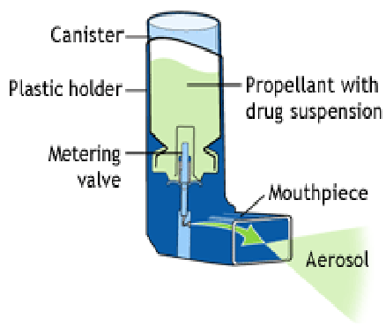
Metered dose inhaler
To increased interest in
modifying metered dose
inhalers (MDIs) to
minimize the number of
Administration error
and to improve the
drug delivery of aerosols
particles into the drug
delivery system of the
nasal passageways and
respiratory tract.

Slide 27
Dry Powder Inhalers (DPIs)
Drug is inhaled as a cloud of fine particles. The drug is either preloaded in an inhalation device or filled into hard gelatin capsule or foil blister discs which are loaded in to a device prior to use.
Dry powder inhalers are devices through which dry powder formulation of an active drug is delivered for local or systemic action via pulmonary route.
They are bolus drug delivery systems that contain solid drug substance that is suspended or dissolved in a non-polar propellant that is fluidized when the patient inhales.

Slide 28
Ideal DPI
Effective dosing
Uniform dose
Targeted delivery
Operable at low inhalation flow rates
Efficient device
Easy to use

Slide 29
FORMULATION
DPI formulations are generally engineered composites, containing a drug material of micron size formulated with or without a large carrier material.
The formulation is formulated around a device that when actuated by patient is capable of producing a respirable aerosol cloud that penetrates the respiratory tract and reaches the site of action.

Slide 30
STEPS INVOLVED IN FORMULATION
Active Pharmaceutical Ingredient (API) production.
Formulation of API with or without carriers.
Integration of the formulation into device.

Slide 31
DPI Design Issues
Inhaler design, especially the geometry of the mouth piece, is critical for patients to produce an air flow sufficient to lift the drug from the dose chamber, break up the agglomerates in the turbulent air stream and deliver the drug dose to the lungs as therapeutically effective fine particles.

Slide 33
Principle of operation
When the patient actuates the DPI and inhales, airflow though the device creates shear and turbulence; air is introduced in to the powder bed and the static powder blend is fluidized and enters the patient airways. There the drug particles separate from the carrier particles and are carried deep into the lungs to exert the effects.

Slide 34
Evaluation
Appearance
Identity
Microbial limits
Water content
Extractives
Drug related impurities
Particle analysis
Drug content per unit dose/dose delivery

Slide 35
Advantages
Propellant free design
Less need for patient coordination
Less potential for formulation problems
Environmental sustainability
Less potential for extractable from device components

Slide 36
Disadvantages
Dependency on patient inspiration flow rate and profile
Device resistance and other device issues
More expensive than pressurized MDI
Complex development and manufacture
Not available world wide
Greater potential problems in dose uniformity

Slide 37
THANK YOU
Prof. Ganesh B. Patil
gbp84@rediffmail.com

