Slide 1
Balanced Diet and
Nutrients

Slide 2
What is balanced diet???
A balanced diet means getting the right types and amounts of foods and drinks to supply nutrition and energy for maintaining body cells, tissues, and organs, and for supporting normal growth and development.

Slide 3
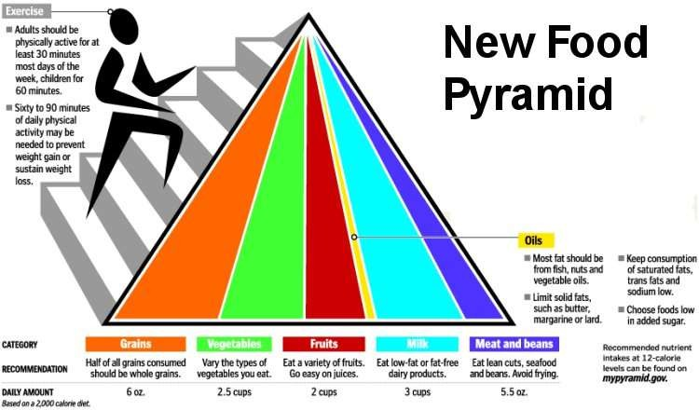
Food pyramid

Slide 4
NUTRIENTS
2 types of nutirents-
1. Major- protein,carbohydrate,fats
2. Micro- minerals- calcium,magnesium,phosphorus,zinc,selenium
Vitamins- a,d,e,k,c,b group
Water

Slide 5
PROTEINS
1. Helps in tissue and muscle building
2. Boost up immunity
3. Helps to maintain fluid balance
4. Healing
Deficiency- muscle wasting, weight gain, poor
immunity and low hb.
Sources- milk and milk products, soya bean,beans,dals,egg,chicken,fish.

Slide 6
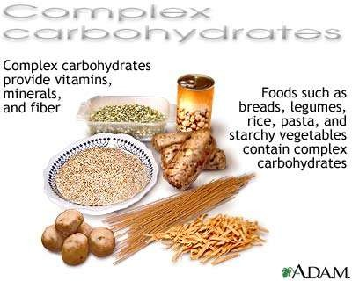
CARBOHYDRATES
1. Energy giving compound necessary for daily activity
2. Necessary for proper working of brain,heart,nervous
tissue.
2 types of carbohydrate
A. Simple- refined flour, glucose
B complex- fibers
Role of fiber: helps in weight reduction, proper bowel movement and healthy intestine
Sources: wheat,oats,brans,vegetables,whole cereals and pulses, fruits.

Slide 7
What happens if it is in excess or low??
Excess- weight gain,diabetes mellitus, insulin resistance, CAD
Deficiency- constipation,low mental performance,ketoacidosis.

Slide 8
FATS
The main function is to give energy
Important for transport of vitamins a,d,e,k
Covers organs acts as insulators to our vital organs like heart,kidney,liver.
Types of fats: saturated and unsaturated.
Saturated- solid at room temperature ghee,butter,coconut oil..
Unsaturated-liquid at room temperature, omega 3 fatty acid omega 6 fatty acid… good for our health
Sources: olive oil,rice bran oil, soyabean oil,groundnut oil,mustard oil
Good source of omega 3 fatty acid- almonds,fish,walnuts.
Deficency- vitamin deficiency,dry skin,nervous disorders
Excess- weight gain,elevated blood lipid levels,CAD

Slide 9
Rda for major nurtrients
Carbohyrates- 65% of total diet
Proteins- 0.8gm/kg of body weight
Fats – 0.5-1 gm /kg

Slide 10
What if our daily diet lack all these nutrients???
It leads to a condition called Protein energy malnutrition simply called as malnutrition.
Cases of cancers has increased two fold. Reason??? Lack of fiber in diet
So what's the remedy????
Inclusion of Protein supplements in our diet. Inclusion of high fiber supplements and food in diet.

Slide 11
Trace Minerals:
Macro Minerals
Potassium Calcium Phosphorous Iodine Sodium
Copper Iron
Fluorine /Fluoride Zinc

Slide 21
VITAMINS
Are complex organic substances
Normal growth, maintenance, Your body cannot produce all vitamins you can get those by eating a nutritious diet.
Fat-soluble vitamins: carried in fatty parts of foods and dissolve in fats (body stores them in fat.)
Water-soluble vitamins: dissolve in water (body does not store them)

Slide 22
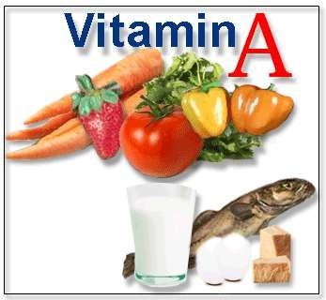
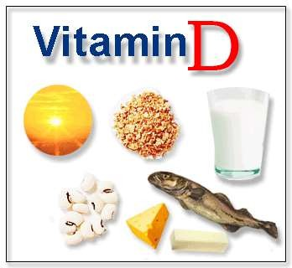
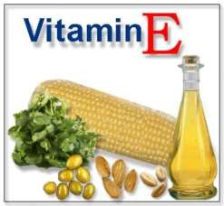
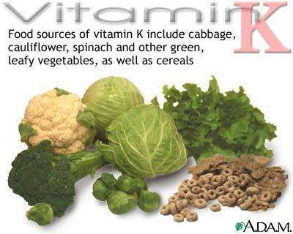
Fat soluble vitamins
This group of vitamins need fat for their absorption.
Deficiency of vit D lead to bone disorders
Deficiency of vit A leads to night blindness,poor eyesight,skin problems
Deficency of vit E leads to skin disease and problems
Vit K deficiency leads to poor blood clotting..

Slide 23
ADEK
He steals Rikshaw at Night dark sky
K - Haemorrhage E - sterility
D - Rickets
A - Night Blindness
C - Scarvy

Slide 24
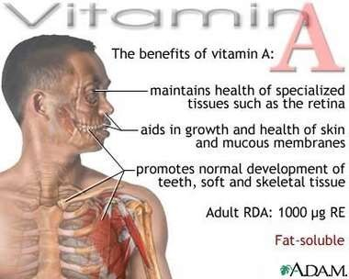
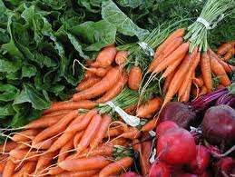
Vitamin A
Function: Promote good vision, normal growth, and healthy nerve function
Sources: Liver, yellow & orange fruits and vegetables, pears, and broccoli
Prevents: skin problems and unhealthy hair, poor vision and night blindness
TOXICITY can cause liver damage and severe birth defects.
Carotene in carrots converts to Vitamin A

Slide 25
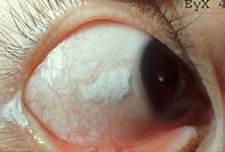
Night Blindness
nyctalopia: Inability to see clearly in dim light; due to a deficiency of vitamin A or to a retinal disorder.

Slide 26
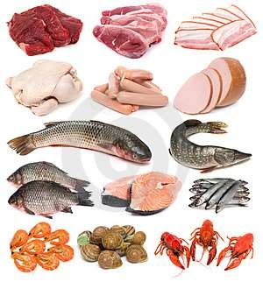
Vitamin D
Function: Formation of strong Bones & Teeth
Sources: Dairy Products, seafood, eggs, mushrooms, cereal, sunshine
Prevents: Malabsorption of calcium; Rickets / Osteoporosis
TOXICITY = calcium build up / bone spurs

Slide 27
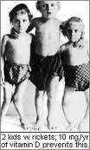
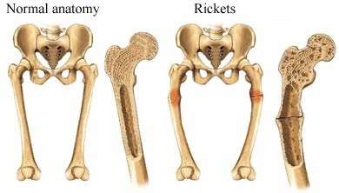
Rickets
A deficiency disease resulting from a lack of Vitamin D or from insufficient exposure to sunlight.
Characterized by softening of developing bone, bow legs,
malnutrition, and enlargement of the liver and spleen.

Slide 28
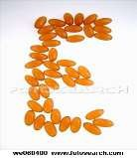
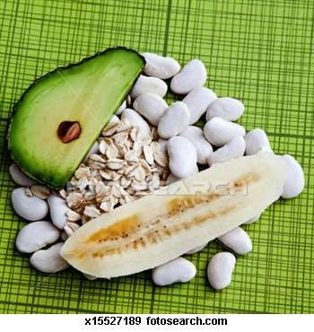
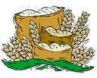
Vitamin E
(ALPHA TOCOPHEROL)
Function: Antioxidant; slows down aging, promotes healthy skin & hair
Sources: Nuts, seeds, green leafy
vegetables, avacados, grains (germ)
Prevents: Cellular degeneration –
TOXICITY can cause blurred vision, nausea, diarhea, dizziness, fatigue

Slide 29
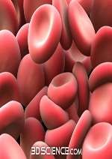
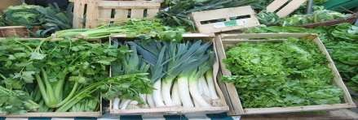
Vitamin K
Function: Assists with blood clotting; essential for bone healing and body repair.
Source: Dark green, leafy vegetables, cabbage, liver, cauliflower.
Prevents: Hemorrhaging
No known TOXICITY

Slide 30
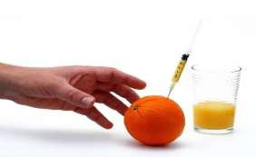
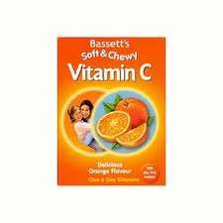
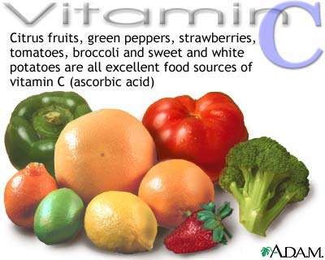
Vitamin C
(ASCORBIC ACID)
Function: Aids in wound healing, helps promote healthy immune system, forms collagen.
Sources: Citrus Fruits, Cantaloupe, strawberries, pineapple, broccoli
Prevents: Scurvy
TOXICITY = acid sores in soft tissues of mouth

Slide 31
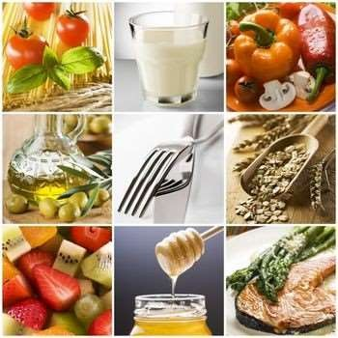
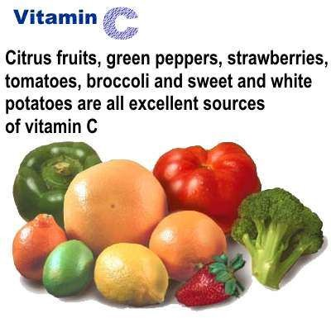
Water soluble
Vit c defiency leads to scurvy,poor wound healing,anemia,heart problems

Slide 32
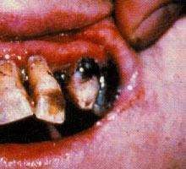
Scurvy
A lack of (DEFICIENCY) of Vitamin C
characterized by weakness, anemia, bruising, inflamed pores, bleeding gums and loose teeth.

Slide 33
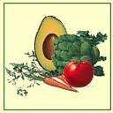
B Vitamins….
“Vitamin Complex”
a GROUP of vitamins…..
B1 = Thiamine B2 = Riboflavin B3 = Niacin
B6 = Pyridoxine
B9 = Folacin / Folic Acid B12 = Cobalamin

Slide 34
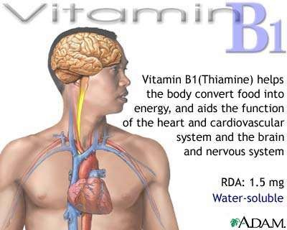
Vitamin B1 =Thiamine
Function: Healthy nerve function and muscle tissue, digestive system, energy metabolism.
Sources: Milk, grains, poultry, fish, dried beans
Prevents: Beriberi
No known TOXICITY

Slide 35
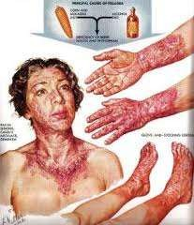
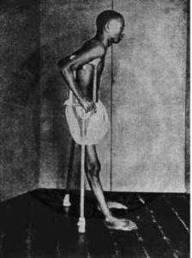
Beriberi
Caused by a deficiency of thiamine (vitamin B1) that affects many systems of the body, including the skin, muscles, heart, nerves, and digestive system.
.
Common in parts of Asia, where white rice is the main food. In the U.S., beriberi is primarily seen in people with chronic alcoholism.

Slide 36
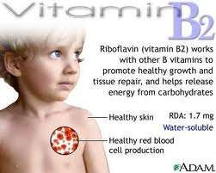
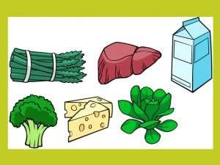
Vitamin B2 =Riboflavin
Function: Growth, nerve function, digestion, works with protein for maintenance, energy metabolism.
Sources: Milk, grains, green vegetables, meat, fish
Prevents Premature aging; Cheilosis
No known TOXICITY

Slide 37
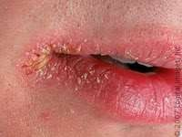
Cheilosis
A disorder of the lips marked by scaling and fissures at the corners of the mouth; caused by a lack of (DEFICIENCY) of
riboflavin

Slide 38
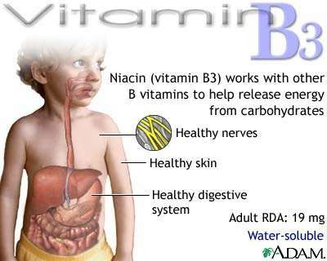
Vitamin B3 = Niacin
Function: Promotes healthy skin and tissues, digestion, and nervous system.
Sources: Milk, grains, poultry, fish.
Prevents: Pellagra
No known TOXICITY

Slide 39
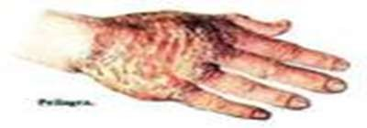
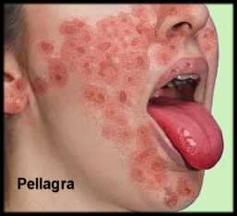
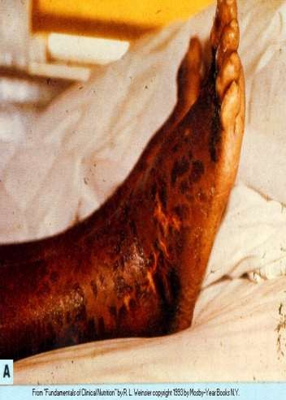
Pellag
An inability to absorb Niacin (B3) or the amino acid may cause scaly sores, cellular degeneration, mucous PH imbalance, and mental barriers.

Slide 40
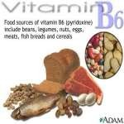
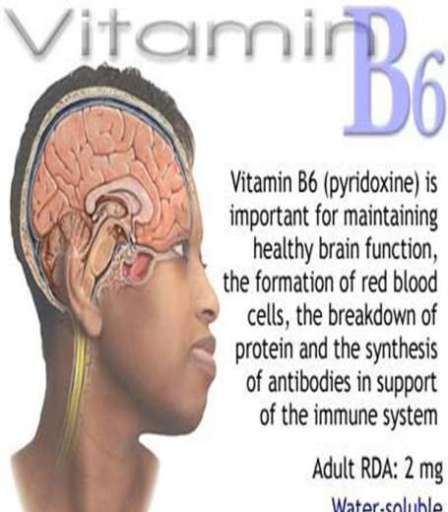
Vitamin B6 = Pyridoxine
Function: Healthy brain function, formation of red blood cells, immune system support.
Sources: Beans, legumes, nuts/seeds, eggs ,meat/fish.
Prevents: Helps fight infection.
No known TOXICITY.

Slide 41
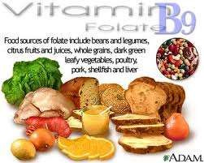
Vitamin B9=Folacin
(Folic Acid / Folate)
Functions: Age related memory, vision and hearing loss; promotes healthy red blood cells, maintains body enzymes.
Sources: beans/ legumes citrus fruit, dark green vegetables, grains, meats, poultry/eggs, liver.
Prevents: Neural Tube birth Defects, anemia and Vitiligo.

Slide 42
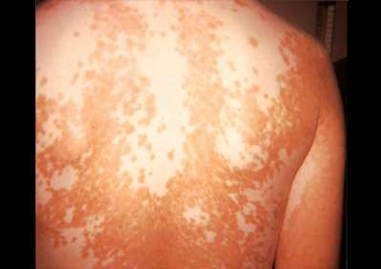
Vitiligo…
Skin condition in which there is a loss of brown color (pigment) from areas of skin, resulting in irregular white patches.
Caused by lack (DEFICIENCY) of Vitamin B or Folic Acid and other vitamins such a B12, C and copper & zinc.

Slide 43
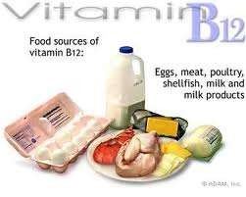
Vitamin B12 = Cobalamin
Function: Healthy red blood cell & marrow, nervous system function, strong immune system. Improves mental energy, memory, protects against allergies and toxins (cyanide in cigarettes)
Sources: Milk, eggs, liver, dairy products, fish, and shellfish
Prevents: Pernicious Anemia, intestinal malabsorption
TOXICITY = slight stomach upset

Slide 44
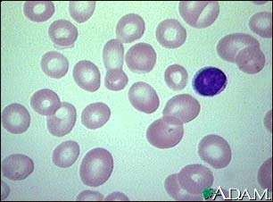
Anemia
Chronic disease cause by lack of (DEFICIENCY)
of Vitamin B12 typified by abnormally large
red blood cells.
Disturbs the nervous system causing depression and
drowsiness.

Slide 45
Deficiency and supplements
The normal rda for mineral and vitamins are
Calcium-1-2g/d
Iron-28-30mg.d
Vit A-2400-3000
Vit E-10-15 mg.d
Vit D-400- 500
Vit K-50-80ug/d
Vit C-40mg/d
B12-3-2mcg/d
Sodium-2-3g/d

Slide 46
What if all these nutrient are lacking in our diet???
Although all the mentioned vitamins are present in our daily diet but some how or the other their absorption is not proper.
Reason??????
Lack of vit c might leads to poor absorption of iron. Lack of vit d leads to calcium deficiecy.
Some one cannot depend completely upon the food to meet RDA
Here supplement play important role. It provides all the necessary amount of nutrients to our body.

Slide 47
Dietary Supplements -Benefits
Enhance immune system
Antioxidants
Reduce risk of CAD, stroke
Decrease risk of Cancers
Decrease risk of Cataracts,Arthrits,Macular
degeneration,Alzeimers
Improvements other chronic diseases

Slide 48
WATER
Water is your body's most important nutrient, is involved in every bodily function, and makes up 70- 75% of your total body weight.
Water helps you to maintain body temperature,
metabolize body fat,
aids in digestion,
lubricates and
cushions organs,
transports nutrients,
flushes toxins from your body.
Daily minimum 10-12 glasses of water should be taken..

Slide 49
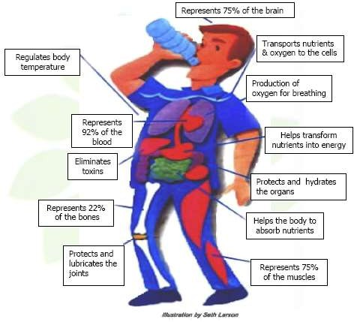

Slide 50
Physical exercise
Daily 30-45 mins of physical exercise should be done or 3-4 hrs per week..
Physical exercise can be of any type- walking,jogging,swimming,aerobics,yoga,cycling.

Slide 51
Tips for healthy diet
A well balanced diet including food from all nutrients in correct form
Engage in regular physical exercise atleast 30 mins
Positive attitude
Keep smiling always.

