Slide 1
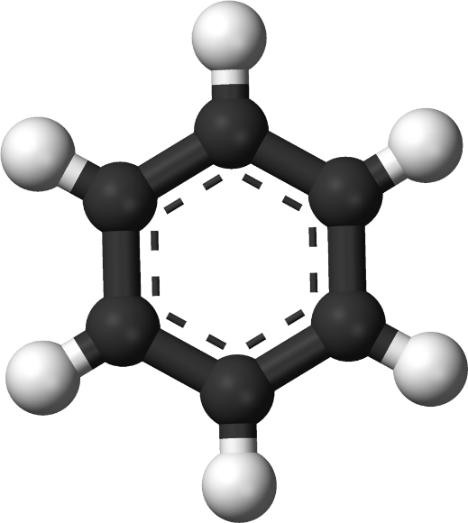
Benzene and its derivatives
Dr. Zamir G Khan
Assistant Professor
H R Patel Institute of Pharmaceutical Education and Research Shirpur, Dist. Dhule, (M.S) 425405

Slide 2
Learning Outcomes
After completion of this topic student shall be able to
Enumerate methods for preparation of benzene
Explain chemical properties / reactions of benzene
Describe chemical reactions like; Halogenation, Nitration, sulfonation
Describe chemical reactions like; Friedal Crafts alkylation, Friedal Crafts acylation

Slide 3
Methods for preparation of benzene
From sodium salt of benzoic acid
From benzene sulfonic acid
From benzene diazonium salts
NaOH +CaO
H₃O⁺ , ∆
H₃PO₂

Slide 4
Methods for preparation of benzene
From Phenol
Zn dust
From Grignard reagent
Mg ether
H₂O
+Mg(OH)Br

Slide 5
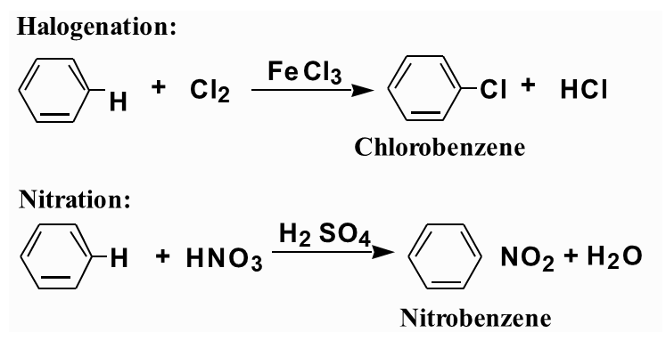
Chemical Properties/ Reactions of benzene
The most characteristic reaction of aromatic compounds is substitution at a ring carbon:

Slide 6
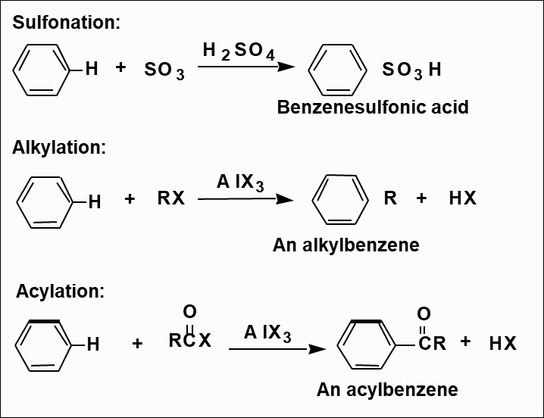
Chemical Properties/ Reactions of benzene

Slide 7
Chemical Properties/ Reactions of benzene
1
2
3
Carbon-Carbon Bond Formations:
R
R Cl
AlCl₃
4
5
Arenes
Alkylbenzenes
4

Slide 8
Chemical Properties/ Reactions of benzene

Slide 9
Chemical Properties/ Reactions of benzene

Slide 10
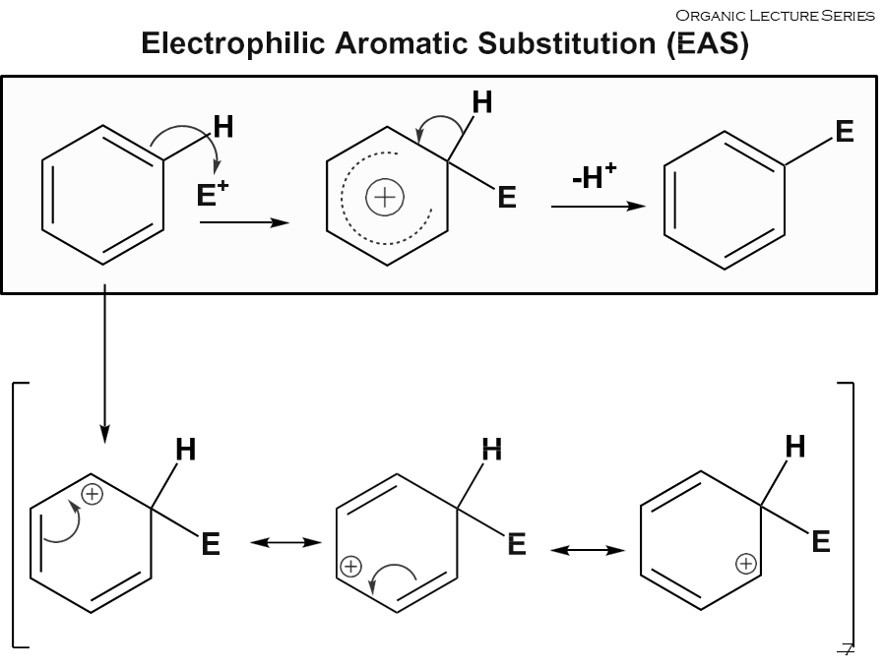
Chemical Properties/ Reactions of benzene

Slide 11
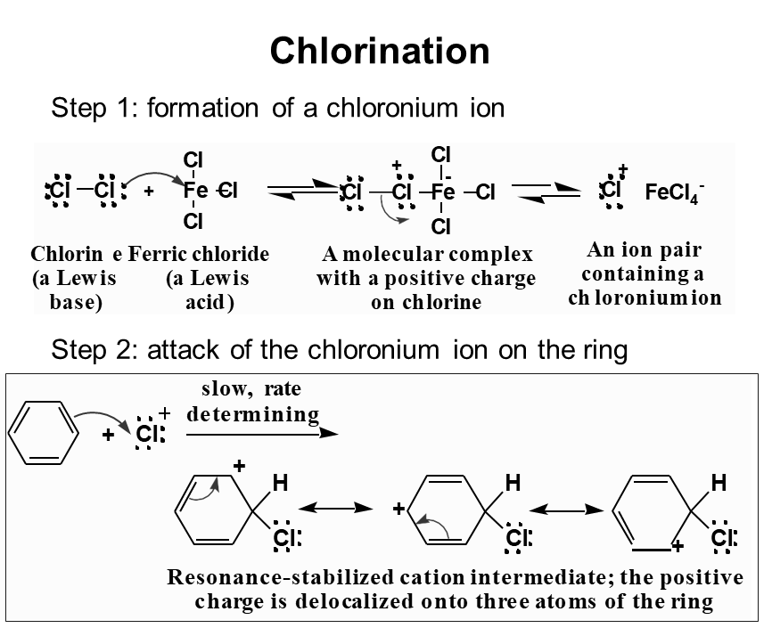
Chemical Properties/ Reactions of benzene

Slide 12
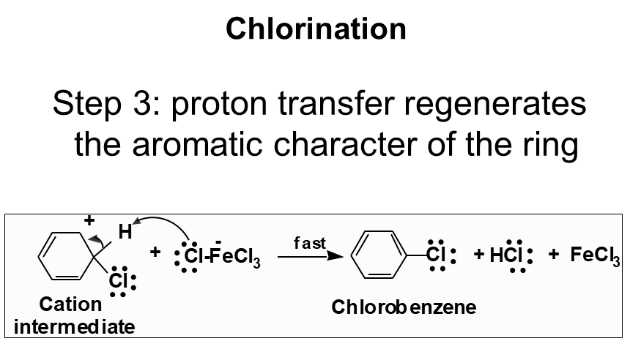
Chemical Properties/ Reactions of benzene

Slide 13
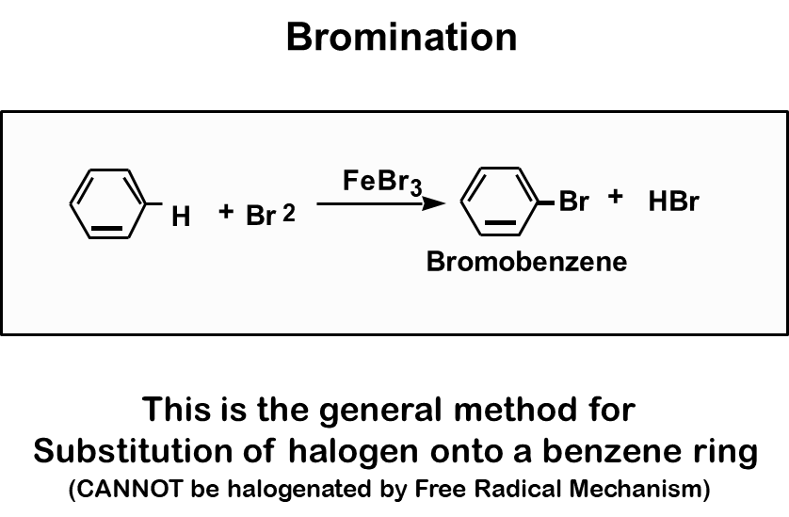
Chemical Properties/ Reactions of benzene

Slide 14
Chemical Properties/ Reactions of benzene
Bromination-Why not addn of Br₂?

Slide 15
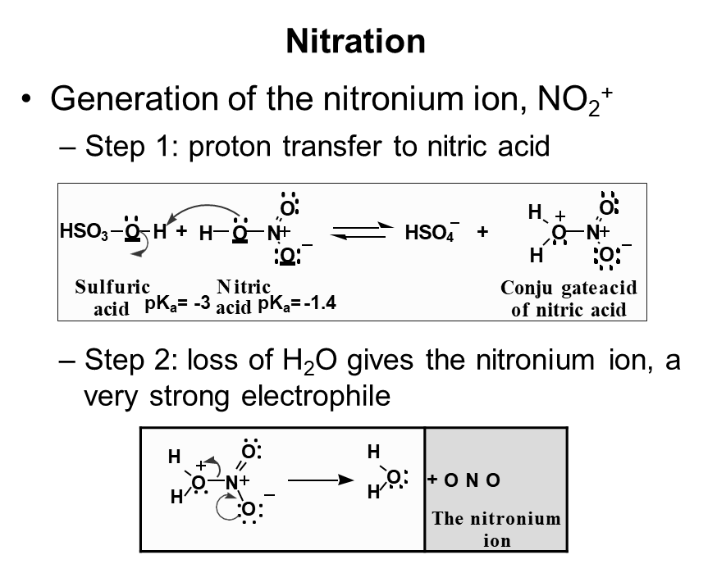
Chemical Properties/ Reactions of benzene

Slide 16
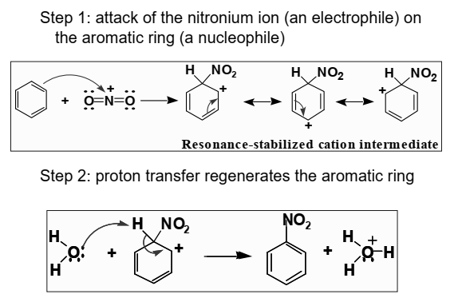
Chemical Properties/ Reactions of benzene
Nitration

Slide 17
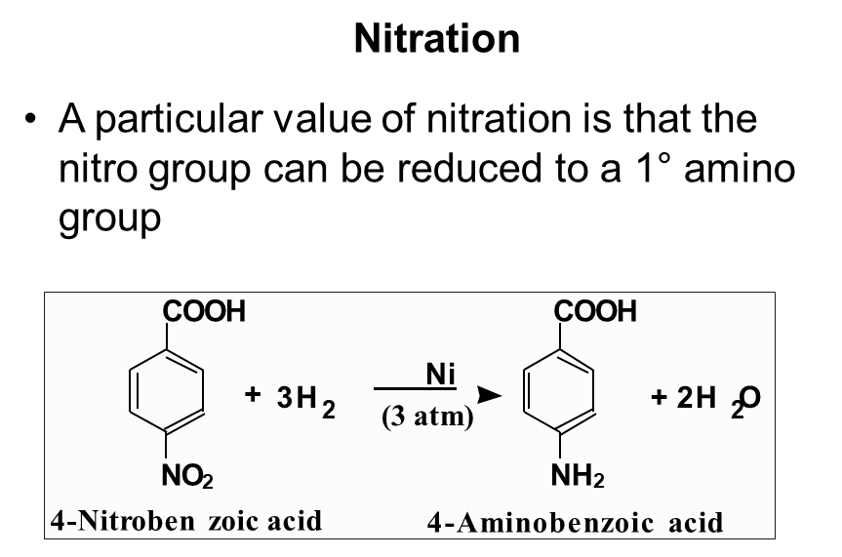
Chemical Properties/ Reactions of benzene

Slide 18
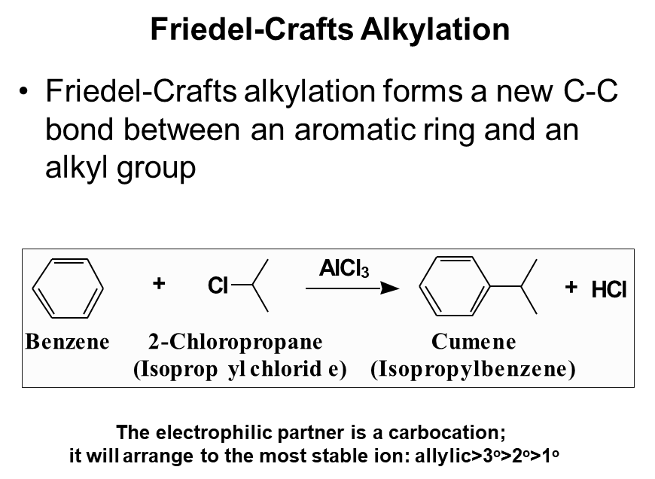
Chemical Properties/ Reactions of benzene

Slide 19
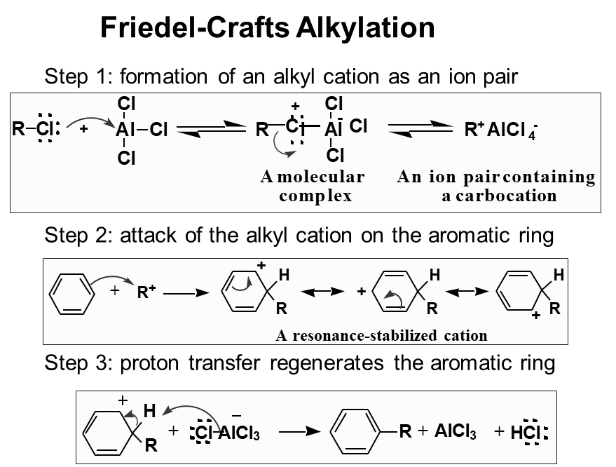
Chemical Properties/ Reactions of benzene

Slide 20
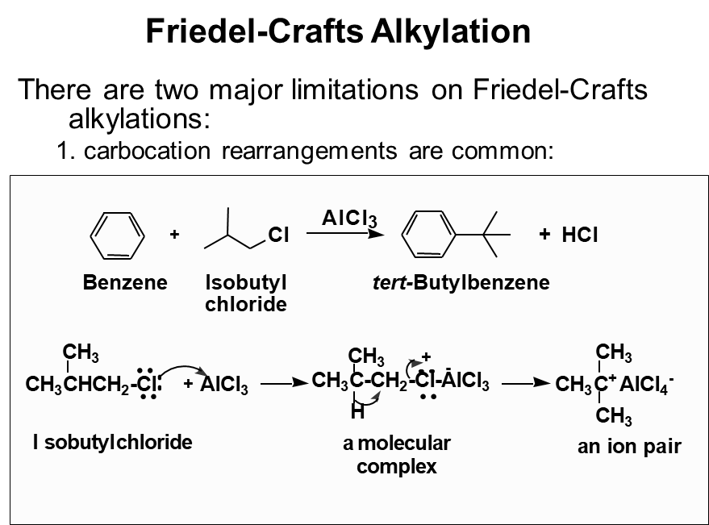
Chemical Properties/ Reactions of benzene

Slide 21
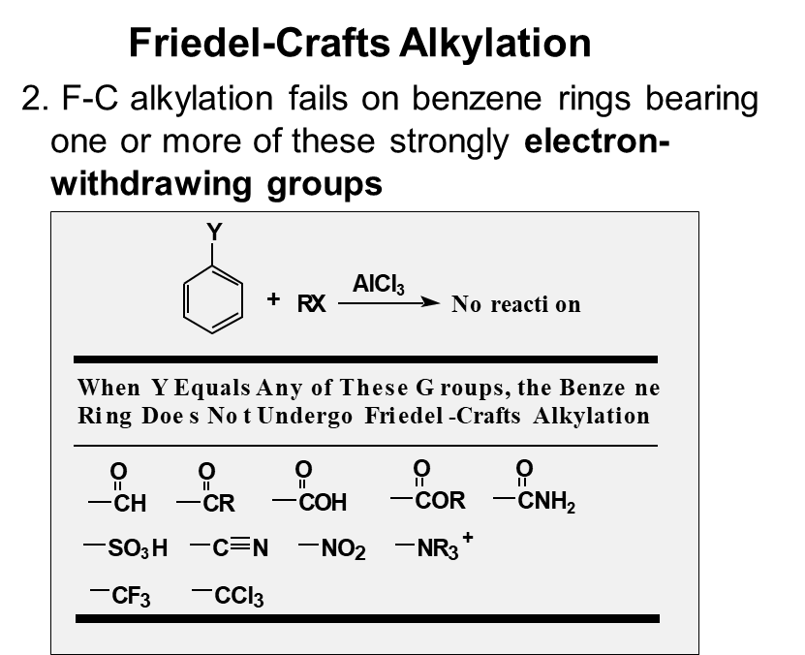
Chemical Properties/ Reactions of benzene

Slide 23
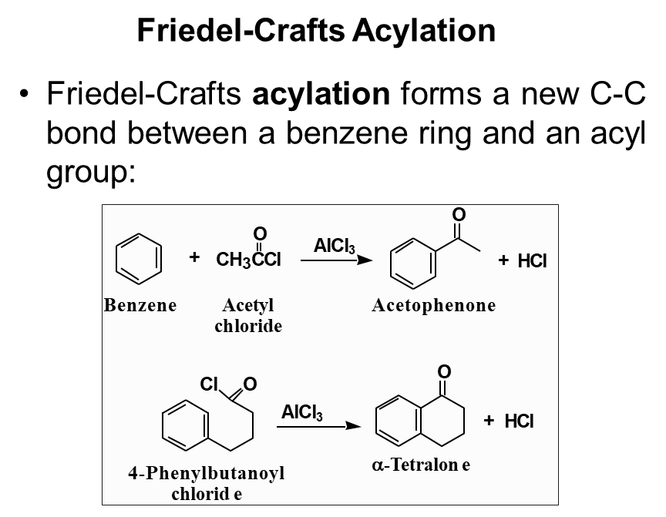
Chemical Properties/ Reactions of benzene

Slide 24
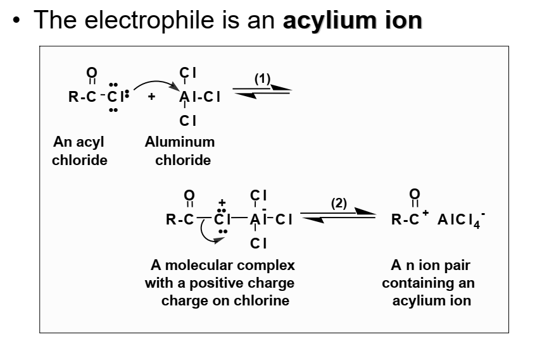
Chemical Properties/ Reactions of benzene
Friedal Craft Acylation

Slide 25
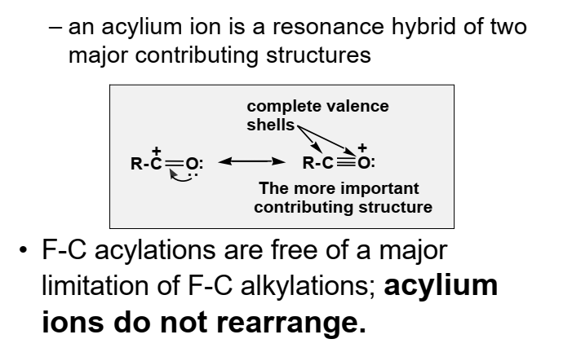
Chemical Properties/ Reactions of benzene
Friedal Craft Acylation

Slide 26
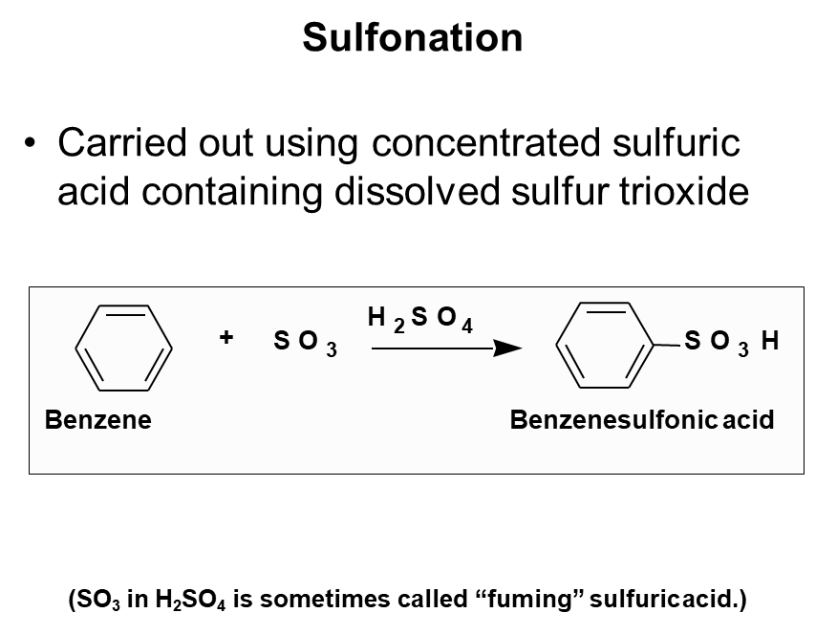
Chemical Properties/ Reactions of benzene

Slide 27
Learning Outcomes
Summary
Enumerate methods for preparation of benzene
Explain chemical properties / reactions of benzene
Describe chemical reactions like; Halogenation, Nitration, sulfonation
Describe chemical reactions like; Friedal Crafts alkylation, Friedal Crafts acylation

Slide 28
Thank you
Mr. Z. G. Khan, Assist. Professor, H R Patel Institute of Pharmaceutical Education and Research Shirpur, Dist Dhule (M.S) 425 405
Email: khanzamir.5588@gmail.com
Webpage: https://khanzamir5588.wixsite.com/zamir
YouTube Channel: https://www.youtube.com/channel/UCsQae74-x4t5iYK02iPRTxA?view_as=subscriber
Whatsapp: +91 9890 044 661

