Slide 1
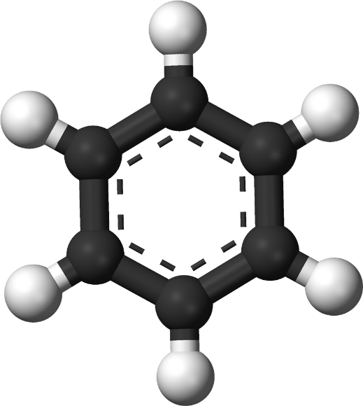
Benzene and its derivatives
Dr. Zamir G Khan
Assistant Professor
H R Patel Institute of Pharmaceutical Education and Research Shirpur, Dist. Dhule, (M.S) 425405

Slide 2
Learning Outcomes
After completion of this topic students shall be able to
Explain the effects of substituents on Orientation of monosubstituted benzene
Explain the effects of substituents on Reactivity of monosubstituted benzene
Discuss the structure and uses of DDT (Dichlorodiphenyltrichloroethane), Saccharin
Discuss the structure and uses of BHC (Benzene hexachloride), Chloramine

Slide 3
Orientation and Reactivity in monosubstituted
benzene
E
Electrophilic substitution
G
G
G
G
Electrophilic substitution
E
+
+
E
Ortho (1,2)
E
Meta (1,3)
Para (1,4)

Slide 4
Orientation and Reactivity in monosubstituted
benzene
Electrophilic substitution reaction results in formation of monosubstituted benzene
Electrophilic substitution reaction of monosubstituted benzene results in formation of three possible disubstituted benzene
With respect to the group already present, reaction results in formation of three possible disubstituted benzene (o, m, p)

Slide 5
NO₂
Conc. HNO₃+H₂SO₄
1
60ºC, 1 hr
Monosubstituted
Nitrobenzene
CH₃
CH₃
CH₃
CH₃
NO₂
Conc. HNO₃+H₂SO₄
+
+
Ortho Para Directing
2
60ºC, 10 min.
NO₂
o-nitrotoluene
(57%)
m-nitrotoluene
(3%)
NO₂
p-nitrotoluene
(40%)
NO₂
NO₂
NO₂
NO₂
3
NO₂
Conc. HNO₃+H₂SO₄
Meta Directing
+
+
90ºC-100ºC, reflux
NO₂
o-dinitrobenzene
(6.4%)
m-dinitrobenzene
(93.3%)
NO₂
p-dinitrobenzene
(0.3%)

Slide 6
Orientation and Reactivity in monosubstituted
benzene
Mentimeter Question

Slide 7
Orientation and Reactivity in monosubstituted
benzene
Mentimeter Question

Slide 8
Orientation and Reactivity in monosubstituted
benzene
The group already attached to benzene ring governs two important factors
Reactivity
Ring activator
Ring deactivator
Orientation
Ortho para directing
Meta directing

Slide 9
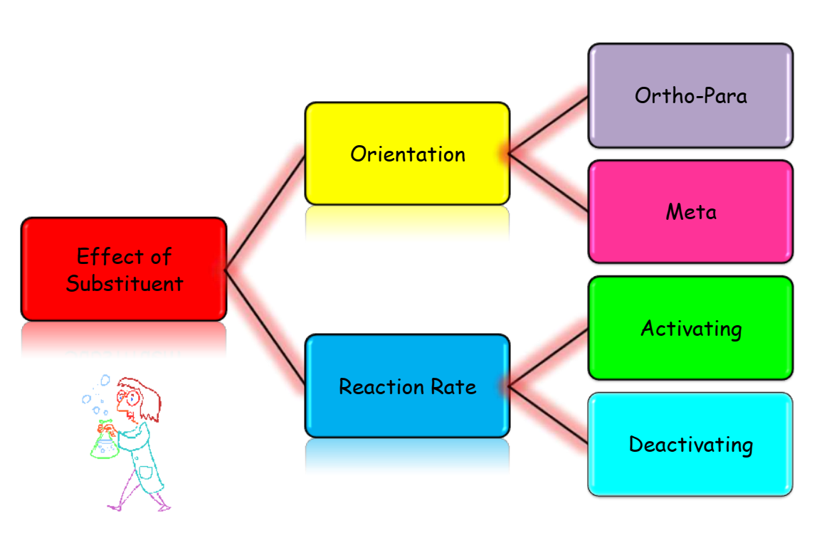
Orientation and Reactivity in monosubstituted
benzene

Slide 10
Orientation and Reactivity in monosubstituted
benzene
Nature of groups:
Electron releasing group (+I) (+R):
-OH, -NH₂, -NHR, -NR₂, -CH₃, -OCH₃, -Cl, -Br, -I, -F
Electron withdrawing group (-I) (-R):
-NO₂, -CN, -C=O, -CHO, -COOH, -COOR,-SO₃H

Slide 11
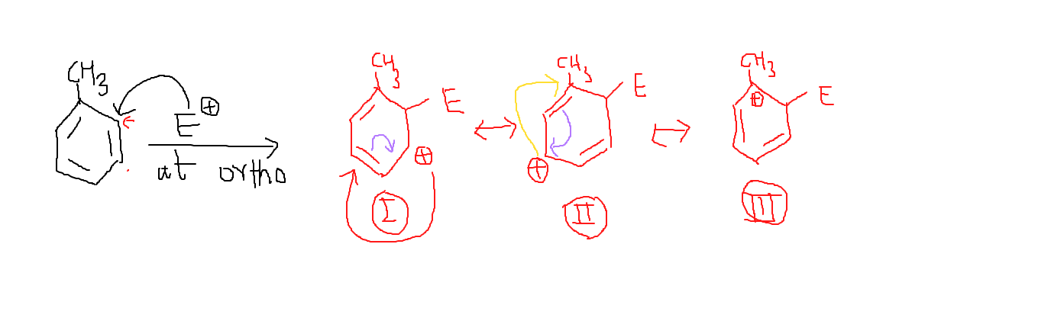
Effect of group on Reactivity in monosubstituted
benzene

Slide 12
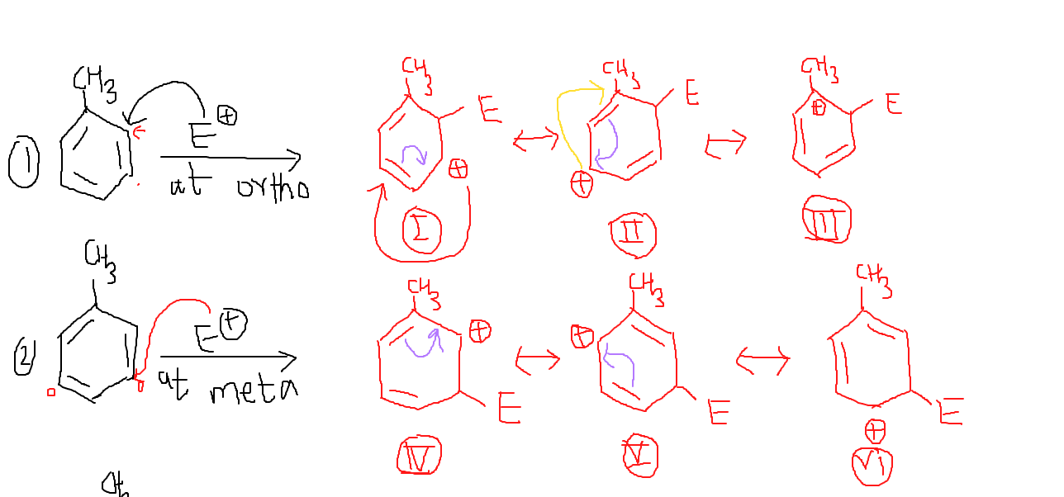
Effect of group on Reactivity in monosubstituted
benzene

Slide 13
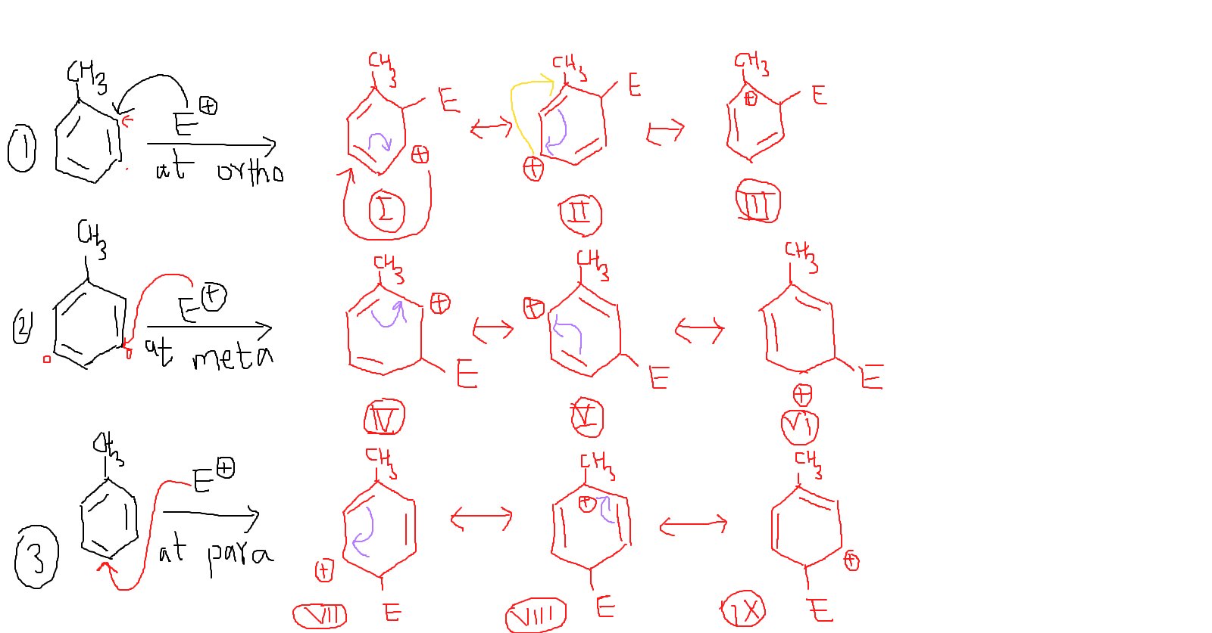
Effect of group on Reactivity in monosubstituted
benzene

Slide 14
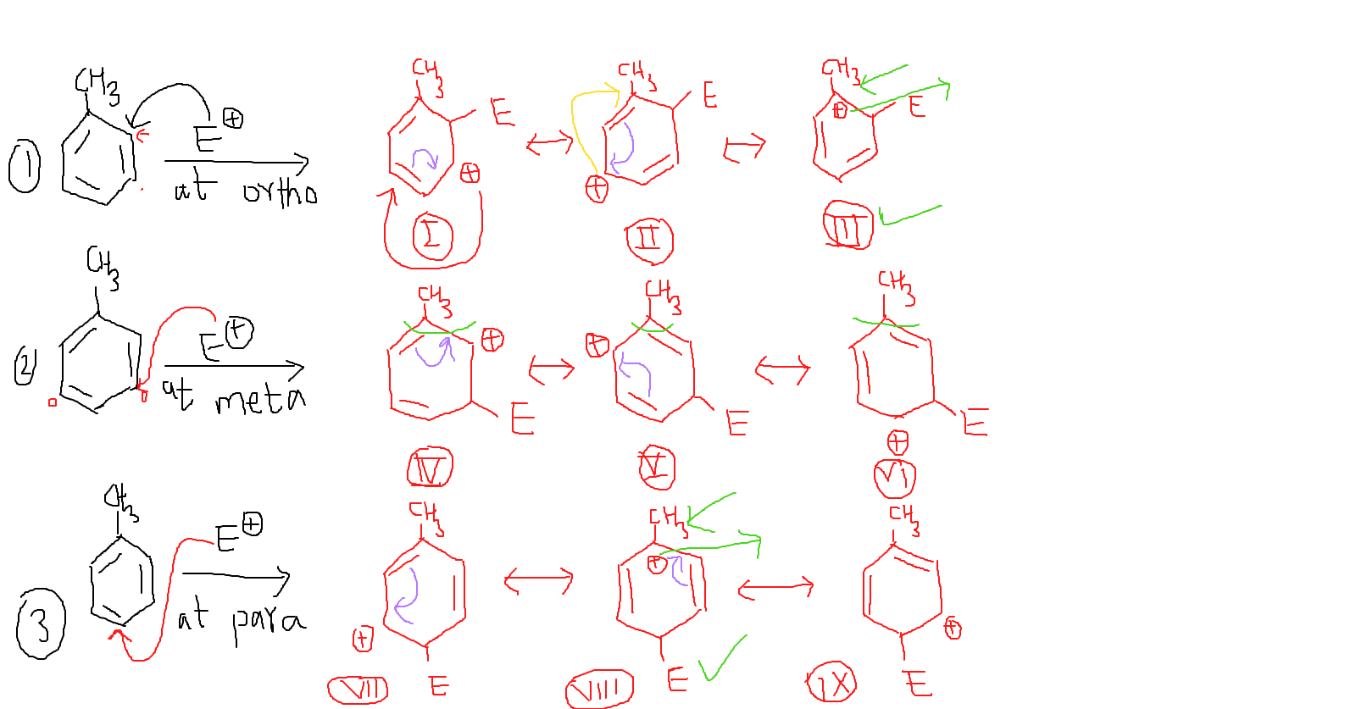
Effect of group on Reactivity in monosubstituted
benzene

Slide 15
Example: Chlorination of methylbenzene
CH₃
CH₃
Cl
CH₃
FeCl₃
+
+
Cl₂
o-Chlorotoluene
Cl
p-Chlorotoluene
Ring activator
CH₃
Ortho Para Director

Slide 16
Example: Nitration of Nitrobenzene
NO₂
NO₂
NO₂
NO₂
NO₂
Conc. HNO₃+H₂SO₄
+
+
NO₂
90ºC-100ºC, reflux
NO₂
o-dinitrobenzene
(6.4%)
p-dinitrobenzene
(0.3%)
m-dinitrobenzene
(93.3%)
Ring deactivator
NO₂
Meta Director

Slide 17
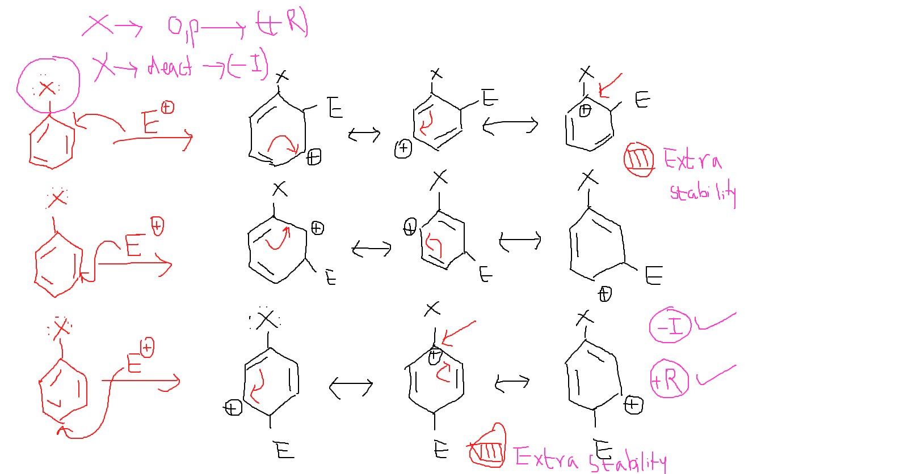
Halogens are ortho para director but ring deactivator

Slide 18
Thank you
Mr. Z. G. Khan, Assist. Professor, H R Patel Institute of Pharmaceutical Education and Research Shirpur, Dist Dhule (M.S) 425 405
Email: khanzamir.5588@gmail.com
Webpage: https://khanzamir5588.wixsite.com/zamir
YouTube Channel: https://www.youtube.com/channel/UCsQae74-x4t5iYK02iPRTxA?view_as=subscriber
Whatsapp: +91 9890 044 661

