Slide 1
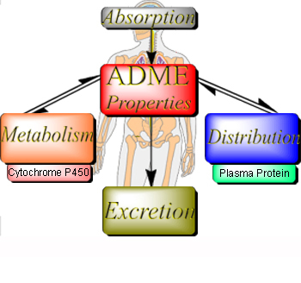
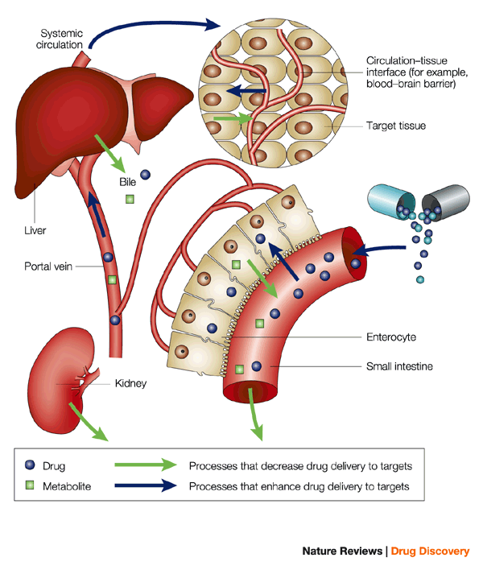
DRUG DISTRIBUTION

Slide 2
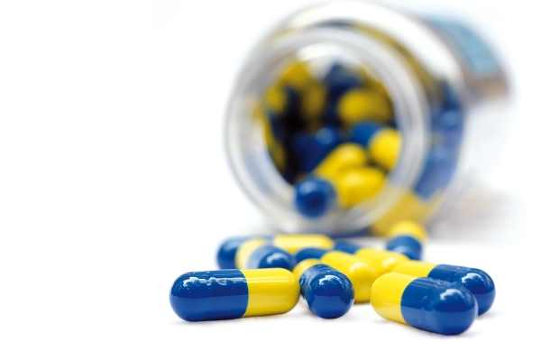
DRUG DISTRIBUTION
Interistitium
Cell
Blood

Slide 3
Once a drug has gained excess to the blood stream, the drug is subjected to a number of processes called as Disposition Processes that tend to lower the plasma concentration.
Distribution which involves reversible transfer of a drug between compartments.
Elimination which involves irreversible loss of drug from the body. It comprises of biotransformation and excretion.

Slide 4
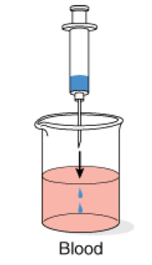
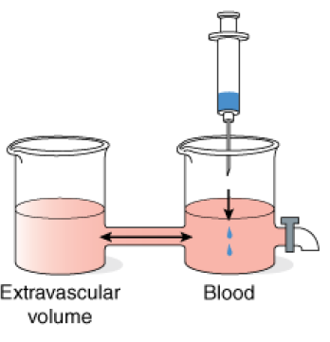
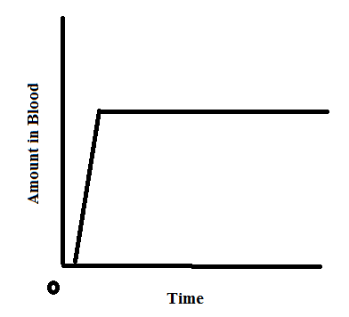
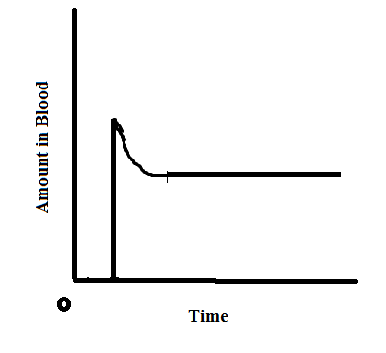
DRUG DISTRIBUTION
Drug distribution: refers to the reversible transfer of a drug between the blood and the extra vascular fluids and tissues of the body (for example, fat, muscle, and brain tissue).

Slide 5
Distribution is a passive process and the driving force is the concentration gradient between the blood and the extravascular tissue. Drug diffuses only until equilibrium is reached.
Distribution of drug is not uniform throughout the body because different tissues receive the drug from the plasma at different rates and different extends.

Slide 6
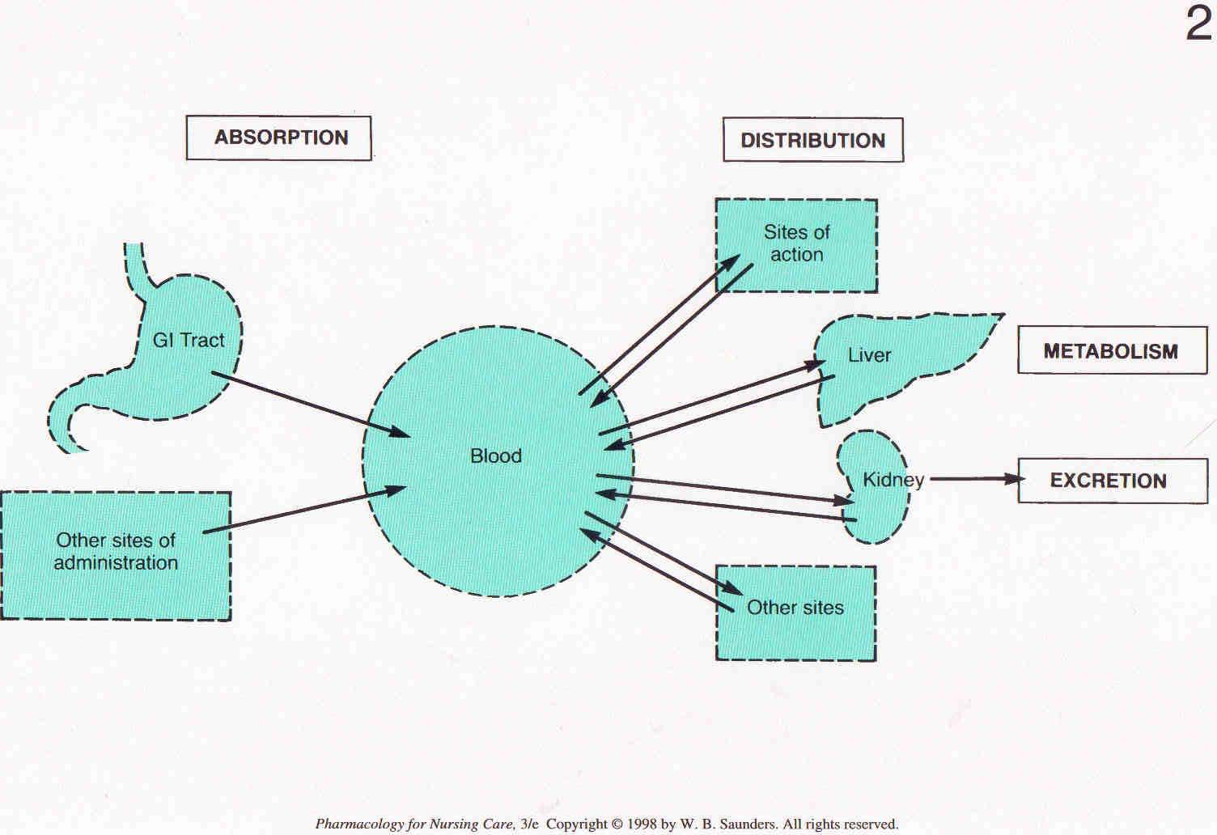

Slide 7
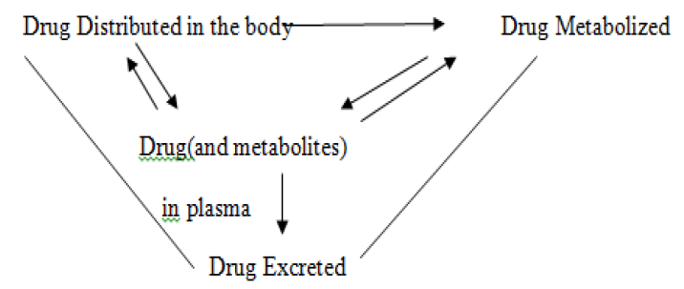
INTER-RELATIONSIP

Slide 8
Pharmacokinetics
Locus of action “receptors” Bound Free
Tissue reservoirs Bound Free
Systemic circulation
Absorption
Free drug
Excretion
Bound drug
Metabolites
Biotransformation

Slide 9
Steps in Drug Distribution

Slide 10
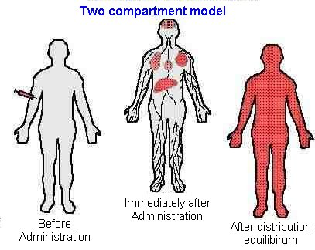
Drug distribution is influenced :
a) Blood flow to target tissues
b) Ability of drug to exit blood vessels
Typical capillary - no barrier
blood-brain barrier = tight junctions between
endothelial cells (only lipid soluble)
Placental barrier - only lipid soluble pass freely
c) Ability to enter cells
Must be lipid soluble, or have transporter
Most drugs act at receptors on cell surface (do not enter)

Slide 11
Factors affecting drug distribution
Factors → rate of distribution
(how fast)
Membrane permeability
Blood perfusion
Factors → extend of distribution (how much)
Lipid solubility
pH – pKa
Protein binding
Plasma protein binding
Tissue protein binding
Elimination processes

Slide 12
Distribution of drugs throughout the body fluid is not equal.
The reasons for unequal distribution are:
Drug factors
pH of the media
Regional blood flow
Drug binding…protein / tissue
Membranes

Slide 13
Drug factors
Lipid solubility of the drugs
Molecular weight of the drugs
pKa of drug

Slide 14
Lipid solubility
LS drugs (non-ionized) can cross easily the membranes & available everywhere
WS drugs (ionized) can’t cross the cell-membrane, and so remains in mostly ECF

Slide 15
Molecular weight
Low molecular weight drugs can cross easily
High molecular weight drugs (albumin) can’t cross the capillary membrane & remains in plasma

Slide 16
pKa of drug & pH of media
More dissociation….less crossing of membranes
Blood is slightly alkaline (pH 7.4)
Acidic low pKa drugs will be ionized more & less crossing of membranes
Basic low pKa drugs will be ionized less & more crossing of membranes

Slide 17
Drug binding
Binding
Plasma protein binding of the drugs
Tissue binding property of the drugs

Slide 18
Protein Binding
Passive (not active) transport of drugs across biological membranes is influenced by protein binding.
Binding may occur
- with plasma proteins or
- with non-specific tissue proteins in addition to the drug’s receptors.
***Only drug that is not bound to proteins (i.e., free or unbound drug) can diffuse across membranes

Slide 19
Protein binding
not only affects the activity of the drug (bound = inactive)
But also can influence its distribution from one compartment to another.
This is particularly true with respect to glomerular filtration and passive transport.
Free + Protein ⇔ Bound Drug Drug

Slide 20
Plasma
Extracellular water
Plasma protein
Tissue protein
drug

Slide 21
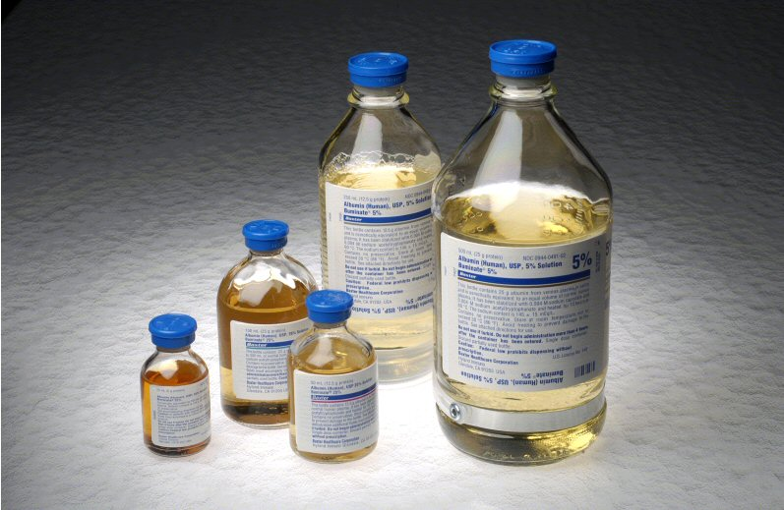
Plasma Proteins
albumin - primarily for acidic drugs
a₁-acid glycoprotein
- for basic drugs
Lipoproteins
- for some drugs
The fraction of total drug in plasma that is bound is determined by
the drug concentration,
its affinity for the binding sites, and
the number of binding sites.

Slide 22
Plasma Protein Binding
Free drug ⇔ Bound drug
Always equilibrium
This equilibrium will always be maintained whatever might be the amount of the drug in circulation at any time.

Slide 23
DRUG DISTRIBUTION
Bound drugs remain as reservoir of drugs.
When free drug concentration is decreased then bound drugs become free and maintains the equilibrium.
Only free drugs are active, metabolized & excreted.
Albumin

Slide 24
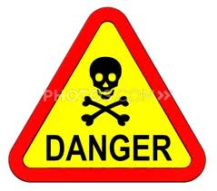
DRUG DISTRIBUTION
Outcome of competition of 2 drugs for plasma protein binding ????????
Drug interaction

Slide 25
DRUG DISTRIBUTION
Warfarin is highly bound to albumin, and only a small fraction is free.
This means that most of the drug is sequestered on albumin and is inert.
W
W
W
W

Slide 26
DRUG DISTRIBUTION
Warfarin+ sulfonamide if given together?
If a sulfonamide is administered at same time, it will displaces warfarin from albumin.
Leading to a rapid increase in the concentration of free warfarin in plasma.
Because almost 100 percent is now free, compared with the initial small percentage
S
S
S
W
S
W
W
W

Slide 27
Redistribution
Termination of drug action is normally by biotransformation, but may also occur as a result of redistribution between various compartments. Particularly true for lipid-soluble drugs that affect brain and heart.

Slide 28
Tissue binding
Some drugs readily distribute in those specific tissues & remain accumulated there….
Tetracycline to bone
Phenobarbitone to brain
Chlorpromazine to eye
Chloroquine to kidneys etc…

Slide 29
Physiological barrier to distribution of drugs:
1. Simple capillary endothelial barrier.
2. Simple cell membrane barrier.
3. Blood brain barrier.
4. Blood-Cerebrospinal fluid barrier.
5. Blood Placental barrier.
6. Blood-testis barrier.

Slide 30
Simple capillary endothelial barrier:^{1,3}
Capillary membrane is composed of an interlocking mosaic of endothelial cells with junction or pores between them.
All the drugs, ionized or unionized with a Mol.wt upto 500-600 Daltons can pass through this barrier.
This barrier responsible for transport of large molecules like proteins, lipid soluble molecules.

Slide 31
Simple cell membrane barrier:^{1,3,4}
After diffusing through capillary wall drug reaches to extracellular fluid then contact with cell membrane.
Then drug gets distributed in the cells.
The cell membrane is the lipoidal barrier.
This barrier permeable to water molecules but impermeable to ions and charged molecules.

Slide 32
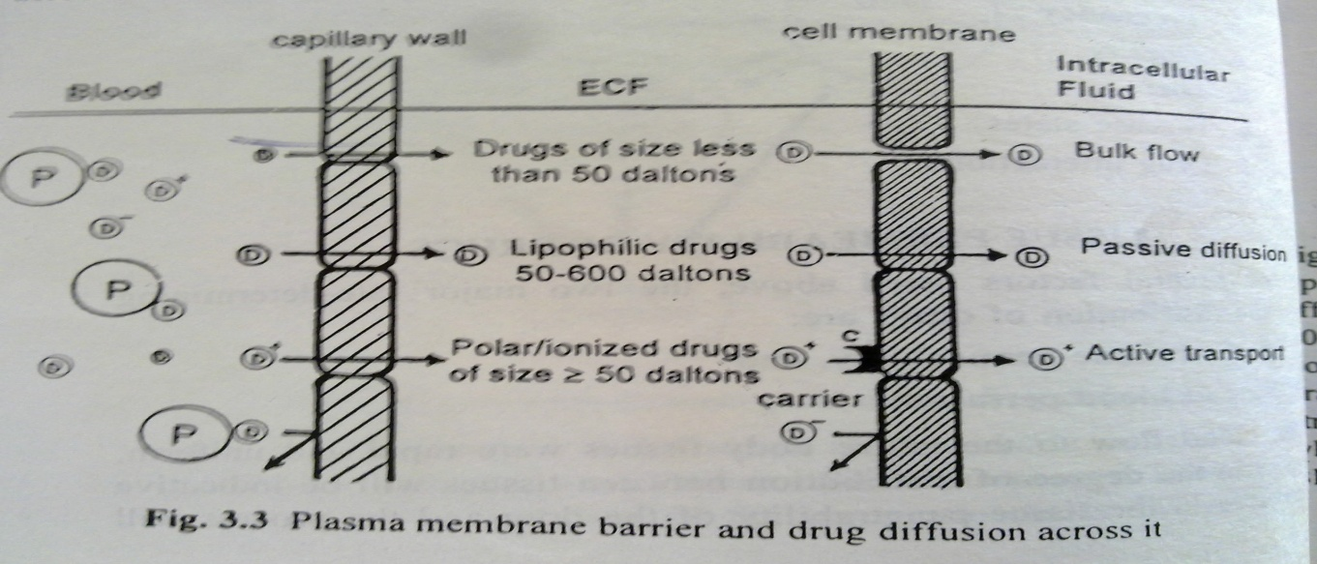
Capillaries differ significantly in their permeability characteristics.

Slide 33
Blood Brain Barrier
This is a tight junction
There is no fenestrations or slit in between the endothelial cells of capillaries
Layer of astrocyte foot processes makes this more impermeable
Only lipid soluble substances can cross the BBB

Slide 34
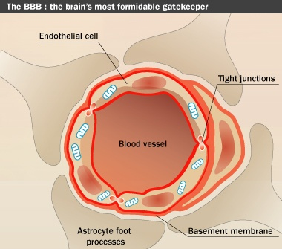
ANATOMICAL BARRIES
Blood brain barrier
Involves highly lipid soluble substance

Slide 35
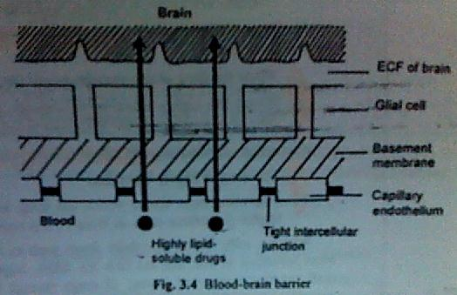
Barrier

Slide 36
Three approaches to promote crossing the BBB by the drugs are:
Use of the permeation enhancers such as dimethyl sulfoxide.
Osmotic disruption of BBB with mannitol.
Use of dihydropyridine redox system as drug carriers.

Slide 37
Blood cerebrospinal fluid barrier(Blood-CSF):
The Blood-CSF is formed by the choroid plexus of the lateral, third and fourth ventricles and is similar in composition to the ECF of brain.
The capillary endothelium that lines the choroid plexus have open junctions or gaps. So the drugs can easily flow into the extracellular space between the capillary wall and the choroid cells.

Slide 38
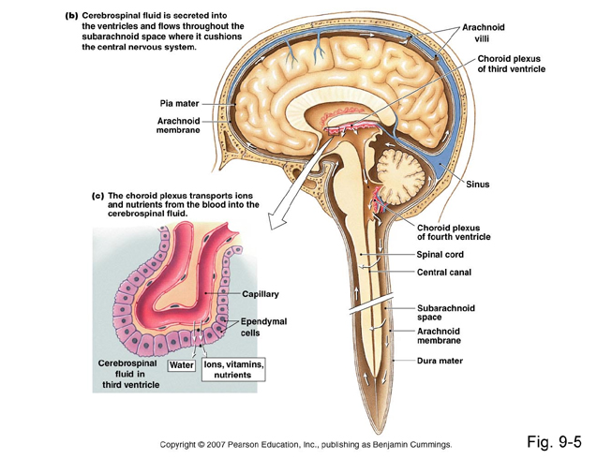
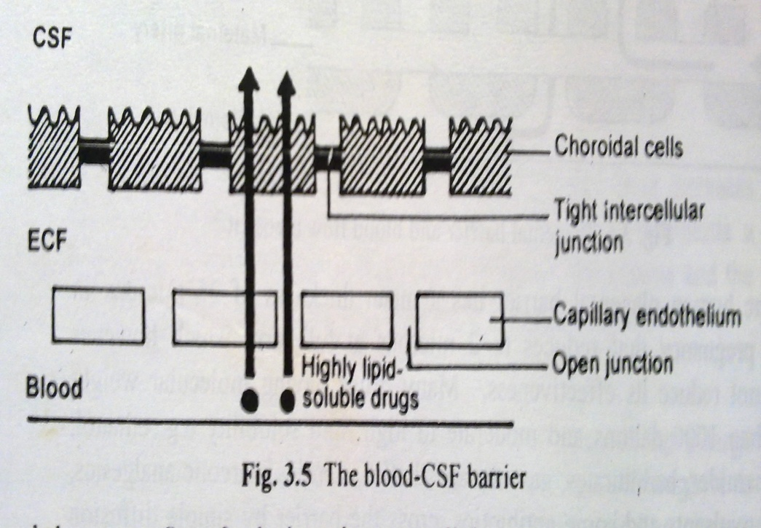
Barrier
Physiology

Slide 39
Blood Placental barrier:^{1,4}
Placental barrier is the membrane separating Foetal blood vessels from the Maternal blood vessels.
It is made up of Foetal Trophoblast Basement Membrane and the Endothelium.
Mean thickness in early pregnancy is (25 µ) which reduces to (2 µ) at full term.
Drugs having molecular weight less than 1000 Daltons and moderate to high lipid solubility can cross the barrier by simple diffusion.

Slide 40
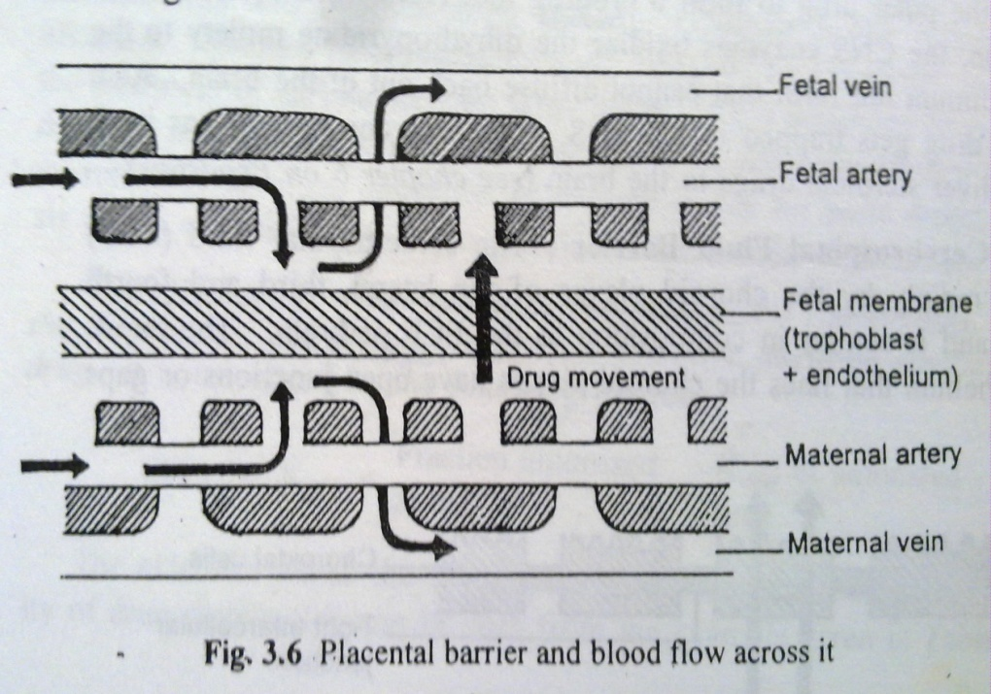
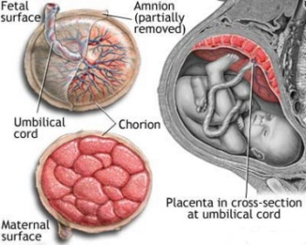
Barrier
Placenta Barrier

Slide 41
Nutrients for fetal growth are transported by carrier mediated process.
Placental barrier having similar permeability as cell membrane.
Highly lipophilic drugs cross placental barrier very rapidly and equilibrium is attained within minute.
This is not an effective barrier as BBB, so it
is better to avoid all drugs during pregnancy.

Slide 42
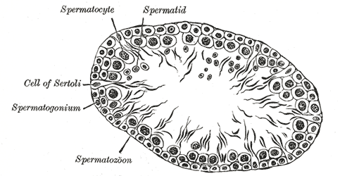
Blood – Testis Barrier:
It has tight junctions between the neighboring cells of sertoli which restricts the passage of drugs to spermatocytes and spermatids.

Slide 43
Organ / Tissue Size and Perfusion Rate
Perfusion Rate is defined as the volume of blood that flows per unit time per unit volume of the tissue.
Greater the blood flow, faster the distribution.
Highly perfused tissues such as lungs, kidneys, liver, heart and brain are rapidly equilibrated with lipid soluble drugs.
The extent to which a drug is distributed in a particular tissue or organ depends upon the size of the tissue i.e. tissue volume.

Slide 44
Organ perfusion rate or Blood flow ( % from Cardiac Output)
Liver 27.8%
Kidney 23.3%
Skeletal muscle 6- 15.6%
Brain 13.9%
Skin 4%
Fat tissues 2%
Placenta & Fetus 9%
Drugs distributed quickly and completely in well perfused tissue (e.g Brain, heart, kidney).

Slide 45
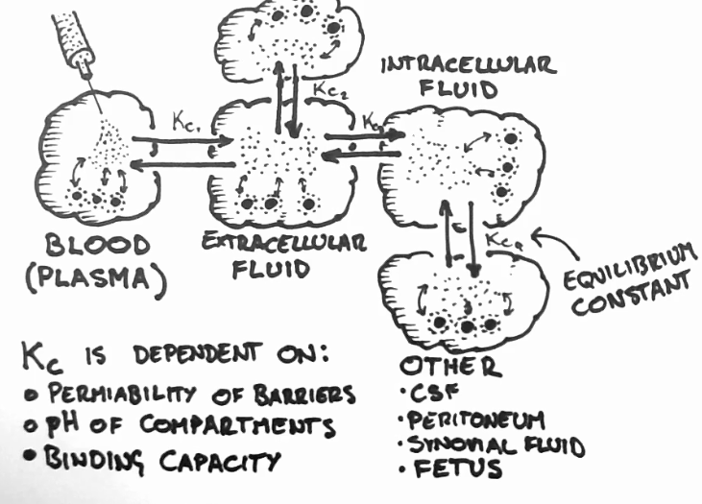

Slide 46
Miscellaneous Factors
Diet: A Diet high in fats will increase the free fatty acid levels in circulation thereby affecting binding of acidic drugs such as NSAIDS to Albumin.
Obesity: In Obese persons, high adipose tissue content can take up a large fraction of lipophilic drugs.
Pregnancy: During pregnancy the growth of the uterus, placenta and fetus increases the volume available for distribution of drugs.
Disease States: Altered albumin or drug – binding protein conc.
Altered or Reduced perfusion to organs /tissues
Altered Tissue pH

Slide 47
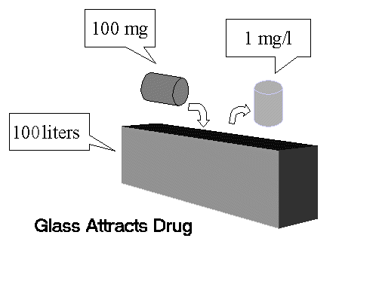
Volume of distribution
Volume of distribution (Vd) of drug:
Vd means the amount of fluid in which the administered drug is distributed.

Slide 48
The Volume of distribution (V_{D}), also known as Apparent volume of distribution, is used to quantify the distribution of a drug between plasma and the rest of the body after oral or parenteral dosing.
It is called as Apparent Volume because all parts of the body equilibrated with the drug do not have equal concentration.

Slide 49
Volume of Distribution (Vd)
How can we measure the extent of distribution?
Apparent volume of distribution (V_{d})
VOLUME OF DISTRIBUTION FOR SOME DRUGS
DRUG Vd (L)
cocaine 140
clonazepam 210
amitriptyline 1050
amiodarone ~5000

Slide 50
Volume of distribution
C = D/V
V = D/C
D
V

Slide 51
Volume of distribution - an example
D = 50 mg
C = 2.5 mg/L
V = D/C
= 50mg / 2.5mg/L
= 20 Litres
D
V

Slide 52
What is the volume of water in
the beaker?

Slide 53
Drug distribution and Body water
Total body water
plasma volume
extracellular
plasma
3 liters
5%
interstitial volume
interstitial volume
15 liters
25%
intracellular volume
intracellular
12 liters
20%
Approximately 42 liters
70%
Water composition in
60 Kg Body Weight
27 liters 45%

Slide 54
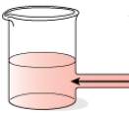
Water compartments in the body:
Cell Volumes

Slide 55
Drug distribution and Body water
cell
Intra-vascular
Interstitial
Intra-cellular

Slide 56
Drug distribution and Body water
cell
Distribution - Evan’s Blue
Intra-vascular space only

Slide 57
Drug distribution and Body water
cell
Distribution – Inulin
Extracellular water

Slide 58
Drug distribution and Body water
cell
Distribution – Ethanol
All water

Slide 59
Drug distribution and Body water
cell
Distribution – Quinacrine
Concentration into cells

Slide 60
DRUG DISTRIBUTION
Volume distribution of heparin 4L means?
It means heparin distributes about 4 liters of body fluid.
So it remains in only 1 compartment, that is blood.
Why so small volume of distribution?
Because, Heparin has-
Very large molecular weight.
Extensive plasma protein binding.

Slide 61
References:
Brahmankar D.M;Jaiswal S.M. “Biopharmaceutics And Pharmacokinetics”A Treatise first edition,Published by Vallabh Publication ,Page No.100-107.
Dr. Tipnis H.P.; Dr.Bajaj Amrita “Principles and Application of “Biopharmaceutics And Pharmacokinetics” first edition publish by Mr.Nishad Deshmukh for career publication , Page No.61-67
Kulkarni J.S; Pawar A.P.; Shedbalkar V.P. “Biopharmaceutics And Pharmacokinetics” first edition CBS Publication , Page No. 73-80
Rani,S., Hiremath,R., Text–Book of Biopharmaceutical and Pharmacokinetics, Prism Books Pvt. Ltd., Edn-2000 , pg: 28- 32
Gibaldi, M. , Pharmacokinetics, Marcel Dekker Inc., New York, 1982 , Edn - 2nd , pg – 44 – 48
www.google.com
www.colorodo.edu
www.stanford.edu
Also used some free downloading presentations available on internet

