Slide 1
Resume Writing
Good Practices and Strategies, Examples
Presented By
Mr. L R Zawar,
H R P I P E R, Shirpur.

Slide 3
What Is a Resume?

Slide 4
Summary of skills and experience
What Is a Resume?
Not a biography
Highlights accomplishments

Slide 5
What We Need of a Resume?
Show our skills and abilities
Show experience
Reflects more than paid work experience
Why we are better than the rest

Slide 6
Why We Need a Good Resume?
No time to fully review every CV
Because of the Recruiters!

Slide 7
Recruiters

Slide 8
Recruiters:
Review 100 CVs

Slide 9
Recruiters spend 20-60 seconds on a Resume

Slide 10
The first impression
The recruiters count most:
Finding the correct keywords

Slide 11
The Goal

Slide 12
Sell
Persuade
Inform
The Goal
Get an Interview!

Slide 13
OK. But how to do all this?
All you need is a!

Slide 14
The Success Strategy?

Slide 15
The Success Strategy?
Be unique

Slide 16
The Success Strategy?
What you want next?
Be unique

Slide 17
The Success Strategy?
The point of the Resume
What you want next?
Be unique

Slide 18
The Success Strategy?
What the employer wants?
The point of the Resume
What you want next?
Be unique

Slide 19
The Success Strategy?
Good presentation
What the employer wants?
The point of the Resume
What you want next?
Be unique

Slide 20
The Success Strategy?
Good presentation
What the employer wants?
The point of the Resume
What you want next?
Be unique
Success Strategy

Slide 21
Be Unique
Good presentation
What the employer wants?
The point of the Resume
What you want next?
Be unique
Success Strategy

Slide 22
Be Unique
Good presentation
What the employer wants?
Don't copy paste
The point of the Resume
What you want next?
Be unique
Success Strategy

Slide 23
Be Unique
Good presentation
What the employer wants?
Don't copy paste
The point of the Resume
What you want next?
Be unique
Success Strategy
Show creativeness
Show what you want to show

Slide 24
What You Want Next?
Good presentation
What the employer wants?
The point of the Resume
What you want next?
Be unique
Success Strategy

Slide 25
What You Want Next?
Good presentation
What the employer wants?
The point of the Resume
What you want next?
Be unique
Success Strategy
Why you choose this exact job offer?

Slide 26
What You Want Next?
Good presentation
What the employer wants?
The point of the Resume
What you want next?
Be unique
Success Strategy
Why you choose this exact job offer?
How you plan to develop yourself in the future?

Slide 27
What the Employer Wants?
Good presentation
What the employer wants?
The point of the Resume
What you want next?
Be unique
Success Strategy
Highlight the relevant things
Show what the employer wants to see
Or just what you have been paid for
Not all you have done

Slide 28
Good Presentation
Good presentation
Be consistent
What the employer wants?
The point of the Resume
What you want next
Be unique
Success Strategy
Be brief
Be Focused

Slide 29
How to Stand Out?
Make your Resume
remarkable

Slide 30
How to Stand Out?
Chance of fail first time

Slide 31
How to Stand Out?
Chance of fail first time
Take risks

Slide 32
How to Stand Out?
Chance of fail first time
Take risks
Use "Trial and Error" methodology

Slide 33
Structure Your Resume
There are some must-have sections in your CV
Personal information
Objective
Previous work experience
Education
Projects developed
E.g. at the university, high school or in free time
Skills and abilities
Other experience
E.g. at the university
Resume

Slide 34
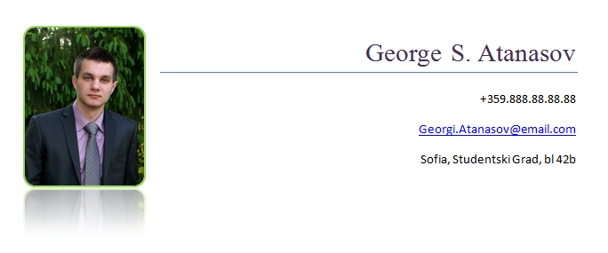
Personal Information
Always put it in the top
Include the following
Your name
A photo
Your contacts
Email address
Telephone number
Home address
Personal Info

Slide 35
Use a professional photo
The Photo
Photo

Slide 36
Use a professional photo
The Photo
Don't use Facebook photos!
Better no photo at all

Slide 37
The Contacts
Use your personal contacts
Personal email, personal telephone!
Never use work contacts
Be sure to have a good-looking email address
Even if you use it only for job applications
PeterPetrov@, Peter.Petrov@, Asen_Georgiev@
Not emails like:
DestructorMachine@, Svalyacha92@, P373rP37r0v@

Slide 38
Objective
The objective should be after the personal information
What you are applying for?
Be descriptive, but be brief
Don't be over descriptive
Objective

Slide 39
Previous Work Experience
Write your previous work experience
Best to order them by date
Explain your duties at this position
Don't be over descriptive about your managers
Better not to include full names and contacts
Experience

Slide 40
Education
Write down all the schools you have gone to
University
High school
It is always better to highlight courses you visited and are relevant to the job offer
Add relevant informal education
E.g. @ Telerik Academy
Education

Slide 41
Projects Developed
The best way to show expertise is to show something real
Like projects you have developed
This gives a better impression than just plain words like "I am good at…"
No projects?
Why not start a project, to gain experience?
Projects

Slide 42
Skills and Abilities
Write down all your skills and abilities
All of them are important
But some are more important than others
Highlight the skills that are most relevant to the current job description
Just mention the others
Skills

Slide 43
Other Experience
If you have any other experience that is relevant to the job offer – show it!
Experience

Slide 44
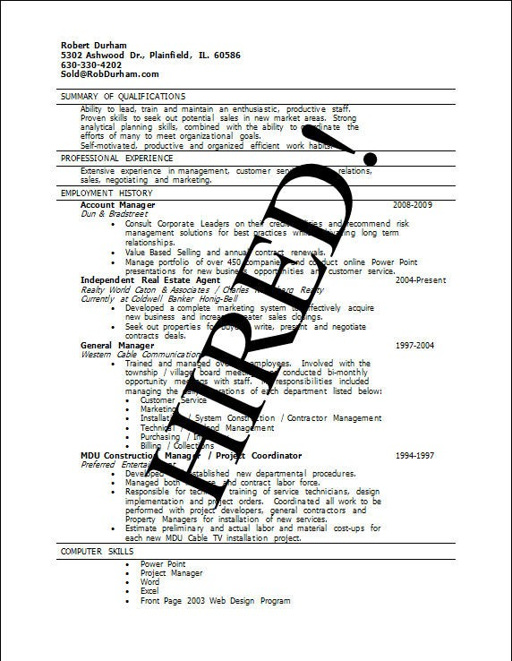
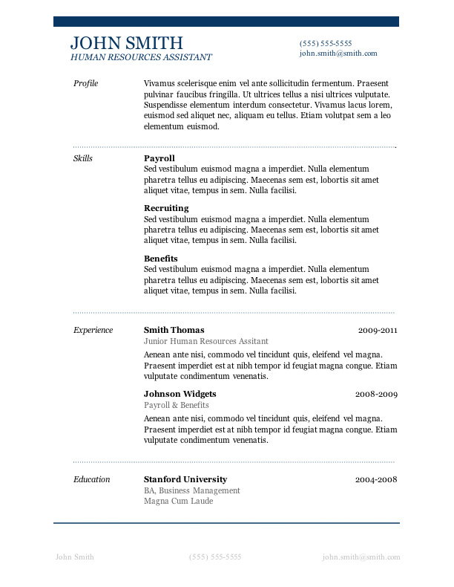

Slide 45
Homework
Following our guidelines write your resume
Target it to your preferred job position and employer
If you don't have work experience think how you could change this
If you don't have any projects, start a project (e.g. open-source in GitHub or Google Code)
E.g. create your own web site
Find people who can write endorsements for you

Slide 46
Writing a Resume
?
?
?
?
?
Questions?
?
?
?
?
?
?

Slide 47
Thank You!

