Slide 1

GPAT_Organic chemistry
Dr. Zamir G Khan
Assistant Professor
H R Patel Institute of Pharmaceutical Education and Research Shirpur, Dist. Dhule, (M.S) 425405

Slide 2
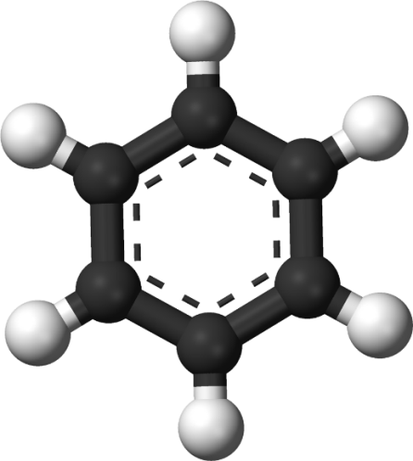
Introduction to aromatic compounds
Mr. Zamir G Khan
Assistant Professor
H R Patel Institute of Pharmaceutical Education and Research Shirpur, Dist. Dhule, (M.S) 425405

Slide 3
Learning Outcomes
After completion of this topic student shall be able to
Describe meaning of aromatic compounds
Differentiate between aliphatic and aromatic compounds
Describe resonance in benzene
Explain orbital structure of benzene

Slide 4
Aromaticity
hydrocarbons
aliphatic aromatic
alkanes alkenes alkynes

Slide 5
Aliphatic compounds: open-chain compounds and ring compounds that are chemically similar to open-chain compounds. Alkanes, alkenes, alkynes, dienes, alicyclics, etc.
Aromatic compounds: unsaturated ring compounds that are far more stable than they should be and resist the addition reactions typical of unsaturated aliphatic compounds. Benzene and related compounds.

Slide 6
Nomenclature for benzene:
monosubstituted benzenes:
Special names:

Slide 7
☺
Mercedes Benzene

Slide 8
Disubsituted benzenes:
ortho- meta- para-
1,2- 1,3- 1,4-

Slide 11
Resonance
We can draw more than one classic structure that differ only in where the electrons are.
The two structures are of the same energy, so resonance is important.
The molecule cannot be adequately represented by classic structures but must be thought of as a hybrid of the contributing structures.
Additionally, the hybrid is more stable than any of the contributing structures (resonance stabilization energy).
I
II
Hybrid

Slide 12
Resonance
Can you draw resonating structure of acetate ion and
carbonate ion?

Slide 13
Orbital picture of benzene
Structure of benzene is planar
All carbon-carbon bond length similar
Bond length is in between C-C single bond and C=C double bond
Six carbons in benzene are SP²
So each carbon has three hybrid orbitals
Two of which are used in formation of C-C sigma bond
One in formation of C-H sigma bond

Slide 14
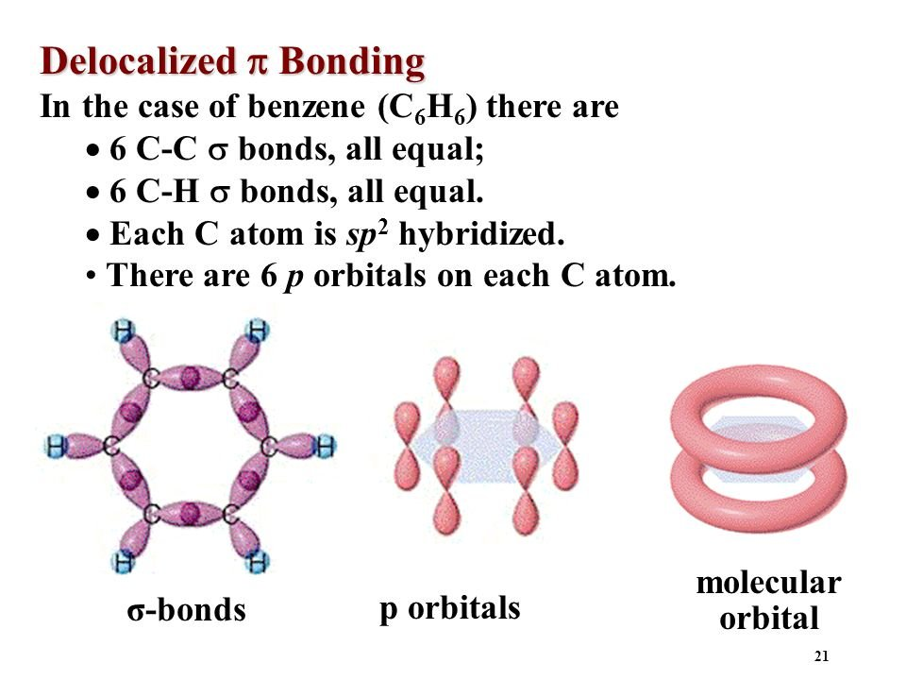
Orbital picture of benzene

Slide 15
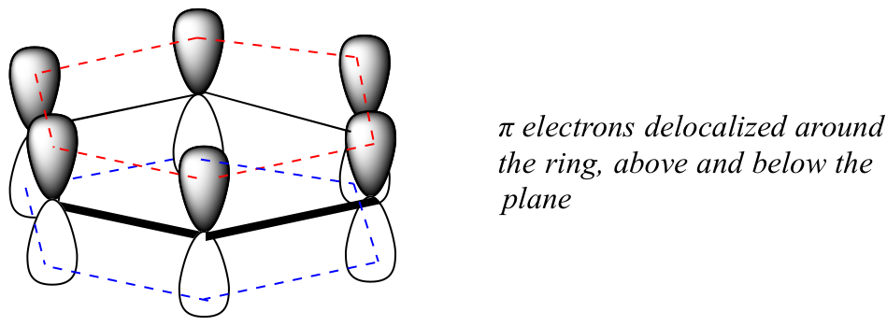
Orbital picture of benzene
Every carbon has p orbital with unpaired electron
In all six p orbital overlap sideway
Overlap sideways to form pi electron cloud above and below the plane of the ring
Due to this overlap six electrons are shared equally and this is known as delocalization of electrons

Slide 16
Orbital picture of benzene
It is evident that double bonds are not localized between any two carbons
There is continuous delocalization of pi electrons
This delocalization causes all six Carbon-Carbon bond lengths to be same (1.39Aº)
This value lies in between pure C-C bond length (1.54Aº) and C=C double bond (1.33Aº)

Slide 17
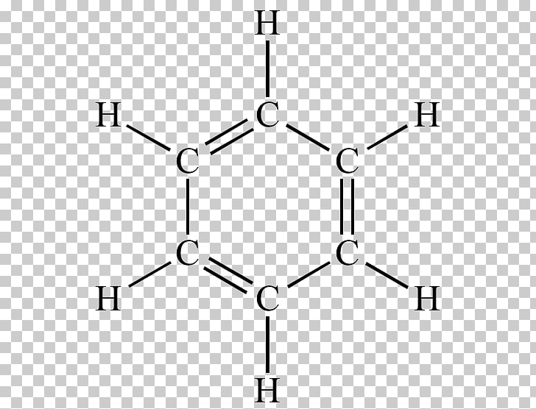
Orbital picture of benzene
C—C single bonds ≈ 1.54 Å
C = C double bonds ≈ 1.33 Å
The bonds in benzene are all equal and 1.39 Å
Bond angle 120º
Bond length 1.39 Å
SP²- SP² overlap
Bond angle 120º
Bond length 1.08 Å

Slide 18
Outcomes achieved
Summary
Student has gained knowledge and shall be able to
Describe meaning of aromatic compounds
Differentiate between aliphatic and aromatic compounds
Describe resonance in benzene
Explain orbital structure of benzene

Slide 19
Thank you
Mr. Z. G. Khan, Assist. Professor, H R Patel Institute of Pharmaceutical Education and Research Shirpur, Dist Dhule (M.S) 425 405
Email: khanzamir.5588@gmail.com
Webpage: https://khanzamir5588.wixsite.com/zamir
YouTube Channel: https://www.youtube.com/channel/UCsQae74-x4t5iYK02iPRTxA?view_as=subscriber
Whatsapp: +91 9890 044 661

