Slide 1
INDUCTIVE EFFECT & ELECTROMERIC EFFECT
PREPARED BY
MR. NARAYAN P. PAWAR
(PHARMACEUTICAL CHEMISTRY)

Slide 2

Inductive effect
Definition:- The polarization of σ bond due to electron withdrawing or electron donating effect of adjacent groups or atoms is called inductive effect.
Or
It is defined as permanent displacement of shared electron pair in carbon chain towards more electronegative atoms or group is called inductive effect.
CH3⁺ᵟ-Cl⁻ᵟ
Methyl chloride

Slide 3
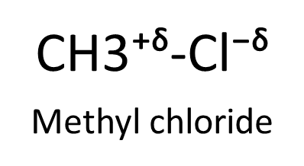

It involves σ electrons.
The σ electrons which forms a covalent bond are shared equally between the two atoms.
The inductive effect (I effect) refers to the polarity produced in a molecule as a result of higher electronegativity of one atom compared to another.
This is because different atoms have different electronegativity values.
This introduce a certain degree of polarity in the bond.
The more electronegative atom acquires a small negative charge (-δ).
The less electronegative atom acquires a small positive charge (+δ).

Slide 4

The inductive effect of C3 upon C2 is significantly less than the effect of the chlorine atom on C1.
It is distance dependent.
There are two types:
Electron-withdrawing/ attracting inductive effect (-I Effect)
Those atoms or groups which withdraw electrons away from another atoms are said to be –I effect.
e.g. –F, -Cl, -Br, -I, -OH, -NH2,….etc.

Slide 5

2) Electron- releasing/ losing inductive effect (+I effect)
Those atoms or groups which lose electrons towards another atom are said to be +I effect.
e.g. (CH3)3C- , (CH3)2CH- , CH3-CH2- , CH3-
Shifting of electrons in covalent bond from low electronegative atom to high electronegative atom.
Always sigma (σ) electrons are displaced (only occur in single boned).
it is permanent effect.

Slide 6

Electromeric effect:-
Definition:- The electromeric effect (E effect) refers to the polarity produced in a multiple bonded compound as it is approached by a reagent.
when a double or a triple bond is exposed to an attacking by a reagent, the two π electrons which form the π bond are completely transferred to one atom or the other.
e.g.

Slide 7


Slide 8

Their are two types of electromeric effect:
+ E effect :
If electron pair shifted towards the site where attacking reagent to be attached.
e.g.

Slide 9

2) – E effect :
If electron pair shifted away from the site where attacking reagent to be attached.
e.g.

Slide 10

Use of electromeric effect:
1)
2)
3)
Use of electromeric effect:
1)
2)
3)

Slide 11

Temporary effect, observed only in reaction.
It involves the π electron.
Displacement of pi (π) electron only.
Only occur in presence of attacking reagent.

Slide 12
THANK YOU

