Slide 1
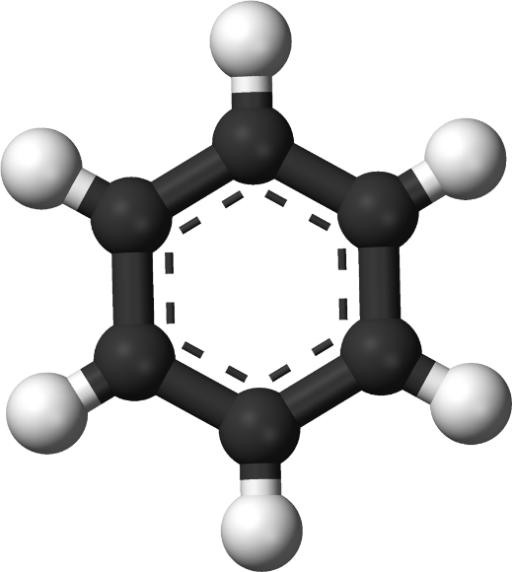
Introduction to aromatic compounds
Dr. Zamir G Khan
Assistant Professor
H R Patel Institute of Pharmaceutical Education and Research Shirpur, Dist. Dhule, (M.S) 425405

Slide 2
Learning Outcomes
After completion of this topic student shall be able to
Describe unusual reactivity of benzene
Explain resonance energy or stability of benzene
Describe nomenclature of aromatic compounds
Judge aromatic and non aromatic compounds

Slide 3
Unusual reactivity of benzene
If benzene is 1,3,5-cyclohexatriene as Kekulé proposed, what should its chemistry be?
Alkenes, dienes, cyclcoalkenes, etc. typically give addition reactions with electrophiles.
But benzene doesn’t undergo the reactions typical of unsaturated hydrocarbons!

Slide 4
Unusual reactivity of benzene
Reagent Cyclohexene Benzene
KMnO₄ | oxidation | no reaction
Br₂/CCl₄ | addition | no reaction
HI | addition | no reaction
H₂/Ni | reduction | no reaction

Slide 5
Question?
If benzene does not undergo reduction. How Birch reduction takes place?

Slide 6
Benzene + 3 H₂, Ni, room temp. → NR
Benzene + 3 H₂, Ni, 200ºC, 1500 psi → cyclohexane
Although highly unsaturated, benzene does not react like alkenes, dienes, cycloalkenes, or alkynes (addition reactions) rather it undergoes substitution reactions instead.

Slide 7
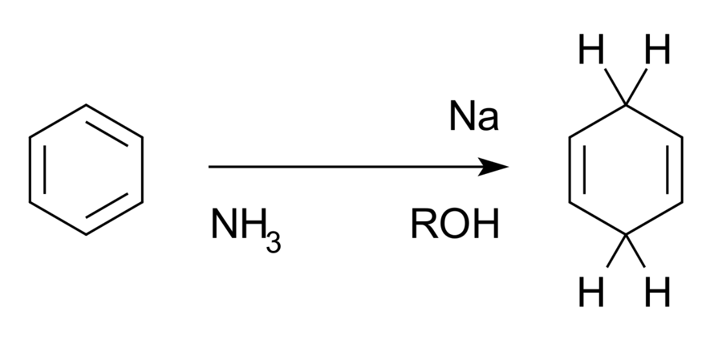
Answer
The Birch reduction is an organic reaction that is used to convert arenes to cyclohexadienes.
In this organic reduction of aromatic rings in liquid ammonia with sodium, lithium, or potassium and an alcohol, such as ethanol and tert-butanol. This reaction is unlike catalytic hydrogenation, which usually reduces the aromatic ring all the way to a cyclohexane.

Slide 8
Resonance energy or Stability of benzene
Aromaticity: cyclic conjugated organic compounds such as benzene, exhibit special stability due to resonance delocalization of pi electrons.
-119.6 KJ/mole
-239.2 KJ/mole
2x(-119.6)=239.2 KJ/mole
-208 KJ/mole
3x(-119.6)=358.8 KJ/mole
Resonance energy or delocalization energy
358.8-208=150.8 KJ/mole

Slide 9
Resonance energy or Stability of benzene
The low heat of hydrogenation of benzene means that benzene is especially stable—even more so than conjugated polyenes. This unusual stability is characteristic of aromatic compounds.
Benzene’s unusual behavior is not limited to hydrogenation. Benzene does not undergo addition reactions typical of other highly unsaturated compounds, including conjugated dienes.
Benzene does not react with Br₂ to yield an addition product. Instead, in the presence of a Lewis acid, bromine substitutes for a hydrogen atom, yielding a product that retains the benzene ring.

Slide 10
Nomenclature of Benzene Derivatives
Aromatic compounds are named according to the system devised by the International Union of Pure and Applied Chemistry (IUPAC).

Slide 11
Nomenclature of Benzene Derivatives
Aromatic compounds have many common names that have been accepted by IUPAC:
Toluene = methylbenzene
Phenol = hydroxybenzene
Aniline = aminobenzene

Slide 12
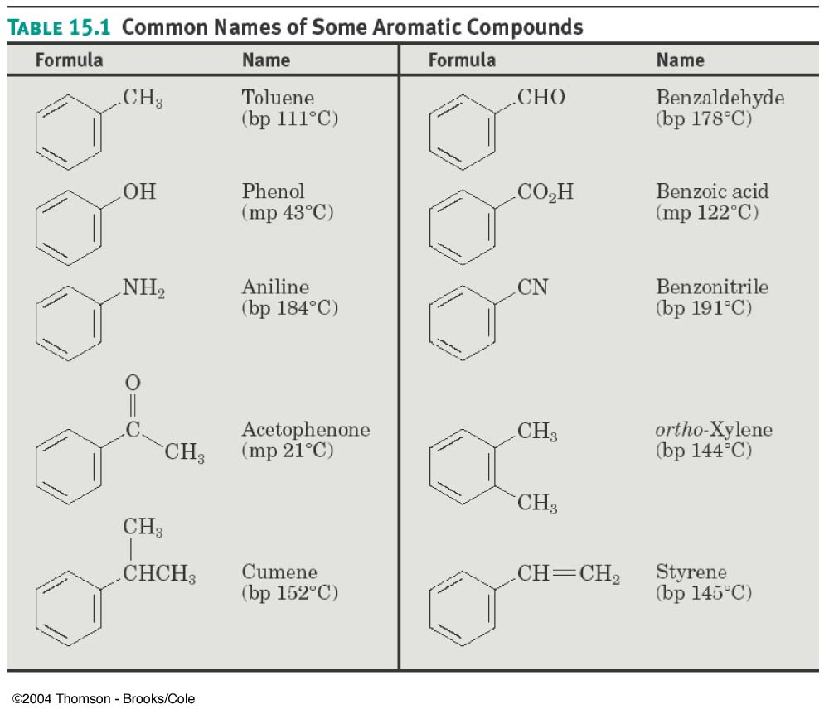
Nomenclature of Benzene Derivatives

Slide 13
Nomenclature of Benzene Derivatives
Monosubstituted benzenes, like hydrocarbons, are systematically named with –benzene as the parent name
C₆H₅Br C₆H₅NO₂ C₆H₅CH₂CH₂CH₃

Slide 14
Nomenclature of Benzene Derivatives
Arenes are alkyl-substituted benzenes
If # C_{substituent} < or = 6, then the arene is named as an alkyl-substituted benzene
If # C_{substituent} > 6, then the arene is named as a phenyl-substituted alkane

Slide 15
Nomenclature of Benzene Derivatives
“Phenyl” refers to C₆H₅ _
It is used when a benzene ring is a substituent
“Ph” or “φ” can also be in place of “C₆H₅ _”
“Benzyl” refers to “C₆H₅CH₂ _ ”

Slide 16
Nomenclature of Benzene Derivatives
Relative positions on a disubstituted benzene ring:
ortho- (o) on adjacent carbons (1,2 disubstituted)
meta- (m) separated by one carbon (1,3 disubstituted)
para- (p) separated by two carbons (1,4 disubstituted)

Slide 17
Nomenclature of Benzene Derivatives
The ortho- (o), meta- (m), and para- (p) nomenclature is useful to describe reaction patterns
Example: “Reaction of toluene with Br₂ occurs at the para position”

Slide 18
Nomenclature of Benzene Derivatives
Multisubstituted benzenes (more than two substituents) are named as follows:
Choose the sequence when the substituents have the lowest possible number
List substituents alphabetically with hyphenated numbers
Use common names, such as “toluene”, as parent name (as in TNT)

Slide 19
Nomenclature of Benzene Derivatives

Slide 20
Nomenclature of Benzene Derivatives
To name a benzene ring with one substituent, name the substituent and add the word benzene.
Many monosubstituted benzenes have common names which you must also learn.

Slide 21
Nomenclature of Benzene Derivatives
There are three different ways that two groups can be attached to a benzene ring, so a prefix—ortho, meta, or para—can be used to designate the relative position of the two substituents.
ortho-dibromobenzene
or
o-dibromobenzene
or 1,2-dibromobenzene
meta-dibromobenzene
or
m-dibromobenzene
or 1,3-dibromobenzene
para-dibromobenzene
or
p-dibromobenzene
or 1,4-dibromobenzene

Slide 22
Nomenclature of Benzene Derivatives
If the two groups on the benzene ring are different, alphabetize the names of the substituents preceding the word benzene.
If one substituent is part of a common root, name the molecule as a derivative of that monosubstituted benzene.

Slide 23
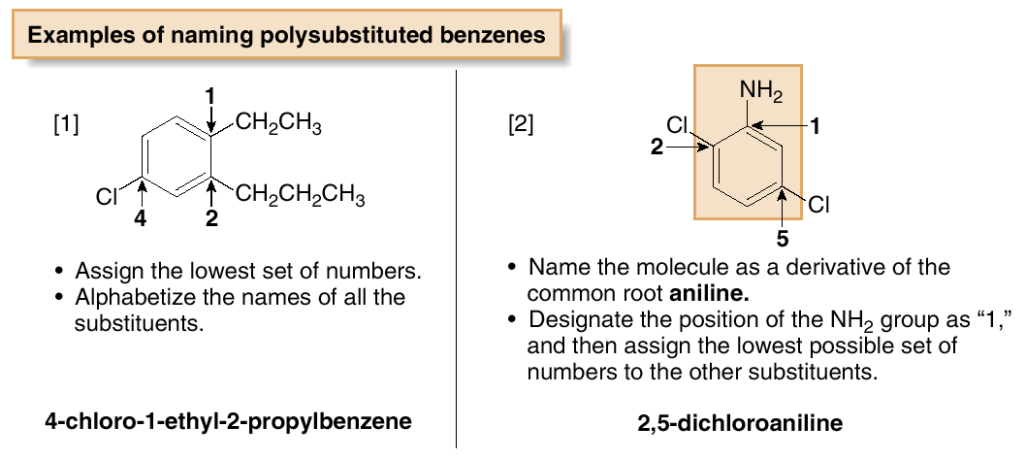
Nomenclature of Benzene Derivatives
For three or more substituents on a benzene ring:
Number to give the lowest possible numbers around the ring.
Alphabetize the substituent names.
When substituents are part of common roots, name the molecule as a derivative of that monosubstituted benzene. The substituent that comprises the common root is located at C1.

Slide 24
Nomenclature of Benzene Derivatives
A benzene substituent is called a phenyl group, and it can be abbreviated in a structure as “Ph-”.
Therefore, benzene can be represented as PhH, and phenol would be PhOH.

Slide 25
Nomenclature of Benzene Derivatives
The benzyl group, another common substituent that contains a benzene ring, differs from a phenyl group.
Substituents derived from other substituted aromatic rings are collectively known as aryl groups.

Slide 26
Practice Problem:
Draw structures corresponding to the following IUPAC names:
p-Bromochlorobenzene
p-Bromotoluene
m-Chloroaniline
1-Chloro-3,5-dimethylbenzene

Slide 27
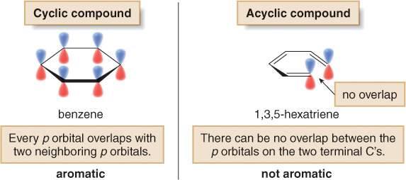
The Criteria for Aromaticity—Hückel’s Rule
Four structural criteria must be satisfied for a compound to be aromatic.
[1] A molecule must be cyclic.
To be aromatic, each p orbital must overlap with p orbitals on adjacent atoms.

Slide 28
[2] A molecule must be planar.
All adjacent p orbitals must be aligned so that the π electron density can be delocalized.
Since cyclooctatetraene is non-planar, it is not aromatic, and it undergoes addition reactions just like those of other alkenes.

Slide 29
[3] A molecule must be completely conjugated.
Aromatic compounds must have a p orbital on every atom.

Slide 30
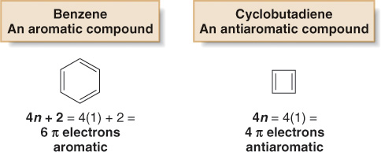
[4] A molecule must satisfy Hückel’s rule, and contain
a particular number of π electrons.
Hückel's rule:
Benzene is aromatic and especially stable because it contains 6 π electrons. Cyclobutadiene is antiaromatic and especially unstable because it contains 4 π electrons.

Slide 31
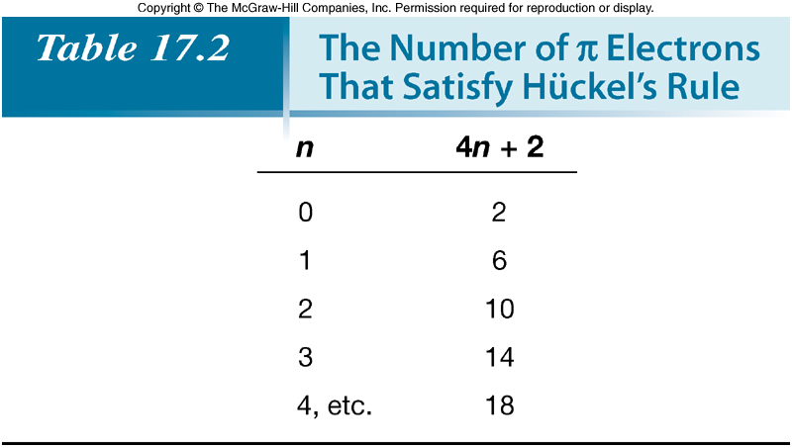
Note that Hückel’s rule refers to the number of π electrons, not the number of atoms in a particular ring.

Slide 32
The Criteria for Aromaticity—Hückel’s Rule
4 structural criteria must be satisfied for a compound to be aromatic:
Cyclic
Planar
Completely Conjugated
Follow Huckels rule (4n+2)

Slide 33
Outcomes achieved
Summary
After completion of this topic student shall be able to
Describe Unusual reactivity of benzene
Explain resonance energy or stability of benzene
Describe nomenclature of aromatic compounds
Judge aromatic and non aromatic compounds (Huckel’s Rule)

Slide 34
Thank you
Mr. Z. G. Khan, Assist. Professor, H R Patel Institute of Pharmaceutical Education and Research Shirpur, Dist Dhule (M.S) 425 405
Email: khanzamir.5588@gmail.com
Webpage: https://khanzamir5588.wixsite.com/zamir
YouTube Channel: https://www.youtube.com/channel/UCsQae74-x4t5iYK02iPRTxA?view_as=subscriber
Whatsapp: +91 9890 044 661

