Slide 1
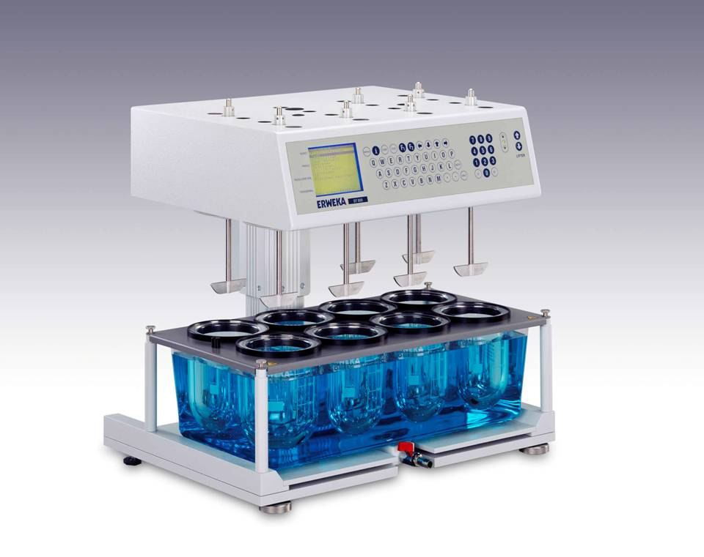
IN-VITRO DISSOLUTION
TESTING MODELS
1

Slide 2
INTRODUCTION:
“Dissolution is a process by which a solid enters into the solution i.e.
mass transfer from solid surface to liquid phase”.
Dissolution testing of pharmaceutical forms is considered as one of the
most important quality control tool for assessing the efficiency of a
product in -vivo.
The process of dissolution of an active ingredient from dosage form involves several intermediate steps like wetting, swelling , solubility and diffusion.
Dissolution can be regarded as a RATE process…higher the rate, greater will be the dissolution.

Slide 3
IMPORTANCE OF DISSOLUTION TESTING:
As reliable Predictor of in vivo dissolution performance of drug.
A Rate limiting factor in determining the physiological availability of drug.
As Quality control tool for monitoring the uniformity and reproducibility
of production batches.
As Research tool in optimizing parameters and ingredients in new drug
formulation.
It is widely accepted as animal experimentation has been restricted
under the Act of Prevention of cruelty of animals.

Slide 4
DOSAGE FORMS REQUIRING DISSOLUTION :
TABLETS ( COATED AND UNCOATED ).
CAPSULES
SUPPOSITORIES
SUSPENSIONS
TOPICAL DOSAGE FORMS LIKE CREAMS,GELS,OINTMENTS,etc.
TRANSDERMAL PATCHES.

Slide 5
FACTORS FOR DESIGNING DISSOLUTION TEST :
1)Factors related to the dissolution apparatus:
  Size of container (several ml to ltrs)
  Shape of container (round bottomed or flat)
  Nature of agitation (stirring, rotating or oscillatin)
  Speed of agitaiton
  Performance precision of the apparatus etc
2)Factors related to the dissolution fluid (media):
  Composition of dissolution media (pH range 1- 8, water etc)
  Temp.
  Viscosity
  Volume
  Sink condition
  Non-sink condition
3)Process parameters:
  Method of introduction of dosage form
  Sampling techniques
  Changing dissolution media

Slide 6
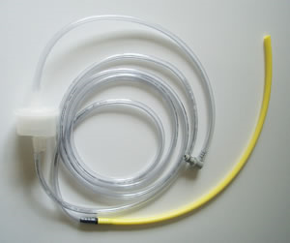
DISSOLUTION MEDIA :
COMMON DISSOLUTION MEDIA USED :
(suggested by different Guidelines.)
Purified water.
Diluted acid (o.1 N HCl ).
Buffered aqueous solutions.
Simulated gastric fluid (with or without enzymes).
Simulated intestinal fluid (with or without enzymes).

Slide 7
1)Dissolved gases-These should be removed prior to dissolution testing.
Dissolved gas can alter the p^{H} of media e.g. Distilled water p^{H} = 6
Deaerated water pH= 7.2
METHODS OF DEGASSING ( DEAEARTION) OF MEDIA :
1) HELIUM SPARGING.
2) VACUUM DEGASSING.
3) HEATING AND FILTRATION
4) BOILING.
FACTORS AFFECTING SELECTION OF DISSOLUTION MEDIA :

Slide 8
2) Composition of dissolution media.-Enzymes ,surfactants ,etc a) ENZYMES like pepsin, pancreatin ,etc. are added for degradation of gelatin which otherwise developes cross-links and with aging becomes insoluble in media slowing down the dissolution rate. b) Two natural surfactants : 1) bile salts .
2) phospholipids. c) Two intestinal surfactants : 1) fatty acids . &
2) monoglycerides. (both in fed state.)
Bile salts in GI tract facilitate dissolution of non polar drugs and hence the surfactants like SLS are added in 0.5 – 2% conc.
Sources of bile : 1) Porcine extract.
2) Soybean phosphoilipids.

Slide 9
3) P^{H} OF DISSOLUTION MEDIA- pH of dissolution media should be always greater than pka of the drug for complete dissolution of drug.
4) VISCOSITY OF DISSOLUTION MEDIA :
Dissolution rate decreases with increase in viscosity of dissolution medium .
5) SURFACTANT : The surfactants are added into the dissolution media for improving the wetting characteristics of the drug … e.g. SLS, TWEEN 80, etc.
6) TEMPETATURE :
It us kept at 37 ± 0.5 º C for almost all types of dosage forms except transdermals for which an ideal temp. would be 32 ± 0.5 ºC.
Any change in temp. brings the change in dissolution rate….

Slide 10
Based on principles of absence or presence of sink condition
Closed Compartment Apparatus
Eg. USP Type- I Basket Type
USP Type- II Paddle Type
OPEN Compartment Apparatus
(Continuous flow through apparatus)
Eg. USP Type- III Reciprocating Cylinder
USP Type- IV Flow Through Cell
USP Type- V Paddle Over Disk
USP Type- VI Rotating Cylinder
USP Type- VII Reciprocating Holder
Dialysis system
TYPES OF DISSOLUTION APPARATUS:

Slide 11

OFFICIAL DISSOLUTION APPARATUS :(USP)
USP Type- I Basket Type
USP Type- II Paddle Type
USP Type- III Reciprocating Cylinder
USP Type- IV Flow Through Cell
USP Type- V Paddle Over Disk
USP Type- VI Rotating Cylinder
USP Type- VII Reciprocating Holder

Slide 12
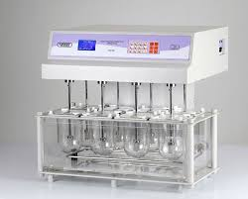
USP TYPE I : BASKET TYPE APPARATUS.

Slide 13

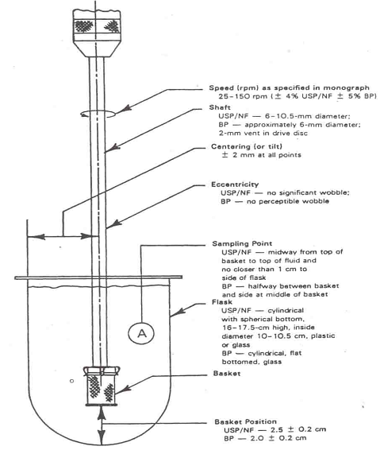
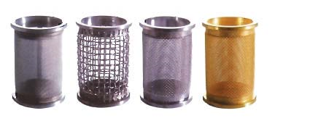
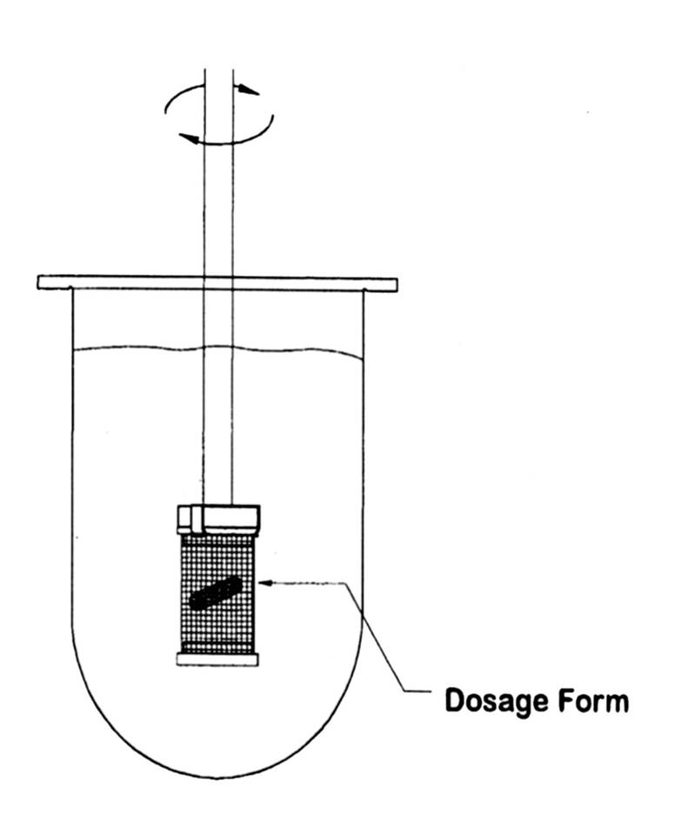
USP TYPE I : BASKET TYPE APPARATUS.
Pernarowski et al. comprising of cylindrical glass vessel with hemispherical bottom

Slide 14
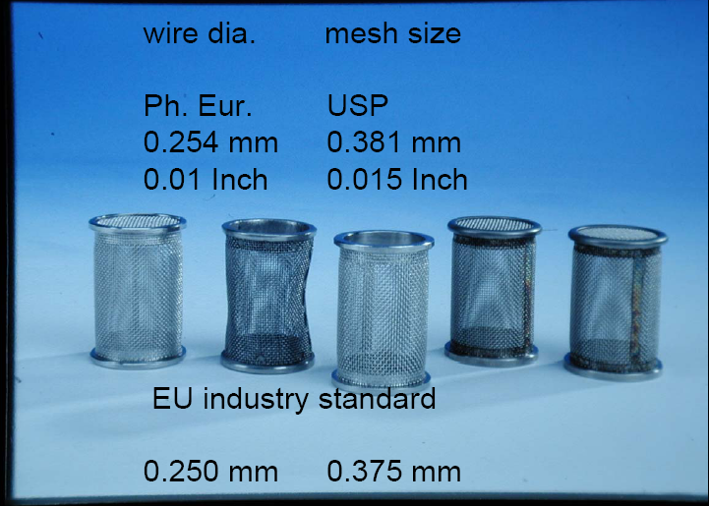

Slide 15
VESSEL:
SHAFT ROTATION- 25-150 rpm .
BASKET – Height= 2.8 cm & Diameter= 2.2 cm. 10,22 or 40 mesh sieve.( clog).
MATERIAL OF CONSTRUCTION- stainless steel type 316.
BASKET POSITION- The distance between the inside bottom of the vessel and the basket is maintained at 25 ± 2 mm during the test.
TEMP. – 37± 0.5 ºC.
A basket with 2.5 µ GOLD COATING may be used.
USP TYPE I : BASKET TYPE APPARATUS.
Capacity | Height | Diameter
1 lit. | 160-210 mm | 98-106 mm
2 lit. | 280-300 mm | 98-106 mm
4 lit. | 280-300 mm | 145-155 mm

Slide 16
USP TYPE II : PADDLE TYPE APPARATUS.

Slide 17
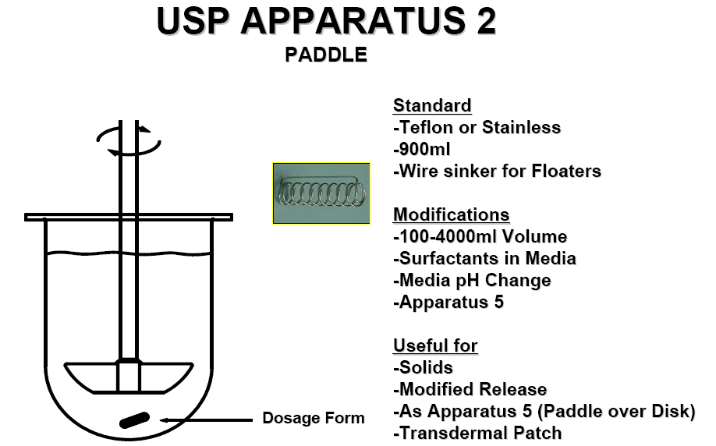
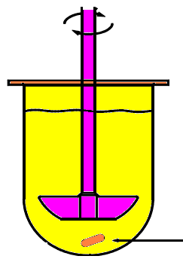
Levy & Hayes comprising of cylindrical glass vessel with hemispherical bottom

Slide 18
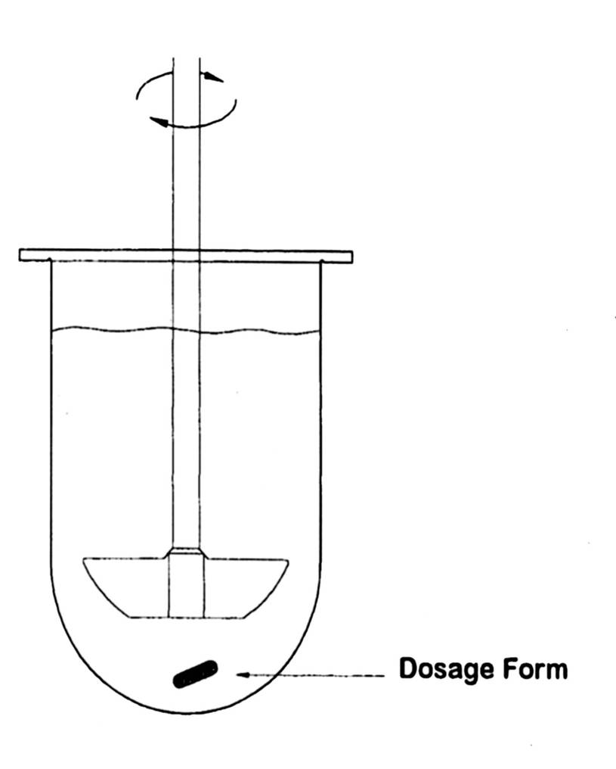
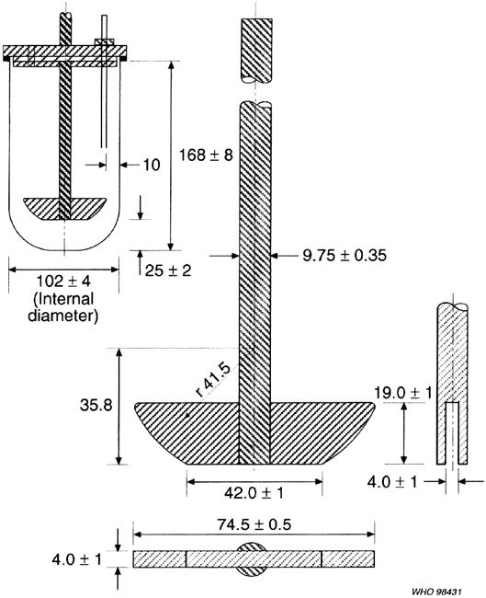
USP TYPE II : PADDLE TYPE APPARATUS.

Slide 19
VESSEL-
SHAFT ROTATION- 25-150 rpm
MATERIAL OF CONSTRUCTION-stainless steel type 316.
BLADE POSITION- The distance between the inside bottom of the vessel and the blade is maintained at 25 ± 2 mm during the test.
TEMP- 37± 0.5 ºC.
Disadvantage: 1)Cone formation at the bottom of the vessel.
So need of CRESCENT SHAPED PADDLE.
2) It needs sinkers for floating dosage units.
USP TYPE II : PADDLE TYPE APPARATUS

Slide 20
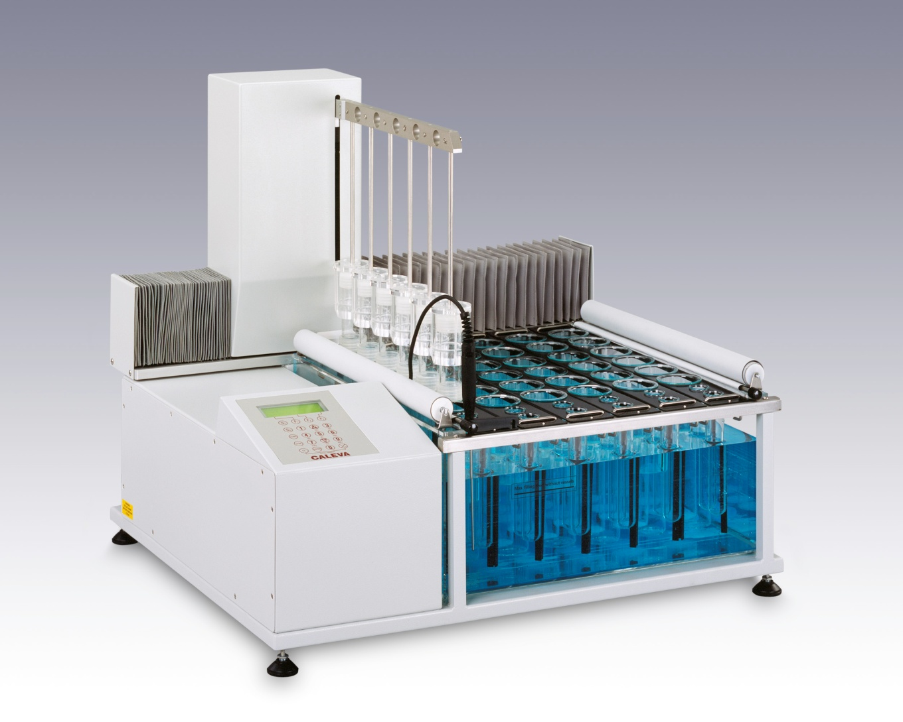
USP TYPE III : RECIPROCATING CYLINDER.

Slide 21
USP TYPE III : RECIPROCATING CYLINDER.
set of cylindrical bottomed glass vessels equipped with reciprocating cylinder

Slide 22
Glass reciprocating cylinder- length =100± 1 mm, diameter=21-26 mm.
GLASS VESSEL- length= 180 ± 1 mm, diameter= 47 ± 1.4 mm.
MESH SCREEN- 19 ± 1.
DURING UPWARD AND DOWNWARD STROKE, THE RECIPROCATING VYLINDER MOVES THROUGH A DISTANCE OF 9.9- 10.1 cm.
Temp.- 37± 0.5 ºC.
USP RS: 1) CHLORPHENIRAMINE EXT. RELEASE TAB. (single unit )
2)THEOPHYLLIN EXT. RELEASE TAB. (multiple unit )
USP TYPE III : RECIPROCATING CYLINDER

Slide 23
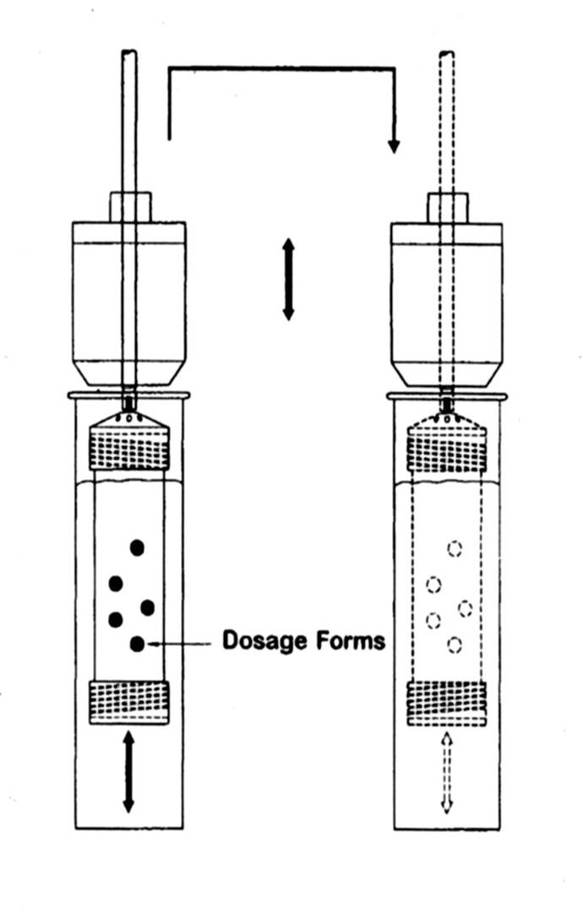

USP Apparatus 3
Reciprocating Cylinder
Procedure:-
Place the dissolution medium in each vessel
Place 1 dosage form unit in each of the 6 reciprocating cylinder
During upward & downward stroke reciprocating cylinder moves through a total distance of 9.9 to 10.1cm
Useful for:-
  Tablets
  Beads
  Controlled release
  Formulation.
Standard volume:-
  200-250 ml per station

Slide 24
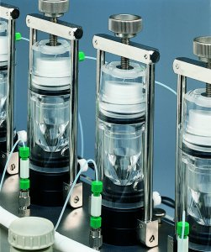
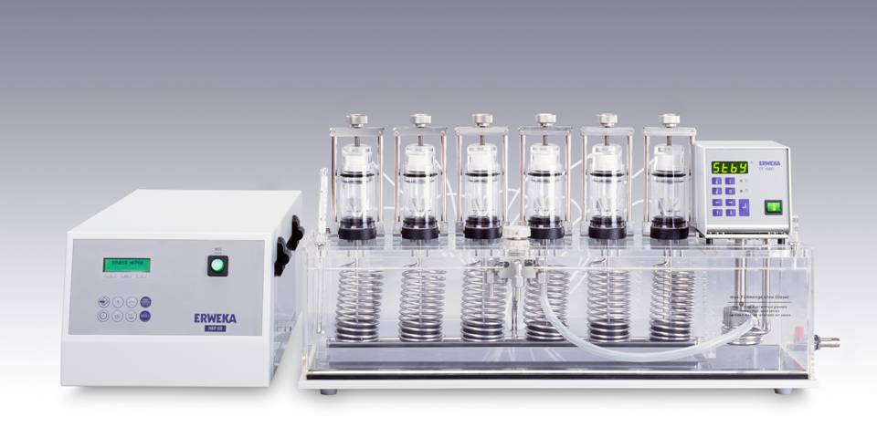
USP TYPE- IV : FLOW THROUGH CELL

Slide 25
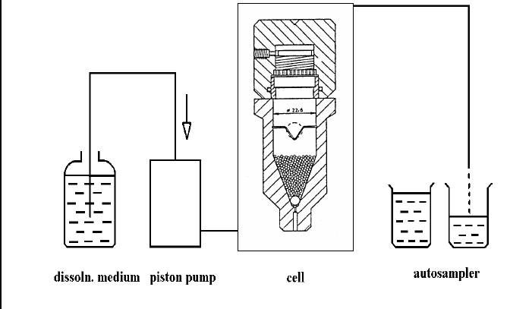
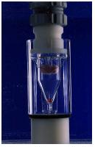
USP TYPE- IV : FLOW THROUGH CELL
Reservoir for dissolution medium and pump that forces diss. Medium through the cell holding sample

Slide 26
Std . Cell Diameter -12mm and 22.6 mm.
Std .flow Rate- 4 ,8, 16 ml/min.
Std .pump delivery range- 240-960 ml/hr.
Sieve size- 40 mesh.
The bottom is filled with small glass beads of about 1mm diameter with one bead of about 5 mm diameter ( RUBY BALL ) to protect the fluid entry tube.
TEMP.-37± 0.5 ºC.
ADVANTAGES : It permits convenience of changing pH during disso. Test.
Each time the released drug particles came in contact with the fresh solvent .
USP TYPE- IV : FLOW THROUGH CELL

Slide 27
FLOW-THROUGH CELL APPARATUS
Procedure:-
Place dissolution medium in vessel
Place glass beads of a suitable size,0.9-1mm in diameter,with 1 bead of 4.5-5.5mm in diameter at the bottom of the cone to protect fluid
entry of the tube.
Warm the dissolution medium & introduce it through the bottom of the cell using a pump to obtain suitable continuous flow at specific rate.

Slide 28
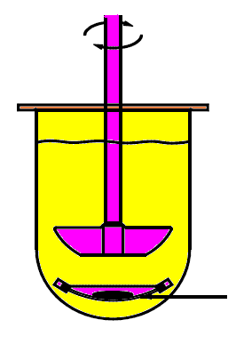
USP TYPE V : PADDLE OVER DISK
Dosage unit kept on the disk assembly.

Slide 29
A stainless steel disk assembly is used for holding the transdermal system at the bottom of the vessel.
The distance between the paddle and the surface of the disk is kept 25 ± 2 mm.
The release surface of the trans dermal patch is kept such that it’s release surface faces upward and parallel to the edges of the blade.
The transdermal system may be attached to the disk assembly by applying a suitable adhesive.
TEMP.- 32± 0.5 ºC.
USP TYPE V : PADDLE OVER DISK

Slide 30
Procedure:-
Place the dissolution medium in the vessel
Apply the transdermal system to the disk assembly.place the disk assembly flat at the bottom of the vessel with the release surface facing up & parallel to the edge of the paddle blade & surface of the dissolution medium.
The system may be attached to the disk by applying a suitable adhesive to the disk assembly.dry for 1 min.the bottom edge of the paddle is 25mm from the surface of the disk assembly.operate the apparatus.

Slide 31
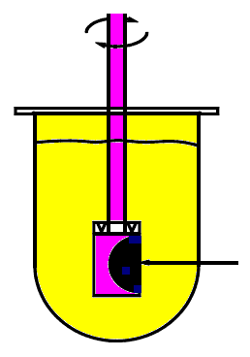
USP TYPE VI : ROTATING CYLINDER
Inert porous cellulosic support

Slide 32
Here basket and shaft are replaced by the cylinder stirring elements.
The dosage unit is kept on the cylinder.
The distance between the inside bottom of the vessel and the cylinder is kept at
25 ± 2 mm.
TEMP.- 32± 0.5 ºC.
It is useful for TRANSDERMAL SYSTEMS AND SEMISOLID DOSAGE
FORMS.
USP TYPE VI : ROTATING CYLINDER

Slide 33
USP TYPE VII : RECIPROCATING HOLDER
Transdermal patch holders for apparatus 7 :
Inert porous cellulosic support

Slide 34
It consist of a set of volumetrically calibrated or tared containers of glass or other suiatable inert material , a motor and a set of sample holders.
A drive assembly reciprocate the cylinder vertically.
TEMP.- 32± 0.5 ºC.
It is useful for assesing the in vitro dissolution of extended release tablets and transdermal drug delivery systems.
USP TYPE VII : RECIPROCATING HOLDER

Slide 35
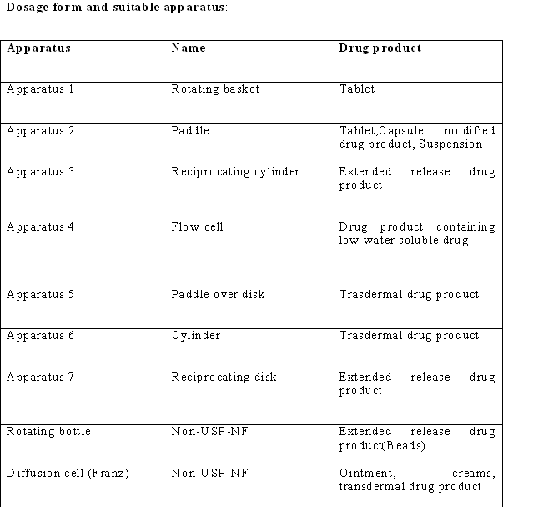
OFFICIAL DISSOLUTION APPARATUS :

Slide 36
SELECTION OF APPROPIATE APPARATUS FOR PARTICLULAR
DOSAGE UNIT :
SR. NO. | DOSAGE FORM. | DISSOLUTION TACHNIQUE.
1 | Orally disintegrating tablets. | Paddle type ( 50 rpm )
2 | Chewable tablets. | Reciprocating cylinder.
3 | Capsules. | Paddle type and flow through cell .
4 | Suppositories. | Basket , paddle & flow through cell.
5 | Oral suspension High viscosity Low viscosity | Paddle type 25 rpm. 50 rpm.
6 | Semisolid dosage forms. | Flow through cell AND franz cell.
7 | TDDS . | TYPE 5 , 6 , 7 .
8 | Solid dispersions | Flow through cell under non -sink condition.

Slide 37
IN- VIVO & IN -VITRO CORRELATION
1) Dissolution rate Vs Absorption Rate.
2) % of drug Dissolved Vs % of drug Absorbed.
3) Maximum drug conc. Vs % of drug dissolved in vitro.
4) Serum drug conc. Vs % of drug dissolved.

Slide 38
1) United State Pharmacopoeia , The National Formulary, 2002,
20th Edition, United State Pharmacopoeial Convention INC,
Washington , 711,2011.
2) Remington , The Science And Practice of Pharmacy , Volume 1,
21st Edition, Indian Edition, B. I. Publications Pvt. Ltd.,654-665.
3) Banakar , U.V. 2000, Pharmaceutical Dissolution Technologies , volume 49. Marcel Dekker INC,N.Y.,174-175,280 .
4) Subramanyam C.V.S. 2006,Textbook Of Physical Pharmaceutics,
2nd Edition , Vallabh Prakashan,Delhi,88-90 .
BIBLIOGRAPHY :

Slide 39
5) Jennifer Dressman , Johannes Cramer, Pharmaceutical Dissolution
Testing 2005, Taylor and Francies Group, 5- 35.
6) Brahmankar D.M., Jaiswal S.B., Biopharmaceutics And Pharmacokinetics
- A Tretise, Ist Edition, Vallabh Prakashan, 19-25.
7) Encyclopedia Of Pharmaceutical Technology; James Swarbrick,
James C. Boylan; 2nd Edition; Volume-1st ,718-724 .
8) Pharmaceutical Dosage Forms: Tablets, Vol.2, 2nd Edition,
Herbert A. Lieberman, Leon Lachman And Joseph B. Schwartz ,
404 .

Slide 40
www.ijpsonline.com www.pubmed.com www.google.com www.dissotech.com www.sciencedirect.com www.bing.com
SOME RESEARCH ARTICLES FROM EUROPIAN JOURNAL OF
PHARMACEUTICLE SCIENCES & PPT FROM GOOGLE AND OTHER SEARCH ENGINE
WEBSITES :

Slide 41


