Slide 1
IVIV CORRELATION
&
BIOEQUIVALENCE STUDY

Slide 2
DEFINITIONS
3,4
USP definition
“The establishment of rational relationship b/w a biological property or a parameter derived from a biological property produced by a dosage form and physicochemical property of same dosage form”
FDA definition
“It is predictive mathematical model describing the relationship b/w in-vitro property of dosage form and a relevant in-vivo response”

Slide 3
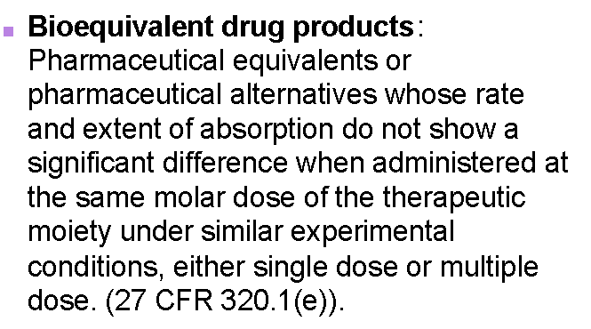

Slide 4
Examples

Slide 5
Types of equivalence
Chemical equivalence
It indicates that two or more
drug products contain the same labeled
chemical substance as an active ingredient in same amount.

Slide 6
Pharmaceutics equivalence
This term implies that two or more drug products are identical in strength, quality, purity & content uniformity and disintegration & dissolution characteristics, they may however differ in containing different excipients.

Slide 7
Therapeutic equivalence
Two or more drug products that contain the same therapeutically active ingredient, elicit identical pharmacological effects & control the disease to the same extent.

Slide 8
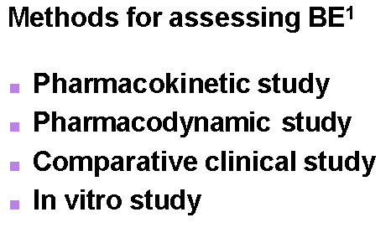

Slide 9
When do we do BE studies ?
Clinical Service Form to Final Market Form
Change of formulations (capsules to tablet)
Generic Formulations
Change of Process or manufacturing site (some times)

Slide 10
PURPOSE OF IVIVC
Key goal in development of dosage form is good understanding of in vitro and in vivo performance of dosage form.
Formulation optimization requires altering some parameters bioavailability studies.
Avoid to delay in marketing, added in time and cost.
Regulatory guidance developed to minimize the additional bioavailability studies.

Slide 11
The guidance is referred as in vitro in vivo correlation.
Surrogate for in vivo bioavailability study.
Optimization of manufacture process and Economic condition

Slide 12
IMPORTANCE
1,4
Serves as a surrogate of in vivo and assist in supporting biowaivers.
Validates the use of dissolution methods and specification.
Assist in QC during mfg and selecting the appropriate formulation.
Batch to batch consistency in physiological performance

Slide 13
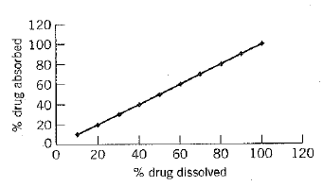
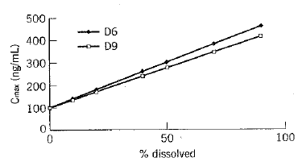
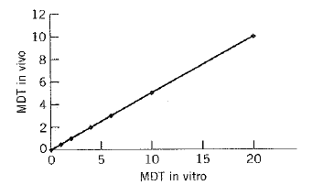
Levels of IVIVC
Level A
Level A – point-point corelation b/w in vivo %drug absorbed, then compare with %dissolved in vitro
Level B – Statistical moments; MRT or MDT in vivo vs. MDT in vitro
Level C – single point; PK parameter vs. %dissolved
Level C
Level B
Level A
Malinowski and Marroum, Encyclopedia of Contr. Drug Deliv.

Slide 14
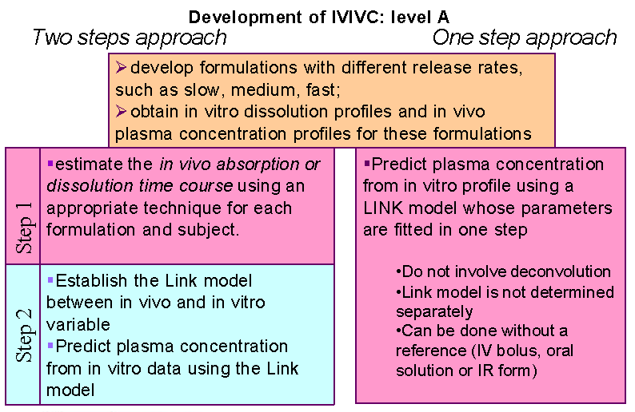

Slide 15
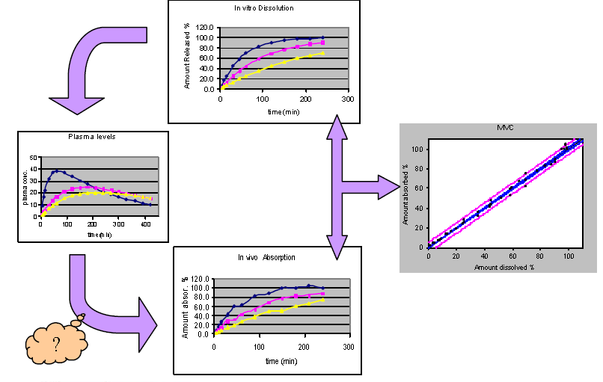
LINK MODEL

Slide 17
1,4

Slide 18
Biopharmaceutics Drug Classification
for Extended Release Drug Products.
CLASS | SOLUBILITY | PERMABILITY | IVIVC
IA | High & Site Independent | High and site independent | Level A expected
IB | High & site Independent | Dependent on site | Level C expected
IIa | Low & site Independent | High and site independent | Level A expected
IIb | Low & site independent | Dependent on site narrow abs. window | No IVIVC
Va: | variables | variables | No IVIVC
Vb: | variables | variables | Level A expected

Slide 19
Generation of In-Vitro Release Profile
USP apparatus 1 (basket, 100 rpm) or 2 (paddle, 50&75 rpm)
Aqueous dissolution medium, 900 ml
pH 1-1.5, 4-4.5, 6-6.5 & 7-7.5 at 37⁰C
A surfactant may be required (For low solubility drugs)
In-vitro food effect
Rotating dialysis cell method
Effects of oils, enzymes and pH

Slide 20
In vitro dissolution:
Compendial method (justify other method)
The dissolution profiles of at least 12 individual dosage units
from each lot should be determined
difference factor f1, similarity factor f2

Slide 21
In vivo absorption (Bioavailability studies)
Number of subjects : 6 to 36.
Crossover studies are preferred
formulations with different release rates
same moiety as measured in vitro
Washout period of at least five half-lives.
BA assessed from Plasma or urine data
AUC, Cmax, Tmax
In vivo absorption- Wagner-Nelson, Loo-Riegelman, and numerical
convolution methods.

Slide 22
Generation of In-Vivo Release Profile
Compartmental Models
Wagner-Nelson
Loo-Riegelman
Linear Systems Models
Deconvolution
Convolution
Mathematically they all yield the same result

Slide 23
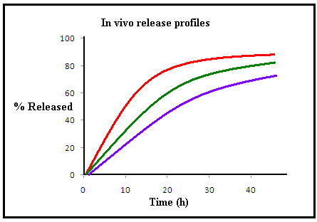
First step:
Calculation of in vivo release profiles from plasma concentrations of an
oral solution and different formulations

Slide 24
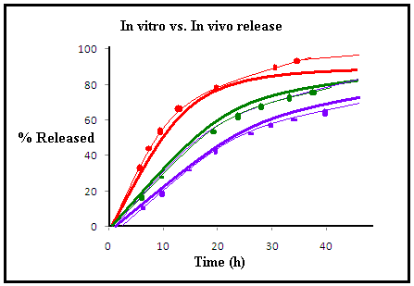
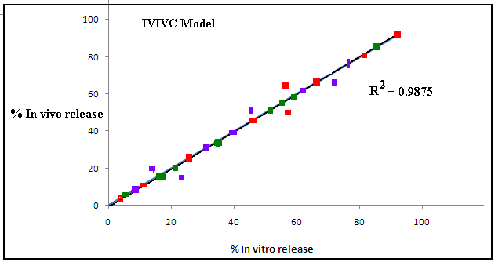
Second step:
Comparison of calculated in vivo release with in vitro release data for the same formulations and establishment of a quantitative correlation model using a linear or non-linear regression

Slide 25
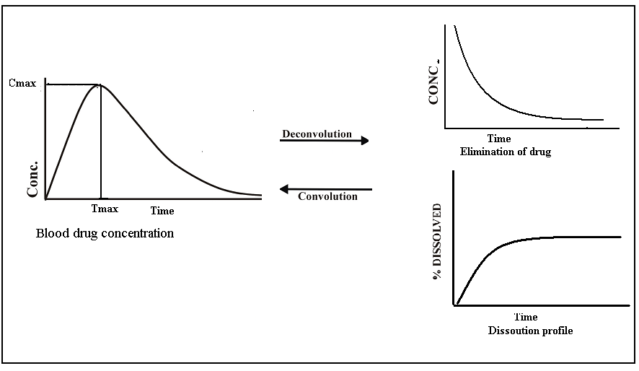
IVIVC MODELS

Slide 26
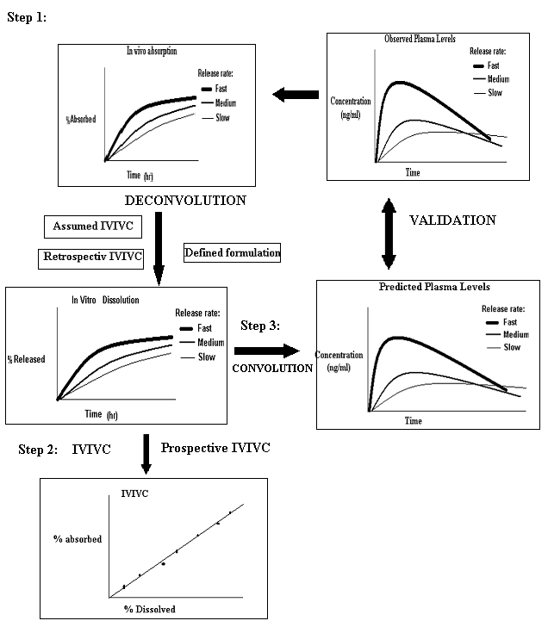
IVIVC DEVELOPMENT

Slide 27
IVIVC in the product development process for extended-release products
J.Emami, J Pharm Pharmaceut Sci (www.cspscanada.org) 9(2):169-189, 2006

Slide 28
IVIVC Model Predictability (Validation)
For Cmax:
For AUC:
Acceptance criteria: According to FDA guidance
≤15% for absolute prediction error (%P.E.) of each formulation.
≤ 10% for mean absolute prediction error (%P.E.)

Slide 29
Design & Evaluation of Bioequivalence Studies ¹
This studies are performed to compare the generic drug product to the brand-name product.
Statistical techniques should be of sufficient sensitivity to detect differences in rate & extent of absorption.

Slide 32
GENERIC DRUG

Slide 33
REFERENCES
Brahmankar D.M. ,Jaiswal S.B. “Biopharamaceutics and pharmacokinetics” ;A Treatise ,2nd ed. ,Vallabh Prakashan, p. 332-336.
Tipnis H.P. ,Bajaj A. “Principle and application of Biopharamaceutics and pharmacokinetics” ,1st ed., Carrier Publication ,p. 332-350.
Shargel L. ,Wa-Pong S. ,Andrew B.C. Yu. “Applied Biopharamaceutics and pharmacokinetics” ,5th ed. ,Mc Graw Hill company ,p.434-436.
Amitava Ghosh, “A Review Journal of Pharmacy Research” vol-2 2009 p. 1255-1260.
www.Google.com

