Slide 1
LIPIDS

Slide 2
Lipid chemistry
Definition
Classification
Biological importance

Slide 3
Lipid chemistry
Organic substances relatively insoluble in water but soluble in organic solvents like chloroform, ether and benzene
Definition

Slide 4
Classification of Lipids
Simple lipid
Complex lipid
Derived lipids

Slide 5
Simple lipids
They are esters of FA with various alcohols
D/U the type of alcohols these are subclassified as
Neutral fats or oils
Waxes
Alcohol is other than glycerol
Alcohol is GLYCEROL

Slide 6
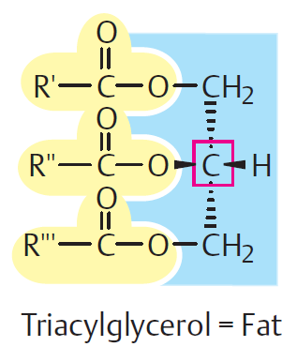
Neutral Fats or Oils
Esters of FA with alcohol GLYCEROL
Uncharged

Slide 7
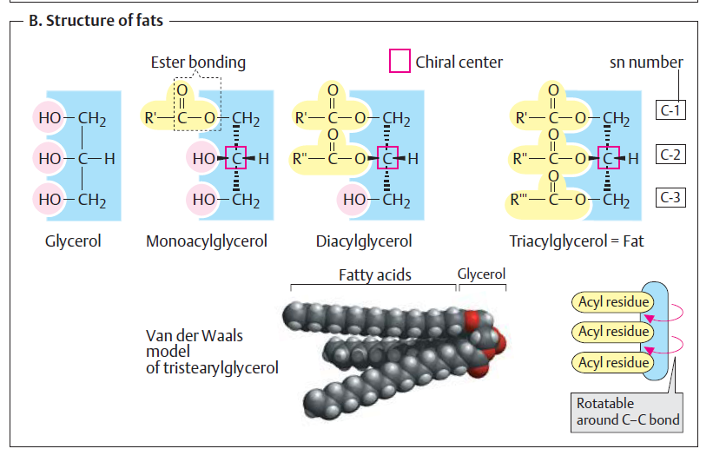

Slide 8
WAXES
Esters of FA with higher molecular weight monohydric alcohols
EXAMPLES
Lanolin
Beeswax
Whale sperm oil

Slide 9
Complex lipids
These are esters of FA with alcohol containing additional[prosthetic] groups.
Subclassified according to the type of prosthetic group
Phospholipids
Glycolipids
Lipoproteins

Slide 10
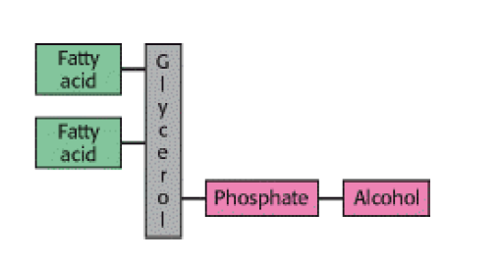
Phospholipids
FA + ALCOHOL + PHOSPHORIC ACID
They frequently have nitrogen containing bases

Slide 11
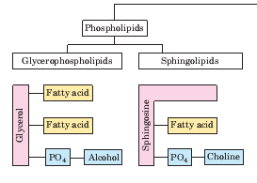
Phospholipids
Phospholipids may be classified on the basis of the type of alcohol present

Slide 12
A. Glycerophospholipids
B. Spingophospholipids
Alcohol is GLYCEROL
Alcohol is SPINGOSINE
Phosphatidylcholine
Phosphatidyl ethanolamine
Phosphatidyl serine
Phosphatidyl inositol
Plasmalogens
Cardiolipins
Spingomyelins

Slide 13
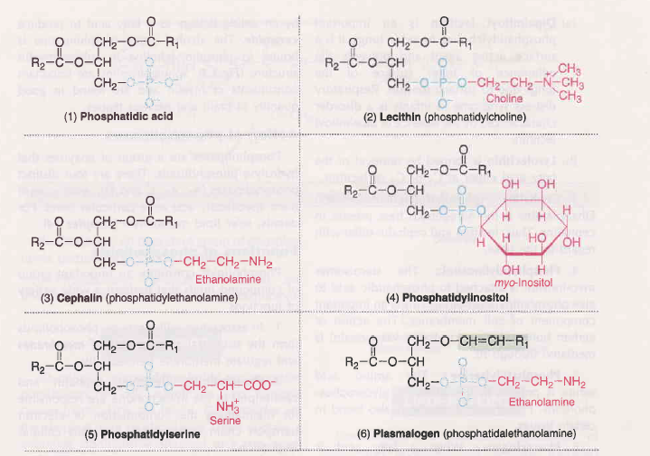

Slide 14
Sphingophospholipid

Slide 15
Functions of phospholipids
In association with proteins phospholipids form the structural components of
membranes and regulate membrane permeability.
Phospholipids participate in the absorption of fat from the intestine.
Essential for the synthesis of different lipoproteins, and thus participate in the
transport of lipids.
Accumulation of fat in liver (fatty liver) can be prevented by phospholipids, hence
they are regarded as lipotropic factors.
Arachidonic acid, an unsaturated fatty acid liberated from phospholipids, serves as a
precursor for the synthesis of eicosanoids (prostaglandins, prostacyclins,
thromboxanes etc.).

Slide 16
Functions of phospholipids
Phospholipids participate in the reverse cholesterol transport and thus help in the
removal of cholesterol from the body.
Phospholipids act as surfactants (agent lowering surface tension).
Cephalins,an important group of phospholipids participatin blood clotting.
Phospholipids( phosphatidyl inositoal ) involved in signal transmission across membranes.

Slide 17
Glycolipids
FA + ALCOHOL[SPINGOSINE] +CARBOHYDRATE WITH NITROGEN BASE
They do not contain phosphate group
Example
Cerebrosides
Gangliosides

Slide 18
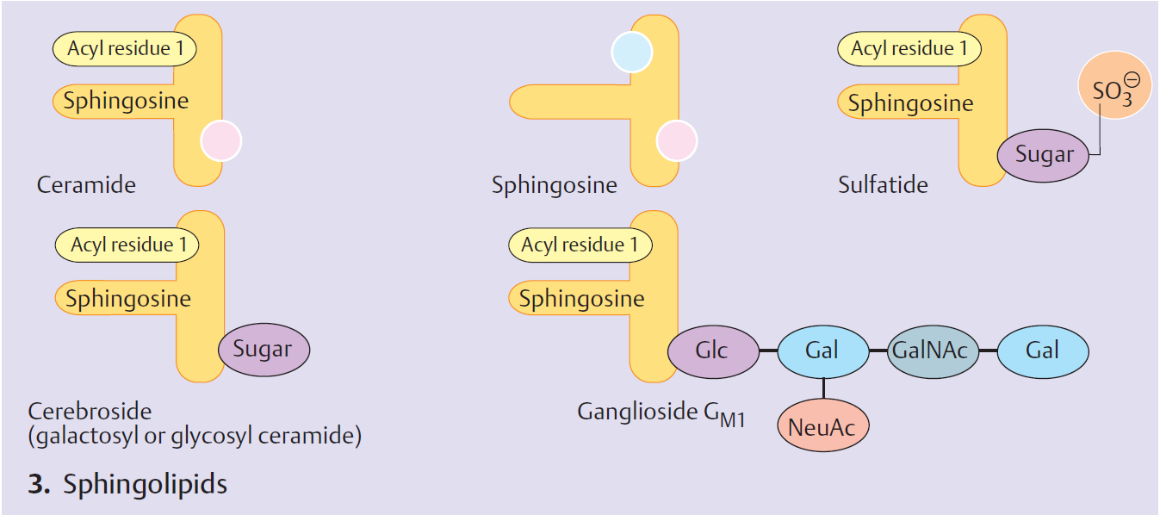
Glycolipids

Slide 19
Lipoproteins
Chylomicrons
Very low density lipoprotein (VLDL)
Low density lipoprotein (LDL)
High density lipoprotein (HDL)
Lipid with prosthetic group PROTEIN

Slide 20
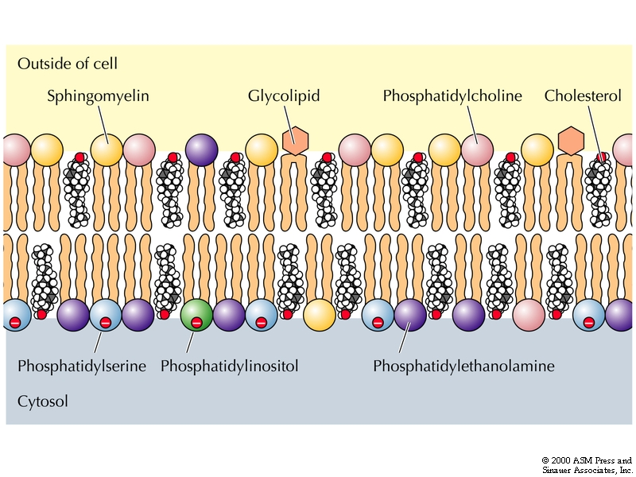

Slide 21
Derived lipids
These are the derivatives obtained on the hydrolysis of group 1 and group 2 lipids which possess the characteristics of lipids.
Example
Fatty acids
Steroids
Cholesterol
Vitamin A and D

Slide 22
Functions of lipids
Storage form of energy
Structural component of cell membrane.
Precursor of many steroid hormones, vitamin D
Act as thermal insulator
Protection of internal organs

Slide 23
Functions of lipids
Helps in absorption of fat soluble vitamins
Fats serve as surfactants by reducing surface tension.
Improve taste and palatability.
Acts as electric insulators in neurons.
Lipoproteins transporting lipids

Slide 24
Fatty acids
Fatty acids are naturally occurring carboxylic acids with an unbranched carbon chain and an even number of carbon atoms.
The pathway by which fatty acids are biosynthesized they almost always contain an even number of carbon atoms.
Long-chain fatty acids (12 to 26 carbon atoms) are found in meats and fish
medium-chain fatty acids (6 to 10 carbon atoms) and short-chain fatty acids (fewer than 6 carbon atoms) occur primarily in dairy products.
There are saturated and unsaturated Fatty acids.

Slide 25
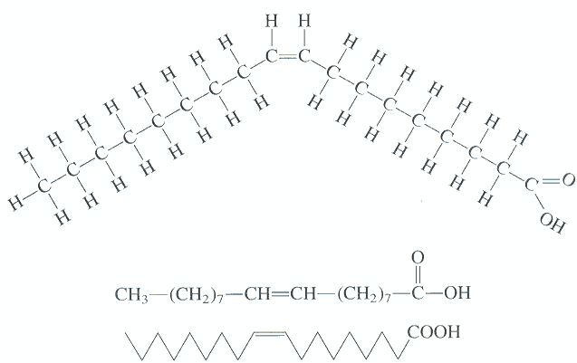
Saturated fatty acid : Fatty acid chains that contain only carbon-carbon single bonds are referred to as saturated (Palmitic acid)
Unsaturated fatty acid : Those molecules that contain one or more double bonds are said to be unsaturated. There are mono- and polyunsaturated fatty acids (Oleic acid)

Slide 27
Prostaglandins are derivative of fatty polyunsaturated acids

Slide 28
What are Essential Fatty Acids (EPA)?
There are TWO essential fatty acids.
Essential means you NEED to get them from the diet because the body cannot manufacture them.
α-linolenic acid (LNA or ALA): an omega-3 fatty acid
Linoleic acid (LA): an omega-6 fatty acid found abundantly in soy oil, sunflower seeds, pumpkin seeds, sesame seeds, corn oil, and in most nuts.

Slide 29
Functions of EFA
Essential fatty acids are required for the membrane structure and function.
Transport of cholesterol.
Formation of lipoproteins.
Prevention of fatty liver etc.
They are also needed for the synthesis of another important group of compounds, namely eicosanoids.

Slide 30
Rancidity
Rancidity: Rancidity is the term used to represent the deterioration of fats and oils resulting in an unpleasant taste. Fats containing unsaturated fatty acids are more susceptible to rancidity.
Rancidity occurs when fats and oils are exposed to air, moisture, light, bacteria etc.
Hydrolytic rancidity occurs due to partial hydrolysis of triacylglycerols by bacterial
enzymes.
Oxidative rancidity is due to oxidation of unsaturated fatty acids.
This results in the formation of unpleasant products such as dicarboxylic acids, aldehydes, ketones etc.
Rancid fats and oils are unsuitable for human consumption.

Slide 31
Test to Check Purity of Fats and Oils
Acid number:- It is the number of milligrams of potassium hydroxide required to completely neutralize the free fatty acids present in 1 g of the oil or fat.
In normal circumstances refined oils should be free from any free fatty acids.
Oils, on decomposition due to chemical or bacterial contamination-yield free fatty acids.
Therefore, oils with increased acid number are unsafe for human consumption

Slide 32
Test to Check Purity of Fats and Oils
Saponification number:- It is defined as the mg (number) of KOH required to hydrolyze (saponify) one gram of fat or oil.
Saponification number is a measure of the average molecular size of the fatty acids present
The value is higher for fats containing short chain fatty acids.
Human fat : 195-200
Butter :230-240
Coconut oil : 250-260

Slide 33
Test to Check Purity of Fats and Oils
Iodine number:- lt is defined as the grams (number) of iodine absorbed by 100 g of fat or oil.
Iodine number is useful to know the relative unsaturation of fats, and is directly proportional to the content of unsaturated fatty acids.
Thus lower is the iodine number, less is the degree of unsaturation.
Determination of iodine number will help to know the degree of adulteration of a given oil.

Slide 34
Test to Check Purity of Fats and Oils
Reichert-Meissl (RM) number:- lt is defined as the number of ml 0.1 N KOH required to completely neutralize the soluble volatile fatty acids distilled from 5 g fat.
RM number is useful in testing the purity of butter since it contains a good concentration of volatile fatty acids( butyric acid, caproic acid and caprylic acid).
Butter has a RM number in the range 25-30, while it is less than 1 for most other edible oils.
Thus any adulteration of butter can be easily tested by this sensitive RM number .

Slide 35
Chemical Reactions of Fatty Acids
Esterification reacts fatty acids with alcohols to form esters and water

Slide 36
Fatty Acid Hydrolysis
Acid Hydrolysis reverses esterification. Fatty acids are produced from esters

Slide 37
Saponification
Saponification is the base-catalyzed hydrolysis of an ester
Products of the reaction are
An alcohol
An ionized salt which is a soap
Soaps have a long uncharged hydrocarbon tail
Also have a negatively charged carboxylate group at end
Form micelles that dissolve oil and dirt particles

Slide 38
Thank You

