Slide 1
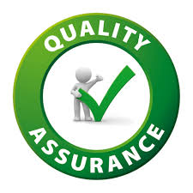
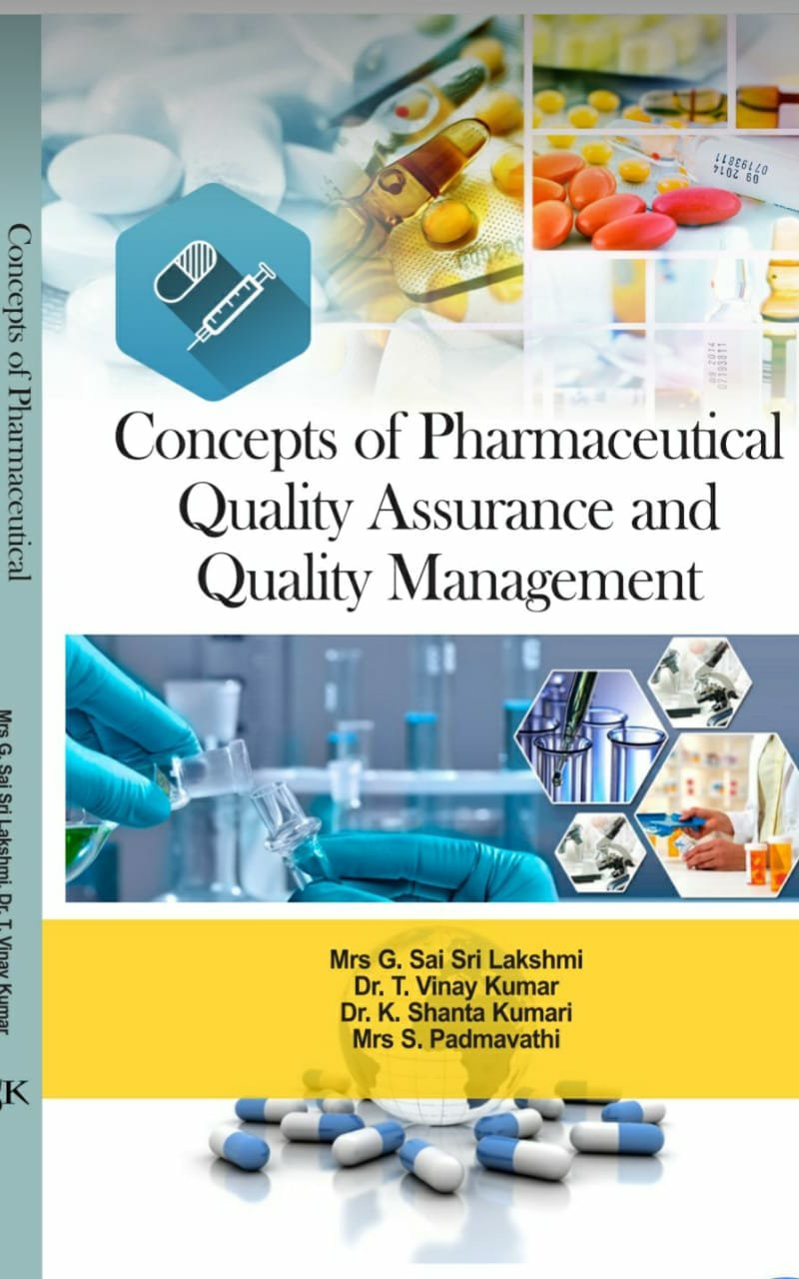
UNIT 1
Quality Assurance and Quality Management Concepts
Mr. Shoheb S. Manyar
Assistant Professor
Department of Pharmaceutical Chemistry
H. R. Patel Institute of Pharmaceutical Education and Research, Shirpur

Slide 2
Contents:
Concept of Quality
Quality Management System
Elements of QMS
Quality Assurance & Quality Control
Difference between QA & QC
Responsibilities of QA
Responsibilities of QC
Role of QA in pharma industries
Control of Quality variation
Quality assurance management procedure
Control and assurance of manufacturing practices

Slide 3
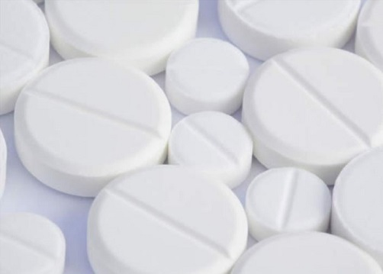
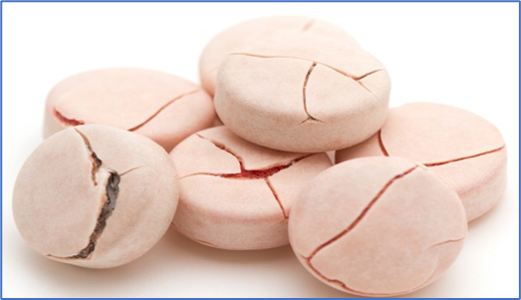
Concepts of Quality
VS
The perspective of quality has become a key factor in the current scenario.
Quality is typically referred to as a factor that determines whether a good or service is substandard or excellent. Or “Degree of Excellence” Understanding how a thing complies with its requirements is an indicator of goodness.
ISO (International Organization for Standardization or International Standard Organization) defines “The ability of a good or service to satisfy a stated or implied need is determined by a product or service's overall qualities and attributes”.
The meaning of the quality could be understood from two perspectives: Manufacturer’s perspective and Consumer's perspective.

Slide 4
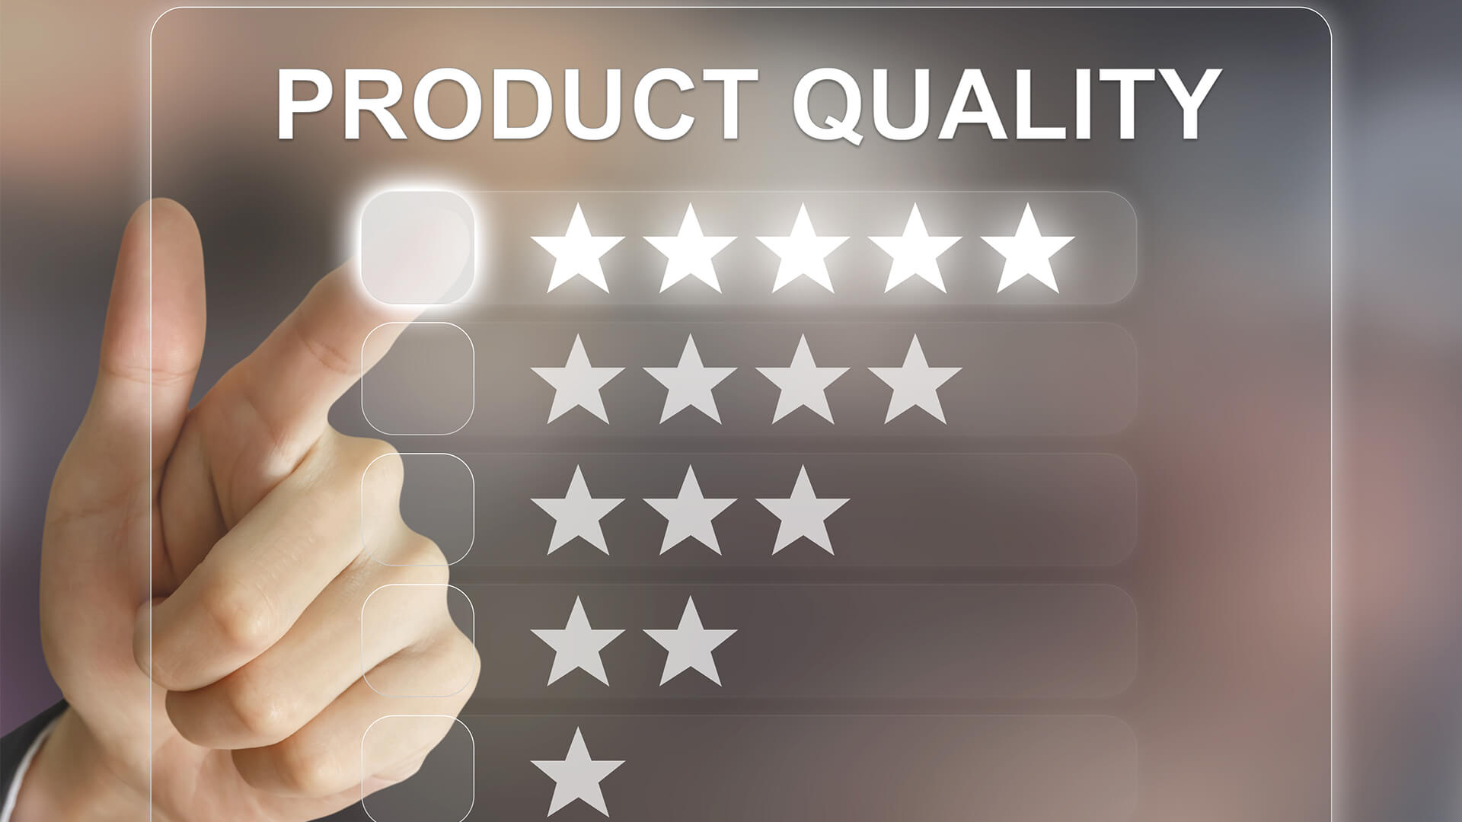
Quality Products
Since pharmaceuticals or pharmaceutical products are directly administered to consumers' bodies.
The regulatory bodies all around the world have accepted that a pharmaceutical product which meets the following five characteristics can be accepted as quality product
Identity, strength, purity, safety, and efficacy ultimately proper quality of the product are greatly emphasized in the pharmaceutical industry.
There are many international regulations that have created requirements that every pharmaceutical firm must adhere to.

Slide 5
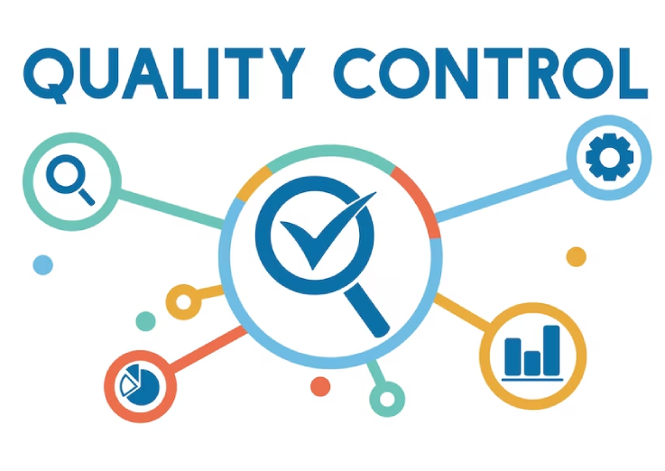
ISO 9000 defines quality control as "A part of quality management focused on fulfilling quality requirements".
According to WHO: It is that part of GMP concerned with sampling, specification & testing, with the documentation & release procedures which ensure that the necessary & relevant tests are performed or actually caried out & the product is released for use only after ascertaining it's quality.
Materials are neither released for use, nor products released for sale or supply, until their quality has been found satisfactory.

Slide 6
According to WHO, Quality assurance (QA) is a wide-ranging concept covering all matter that individually or collectively influence the quality of a product. With regard pharmaceuticals, quality assurance can be divided into major areas: Development, quality control, production, distribution, and inspections.
According to MCC South Africa (Medicines Control Council): “Quality Assurance is the sum total of organized arrangement made with the objective of ensuring that medicines are of quality required for their intended use. Thus it is wide-ranging concept covers all matters that affecting quality.
ISO 9000 defines QA as "part of quality management focused on providing confidence that quality requirements will be fulfilled“.

Slide 7
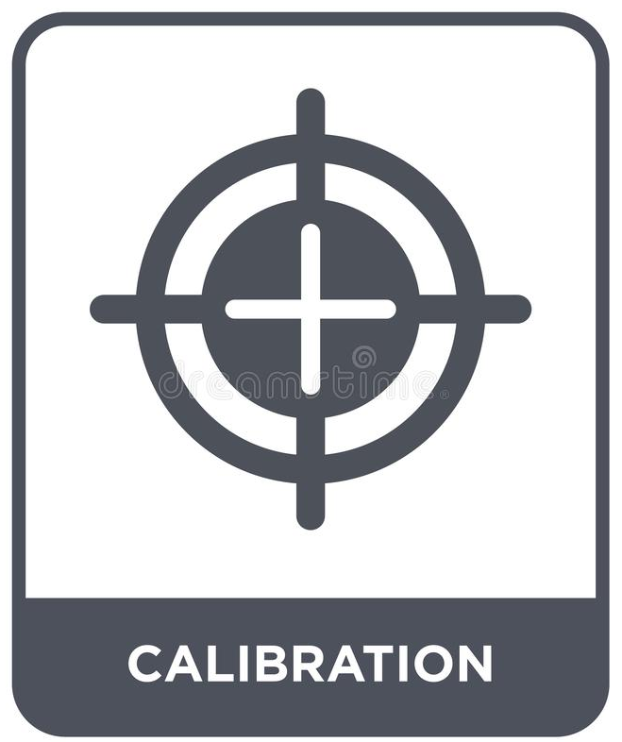
Calibration
The set of operations that establish, under specified conditions, the relationship between values indicated by an instrument or system for measuring (for example, weight, temperature and pH), recording, and controlling, or the values represented by a material measure, and the corresponding known values of a reference standard.
Calibration of an instrument is the process of determining its accuracy.
The process involves obtaining a reading from the instrument and measuring its variation from the reading obtained from a standard instrument.
Calibration of an instrument also involves adjusting its precision and accuracy so that its readings come in accordance with the established standard.

Slide 8
Validation
Validation is the documented act of proving that any procedure, process, equipment, material, activity or system actually leads to the expected result.
“Establish documented evidence which provides a high degree of assurance that a specific process will consistently produce a product meeting its predetermined specifications and quality attributes.”

Slide 9
Qualification
It is the action of proving and documenting that any premises, systems and equipment are properly installed, and/or work correctly and lead to the expected results.
Qualification is often a part (the initial stage) of validation, but the individual qualification steps alone do not constitute process validation.
The term qualification is normally used for equipment, utilities and systems, and validation for processes.
In this sense, qualification is part of validation.
Qualification should be completed before process validation is performed.

Slide 10
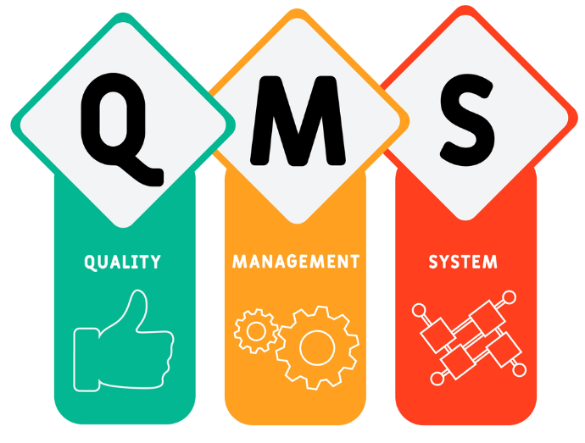
Quality Management System (QMS)
A organized system that records processes, methods, and roles for carrying out quality policies and objectives is referred to as a quality management system (QMS).
A QMS aids in coordinating and directing an organization's actions to satisfy customer and regulatory requirements and continuously increase effectiveness and efficiency.
Elements of Quality Management System:-
Quality Planning
Quality Assurance
Quality Control
Quality Improvement

Slide 11
ELEMENTS OF QUALITY MANAGEMENT SYSTEM
Typically, a quality management system has four components.
Quality planning: Process of transforming quality policy into practices, protocols, and guidelines in order to satisfy quantifiable objectives and requirements.
Quality assurance: actions carried out as part of a quality system that are deliberate and meticulous in order to guarantee that the standards for a process', product's, or service's quality are being met.
Quality control: monitoring, assessing, and making corrections to ensure that a procedure, good, or service fulfills quality standards.
Quality improvement: Implementing methodical, systemic improvements after executing a performance analysis.

Slide 12
The needs specific to each organization should be addressed by quality management systems, however all systems have the following components:
The organization's quality policy and quality objectives
Quality manual
Procedures, instructions, and records
Data management
Customer satisfaction from product quality
Quality analysis
Quality management systems serve many purposes, including:
Improving processes
Reducing waste
Lowering costs
Facilitating and identifying training opportunities

Slide 13
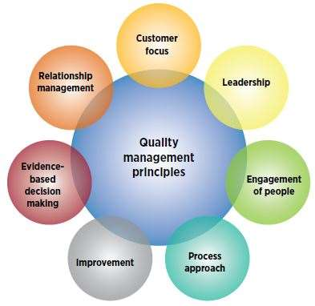

Slide 14
QUALITY MANAGEMENT STANDARDS
To maintain quality in pharmaceutical products, Quality Management System is followed.
Internationally harmonized guidance ICH Q10 governs the concept of current pharmaceutical quality management system for Registration of Pharmaceuticals for Human Use and USFDA and in final phases.
Other standards related to quality management systems include the rest of the ISO 9000 family including (ISO 9000 and ISO 9004)
The ISO 14000 family (environmental management systems)
ISO 13485 (quality management systems for medical devices)
ISO 19011 (audits management systems)
ISO/TS 16949 (quality management systems for automotive related products).

Slide 15
Quality Assurance
According to WHO, Quality assurance (QA) is a wide-ranging concept covering all matter that individually or collectively influence the quality of a product. With regard pharmaceuticals, quality assurance can be divided into major areas: Development, quality control, production, distribution, and inspections.
According to MCC South Africa (Medicines Control Council): “Quality Assurance is the sum total of organized arrangement made with the objective of ensuring that medicines are of quality required for their intended use. Thus it is wide-ranging concept covers all matters that affecting quality.
ISO 9000 defines QA as "part of quality management focused on providing confidence that quality requirements will be fulfilled“.

Slide 16
Responsibilities of QA
It helps to identify and prepare the necessary SOPs relative to the control of quality.
The QA department is responsible for ensuring that the quality policies adopted by a company are followed.
It must determine that the product meets all the applicable specifications and that it was manufactured according to the internal standards of GMP.
QA also holds responsibility for quality monitoring or audit function.
QA functions to assess operations continually and to advise and guide them towards full compliance with all applicable internal and external regulations.

Slide 17
ISO 9000 defines quality control as "A part of quality management focused on fulfilling quality requirements".
According to WHO: It is that part of GMP concerned with sampling, specification & testing, with the documentation & release procedures which ensure that the necessary & relevant tests are performed or actually caried out & the product is released for use only after ascertaining it's quality.
Materials are neither released for use, nor products released for sale or supply, until their quality has been found satisfactory.

Slide 18
Quality Control system should ensure that
There should be Adequate facilities, trained personnel and approved procedures are available for sampling, inspecting and testing.
Raw materials, packaging materials, intermediate products, bulk, and finished products, and where appropriate for monitoring environmental conditions for GMP purposes.
Samples of starting materials, packaging materials, intermediate products, bulk products and finished products should be taken by personnel according to the methods approved by Quality Control.
Test methods should be validated.
Records should be made, manually and/or by recording instruments, which demonstrate that all the required sampling, inspecting and testing procedures were actually carried out. Any deviations are fully recorded and investigated.

Slide 19
Responsibilities of Q.C Department
QC is responsible for the day-to-day control of quality within the company.
QC department is responsible for analytical testing of incoming raw materials an inspection of packaging components, including labelling.
To conduct in-process testing when required, perform environmental monitoring, an inspect operations for compliance.
They also conduct the required tests on finished dosage form.
QC plays a major role in the selection of qualified vendors from whom raw materials purchased.
The environmental areas for manufacturing of various dosage forms are tested inspected by QC department.
Maintenance of all documents related to QC department.

Slide 20
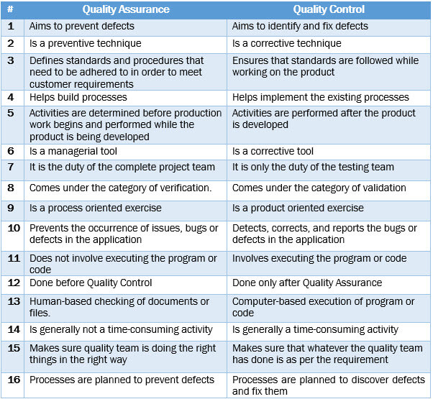

Slide 21
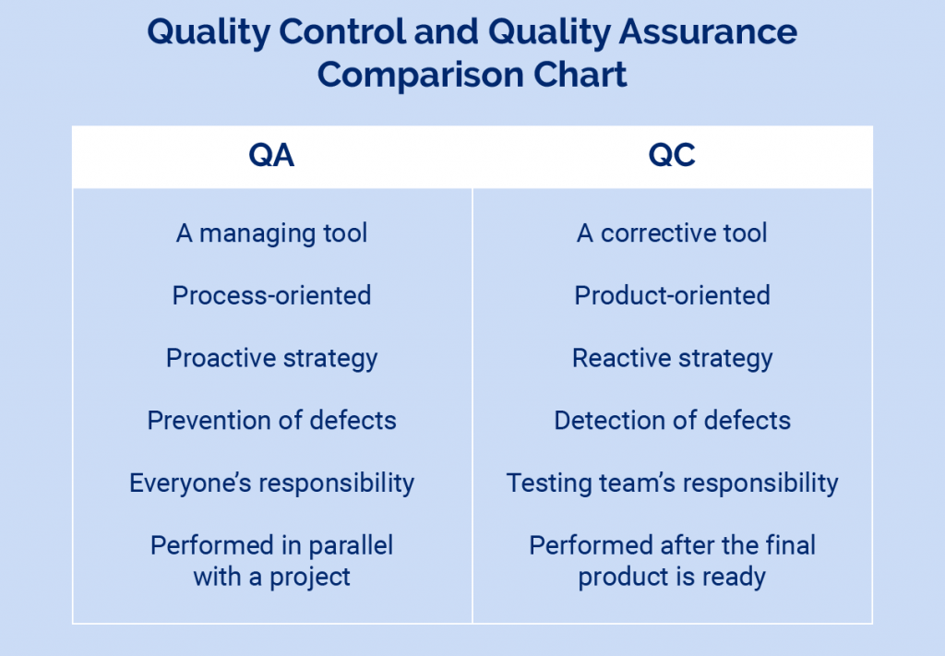

Slide 22
Flow chart for raw material and packaging material quality assurance

Slide 23
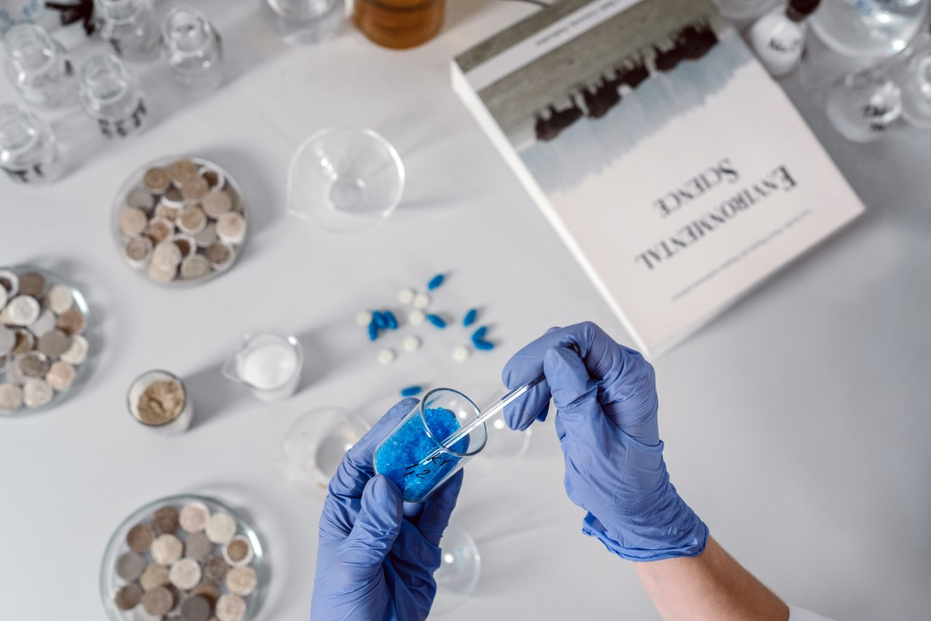
SOURCES OF QUALITY VARIATION
Raw material
In process variations
Packaging material
Labelling
Finish product
Manual Error

Slide 24
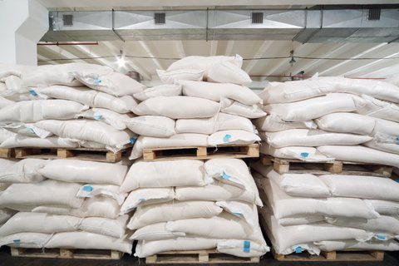
CONTROL OF QUALITY VARIATION
1. Raw material control
Good raw material specifications must be written in precise terminology, must be complete, must provide specific details of test methods, type of instruments, and manner of sampling must be properly identified.
Each raw material is sampled according to standard sampling procedures and is sent to the quality control laboratory for testing according to written procedures.
If acceptable, it is moved to the release storage area, after being properly stickered to indicate the item no., material name, lot no., release date, reassay date and sign of QA inspector.
Approved material should be rotated so that the oldest stock is used first.

Slide 25
2. In-process Items Control
The FDA-cGMP regulations emphasize environmental factors to minimize cross- contamination of products and errors, however, they do little to minimize within-batch and batch-to-batch variation.
Therefore, it is important function of the IPQA program to ensure that the final products have uniform purity and quality.

Slide 26
3. Manufacturing Variation Control
Monitoring environmental conditions under which products are manufactured/stored
Monitoring of air and water systems to prevent contamination- Air Handling Units
Monitoring of personnel
Feedback and follow-up
Temperature
Humidity
Light

Slide 27
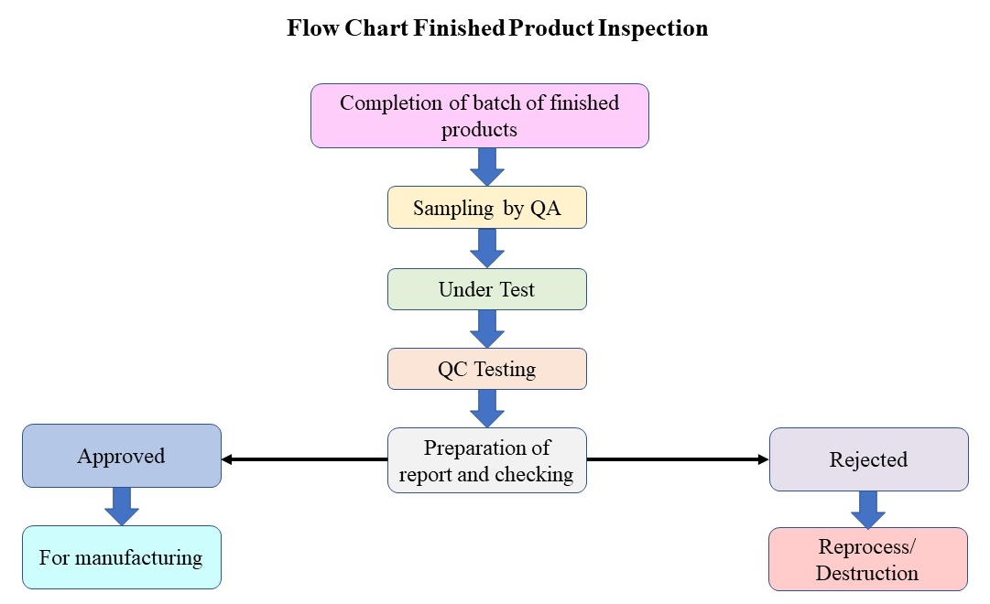

Slide 28
ROLE OF QA IN PHARMA INDUSTRIES
To Establish Quality Audit
Audit: Auditing is defined as the on-site verification activity, such as inspection or examination, of a process or quality system, to ensure compliance to requirements.
Establish the quality management system to describe how the firm complies CGMPs and operates to maintain a state of control
Keep current with good industry practices, and applicable to the mission of your operation.
To audit compliance to the Quality System
Report on the performance of the quality system, including trends, that help decision making for targeted actions

Slide 29
ROLE OF QA IN PHARMA INDUSTRIES
2. To establish procedures and specifications
Ensure that procedures and specifications are appropriate and followed.
Ensure that the procedures and specifications of firms under contract are also appropriate and followed, i.e., maintain control and take responsibility for third-party services providers (contract manufacturers, contract laboratories, etc.)
3. To establish manufacturing controls
Ensure that appropriate manufacturing in-process controls are implemented.
Ensure in-process controls are performed during manufacturing operations and results are satisfactory.

Slide 30
4. To operate laboratory tests
Operate laboratory testing of components, containers, in-process materials, packaging materials and drug product using validated methods
Approve or reject drug products manufactured, processed, packed, or held under contract by another company. Perform retests or re-examine approved components, drug product containers and closures after long storage or exposure to adverse conditions.
5. To review and approve or reject
Review and approve/reject any document that gives work instructions and set requirements such as procedures, protocols, test methods, and specifications--including changes to these documents.
Review and approve/reject production batch records and make the final decision to release a product lot into market.

Slide 31
6. To ensure investigation of nonconformance
Review complaints to determine if it relates to a failure to meet specification, if so investigate and report to FDA if it is serious and unexpected
7. To keep management informed
Report on product, process and system risks
Report on outcome of regulatory inspections and ensure responses are complete and managed to verifiable closure
8. To describe responsibilities in writing
Have a complete and compliant procedure that describes responsibilities

Slide 32
CONTROL AND ASSURANCE OF MANUFACTURING PRACTICES
Personnel
Important parts for successful personnel are:
Proper selection – Training -- Motivation of Production -- Packaging -- Control
It is essential that the qualified personnel be employed to supervise the formulation, processing, Sampling, testing, packaging and labelling of the drug product, and that competent staff be placed in charge of the maintenance of machinery, equipment and sanitation.

Slide 33
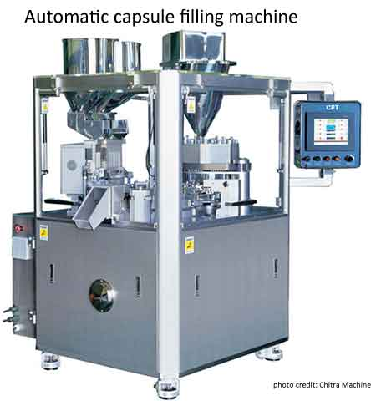
2. Equipment's and Buildings
The building should provide adequate space for the orderly placement of materials and equipment to minimize any risks of mix-ups or cross-contamination between the drugs, excipients, packaging and labelling from the time the materials are received to the time the products are released.
The desired characteristics of equipment's for producing quality products are numerous, however, the equipment should be of suitable size, accurate and reproducible.
CONTROL AND ASSURANCE OF MANUFACTURING PRACTICES

Slide 34
3. Control of records
The records, such as Master Formula and Batch production records, should be prepared and maintained in accordance with established procedures.
Control of Production Procedures
To ensure that products have the intended characteristics of identity, strength, quality, and purity
Production and the related in-process quality control procedures should be rigidly followed as required by the master formula record or batch production record.
CONTROL AND ASSURANCE OF MANUFACTURING PRACTICES

Slide 35
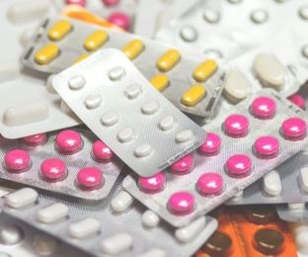
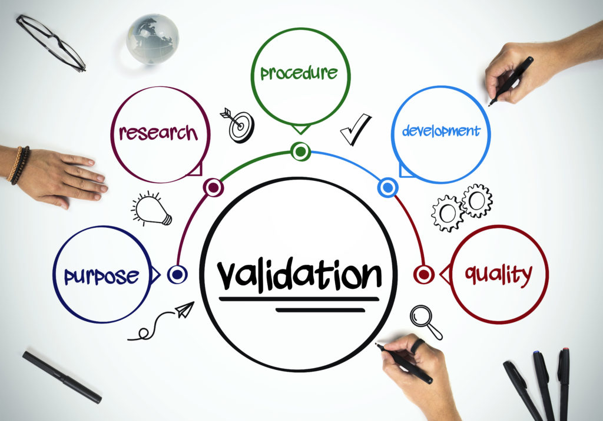
4. Packaging Control
A packaging record bearing an identification number is issued to the packaging section.
This record specifies the packaging materials to be used, operations to be performed, and the quantity to be packaged.
5. Validation
Validation of a process is the demonstration that controlling the critical steps of a process results in products of repeatable attributes or causes a reproducible event.
CONTROL AND ASSURANCE OF MANUFACTURING PRACTICES

Slide 36
6. Control and Assurance of Finished Products
Unless the testing procedures by which the product quality is finally measured are established on an equally sound basis, the entire system may be deficient.
Product failures causing rejections or recalls after market introduction are serious and can be easily detected and minimized by an effectively administered quality testing program.
Therefore, the testing of the finished products for compliance with the established standards prior to release of the material for distribution is a critical factor for quality control and assurance.
CONTROL AND ASSURANCE OF MANUFACTURING PRACTICES

Slide 37
GOOD MANUFACTURING PRACTICE
Defination of GMP as per WHO:
GMP is that part of Quality Assurance, which ensures that products are consistently produced and controlled to the quality standards appropriate to their intended use and as required by marketing authorization“.
GMP guidelines represent minimal standards that are necessary conditions for marketing authorization, drugs are considered to be adulterated, if GMP's are not met.
GMP guidelines typically comprise strong recommendations on quality management, personnel, production facilities and equipment's, documentation and records, production and in-process controls, packaging and labeling, storage and distribution, laboratory controls, validation, complaints and recalls.

Slide 38
IMPORTANCE OF GMP
GMP is intended to help manufacturers, implementing modern quality systems and risk management approaches to meet the requirements of quality products to ensure their intended purpose and to protect the public health.
GMP ensures that quality is built into the organization and processes involved in the manufacture of the products and all those operations should be carried out strictly according to GMP.
The GMP guideline serves as a basic minimum requirement for both local pharmaceutical companies and foreign companies to be authorized for import products.
It is also a reference and guidance tool to the Authority for GMP inspection and licensing of establishments.
Good Manufacturing Practice is concerned with both production and quality control.

Slide 39
GMP COVERS
Personnel
Building and facilities
Equipment's
Sanitation and Hygiene
Control of components, Drug product, containers and closures
Production and Process controls
Packaging and Labelling controls
Holding and distribution
Laboratory controls
Returned and Salvaged drug products
Reports and records (Documentation)

Slide 40
1. Personnel
The establishment and maintenance of a satisfactory system of quality assurance and the correct manufacture of quality products relies upon people.
For this reason there must be sufficient qualified personnel to carry out all the tasks which are the responsibility of the manufacturer.
All personnel should be aware of the principles of Good Manufacturing Practice that affect them and receive initial and continuing training, including hygiene instructions.
The manufacturer should have an adequate number of personnel with the necessary qualifications and practical experience.
People in responsible positions should have specific duties recorded in written job descriptions and adequate authority to carry out their responsibilities.

Slide 41
Key Personnel
Key Personnel includes the head of Production, the head of Quality Control, and the head of engineering and if at least one of these persons is not responsible for the release of products the authorized person(s) designated for the purpose (Quality Assurance Head).
1.1 The Head of the Production Department generally has the following responsibility
Ensure that products are produced and stored according to the appropriate documentation in order to obtain the required quality
Approve the instructions relating to production operations and to ensure their implementation
Ensure that the production records are evaluated and signed by an authorized person
Ensure that the required initial and continuing training of his department personnel carried out and adapted according to need.

Slide 42
1.2 The Head of the Quality Control Department generally has the following responsibilities:
Approve or reject starting materials, packaging materials, and intermediate bulk and finished products.
Evaluate batch records
Ensure that all necessary testing is carried out
Approve specifications, sampling instructions, test methods and other Quality Control procedures
1.3 The Heads of Production and Quality Control generally have some shared, or jointly exercised, responsibilities relating to quality. These may include:
The monitoring and control of the manufacturing environment.
Plant hygiene
Training
Approval and monitoring of suppliers of materials
Monitoring of contract manufacturers

Slide 43
1.4 The Quality Assurance Head (authorized and/or designated person (s)) shall have the following general responsibilities
Ensuring compliance with technical or regulatory requirement and other national legislation and international standards as applicable.
Conformation that the marketing authorization and the manufacturing authorization requirements for the product have been met.
Conformation that installed manufacturing premises, equipment and testing procedures have been validated and/or qualified.
Supervises and ensures that appropriate audits and self inspection are carried out by experienced and trained staff in a team.
Review and approval of Master Manufacturing and Packaging Record
Review of all QC testing results, production documents, results of in-process control and overall compliance to the specification for the finished product prior to release
Review and approval of Qualification & Validation Protocols and reports

Slide 44
2. BUILDING AND FACILITIES
Design and construction features
Buildings should be of suitable size, construction location to facilitate cleaning, maintenance, and proper operations.
Space should be adequate for the orderly placement of equipment and materials to prevent mix - ups between different components, drug product containers and closures, labeling, in- process materials, or drug products and to prevent contamination.
The movement of components and product through the building must be designed to prevent contamination.
Floors, walls, and ceilings of smooth, hard surfaces that is easily cleanable.
An air supply filtered through High Efficiency Particulate Air (HEPA) filters under positive pressure.
A system for monitoring environmental conditions
A system for cleaning and disinfecting the room and equipment to produce aseptic conditions.

Slide 45
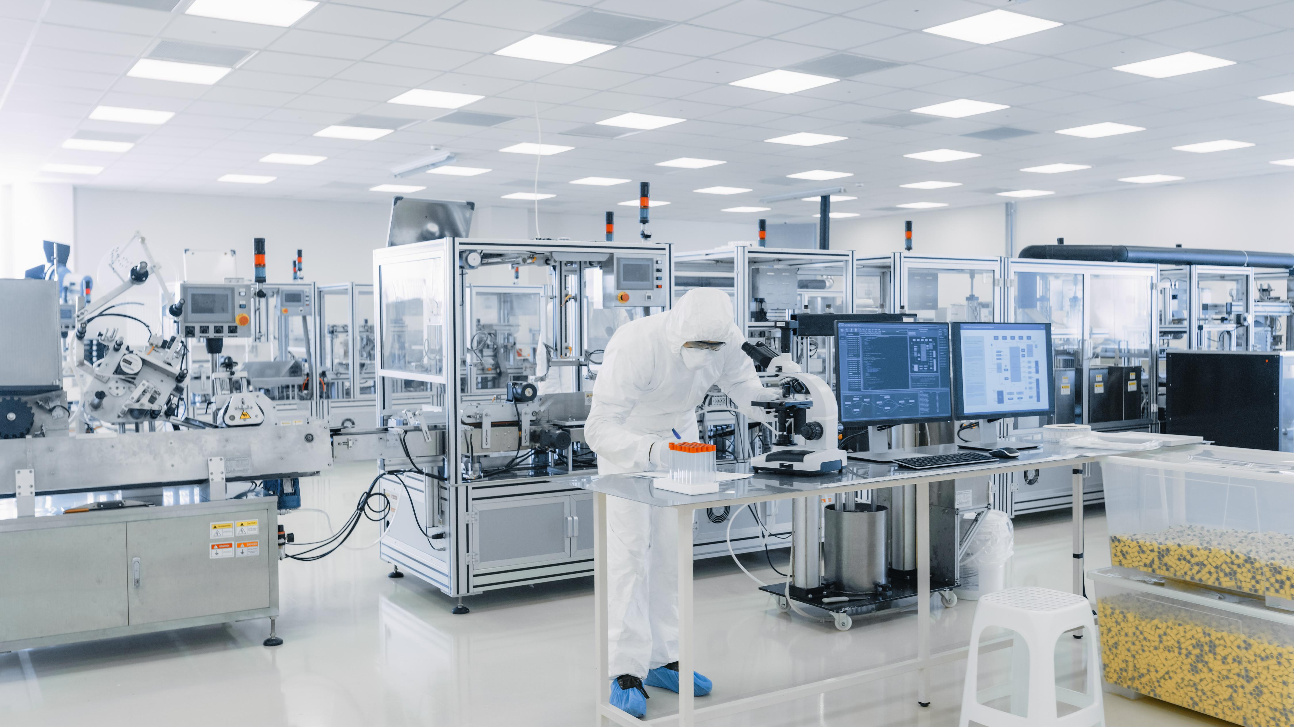
3. Equipment's
1. Equipment should be of appropriate design, adequate size, and suitably located to facilitate operations for its intended use and for cleaning and maintenance.
2. Equipment construction:
Equipment should be constructed so that surfaces that contact components, in - process materials, or drug products should not be reactive, additive, or absorptive so as to alter the safety, identity, strength, quality, or purity of the drug product beyond official or other established requirements.
3. Equipment cleaning and maintenance:
Equipment and utensils should be cleaned, maintained, and sanitized at appropriate intervals to prevent malfunctions or contamination (Floor cleaning Dettol, Savlon &Equipment's – SLS)
Written procedures must be established and followed for cleaning and maintenance of equipment and utensils used in the processing of a drug product.

Slide 46
4. SANITATION AND HYGIENE
A high level of sanitation and hygiene should be practiced in every aspect of the manufacture of pharmaceutical products.
The scope of sanitation and hygiene covers personnel, premises, equipment and apparatus, production materials and containers, products for cleaning and disinfection, and anything that could become a source of contamination to the product.
The layout and design of premises must aim to minimize the risk of errors and permit effective cleaning and maintenance in order to avoid cross-contamination, build-up of dust or dirt and in general, any adverse effect on the quality of products.
Where dust is generated (e.g. during sampling, weighing, mixing and processing operations, packaging of powder), measures should be taken to avoid cross contamination and facilitate cleaning.

Slide 47
THANK YOU…

