Slide 1
Chapter 4
Mr. Shoheb S. Manyar
Assistant Professor
Department of Pharmaceutical Chemistry
H. R. Patel Institute of Pharmaceutical Education and Research, Shirpur

Slide 2
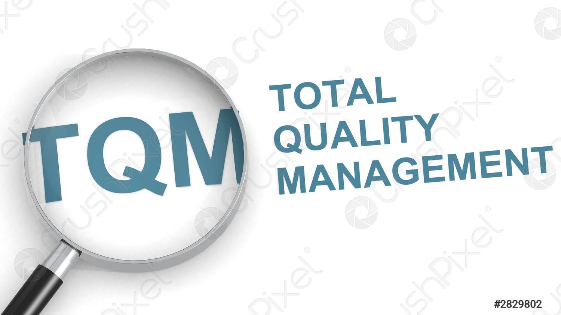
Quality
Quality refers to how good something is compared to other similar things.
In other words, its degree of excellence.
TQM
Total Quality Management is defined as a customer-oriented process and aims for continuous improvement of business operations.

Slide 3
QbD
Defination:
The pharmaceutical Quality by Design (QbD) is a systematic approach to product development that begins with predefined objectives and emphasizes product and process understanding and process control, based on sound science and quality risk management (ICH Q9).
Dr. Joseph M. Juran first introduced the concept of Quality by Design (QbD).
He proposed that quality should be designed into a product and that most quality crises and problems relate to the way in which a product is designed in the first place.

Slide 4
Cont…
The US Food and Drug Administration (FDA) has adopted the quality by design principles in the pharmaceutical product development with the understanding that increased testing does not necessarily improve product quality and quality must be built into the product.
Quality by Design (QbD) is a strategic process for development and manufacturing. It is meant to ensure that the intended performance of a final drug product is as expected – both in terms of purity and efficacy. To achieve this requires well-described objectives, and proper risk management.
Quality by Design (QbD) is emerging to enhance the assurance of safe, effective drug supply to the consumer, and also offers promise to significantly improve manufacturing quality performance.

Slide 5
Dr. Juran Trilogy
Quality Planning
Determine the needs of the customers
Develop product features that responds to customers needs
Develop processes that are able to produce those product features
Quality Control
Evaluate actual quality performance
Compares actual performance to quality goals
Quality Improvement
Establish the well design and equipped infrastructure
Identify specific scientific needs for improvement
Provides training, motivation
Product Quality
Quality Planning
Quality Control
Quality improvement

Slide 6
GOALS OF PHARMACEUTICAL QbD
May include the following:
The main objective of QbD is to achieve the quality products.
To achieve meaningful product quality specifications that are based on clinical performance
To increase process capability and reduce product variability and defects by enhancing product and process design, understanding, and control
To increase product development and manufacturing efficiencies

Slide 7
Benefits of QbD for Industry
Eliminate batch failures
Minimize deviations and costly investigations
Increase manufacturing efficiency, reduce cost and project rejections and waste
Build scientific knowledge base for all products
Avoid regulatory compliance problems
Real time control
Continuous improvement
Ensure better design of product with less problem
Reduce end-product testing

Slide 8
Benefits for FDA
Provide better consistency
More flexibility in decision making
Ensure scientific base of analysis
Improves quality of review
More drug availability and less recall

Slide 9
Approaches of QbD
Pharmaceutical development by QbD approach includes the following elements
Defining an objective:
Define the desired performances of the product and identify the quality targeted product profile (QTPP) considering e.g. the route of administration, dosage form, bioavailability, strength, and stability.
Identification of the critical quality attributes (CQAs):
Identify the produce characteristics that affect product quality
Risk assessment:
Identification of possible critical material attributes (CMAs) and critical process parameters (CPPs)

Slide 10
Development of experimental design:
Use of Design of Experiment to link CMAs and CPPs to CQAs and get enough information of how these parameters impact quality targeted product profile.
Thereafter, a process Design Space should be defined, leading to an end product with desired quality targeted product profile.
Control strategy:
Using the enhanced product and process understanding, establish an appropriate control strategy and control the sources of variability from the raw materials and the manufacturing process
Continuous improvement:
Continually monitor and improve the manufacturing process to assure consistent product quality throughout the product lifecycle

Slide 11
ELEMENTS OF QbD
There are five elements of QbD
They are listed below
Quality Target Product Profile (QTPP) and Define Critical Quality Attributes (CQAs)
Product Design and identification of critical material attributes (CMAS)
Link raw material attributes and process parameters to CQAS
Design and implement a control strategy
Manage product lifecycle, including continuous improvement

Slide 12
1. Quality Target Product Profile (QTPP)
It is defined as a summary of the quality characteristics of a drug product ideally to be achieved to ensure the desired quality, taking into account the safety and efficacy of the drug product.
The quality target product profile forms the basis of design for the development of the product.
Considerations for the quality target product profile could include:
Intended use in a clinical setting, route of administration, dosage form, delivery systems
Dosage strength(s)
Container closure system
Therapeutic moiety release or delivery and attributes affecting pharmacokinetic characteristics (e.g. dissolution)
Drug product quality criteria (e.g. sterility, purity, stability and drug release) appropriate for the intended marketed product

Slide 17
CMA includes binders, disintegrants, fillers (diluents), lubricants, glidants (flow enhancers), compression aids, colors, sweeteners, preservatives, suspending/dispersing agents, pH modifier/buffers, tonicity agents, film formers/coatings, flavors, and printing inks.

Slide 20
2. PRODUCT DESIGN AND UNDERSTANDING
Product design determines whether the product is able to meet patients' needs, which is confirmed with clinical studies.
Product design also determines whether the product is able to maintain its performance through its shelf life, which is confirmed with stability studies.
The key objective of product design and understanding is to develop a robust product that can deliver the desired QTPP over the product shelf life.

Slide 21
Cont…
Key elements of product design and understanding include the following:
Physical, chemical, and biological characterization of the drug substance(s)
Identification and selection of excipient type and grade, and knowledge of intrinsic excipient variability
Interactions of drug and excipients
Optimization of formulation and identification of CMAs of both excipients and drug substance

Slide 22
3. Process design and understanding

Slide 24
4. Control Strategy
control strategy include three levels of controls as follows:
Level 1
utilizes automatic engineering control to monitor the CQAs of the output materials in real time.
Input material attributes are monitored and process parameters are automatically adjusted to assure that CQAs consistently conform to the established acceptance criteria.{Real time testing}
Level 2
consists of pharmaceutical control with reduced end-product testing and flexible material attributes and process parameters within the established design space. {Identify source of variability}
Level 3
is the level of control traditionally used in the pharmaceutical industry.
This control strategy relies on extensive end-product testing and tightly constrain end material attributes and process parameters.

Slide 26
Cont…
ICH Q8 R2 defines a control strategy as a planned set of controls, derived from current product and process understanding that ensures process performance and product quality.
The controls can include parameters and attributes related to
drug substance and drug product materials and components
facility and equipment operating conditions
in-process controls
finished product specifications
and the associated methods and frequency of monitoring and control.

Slide 27
Cont…
A control strategy can include the following:
Control of input material attributes (e.g., drug substance, excipient, in process material, and primary packaging material) based on an understanding of their impact on processability or product quality
Product specification(s)
Controls for unit operations that have an impact on downstream processing or product quality (e.g, the impact of drying on degradation and particle size distribution of the granulate on dissolution)
In-process or real-time release testing of end-product testing (eg. measurement and control of CQAs during processing)

Slide 29
QUALITY BY DESIGN TOOLS
Design of experiments (DOE), risk assessment, and process analytical technology (PAT) are tools that may be used in the QbD process.
1. DESIGN OF EXPERIMENTS (DOE)
Design of Experiments (DOE) Structured, organized method for determining the relationship between factors affecting a process and the response of that process.
Choose experimental design (e.g., full factorial)
Conduct randomized experiments
Analyse data

Slide 30
Cont…
When DOE is applied to formulation or process development, input variables include the material attributes (e.g, particle size) of raw material or excipients and process parameters (e.g. spray rate).
While critical quality attributes of the in-process materials or final drug product (e.g, blend uniformity, particle size or particle size distribution of the granules, tablet assay, content uniformity, or drug release).
DOE can help identify optimal conditions, CMAs, CPPS, and, ultimately, the design space.

Slide 31
2.

Slide 33
3. PROCESS ANALYTICAL TECHNOLOGY (PAT)
A system for designing, analysing, and controlling manufacturing through timely measurements (i.e., during processing) of critical quality and performance attributes of raw and in process materials and processes with the goal of ensuring final product quality.
Process Analytical Technology (PAT)) reduces the analysis burden and improves the product quality
The term analytical in PAT is viewed broadly to include chemical, physical, microbiological, mathematical, and risk analysis conducted in an integrated manner.

Slide 34
APPLICATIONS OF QUALITY BY DESIGN (QbD)
Quality by design (QBD)- A comprehensive systematic approach to pharmaceutical development and manufacturing advancement
In the pharmaceutical development
To design a quality product and a manufacturing process
Continual improvement

